Slide 1
Cyclistic_2022
Last edited- 07.01.2023
Presented by- Swasti P

Slide 2
Cyclist
Objective
Analysis
Conclusion
Appendix

Slide 3
Objective
To analyse the usage of Cyclistic bikes by Customers and Subscribers
Identifying the trends in Cyclistic bike trip
Strategies to improve membership

Slide 4
Data
More than 5.5 Million data of 2022 were analysed
  2.8 Million used electric bikes
  2.5 Million used Classic bikes
  0.17 Million used docked bikes

Slide 5
Customer Vs. Subscriber
The usage of Cyclist bike by daily Customer(casual) is more than that of the Subscriber(Member)

Slide 6
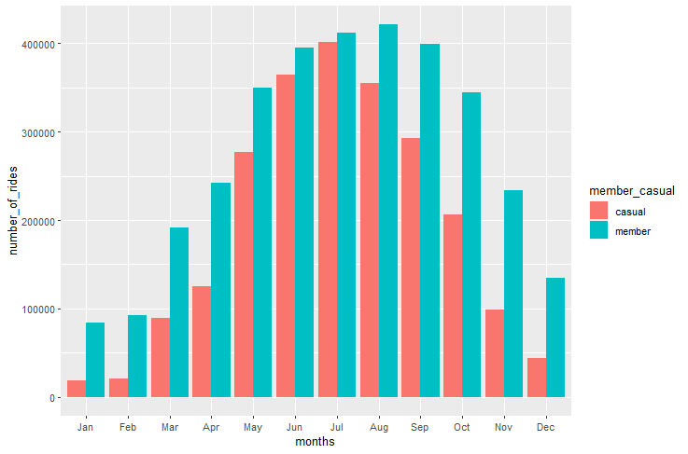
Total rides
- by month
Maximum individuals’ ride length are obtained during October, May and June respectively

Slide 7
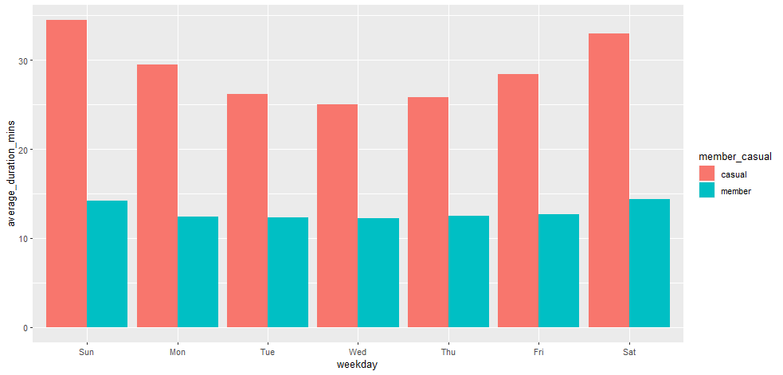
Average duration
-by Weekday
Usage of bike by Casual is TWICE than that of the member
Maximum ride duration by
  Members = 26 hours
  Casuals = 689 hours 47minutes

Slide 8
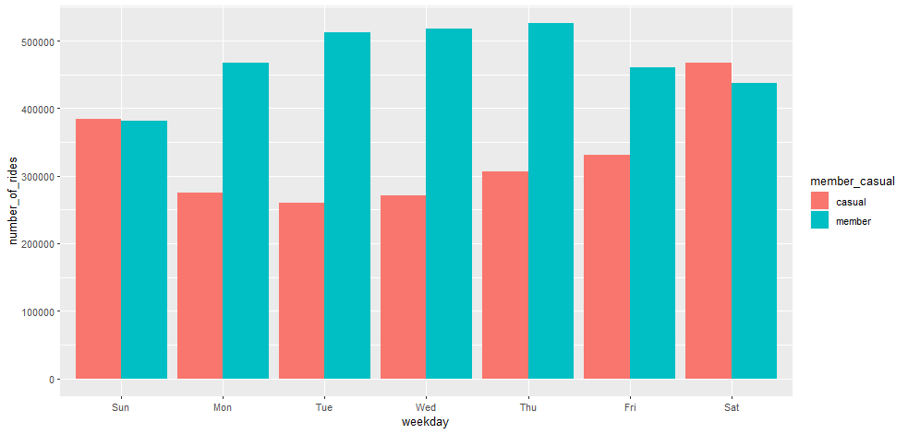
Rides by Weekday
Subscribers(members)
Customers(casual)
  Rides are more during weekend
  Bike usage is more on Saturday and less on Tuesday
  Rides are more during weekdays
  Bike usage is more on Thursday

Slide 9
Suggestion to meet objectives
Promoting Healthy and greener lifestyle
Discounts and Promotion for Docked bikes
Seasonal discounts for weekends
Building bike stations

Slide 10
THANK YOU

