Slide 1
HOW TO READ A QUANTITATIVE PAPER

Slide 2
Reading a Quantitative Paper
Read the abstract and write down/underline the main point.
Read the introduction.
Skim the data section to figure out what variables & units of observation they care about and why.
Examine the tables presenting the data analysis.
Focus on the variables the data section and introduction said were important.
Look for stars (or calculate stars if needed) on those variables.
Look at the direction of the effect.
Read the conclusion.
Skim the results section (always comes after the data and theory sections).
Read the full paper (ignore anything in the methods section that doesn’t make sense).

Slide 3
UNDERSTANDING A COMMON TABLE: REGRESSIONS

Slide 4
Visual Intuition

Slide 5
Regression function
At the most basic level
c is a constant (the y intercept value)

Slide 6
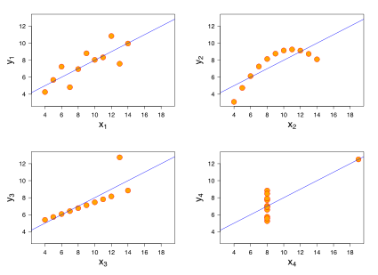
Potential for linear regressions and other techniques to obscure relevant information
Each graph shows the best fitting straight line for the data
All relationships were designed so that the standard numerical summaries look exactly identical even though the underlying relationships are clearly different.
Quick question:
Is beta positive or negative in each of these four graphs?

Slide 7
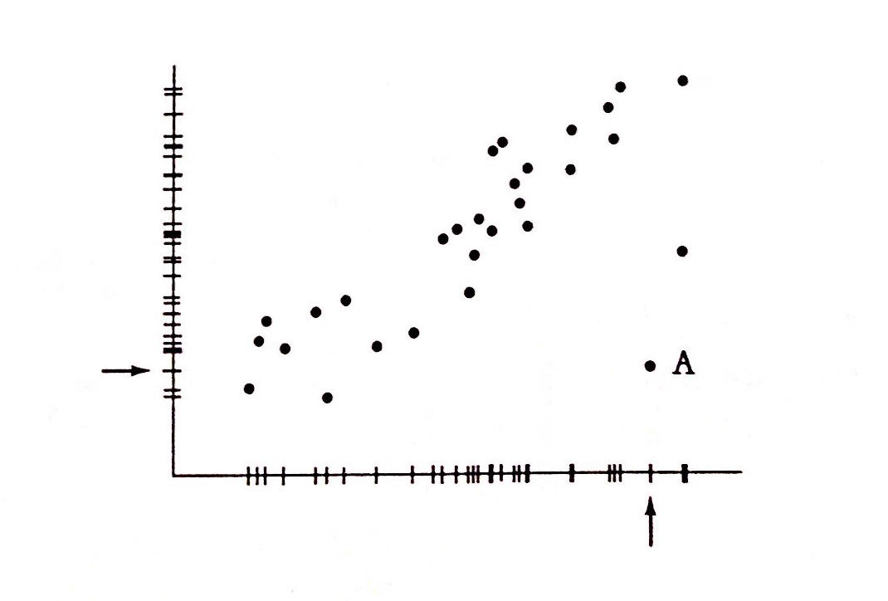
More Complex Outliers
Point A is called an outlier of the data
It will corrupt your linear regressions
Scatterplots reveal these distorting points

Slide 8
Regression Tables

Slide 9
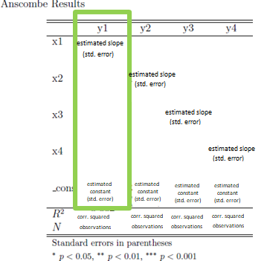
Regression Table

Slide 10
Anscombe Regression Results

Slide 11
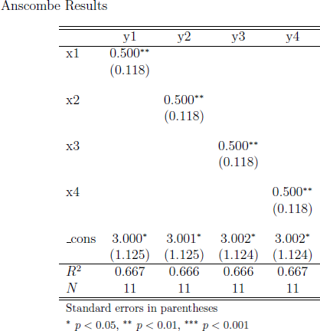
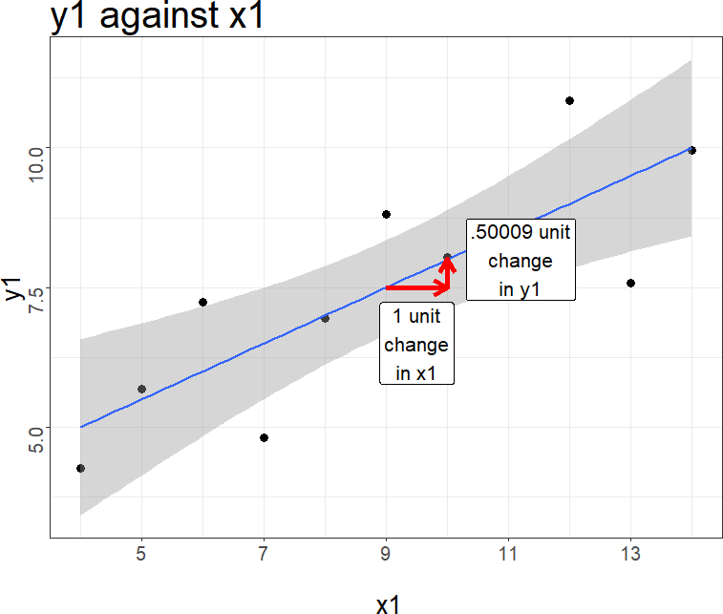

Anscombe Regression Results

Slide 12
Anscombe Regression Results

Slide 13
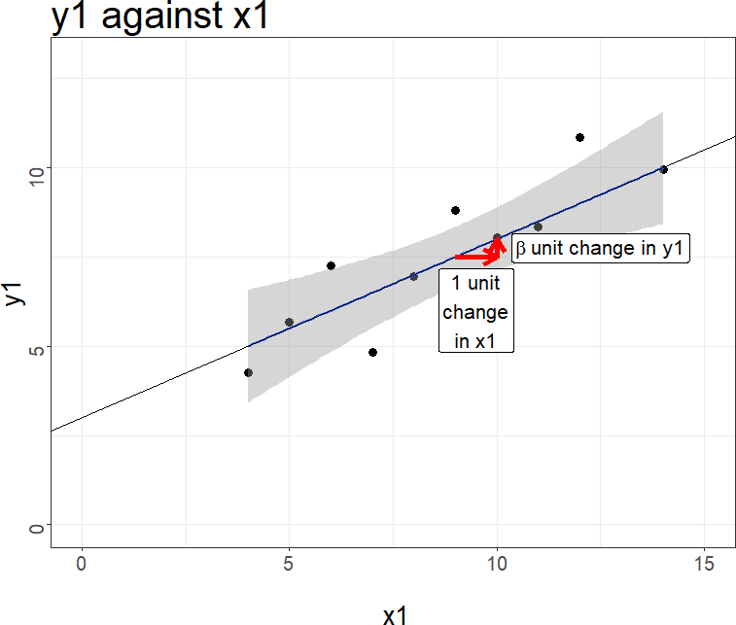
Anscombe Regression Results
3.0000909
y intercept, called c

Slide 14
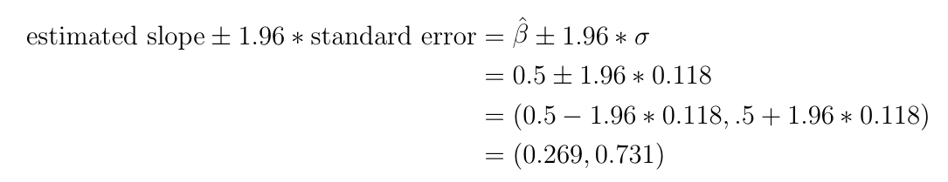
Anscombe: Regressions & Uncertainty
The grey area represents the 95% confidence interval for the values of the slope given the variation in the data.
This visualizes the range of confidence we have in the slope. If a flat line fits inside the gray shaded area, then the slope could be 0. (It isn’t here)

Slide 15
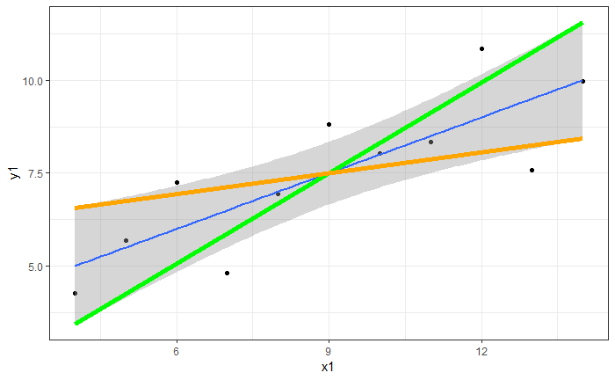
Anscombe Regression Uncertainty
The lowest slope in the 95% confidence interval (orange): 0.269
The steepest slope in the 95% confidence interval (green): 0.731

Slide 16
Anscombe Regression Uncertainty
Conclusion: No flat line can live in the grey 95% confidence interval; therefore, we are 95% confident that the slope is not flat.

Slide 17
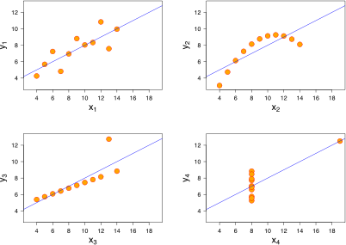
Potential for linear regressions and other techniques to obscure relevant information
Each graph shows the best fitting straight line for the data
All relationships were designed so that the standard numerical summaries look exactly identical even though the underlying relationships are clearly different.

Slide 18
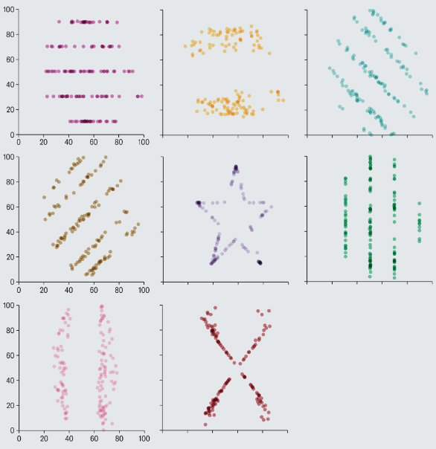
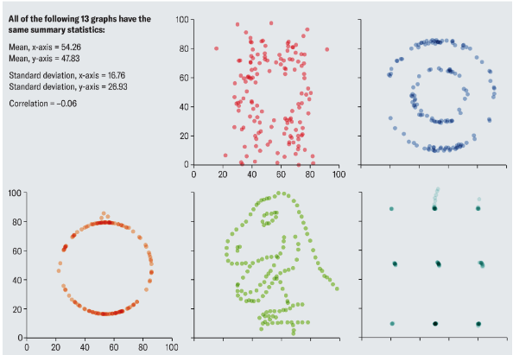
For fun:
All of these graphs have the same summary statistics

Slide 19
APPLICATION: Counties Shifting to Trump

Slide 20
See link
https://swat-ssql.github.io/read-regression-table/

Slide 21
Statistical vs Substantive SIGNIFICANCE

Slide 23
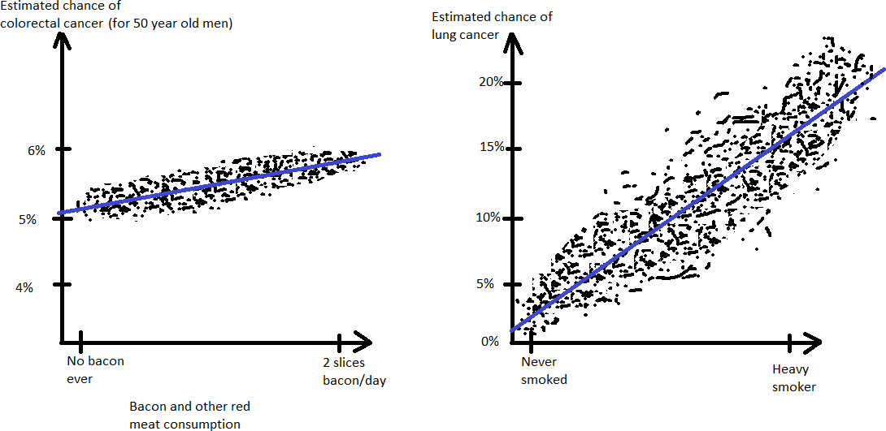
Large effect size vs fuzzy data (not real data, but based on real numbers)

Slide 24
Statistical “significance”/p values are not substantive significance/effect sizes
In layman’s English, “significance” means “importance”
In statistics, it just means how much do we believe the effect is real/not zero
I believe that eating more bacon causes colorectal cancer. I’m not sure whether I think a .05% higher chance of cancer from eating bacon once per month is important.
I believe that smoking causes lung cancer. I am sure that a 9.1% higher chance of cancer (0.4% to 9.5%) is very important.

Slide 25
You can have a very small effect size with a lot of stars
This usually happens with a lot of data. The more data you have, the more likely the data reflects reality. Even if the reality is very small in size.

Slide 26
Mathematical definition is complex
NOTE: This is a very surface level description. The stars represent the “p-value”, which indicates how often the sample being used would yield the direction of the coefficient if the ‘true’ effect was 0.

Slide 27
Reading a Quantitative Paper
Start by skimming

Slide 28
Reading a Quantitative Paper
Read the abstract and write down/underline the main point.
Read the introduction.
Skim the data section to figure out what variables & units of observation they care about and why.
Examine the tables presenting the data analysis.
Focus on the variables the data section and introduction said were important.
Look for stars (or calculate stars if needed) on those variables.
Look at the direction of the effect.
Read the conclusion.
Skim the results section (always comes after the data and theory sections).
Read the full paper (ignore anything in the methods section that doesn’t make sense).

Slide 29
Reading a Quantitative Paper
Steps 1-5 are the key steps to understand the main point of a paper
Won’t let you critique the methodology
Step 1-2 are often enough to give you a cursory idea of what the paper says.
Steps 6 and 7 are needed to critique the content of the paper.
*seriously, don’t spend too much time trying to understand the methods section*

Slide 30
More on Confidence Intervals:
Why We Pay Attention to Coefficients with Stars

Slide 31
Normal Distribution
Most common distribution in statistics and life
Symmetric, unimodal, bell curve
Many distributions of events are effectively normal (height, blood pressure, SAT scores)
Critically, the distribution of any average value follows a normal distribution
This also applies to any expected value
No distribution will be perfectly normal, because we live in the real world. But many will be so close that it’s the most effective distribution to use in calculations.

Slide 32
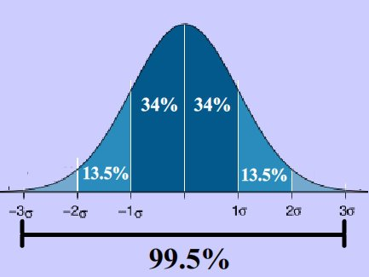
95% Confidence Interval
Generic Normal Distribution
95% of the population falls within 1.96 standard deviations ( ) of the mean value.
99% of the population falls within 2.58 standard deviations ( ) of the mean value.
99.9% of the population falls within 3.291 standard deviations ( ) of the mean value.

Slide 33
Difference between distribution of observations and distribution of means
The distribution of the individuals/observations is much wider than the distribution of the means of those observations

Slide 34
95% Confidence Interval
95% of all possible coefficients fall within 1.96 standard errors ( ) of the expected coefficient.
99% of all possible coefficients fall within 2.58 standard errors ( ) of the expected coefficient.
99.9% of all possible coefficients fall within 3.291 standard errors ( ) of the expected coefficient.

Slide 35
More confidence interval examples

Slide 36
Step 0: Know the variables and what they mean
Demographics and budgetary spending
Budget for the chief of staff of a member of Congress, measured as a percentage of their total expenditures on staffing salaries.
Median income of the district of a member of Congress
Question: Do members of Congress from higher income districts spend more of their budget on their chief of staff?

Slide 37
Step 1 (Republicans): Stars
There are stars on the coefficient for median income for Republicans (but not Democrats).
Notes:
I will obtain answers in two different ways. The first will be to ask a select number of legislators why they delegate to bureaucrats. This will be an open-ended question. The second will be to create a survey that lists multiple possible reasons for delegation, and asks the legislators to rank the reasons according to their importance.

Slide 38
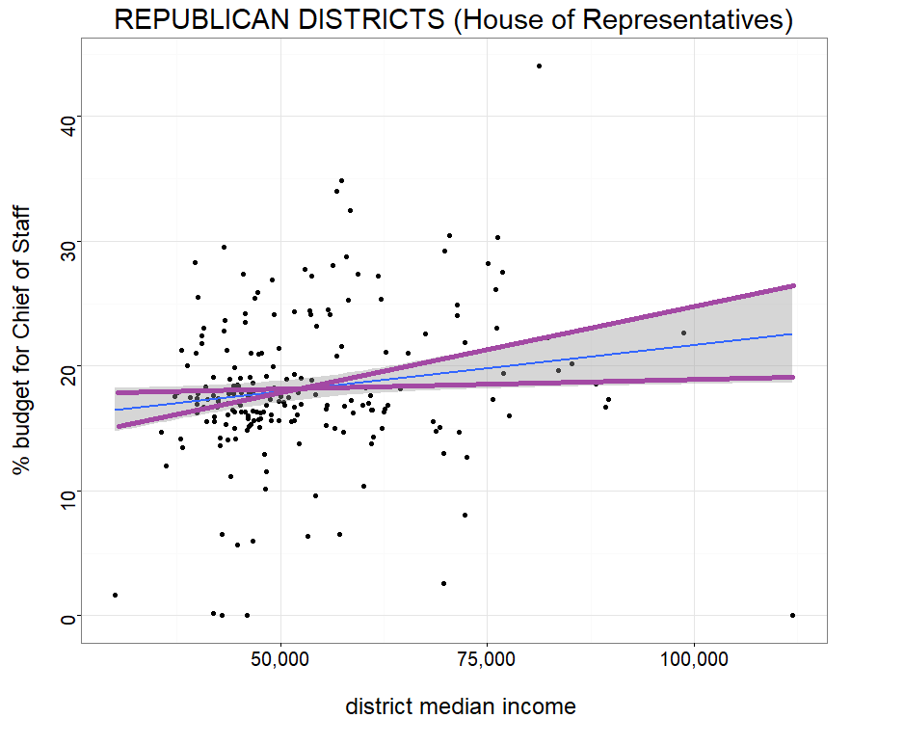
Step 1 (Republicans) : Stars and the Standard Error
The number in parentheses is the standard error. The larger this number is relative to the estimated effect size, the less certain the estimate is.
Notes:
I will obtain answers in two different ways. The first will be to ask a select number of legislators why they delegate to bureaucrats. This will be an open-ended question. The second will be to create a survey that lists multiple possible reasons for delegation, and asks the legislators to rank the reasons according to their importance.

Slide 39

Step 1 (Republicans): Calculating the maximum/minimum line in the shaded area
95% Confidence Interval (95% of all expected regression coefficients will be in this range):
So 95% of the time the ‘true’ coefficient is positive (between 0.00508 and 0.11092),
We expect that the average, expected value of the coefficient is 0.058.

Slide 40
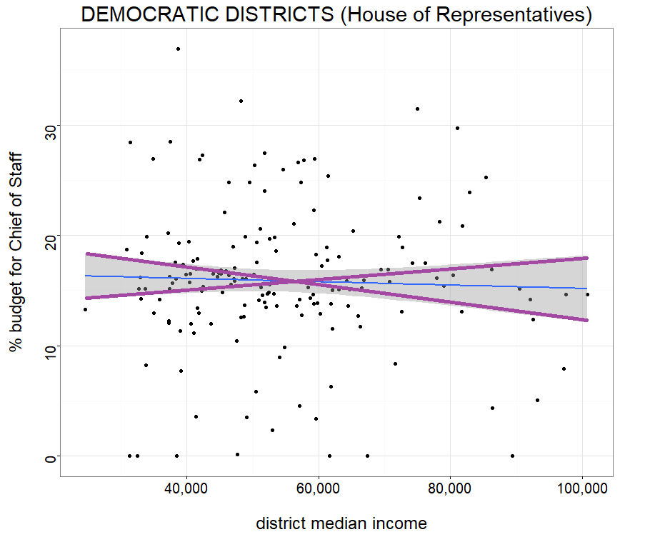
Step 1 (Democrats): No stars
The number in parentheses is the standard error. The larger this number is relative to the estimated effect size, the less certain the estimate is.
Notes:
I will obtain answers in two different ways. The first will be to ask a select number of legislators why they delegate to bureaucrats. This will be an open-ended question. The second will be to create a survey that lists multiple possible reasons for delegation, and asks the legislators to rank the reasons according to their importance.

Slide 41

95% Confidence Interval (95% of all expected regression coefficients will be in this range):
So some of the time the ‘true’ coefficient is negative (between -0.08488 and 0), and sometimes it is positive (between 0 and 0.02488)
We expect that the average, expected value of the coefficient is -0.030.

Slide 42
More Interpretation Facts: Multivariate vs Univariate Regression

Slide 43
Multivariate Regression

Slide 44
Multivariate v Univariate Regression
Coefficients change when you add new variables:

Slide 45
Comparing Coefficients
ONLY compare coefficients if the variables are measured in the same units

Slide 46
Intercept/constant/b
This is not a variable of interest. It represents the y-intercept... where the estimated line crosses the y-axes.
Why have it? Because it is needed to write out the regression function.
The intercept often doesn't have real world significance. For example, no district has $0 median income.

Slide 47
Size of effect
For now:
You can only estimate the size of the effect if it is a linear regression
Otherwise, rely on the text in the paper to provide insight into what the size of the effect means

Slide 48
How to Lie With Graphs

Slide 49
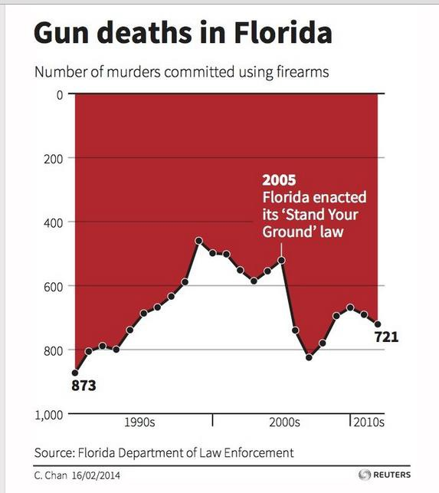
What's Wrong with This Picture?
This graph was created and printed by Reuters

Slide 50
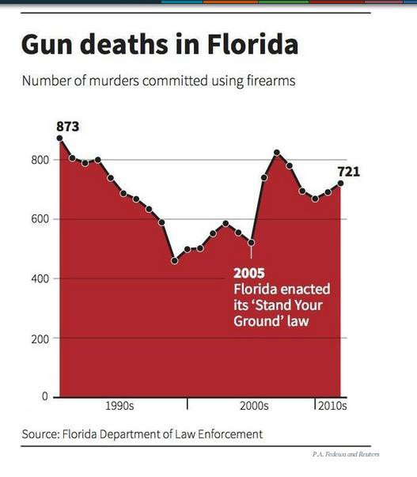
Corrected Graph

Slide 51
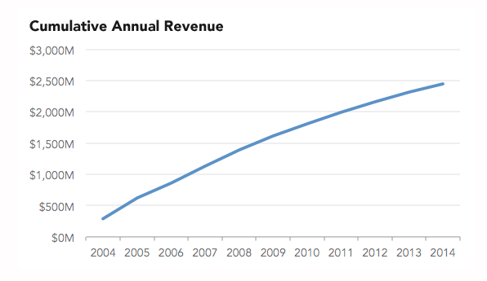
Size of effect

Slide 52
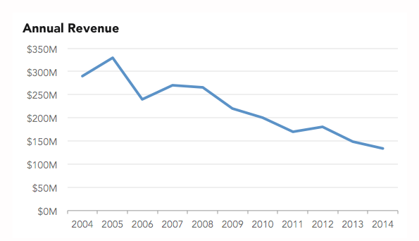
Size of effect

Slide 53
Spurious Correlation
http://www.tylervigen.com/spurious-correlations

Slide 54
More about the dinosaur graphic
What This Graph of a Dinosaur Can Teach Us about Doing Better Science
Jack Murtagh, Scientific American 2023

