Slide 1
Optical Flow Analysis For Pedestrian Counting
May 4th , 2019
Swatantra Kumar Goswami
171500354

Slide 2
Outline
Introduction
Problem Description
Approach
Optical flow computation
Image thresholding
Morphological processing and noise removal
Contours detection and extraction
Results and analysis
Conclusion and future works

Slide 3
Introduction
Pedestrian counting is important in various domains, from marketing to video surveillance. The large number of pedestrians flooding through the entrance paths of transportation stations, buildings and shopping malls represents an ongoing challenge for decision makers in charge of ensuring both public safety and business improvement.

Slide 4
Problem Description
Traditionally, pedestrian counting is conducted manually, which entails high cost and may introduce human error. Therefore, automatic pedestrian counting has received much attention. The main aim of this project is to count the number of pedestrian in video sequence retrieved by a single stationary camera.

Slide 5
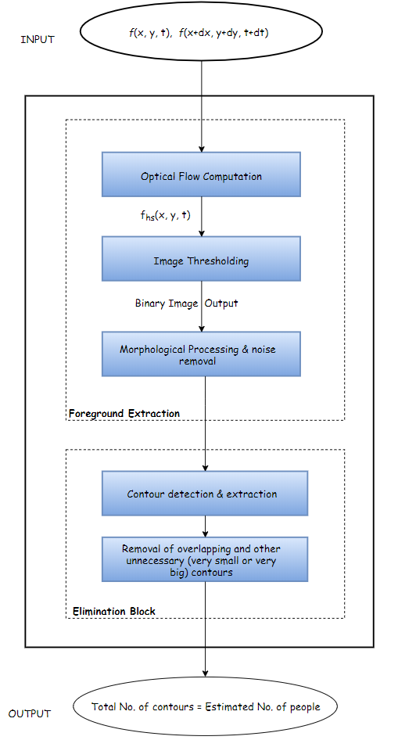
Approach

Slide 6
Optical Flow Computation
Optical flow computation is useful for detection, tracking and understanding the behaviour of the object.
Traditionally, in video surveillance with a fixed camera, researchers use background subtraction method, where foreground objects are extracted from video if the pixels in the current frame deviate significantly from the background.

Slide 7
In this project, foreground mask, that is generated by optical flow, f_{hs}(x, y, t) is used. Two consecutive frames f(x, y, t) and f(x +dx, y+dy, t+dt) are applied to foreground extraction block. Then the dense optical flow is computed between the adjacent frames
For each frame, after calculating optical flow, velocity vectors of all the points in the 2-D plane are obtained.

Slide 8
Image Thresholding
From the previous step velocity vectors of all the points in the 2-D plane are obtained. Then, the velocity of each point in the frame is computed.
Now the image is converted into the hsv image, in such a way such that the value of v(which is the intensity of hsv image) is directly correlated with the velocity of the points.
The points which are stationary will have zero(or very less) velocity and hence they will have very less (or zero) intensity in the hsv image and vice versa.

Slide 9
The obtained hsv image in the previous step is now converted into the binary image by using the concept of threshold.
The value of threshold which is taken is zero.
After the above step white patches in the black background will be obtained. Those white patches denotes moving objects

Slide 10
Morphological processing and noise removal
After the binary image is obtained, still there will be lots of noise in the image and thus to remove the noise, morphological processing followed by median filter is applied.

Slide 11
Contours detection and extraction
Now, the contours are created on the binary image obtained from the previous step.
Lots of overlapping and unnecessary contours having a very small area will also be formed.
Such unnecessary contours are removed.
Now, number of contours in the current frame, will give the approximate number of pedestrians in the current frame of the video.

Slide 12
Results and Analysis
Video 1

Slide 13
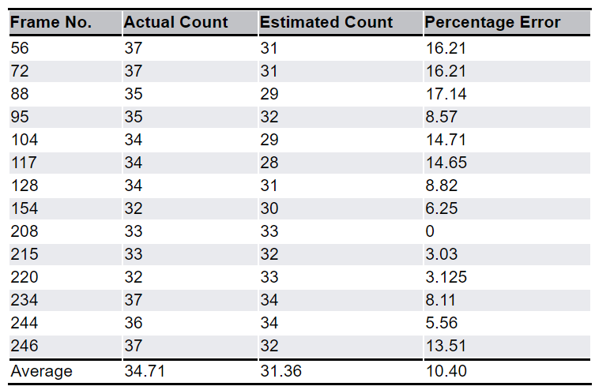
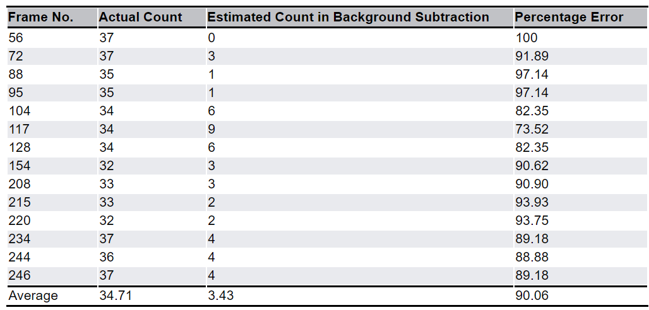
Comparison for video 1
Result of optical flow
Result of background subtraction

Slide 14
Video 2

Slide 15
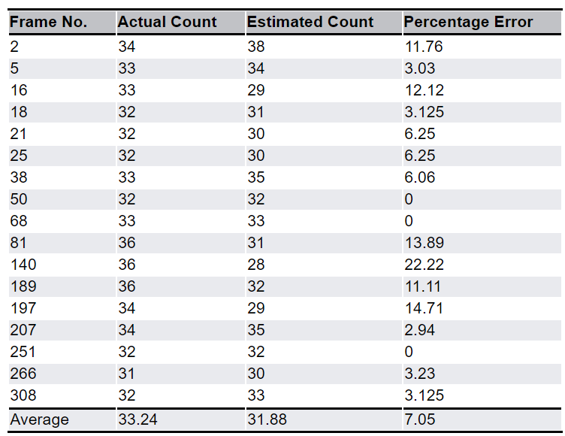
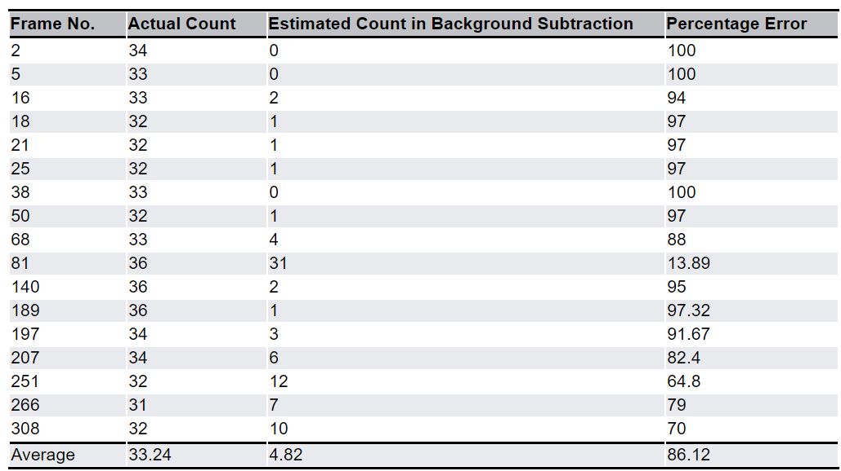
Comparison for video 2
Result of optical flow
Result of background subtraction

Slide 16
Conclusion And Future Works
It can be clearly seen from the obtained comparison tables that optical flow method provided a greater accuracy than the background subtraction method.
Also, in this project we were able to calculate only moving pedestrians. In the future , we aim to also count stationary persons.

