Slide 1
Project Application Development
Adu, Stephen; Andreicha, Semida; Buaron, Tal;
Cholodov, Andrej; Domela Nieuwenhuis, Jens

Slide 2
Table of Contents
Introduction
Problem
Purpose of the project
Research Questions
Research Methodology
Data Collection
Mathematical Models and Equations
Software Development
Connection between Applications
Assumptions and Limitations
Research Results
Q&A Session

Slide 3
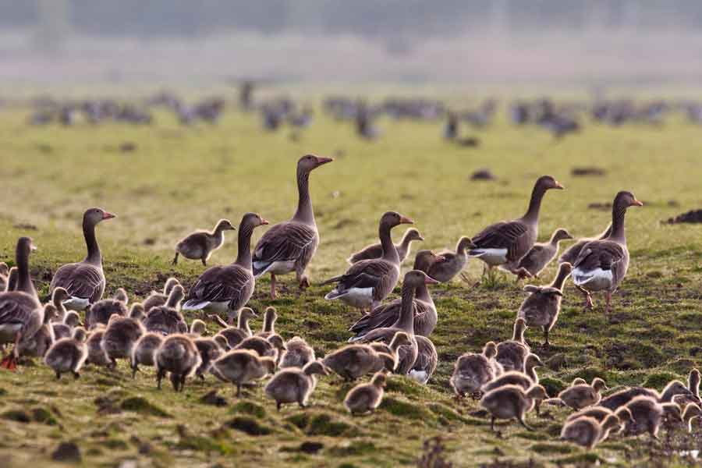
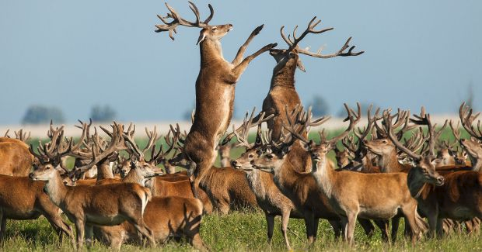
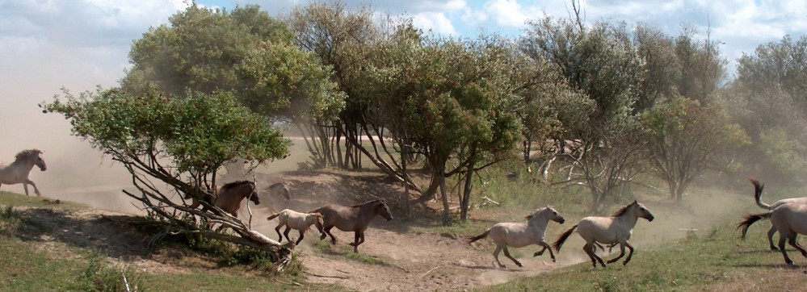
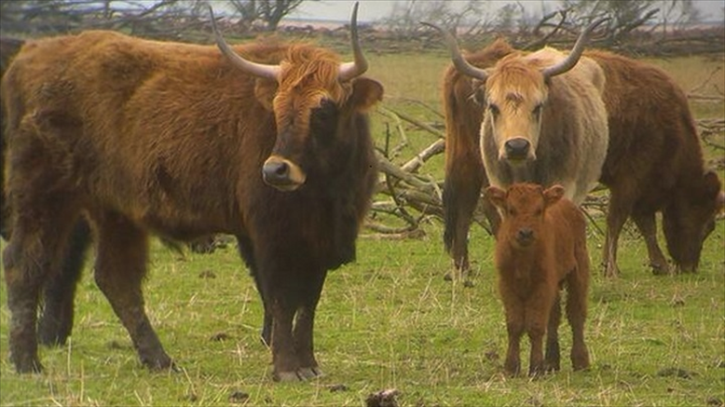
Introduction
The ecological preserve of Oostvaardersplassen has three large herbivores living there. They are: wild horses, wild cattle, and deer; and other foremost species such as geese and birds of prey.

Slide 4
Problem
The problem comes from the major factor of the ecosystem has hardly any predators and the herbivore's prohibitation of migrating.
As well the number of geese, particularly during winter, increase which causes the level of competition to increase. The interaction between the herbivores and the geese for resources can be quite severe, and can lead to extreme situations such as extinction.
Thus in consequence the Oostvaardersplassen preservation has established an unbalanced ecosystem.

Slide 5
Purpose of the project
The purpose for this project was to work towards a possible solution of the problem involving Oostvaardersplassen. This solution is based on mathematical model used in an application, which graphical illustrates predictions of the ecosystem.

Slide 6
Research Questions
Main Research Question at programme level:
What will happen to the populations of deer, cattle, horse and geese if releasing a number of foxes in the preserve (with the number of foxes being the free variable)?
The Main Research Question at project level:
How do the herbivores and the geese compete for the grass in an enclosed area?

Slide 7
Research Questions
Research sub-questions:
What is the rate of grass consumption of each animal?
How do animal populations change as a result of grass availability?
What are the populations of each animal?
How can the start data and historical data help shape existing mathematical models to an equation which fits the problem in Oostvaardersplassen?
How can the application hold all the implementations that are being asked?

Slide 8
Research Methodology
The research methodology had several development phases:
Data Collection
Mathematical Models
Software development
Connection

Slide 9
1. Data Collection

Slide 10

2. Mathematical Models and Equations
$$\frac{{dx}_{i}}{dt}=r_{i}x_{i}\left(1−\frac{\sum_{j=1}^{N}{a_{ij}x_{j}}}{{GK}_{i}}\right) \text{Equation}\text{ 1.1}$$
A Modified version of the equation of competitive Lotka-Volterra model, for N species.
$$\frac{{dx}_{i}}{dt}=r_{i}x_{i}\left(1−\frac{\sum_{j=1}^{N}{a_{ij}x_{j}}}{K_{i}}\right) \text{Equation}\text{ 1.2}$$
Competitive Lotka-Volterra model, for N species.

Slide 11
3. Software Development

Slide 12
4. Connection between Applications

Slide 13
Assumptions and Limitations
During the project development, several limitations may occur, that could harm the result of the application. Some of those Limitations for this research are the time frame which project needs to be finished. The information availability constraints which might be lacking data or not accurate at all. Another challenge is the interdependence on the other group that is investigating relating variable. This research has limited scope to Oostvaardersplassen preservation.

Slide 14
Research Results

Slide 15
Q&A Session

