Slide 1
Project Application Development
Adu, Stephen; Andreicha, Semida; Buaron, Tal;
Cholodov, Andrej; Domela Nieuwenhuis, Jens

Slide 2
Table of Contents
Introduction
Problem
Purpose of the project
Research Questions
Research Methodology
Data Collection
Mathematical Models and Equations
Software Development
Connection between Applications
Assumptions and Limitations
Research Results
Q&A Session

Slide 3
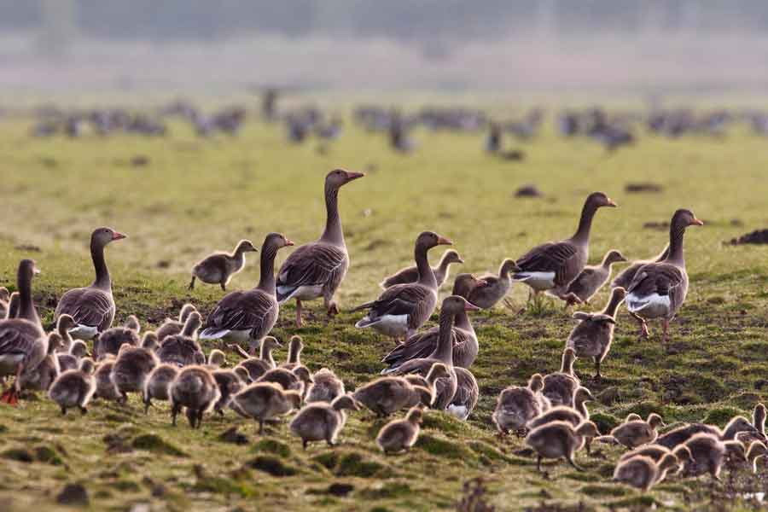
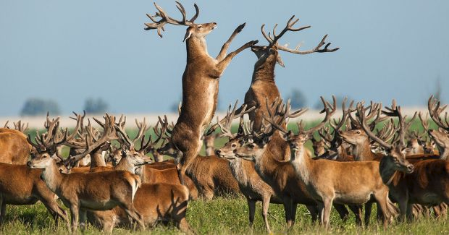
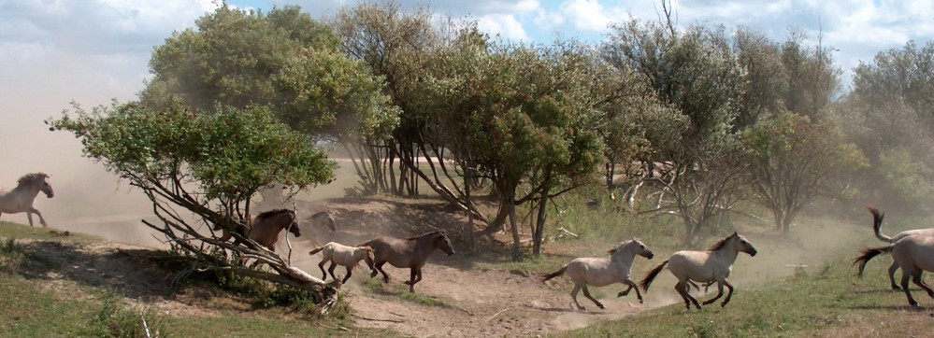
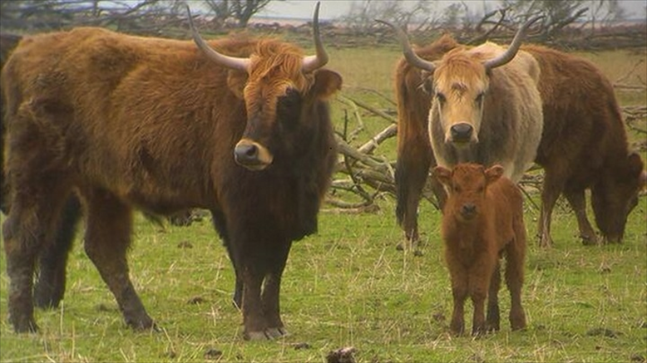
Introduction
The ecological preserve of Oostvaardersplassen has three large herbivores living there. They are: wild horses, wild cattle, and deer; and other foremost species such as geese and birds of prey.

Slide 4
Problem
The problem comes from the major factor of the ecosystem has hardly any predators and the herbivore's prohibitation of migrating.
As well the number of geese, particularly during winter, increase which causes the level of competition to increase. The interaction between the herbivores and the geese for resources can be quite severe, and can lead to extreme situations such as extinction.
Thus in consequence the Oostvaardersplassen preservation has established an unbalanced ecosystem.

Slide 5
Purpose of the project
The purpose for this project was to work towards a possible solution of the problem involving Oostvaardersplassen. This solution is based on mathematical model used in an application, which graphical illustrates predictions of the ecosystem.

Slide 6
Research Questions
Main Research Question at programme level:
What will happen to the populations of deer, cattle, horse and geese if releasing a number of foxes in the preserve (with the number of foxes being the free variable)?
The Main Research Question at project level:
How do the herbivores and the geese compete for the grass in an enclosed area?

Slide 7
Research Questions
Research sub-questions:
What is the rate of grass consumption of each animal?
How do animal populations change as a result of grass availability?
What are the populations of each animal?
How can the start data and historical data help shape existing mathematical models to an equation which fits the problem in Oostvaardersplassen?
How can the application hold all the implementations that are being asked?

Slide 8
Research Methodology
The research methodology had several development phases:
Data Collection
Mathematical Models
Software development
Connection

Slide 9
1. Data Collection
This phase includes information regarding: population statistics during different seasons, birth rate and death rate, the amount of grass eaten, and any other related data.
By the use of provided resources, initial information was deduced. Due to lack of information, on some of the species, similar specie data was used. However, further calculations were involved to find variables that fitted to the answer of the ecological problem.

Slide 10


2. Mathematical Models and Equations
The equation, used in the first mathematical model, is a modified version, of the competitive Lotka-Volterra model.
$$\frac{{dx}_{i}}{dt}=r_{i}x_{i}\left(1−\frac{\sum_{j=1}^{N}{a_{ij}x_{j}}}{K_{i}}\right)$$
$$G$$
Competitive Lotka-Volterra model, for N species.
A Modified version of the equation of competitive Lotka-Volterra model, for N species.
The modification made to the model was the introduction of an extra variable, G, which measures the grass availability.
This model calculates the population growth rate of a specific species, given the specific species’ grass availability, intrinsic rate of increase, carrying capacity, competing species’ population and their competition coefficients.

Slide 11

2. Mathematical Models and Equations
A second mathematical model was developed, to calculate the total grass consumption for each animal’s specie.
$$Amount of{{cows}/{deer}}/{ horses}∗ consumption each day ∗ 365 days a year = total amount of grass eaten by each herbivore$$

Slide 12
3. Software Development
The software development began with the creation of UML diagrams and models.
During the development of the UML models and diagrams, important aspects based on user goals shaped the final features of the applications. As well the behavioral set of actions, that the system can perform in collaboration with the external users of the system, was deduced. Then UML models and diagrams related to the backend of the development followed. The conceptual classes and the relationships between them, provided an initial view of how the interaction between predicted population changes and update of the UI. The structural diagrams helped with the visualization of the connection between the applications. Here the process goes from data user inputs and a description of the steps of the process of handling that information to get an output, was described. By the usage of the software design pattern, descriptions and structural behaviour of the system were shown, the system's classes, their attributes, methods, and the relationships among objects.

Slide 13
3. Software Development
The software development was divided into two parts the backend work and the frontend work.
The front-end development, which is the creation of the Graphical User Interface (GUI) was by utilizing Scene Builder. It consists of Menu Bar, Text Fields, Buttons, Radio Buttons and Graph, which visually represent the data.
In the backend work, the development of the software side, makes the prediction possible. The key aspects of the backend is to make the GUI work. One of the functionality is to take all the text fields inputs, from the GUI, process them inside the mathematical model and then to display the prediction in the GUI.

Slide 14
4. Connection between Applications
The connection between the two applications is done the use of sockets, which send JavaScript Object Notation (JSON) objects containing values used in calculating a prediction. The object will be sent, the application will wait until it receives a response from the other application, then the following year’s prediction will commence. The process of communication will be similar for both applications.

Slide 15
Assumptions and Limitations
During the project development, several limitations occurred, that harmed the result of the application. Some of those Limitations for this research are related to the time frame for the completion of the project. The information availability constraints, such as lacking data or data not accurate at all, allowed for assumptions in the construction of the mathematical model. Another challenge is the interdependence on the other group, the variable data that was supposed to be exchanged in order for an accurate prediction. This research has limited scope to Oostvaardersplassen preservation.

Slide 16
Research Results

Slide 17
Q&A Session

