Slide 1
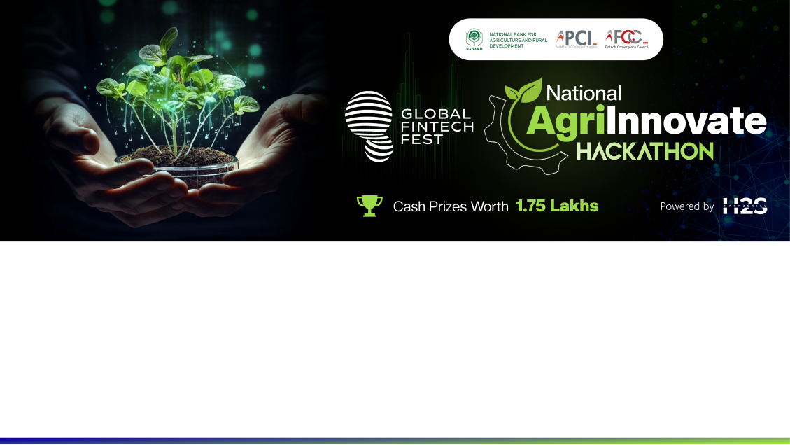
Team Details
Team name: LocateLabs
Team leader name: Swata Swayam Dash
Problem Statement: Revolutionizing Agricultural Advisory

Slide 2

Brief about the Idea
FarmGenie is here to help. This comprehensive online platform (website) harnesses the power of large language models and conversational AI to put a wealth of agricultural knowledge right at farmers' fingertips.
It consists of custom conversational AI framework leveraging the power of LLMs, SLMs and MoE-style architectures along with IoT-enabled devices for predictive analysis, namely, prediction of best crop acc. to a particular field conditions and/or easy-to-read analysis of one’s field attributes in the regional language of the farmers.
IoT-enabled devices will be used to get real-time data for a particular agriculture field which then gets feed to our framework with which the farmer can have an easy-to-go conversation.
A Multi-Agent Debate-styled LLM –based framework for better prediction of next-best crop for a user’s field using realtime data from agricultural fields using IoT-enabled devices.

Slide 3
Opportunities
How different is it from any of the other existing ideas?
The product is built as a web application using a Next.js client, and a Next.js backend, leveraging a Redis queue and multiple worker nodes to ensure scalability and robustness. The Knowledge Base (Chatbots) is curated from openly available PDF books and reports covering various agricultural topics.
Many of existing solutions lack the incorporation of GenAI system to carry out the user queries which leads to poor user experience and incorrect response to their queries without any real-time input from devices which are present on the agricultural fields to extract its exact conditions.
Our solutions incorporate a robust MoE-styled framework which incorporates data from external IoT devices while making use of GenAI like Gemini 1.5 Pro and fine-tuned SLMs(Phi3) acting as ”experts” in their respective fields.
This is accompanied by a sophisticated RAG system which make use of publicly available books on agricultural and other components to better expand and build upon the user queries for a hallucination-free and high accuracy answer.

Slide 4
Opportunities
How will it be able to solve the problem?
Our framework incorporates a MoE (Mixture of Style framework) + sophisticated RAG framework catered towards reducing hallucinations by leveraging the prowess of fine-tuned SLMs(Phi-3) as experts and LLMs for conversation.
We also introduced a multi-agent debate framework to better predict the crops using IoT-enabled devices real-time data which make use of multiple LLMs as agents or “Experts” sharing their views on a particular user query and the “Judge” LLM makes the final judgement call (answer).
USP of the proposed solution
A fast and responsive website with seamless user-experience encompassing various features including Conversational-AI for hallucinations-free and accurate answers, Marketplace for easy online shopping alongside promoting local shops into “Digital Marketing”, AI-enabled Decision Support System for complex demands and a Community Forum to promote collaborations.
Our Conversational AI and Multi-Agent Debate Framework powered by LLMs and Realtime data from IoT-devices will provide the farmers the ease with which they can communicate with AI which can be referred to as their ‘partner’ which can not only help them with simple-to-complex queries with high accuracy and low hallucinations but also give suggestions about best-yields crop suited purely according to their agricultural fields conditions.

Slide 5
List of features offered by the solution
WEBSITE
COMMUNITY FORUM
1. Dual Marketplace:
i. Input Marketplace (for local sellers and dealers)
ii. Output Marketplace (for farmers)
2. AgriScheme
Empowering Farmers: A dedicated platform designed to provide farmers with essential information on government schemes for agriculture and farming.
User-Friendly Interface: Intuitive navigation allows for easy access to a wealth of resources, ensuring a seamless experience for users.
Comprehensive Database: Explore a wide variety of initiatives, including subsidies, grants, and training programs tailored to support farmers.
1. Multilingual Support
2. Gamified help system
3. Communities

Slide 6
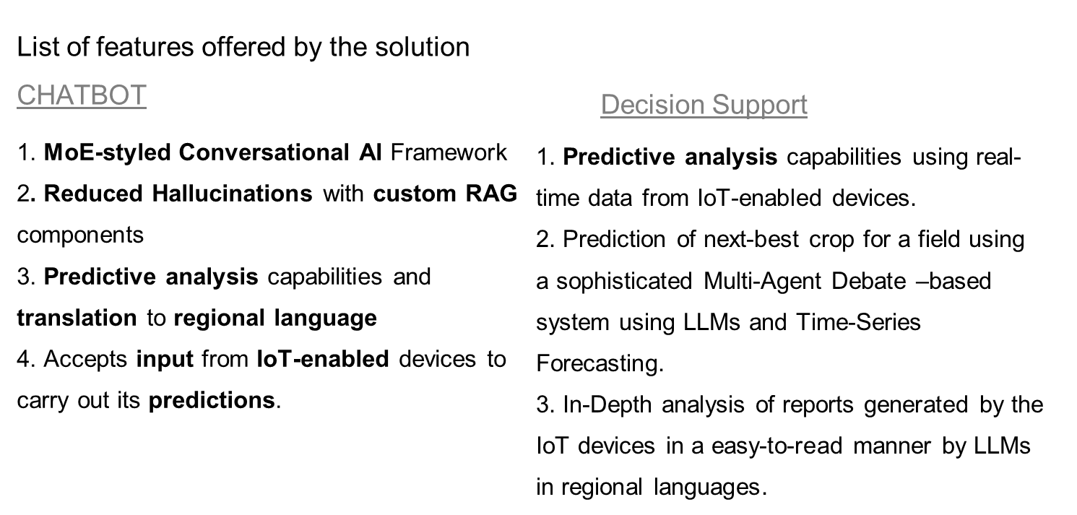

Slide 7
List of features offered by the solution
Market ChatBot
Query using Natural Language
Fetches in-depth Product Reviews, Relevant Search Items, etc
Shows the availability of the item from nearby stores first

Slide 8
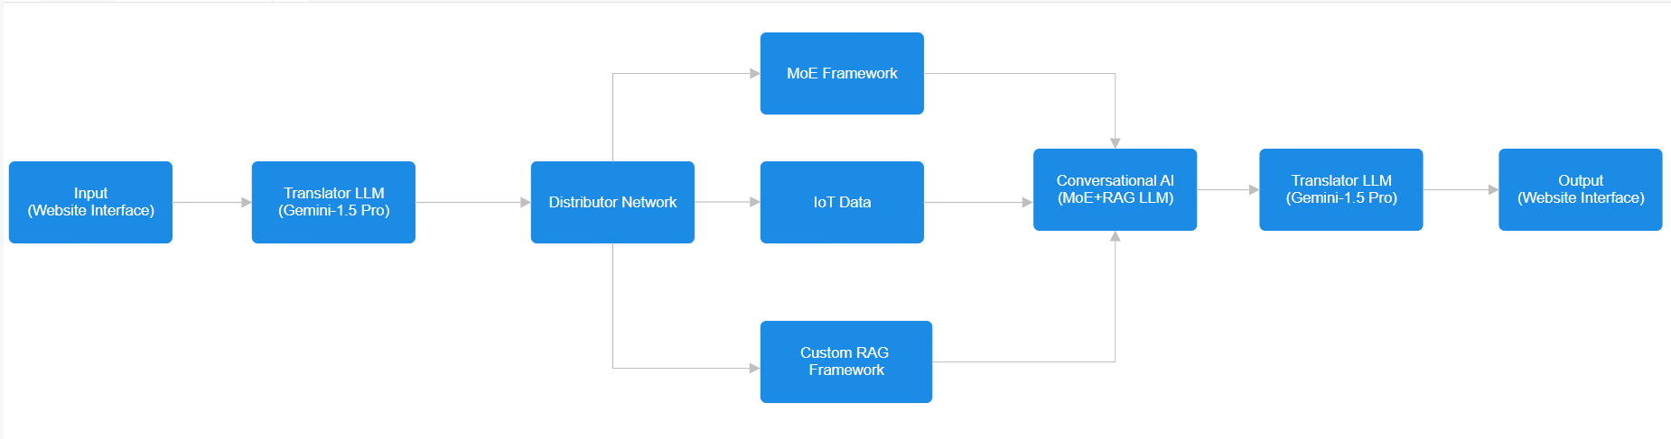
Process flow diagram or Use-case diagram

Slide 9
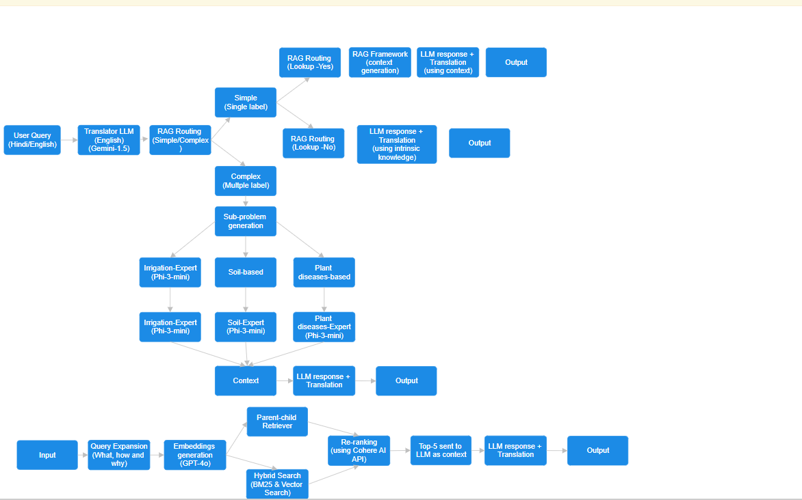
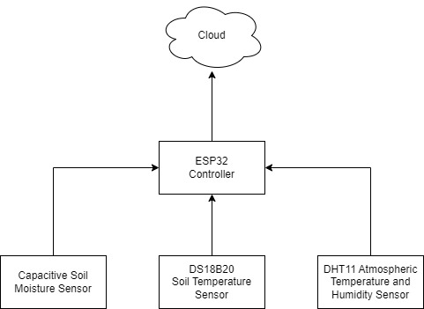
Wireframes/Mock diagrams of the proposed solution (optional)
CHATBOT

Slide 10
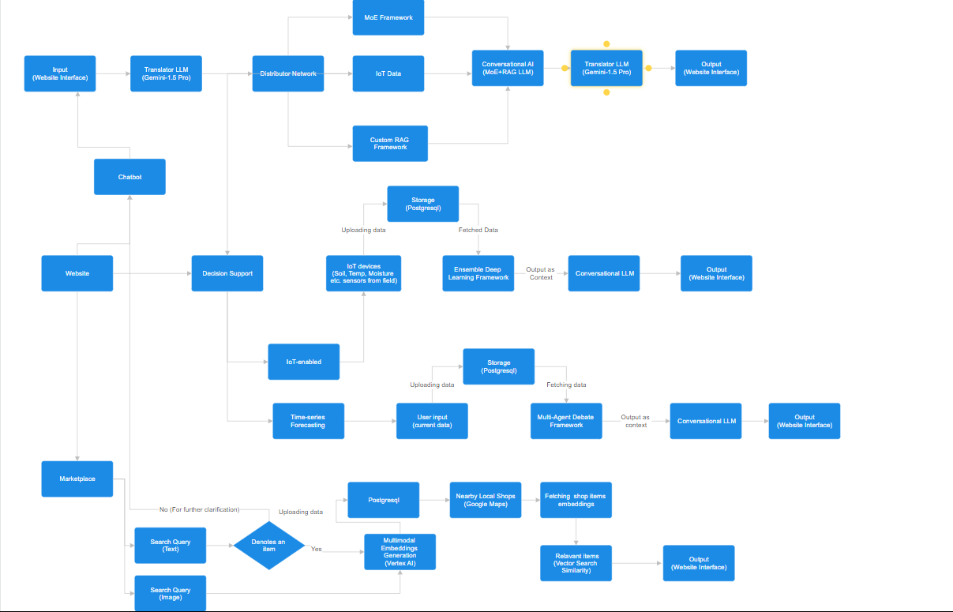
Architecture diagram of the proposed solution

Slide 11
Technologies to be used in the solution
Client: Tailwind CSS, TypeScript, Next.js
Backend: Flask, Python, Langchain, GeminiPro API, peft , bitsandbytes, transformers
Storage/VectorStore: PostgreSQL, FAISS
Other Tools: Docker, Vercel, Unsloth, DigitalOcean
Hardware: IoT-enabled devices

Slide 12
Estimated implementation cost (optional)
The following is the cost required for the development of prototype of the hardware segment of our project
Soil moisture content - 200 rs
Temperature and humidity of environment - 300 rs
esp32 wireless board - 550rs
Jumper cable and other stuff - 50rs
3d printed casing - 300rs
(This is just an initial pay info which will be optimized to reduce the cost as much as possible as the build progresses).

Slide 13
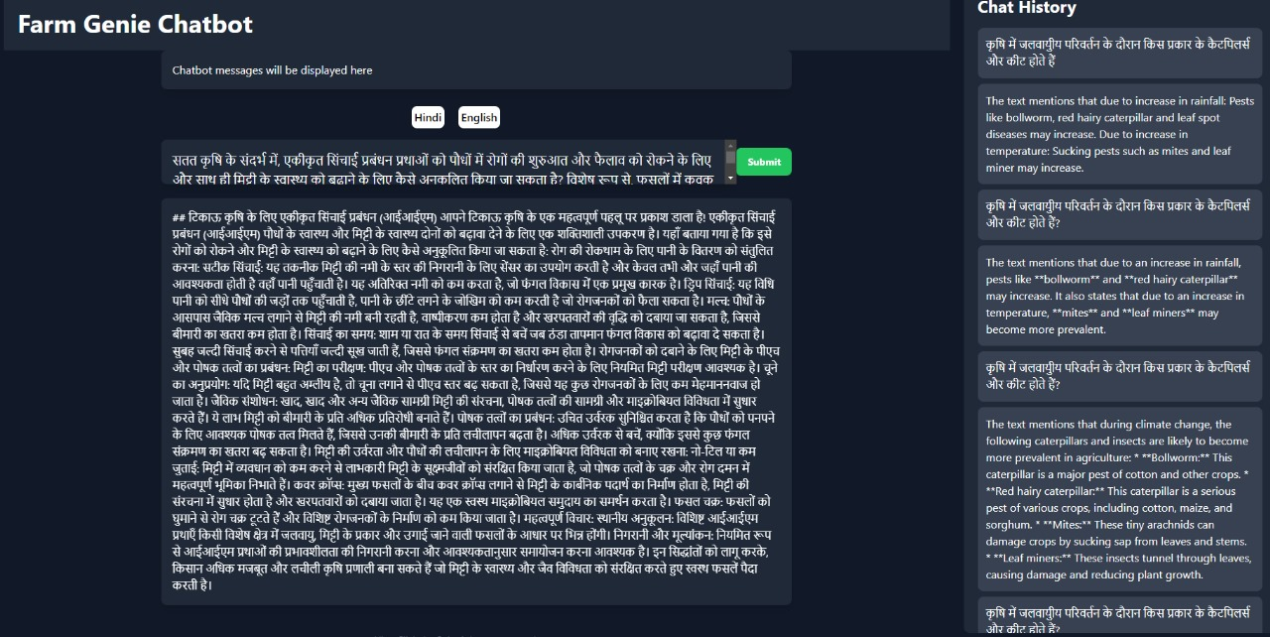
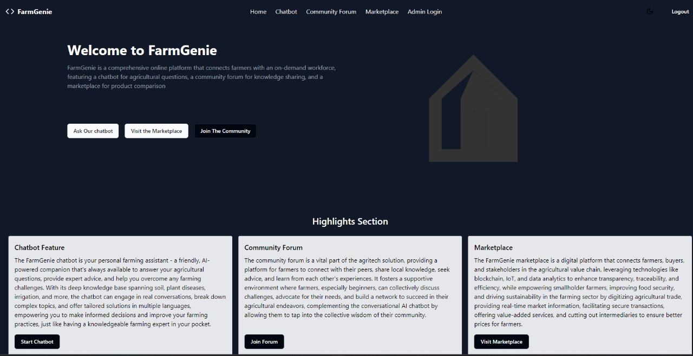
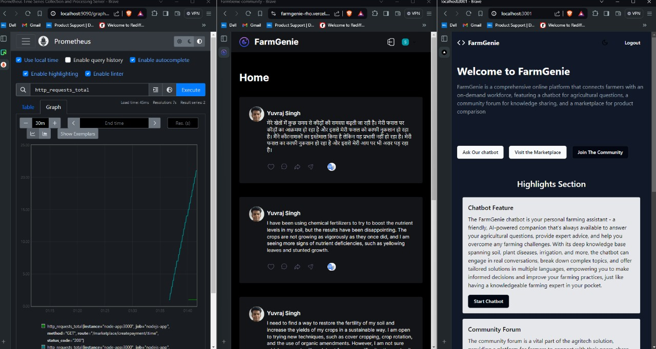
Snapshots of the prototype

Slide 14
Prototype Performance report/benchmarking
We have tested the performance of the Chatbot on a specific set of questions (simple + complex types) generated by GPT-4o with a few shot template consisting of a few handwritten examples.
With Gemini-1.5-Pro as the Conversational LLM, It is observed that with our framework does indeed reduce hallucinations and improves the accuracy of the answers generated in the language specified by the farmers (Hindi/English/Hinglish). This was verified by using Human Evaluations from our own team and outside volunteers.

Slide 15
Additional Details/Future Developments
Develop a multi-agent framework using LLMs along with a deep learning framework to better predict the next-best crop for a particular fields-based on market/it’s history/user-wish.
This feature, accompanied by real-time data from IoT devices will help the farmers to get an idea what’s the best suited crop for their next harvest season based on factors such soil nutrient, temperature, humidity, rainfall along with farmland’s history (if possible).
These data, when presented in the form of numbers and chosen language-specific bar charts and graphs will help farmers take an informed decision regarding their crops and grow their profits is our motto.

Slide 16
Provide links to your:
GitHub Public Repository https://github.com/swataswayam-14/FarmGenie
Demo Video Link (3 Minutes) https://youtu.be/KXKhoLb8EfA
FarmGenie Official Website featuring the chatbot and marketplace http://64.227.135.219:3000/
FarmGenie Community Forum https://farmgenie-rho.vercel.app/
FarmGenie Agri-Schemes Website https://farmgenie-agrischemes.vercel.app/

Slide 17
