Slide 1


SMART CITY A Complaint Management System for the Convenience and Better Living of citizens using GPS.
Indira College Of Engineering And Management, Pune
Guide:- Dr. Priya Pise Goup ID:- 4
Swateja Bagal B150524208
Shraddhha Namde B150524258
Rohit Anagire B150524283
Vinay Sawardekar B150524311
Department Of Computer Engineering, 2020-2021

Slide 2
Contents
Problem Statement/Definition
Motivation
Objectives
Project Scope
Justification with Literature Review
Proposed Architecture
Algorithms
Requirements
System Specifications
System Architecture
Future scope
Design
References

Slide 3
Problem Statement
“To make current waste disposal and road management system SMARTER using machine learning algorithm and operational process flows, intern to make a city as Smart City”.
1. Define required process flows for garbage management, road network and accident module.
2. Interface to raise the service requests.
3. User registration to use the current system functionality.
4. Reporting and dashboard for service requests and issues raised by end user.

Slide 4

Motivation
The main motivation is to handle the complaints regarding healthcare, roads and garbage and provide service to the user complaint registered.
Communication gap of reporting an roads and street-lights to the emergency number, slow service cause problems. Time taken to relay information to the authorities is long, as no one is interested go to the office and place a complain regarding roads.
The third motivation is developing convenient citizen complaint management system for better living.

Slide 5
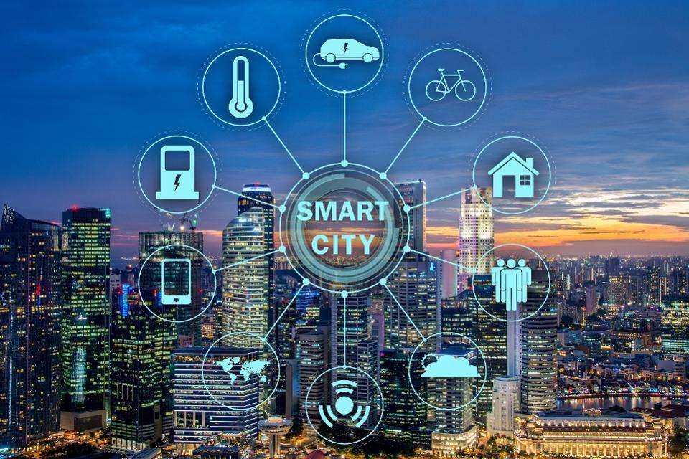
Objectives
1.Time Saving
2.User Friendly
3.Verification
4.Portable

Slide 6

Project Scope:
As we all know there are many problems/complaints regarding garbage overflow, road damage problems and healthcare issues in cities. To resolve this problem of common people we are proposing an application through which they can easily register their complaint and get proper treatment according to the problem.
The project is all about to save the time of people and get proper solution to the problem at time. We all as a human being want a better, convenient and smart life-style so the main motive behind developing this project is to make current waste disposal, road management system and healthcare management system SMARTER using machine learning algorithm and operational process intern to make a city as Smart City.

Slide 7
Introduction
We are proposing an application that replaces the current manual processes for a smart city. Users can take photos of garbage, road networks, accidents and send them to a higher authority.
Higher authorities take appropriate action on the complaint. Proposed system improves the handling of service requests and issues raised by common people regarding garbage, road network and healthcare issues in municipal corporation jurisdictions very effectively and efficiently by the service providers and respective departments in municipal corporation.
It will help to review and analyze the operational performance of service providers and Municipal departments and governance bodies.

Slide 8

Literature Survey

Slide 9
Justification of Literature Survey
Sr. No. | Paper Title | Keywords | Abstract | Techniques/Algorithms
1. | Smart E-Grievance System For Effective Communication In smart Cities, 2018 | e-grievance, effective communication, Serve India, volunteer, free service, digital India | In smart E- grievance system Map reduce algorithm is used for sorting of the complaints. Implementation of MapReduce Algorithm All the complains that will be uploaded by the users will be analyzed by using the map reduce method, as the amount of data will be large and therefore the basic analysis method cannot be used. Map reduce method with Hadoop file system for simplifying the analysis of the large data. | Map Reduce
2. | Smart Contracts for supply chain applicable to Smart Cities daily operations, 2019 | Blockchain, Smart Cities, Smart Contracts, Document of Understanding, Design Thinking, Agile | Paper focuses on the Document of Understanding (DOU) contract oriented to provide chain operations, which forms the idea for the connection between a consumer service and therefore the provider of that service. The sign-off of this process is currently too long; opening a chance to use blockchain as an answer . For this task, we've used local resources, applying design thinking and agile practices to make an area blockchain Ledger. | Blockchain, DOU

Slide 10
Justification of Literature Survey
Sr. No. | Paper Title | Keywords | Abstract | Techniques/Algorithms
3. | A Use Case in Cybersecurity based in Blockchain to deal with the security and privacy of citizens and Smart Cities Cyberinfrastructures, 2018 | Smart Citizens Identity, Blockchain, Cybersecurity, Internet of Things, Smart Cities, Smart Buildings. | The ledger system is decentralized, but information is transparently available to members of the precise blockchain. All members (or nodes) can record, pass along and consider any transactional data that's encrypted onto their blockchain. This process creates trust while also maintaining a high level of knowledge integrity. | Blockchain, SVM, KNN
4. | Resolving the shortest path problem using the haversine algorithm. | Shortest path, haversine algorithm | The haversine method calculates the space between one coordinate with another during a line and ignores hills or valleys on the surface. The input of this method is latitude and longitude. It is the coordinates of the earth. The output is the value of the distance between the two locations. | Graph theory, Dijkstra's algorithm, Haversine algorithm

Slide 11
Justification of Literature Survey
Sr. No. | Paper Title | Keywords | Abstract | Techniques/Algorithms
5. | Mobile application for a smart city, 2018 | Smart home; Mobile application | This project focuses on the Document of Understanding (DOU) contract oriented to supply chain operations, which forms the basis for the relationship between a consumer service and the provider of that service. The sign off of this process is currently too long; opening an opportunity to apply Blockchain as a solution. For this task, we have used local resources, applying design thinking and agile practices to create a local Blockchain Ledger. | Blockchain, SVM, KNN
6. | Advance e-governance system, 2017 | Services, NGO, Public sector, Private sector, schemes, services, tracking. | The proposed system is based on MVC design pattern. It is implemented using Java language on Hibernate and Spring framework. The proposed system will provide the additional services related to education, health, insurance, banking, personal etc. with extra features in existing services. | Graph theory, Dijkstra's algorithm

Slide 12
Sr. No. | Paper Title | Keywords | Abstract | Techniques/Algorithms
7. | HERMES: GS1-based Smart City Service Intercommunity, 2018 | Service Intercommunity Platform; GS1 | The GS1 is a non-profit international standards organization that develops the GS1 ID, a global identification standard for increasing the quality and visibility of global production, logistics, distribution, and consumption networks. The GS1 ID is made up of the following elements: GS1, company prefix, reference, and serial/extension number. | GS1, cybersecurity

Slide 13
Proposed System
The proposed system is based on GPS, where citizens can share their complaints with real time image and location. The proposed system replaces the current manual processes for a smart city. As we discussed earlier this system saves citizens complaint process time. Citizens can take photos of garbage, road networks, accidents and send them to a higher authority. Higher authorities take appropriate action on the complaint. Further higher authorities divided into three sub-divisions i.e., Main desk, Sub Desk, Service Provider.
There are three modules in the system:
Road Module
Garbage Module
Accident Module

Slide 14
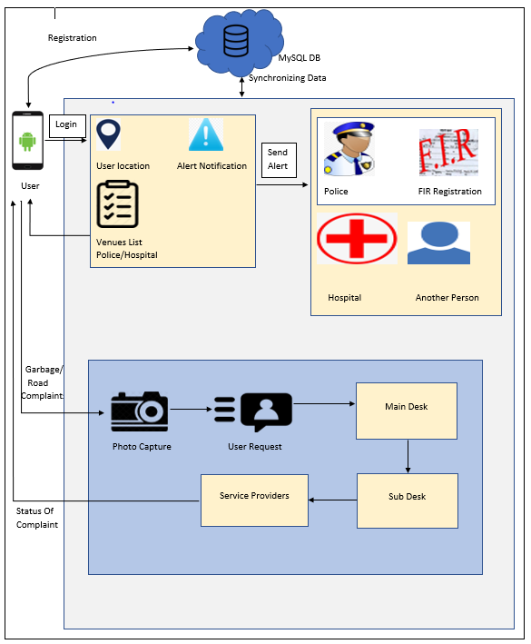
Proposed System Architecture

Slide 15
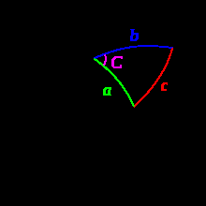
Algorithm – Haversine Formula
The Haversine Formula is an essential equation in finding straight line distance between two coordinates on the earth using longitude and latitude parameters. The haversine algorithm is an example of modelling calculation in the form of trigonometry, which is applied to a round shape. This algorithm discusses the shapes of sides and angles in spherical triangles.
Many methods can be occupied to find the distance among locations on the world map, one of which is the haversine algorithm / method. The haversine method is commonly used in the world of aviation to calculate the distance of an aircraft with the coordinates of the destination.

Slide 16

Requirements
Software Requirements
Operating System: Windows 7 and Above
Front - End: HTML and CSS, JavaScript, XML
Back - End: PHP and MySQL, JAVA
Server: Tomcat 8.0
Platform: Eclipse, Android studio
Hardware Requirements
Processor: Intel P4 1.5GHz or above
RAM: 512MB and above
Hard Disk: 80GB HDD and Above

Slide 17
System Specifications:
Through the GPS location tracking is simple.
Haversine formula is used for capturing nearby service provider and near by police station and hospital.
Each complaint have unique ticket number so easy to track.
Graphical visualization of complaint progress.
Feedback system.
OTP verification .

Slide 18
System Architecture:
System architecture is the phenomenon in which the relationship between different types of components can be denoted.
After developing a particular system, it is necessary to design various types of diagrams that gives a short summary about components used in the system.
System architecture also deals with the ow of the entire system because of which the developer as well as the organization can understand easily the working model of particular project or system. There are various ways in order to define system architecture.

Slide 19
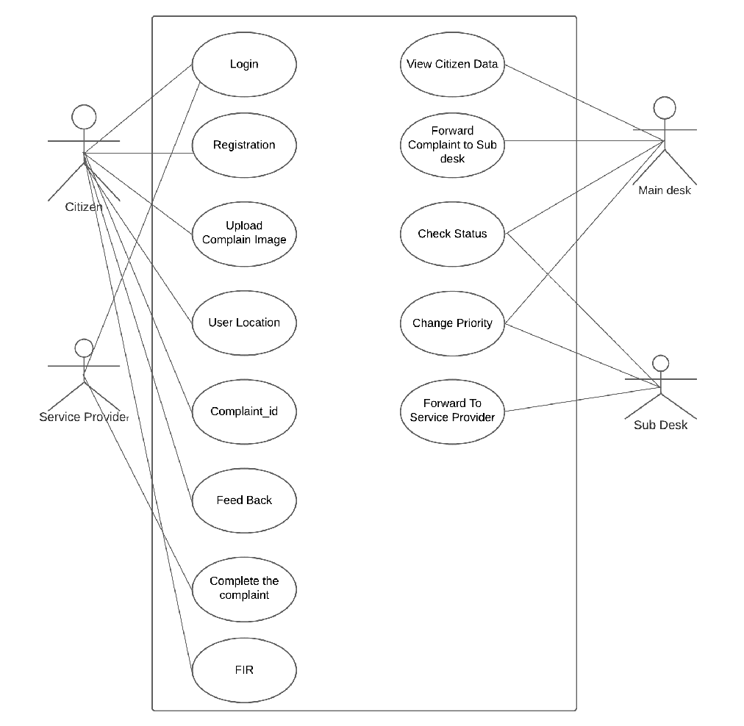
UML Diagram

Slide 20
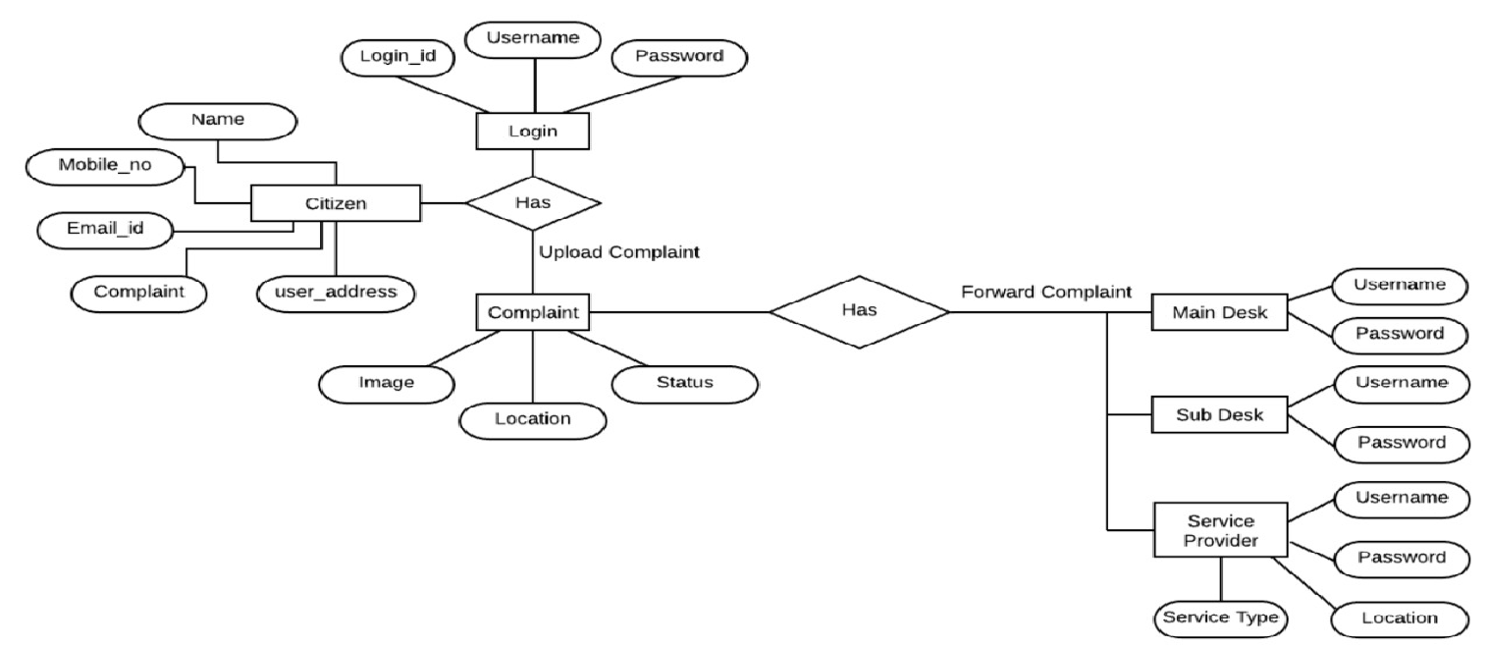
Entity Relationship Diagram

Slide 21
Observation & Result
This study uses the unit of kilometres in determining the results of the distance test between two coordinates. The test results will be based on a predetermined sample. There are 7 samples tested to determine the nearest service provider based on haversine formula. The service request raised at Nigdi location so before forwarding to service provider, we have to check nearest service provider. There are 7 service providers who are working at different city location so the new service request will map with existing service request and assign to nearest service provider. By
using Haversine formula will calculate distance and then find nearest location.
The following calculation will explain the Haversine calculation.
Source: Nigdi
Latitude: 18.648964989771898,
Longitude: 73.77045729012457
Destination: Ravet
Latitude: 18.660837905935313,
Longitude: 73.73183348048588
Haversine = ACOS((SIN(18.648964989771898,) * SIN(18.660837905935313,)) + (COS(18.648964989771898,) * COS(18.660837905935313,) * COS(73.73183348048588 - 73.77045729012457))) * 63713,549128345
Distance is 4.2 Km.

Slide 22
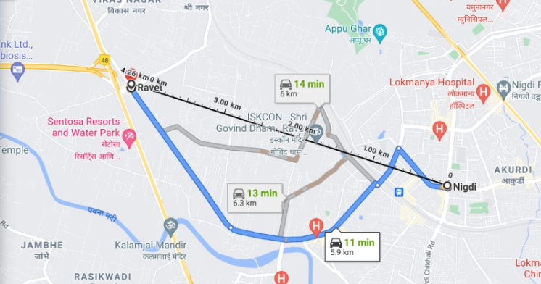
Similarly, distance for all service provider location is calculated and we get Ravet as nearest service provider location.
Sr.No | Location | Latitude | Longitude | Distance
1 | Pimpri | 18.626053374966805 | 73.80535412978594 | 12.2KM
2 | Bhosari | 18.631711800447366 | 73.84679235225029 | 16.5KM
3 | Ravet | 18.660837905935313 | 73.73183348048588 | 4.2KM
4 | Shivajinagar | 18.53295131778907 | 73.84273719016952 | 19.7KM
5 | Dapodi | 18.58590956256002 | 73.83335444975128 | 13KM
6 | Wagholi | 18.58084918119413 | 73.97888428157549 | 29KM
7 | Aundh | 18.564486511029703 | 73.81016681248482 | 14KM

Slide 23
Future Scope
As Considering future work the image processing will add to this system to automatically classify the complaint details. Such as if the image of road issue attached then it will identify does it street issue, speed breaker issue, broken road. Similarly, If garbage complaint upload then verify the type of garbage and density of garbage. So it will reduce citizen effort to write complaint details this will automatically capture the image info.
There are chances that different citizens from same city can upload same complaint. So in future by applying suitable algorithm the complaint will verify with existing complaints if same complaint already upload then citizen get message which indicates progress of the particular complaint. In future not only road or garbage module will be there we will add other module as well such as Electricity, Gas pipeline issue, Water management, residents’ complaints issue.

Slide 24
Conclusion
In our predicted system, individuals will take exposure to the real task i.e., waste, road network, and health. The device could enhance the present position anywhere the picture is taken. The priority of the objection would certainly be raised if the quantity of them is dramatically a great deal in a region. These System also provides us the documents without taking time which is needed on an urgent basis for important work. Then it is an excellent relevance to the everyday life of the people within a country like India. This predicted job could supply vital details worrying about the accidents also an unoccupied space. This full forecasted system, application, and our learning and understanding of automaton have significantly fully grown over the last couple of months.

Slide 25
References
[1] S. Kazi, S. Ansari, M. Momin and A. Damarwala, "Smart E-Grievance System For Effective Communication In smart Cities," 2018 International Conference on Smart City and Emerging Technology (ICSCET), 2018, pp. 1-4, doi: 10.1109/ICSCET.2018.8537244.
[2] J. M. Montes, C. E. Ramirez, M. C. Gutierrez and V. M. Larios, "Smart Contracts for supply chain applicable to Smart Cities daily operations," 2019 IEEE International Smart Cities Conference (ISC2), 2019, pp. 565-570, doi: 10.1109/ISC246665.2019.9071650.
[3] O. B. Mora, R. Rivera, V. M. Larios, J. R. Beltrán-Ramírez, R. Maciel and A. Ochoa, "A Use Case in Cybersecurity based in Blockchain to deal with the security and privacy of citizens and Smart Cities Cyberinfrastructures," 2018 IEEE International Smart Cities Conference (ISC2), 2018, pp. 1-4, doi: 10.1109/ISC2.2018.8656694.

Slide 26
References
[4] Prasetya, DA, Nguyen, PT, Faizullin, R, Iswanto, I & Armay, EF 2020, 'Resolving the shortest path problem using the haversine algorithm', Journal of Critical Reviews, vol. 7, no. 1, pp. 62-64. https://doi.org/10.22159/jcr.07.01.11
[5] A. Nitu, C. Stirbu and F. M. Enescu, "Mobile application for a smart city," 2018 10th International Conference on Electronics, Computers and Artificial Intelligence (ECAI), 2018, pp. 1-4, doi: 10.1109/ECAI.2018.8679038.
[6] S. Kumar, S. K. Sharma, R. K. Keswani and S. Mohanta, "Advance e-governance system," 2017 International Conference on Energy, Communication, Data Analytics and Soft Computing (ICECDS), 2017, pp. 521-525, doi: 10.1109/ICECDS.2017.8390221.
[7] W. Yoon et al., "HERMES: GS1-based Smart City Service Intercommunity," 2018 IEEE International Smart Cities Conference (ISC2), 2018, pp. 1-8, doi: 10.1109/ISC2.2018.8656925.

Slide 29


