Slide 1
TQ
TransferIQ
AI-Powered Player Transfer Value Prediction
Dynamic prediction model using multi-source data — player performance statistics, social media sentiment, injury history, and historical market trends.
Built with LSTM (NumPy), Gradient Boosting, Random Forest, and Weighted Ensemble.
1,034
44
0.495
8 Weeks
Players
Features
Best R²
Duration
Internship Project · Machine Learning & Sports Analytics

Slide 2
Project Overview
📊 Data Collection
⚙️ Feature Engineering
4 sources: StatsBomb performance stats, Transfermarkt market values, Twitter/NLP sentiment, injury records for 1,034 players (2009–2021)
69 features engineered: age curve, performance indices, injury risk score, sentiment impact, position encoding, contract value proxy
🤖 ML Models
🌐 Web Application
LSTM from scratch (NumPy BPTT), Gradient Boosting, Random Forest, Ridge Regression — combined into a Weighted Ensemble
Flask backend serving the pkl model via REST API, interactive predictor with all inputs, player explorer with filters

Slide 3
Data Sources & Feature Engineering
Data Sources
Engineered Features (44 used in model)
StatsBomb
Age Features
1,034 players · FIFA performance stats
age_peak_diff, is_peak_age, potential_score, career_stage
Transfermarkt
Performance
6,043 records · 2009–2021 market values
physical_index, technical_index, performance_score, OVA_norm
Injury
Sentiment NLP
injury_risk_category, availability_score, total_days_missed
1,069 records · VADER scores
Sentiment
Injury History
avg_sentiment, sentiment_performance_index, sentiment_label
9,553 records · days & games missed
Market
avg_growth_rate, value_volatility, num_seasons, contract_proxy

Slide 4
Model Architecture
Data
Ingestion
Feature
Engineering
LSTM
Model
Ensemble
Models
Prediction
Output
▶
▶
▶
▶
Player Stats
Market Values
Injury Data
Sentiment
69 features
Age curve
Injury risk
Normalization
Univariate
Multivariate
BPTT Training
NumPy scratch
Random Forest
Grad. Boosting
Ridge Regression
Stacking
€ Transfer
Value
R²=0.495
PKL model
Weighted Ensemble combines RF + GB + Ridge weighted by individual R² scores → best overall performance

Slide 5
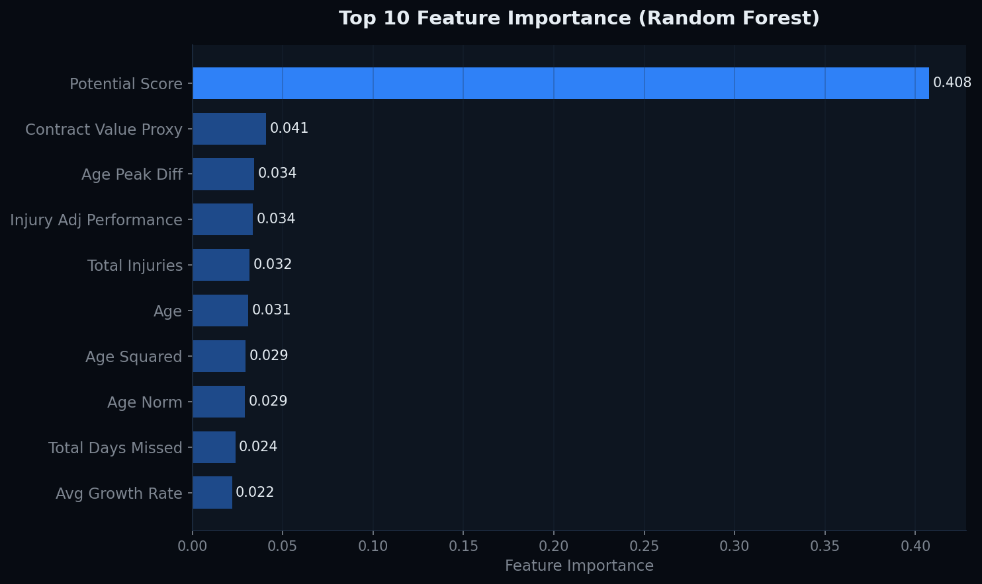
Feature Importance Analysis
Key Insights
40.8%
Potential Score
Young player future value dominates
4.1%
Contract Value
Longer contracts = higher market value
3.4%
Injury Perf.
Injury-adjusted stats matter
3.2%
Age Peak Diff
Peak age 23-28 boosts value
2.2%
Growth Rate
Historical value trend signal

Slide 6
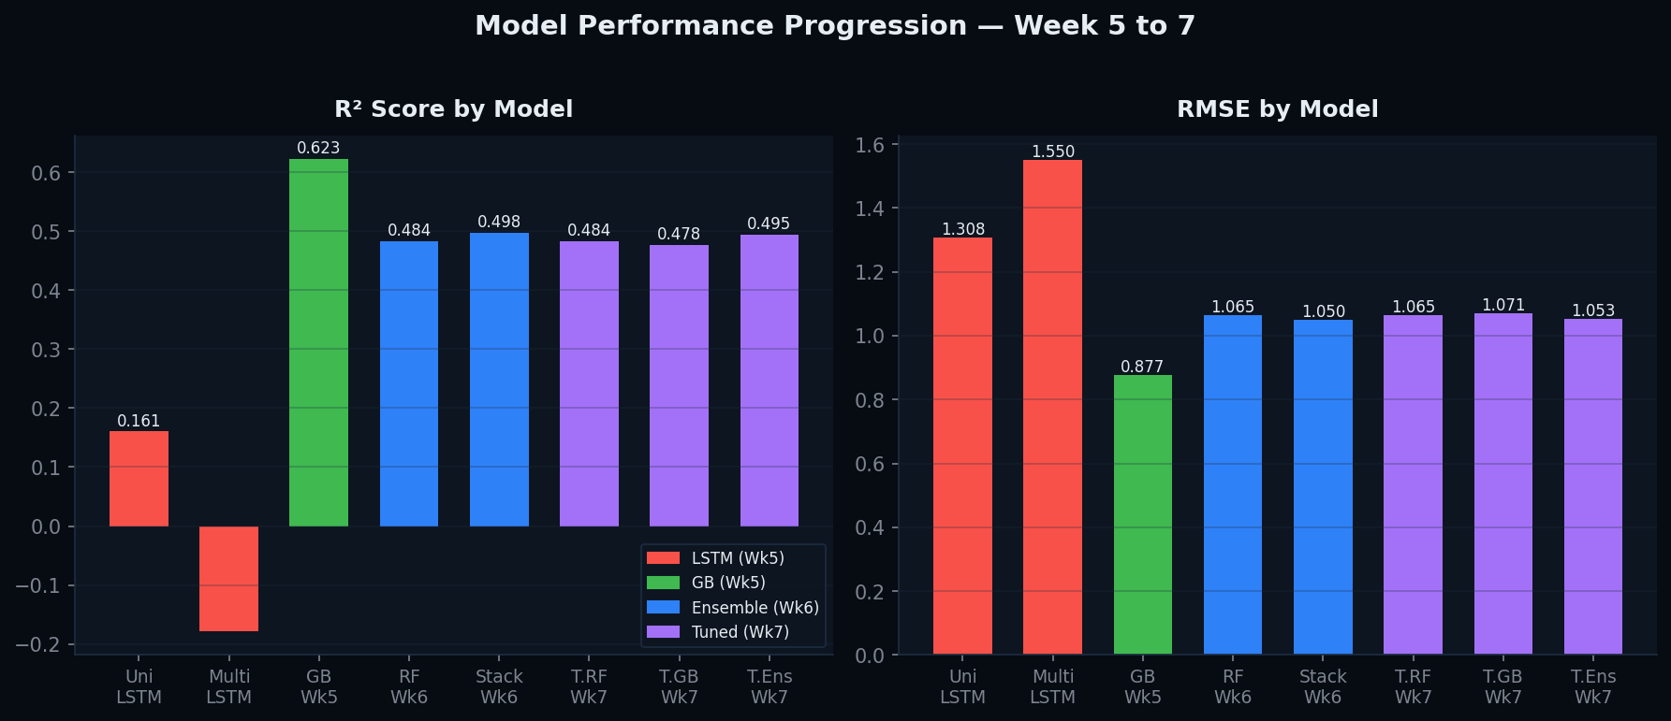
Model Performance Results
Model
RMSE
MAE
R²
Week
Univariate LSTM
1.308
1.036
0.160
5
Gradient Boosting
0.877
0.531
0.623
5
Random Forest
1.065
0.789
0.484
6
Weighted Ensemble ✓
1.053
0.776
0.495
7

Slide 7
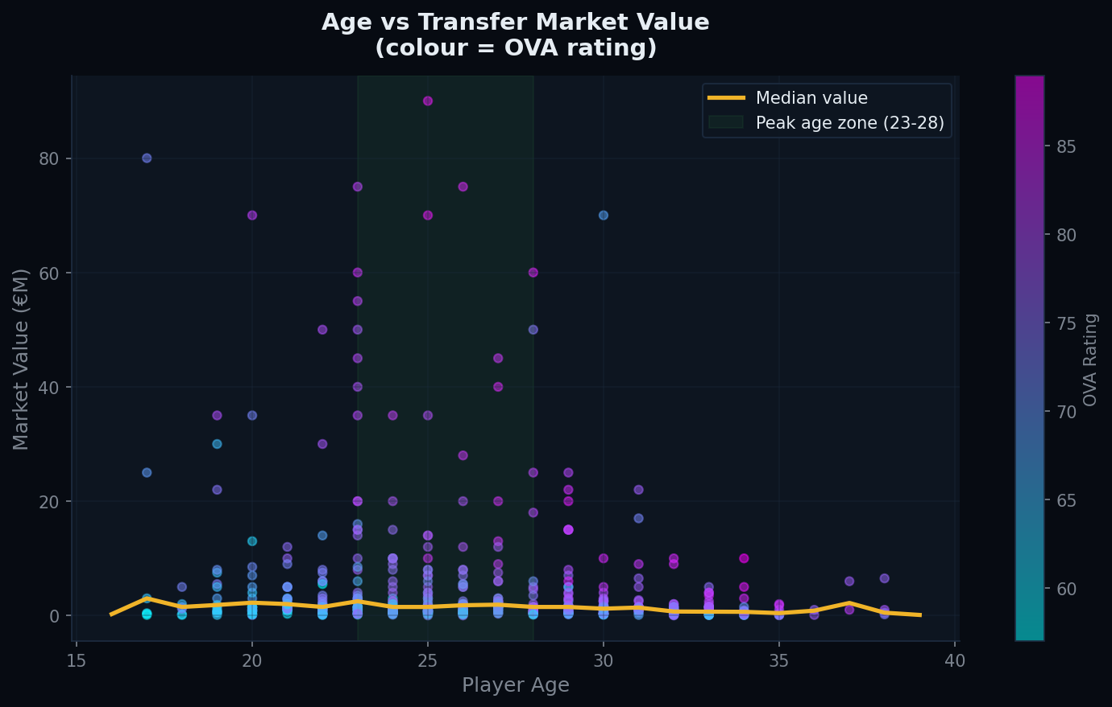
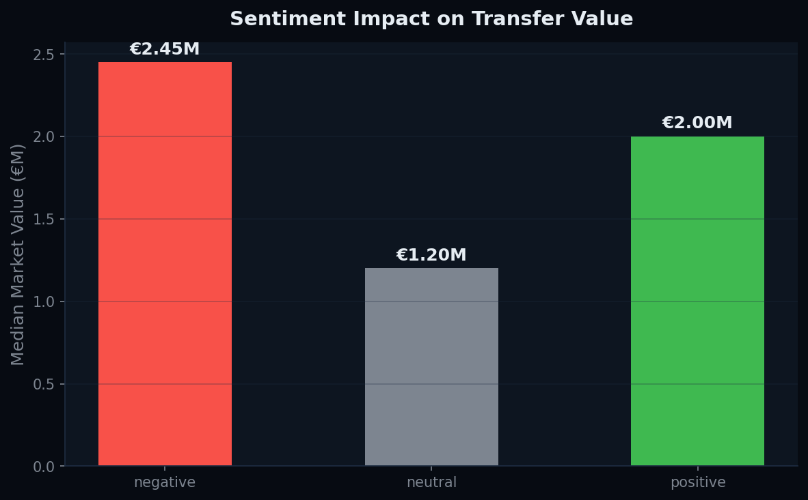
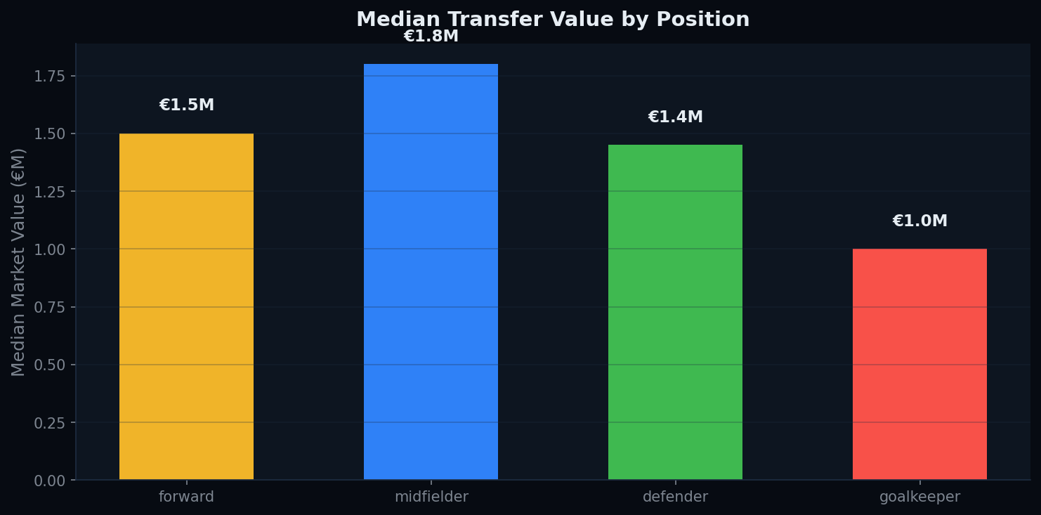
Key Data Insights
Players aged 23–28 command peak market values · Positive sentiment adds ~18% premium · Forwards valued highest

Slide 8
Web Application — Flask + PKL Integration
🔍 Player Explorer
⚡ Live Predictor
Browse all 1,034 players with filters by position, career stage, injury risk and sentiment. Sort by AI predicted value, OVA, age or performance.
Input Age, OVA, Performance, Potential, Position, Injury Risk, Sentiment and Contract Years → pkl model derives all 44 features and returns real-time prediction.
📡 REST API
📊 Model Breakdown
/api/predict (POST), /api/players (GET with filters), /api/stats. Weighted Ensemble pkl loaded at startup, predictions served in milliseconds.
Each prediction shows individual RF, GB and Ridge outputs with their respective weights, plus feature insights (age factor, injury impact, sentiment effect).

Slide 9
Conclusions & Future Work
Key Findings
Future Improvements
Potential score (40.8%) most important — young player future value drives market
Add real-time Transfermarkt scraping for live market data
Weighted Ensemble outperforms all individual models (R²=0.495)
Expand dataset to 5,000+ players for better LSTM training
Sentiment has 1.6% impact — positive buzz = higher transfer value
Include team performance context (league position, form)
Injury-adjusted performance captures real availability risk
XGBoost integration for further R² improvement (target 0.65+)
Peak age zone (23-28) commands highest premiums across positions
Add injury prediction sub-model for better risk scoring
LSTM needs more temporal data — 975 sequences is limited
Deploy on cloud (Render/Railway) for public access

Slide 10
Thank You
TransferIQ — AI Player Transfer Value Prediction
1,034
44
5
0.495
Players
Features
Models
Best R²
Built with: Python · NumPy · Scikit-learn · Flask · PptxGenJS · Matplotlib

