Slide 1
AI-DRIVEN CUSTOMIZED CYBER SECURITY TRAINING AND AWARENESS
NAME: BHAVANI S
HALLTICKET NO: 151223862025

Slide 2
ABSTRACT
Artificial Intelligence (AI) has been effectively used to enhance understanding, investigation, and evaluation of cyber threats.
AI can efficiently anticipate cyber risks, making threat detection and response more proactive.
AI assists in developing and implementing strategies to protect digital assets and sensitive data.
Due to the complexity and evolving nature of cybersecurity, understanding controls and adopting effective training, security policies, and plans remain challenging.
Both cyber academics and practitioners require a deep understanding of cybersecurity rules and practices.
AI can be a crucial asset in educating users and raising awareness about cybersecurity.
The study focuses on how AI-driven mechanisms can efficiently support the entire cybersecurity education life cycle.
AI can help in the fast and accurate creation of cybersecurity policies to meet required standards.

Slide 3
EXISTING SYSTEM
Many cybersecurity training programs use generic, one-size-fits-all content that doesn't address the specific roles or responsibilities of different employees.
This lack of personalization leads to low engagement and poor knowledge retention, as employees struggle to relate the material to their day-to-day work.
The programs often fail to consider diverse learning styles and skill levels, making it difficult for all employees to effectively absorb the content.
Traditional training lacks adaptability and cannot keep up with the fast-changing landscape of cybersecurity threats.
There is often a lack of interactive elements and real-time feedback, which limits the effectiveness of the learning experience.
The absence of practical simulations, such as phishing tests, leaves employees unprepared for real-world cyber attacks, increasing organizational risk.

Slide 4
REVIEW OF LITERATURE
Ranjan, Sharma, and Gupta (2020) highlight AI-driven systems that personalize cybersecurity training based on employee skills and learning styles, improving knowledge retention and addressing gaps.
Alharthi, Alghamdi, and Khan (2021) show that adaptive AI learning adjusts content and feedback in real time, enhancing the effectiveness of cybersecurity awareness programs.
Burgess, Patel, and Roberts (2019) demonstrate AI-powered phishing simulations to assess employee risk and identify weak points for targeted training.
Sheng, Wang, and Li (2021) use AI behavioral analytics to detect risky user actions and tailor training to address vulnerabilities and risky habits.
Higgins, Morgan, and Wright (2020) find gamification boosts engagement and retention in cybersecurity training, with AI personalizing challenges based on performance.
García, Fernández, and Torres (2021) explore AI-powered gamification that adapts game challenges to user preferences, reinforcing cybersecurity knowledge through interactive learning.

Slide 5
PROPOSED SYSTEM
Utilizes artificial intelligence to create personalized learning paths tailored to each employee’s role, prior knowledge, and learning preferences.
Incorporates interactive elements such as gamified content and real-time simulations to boost engagement and provide hands-on practice in a safe environment.
Continuously updates training materials based on the latest cybersecurity threats and incidents to ensure relevance and effectiveness.
Provides immediate feedback on employee performance to identify weaknesses and reinforce learning, promoting a proactive cybersecurity culture.

Slide 6
HARDWARE REQUIREMENTS
System : Intel i7
Hard Disk : 1 TB.
Monitor : 14’ Colour Monitor.
Mouse : Optical Mouse.
Ram : 8GB.
SOFTWARE REQUIREMENTS
Operating system : Windows 10.
Coding Language : Python.
Front-End : Html. CSS
Designing : Html,css,javascript.
Data Base : SQLite.

Slide 7
ARCHITECTURE
The system follows a three-tier architecture: Presentation Layer, Application Layer, and Data Layer.
The Presentation Layer handles user interaction and delivers a user-friendly interface.
The Application Layer manages the core logic, processing user inputs, managing sessions, and coordinating between layers.
The Data Layer is responsible for secure data storage, retrieval, and integrity through a structured database.
This layered approach ensures modularity, scalability, and ease of maintenance.
It enhances security by separating user interfaces from business logic and data management.
Each tier can be developed, tested, and updated independently, supporting flexible deployment and efficient debugging.
The architecture supports real-time monitoring and reporting on user progress, assessments, and security behavior.

Slide 8
MODULES
User Module: Personalized learning with dashboards, quizzes, and gamification.
Admin Module: Manages users, tracks progress and handles phishing tests.
Training Module: AI-powered, real-time, hands-on cybersecurity content.
Input Design: Simple, secure data entry with validation checks.
Output Design: Clear reports and visuals for user progress and admin insights.

Slide 9
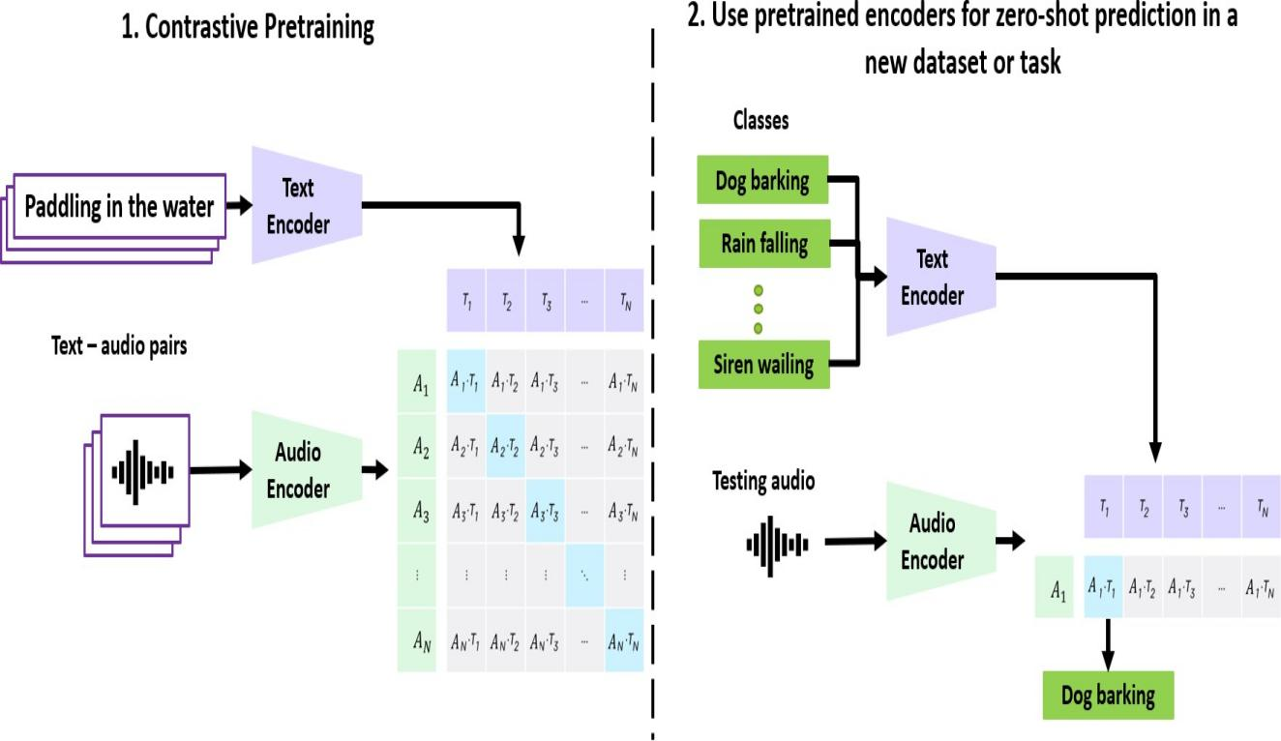
ARCHITECTURE DIAGRAM
Workflow of the System:
Collect learner data.
AI analyzes skill gaps.
Generate personalized content.
Learners' complete modules and assessments.
AI monitors and adjusts training.
Final evaluation and report generation.
Layers of the System:
Data Collection: Gathers learner data.
AI Analysis: Assesses and personalizes.
Content Generation: Creates relevant training.
User Interface: Displays lerning materials.
Monitoring: Tracks progress and adjusts.
Reporting: Generates performance reports.

Slide 10
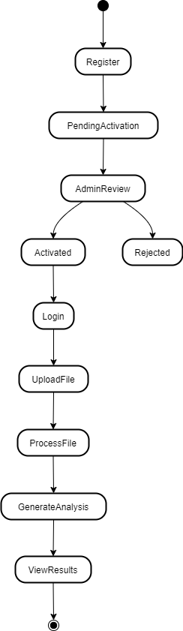
UML DIAGRAM
Activity diagrams are graphical representations of workflows of stepwise activities and actions with support for choice, iteration and concurrency. In the Unified Modeling Language, activity diagrams can be used to describe the business and operational step-by-step workflows of components in a system. An activity diagram shows the overall flow of control.

Slide 11
TYPE OF TESTING
Unit Testing: Checks individual software units for correct logic and outputs before integration.
Integration Testing: Verifies combined components work together without interface errors.
Functional Testing: Ensures software functions as per business and technical requirements.
System Testing: Validates the complete, integrated system’s behavior and performance.
White Box Testing: Testing with knowledge of internal code structure and logic.
Black Box Testing: Testing without any knowledge of internal workings, based only on inputs and outputs.
Acceptance Testing: Final testing by users to confirm system meets their requirements.

Slide 12
FUTURE SCOPE
AI customizes training content, pace, and modules based on individual skills and progress.
Real-time phishing simulations and behavior tracking identify vulnerabilities and risks.
AI-driven gamification boosts engagement while keeping content updated with new threats.
Micro-learning sessions make training manageable and link to real incidents for relevance.
AI supports forums and peer learning to build a security-aware community.
Instant AI assessments give quick feedback, with training accessible on all devices, including mobile.

Slide 13
CONCLUSION
Organizations invest significant time and effort in creating security training, policies, and procedures.
Poorly developed materials can lead to security vulnerabilities.
AI serves as an effective tool to generate and maintain high-quality, up-to-date training and plans.
AI helps periodically revise and align training with newly published security frameworks.
This project uses AI-driven APIs to create cybersecurity awareness and training tailored to learners’ skills and target proficiency levels.
Generated training materials were reviewed and found to be highly effective and accurate.

Slide 14
REFERENCES
M. E. Erendor and M. Yildirim, "Cybersecurity Awareness in Online
  Education: A Case Study Analysis," in IEEE Access, vol. 10, pp. 52319-
  52335, 2022, doi: 10.1109/ACCESS.2022.3171829.
R. S. Shaw, C. C. Chen, A. L. Harris, and H.-J. Huang, ‘‘The impact of
  information richness on information security awareness training
  effectiveness,’’ Comput. Educ., vol. 52, no. 1, pp. 92–100, Jan. 2009.
A. Garba, M. Siraj, S. Othman, and M. Musa, ‘‘A study on cybersecurity
  awareness among students in Yobe State University, Nigeria: A
  quantitative approach,’’ Int. J. Emerg. Technol., vol. 11, no. 5, pp. 41–49,
  2020.
V. Sundararajan, A. Ghodousi and J. E. Dietz, "The Most Common
  Control Deficiencies in CMMC non-compliant DoD contractors," 2022
  IEEE International Symposium on Technologies for Homeland Security
  (HST), Boston, MA, USA, 2022, pp. 1-7, doi:
  10.1109/HST56032.2022.10025445.

Slide 15
THANK YOU

