Slide 1
Darknet Traffic Analysis Investigating the Impact of Modified Tor Traffic on Onion Service Traffic Classification
Vangari Akshitha
151223862092

Slide 2
ABSTRACT
This project focuses on classifying Onion Service traffic in the Tor network, which is part of the darknet and often difficult to analyze due to encryption and obfuscation techniques. By applying machine learning models, I aim to detect traffic patterns that distinguish Onion Service traffic.
A Django-based web application was developed that integrates user registration, dataset viewing, model training, and prediction in a single platform. This ensures that even non-technical users can interact with the system.
Logistic Regression, Decision Tree, and Random Forest algorithms were implemented and trained on a predefined dataset containing six traffic features. These models were compared using standard performance metrics.
The project demonstrates how WTFPAD, a traffic modification method, impacts Onion Service classification and shows the feasibility of machine learning for darknet traffic analysis.

Slide 3
EXISTING SYSTEM
Current systems for darknet traffic analysis primarily focus on Tor detection without exploring Onion Services specifically. This limits their usefulness in handling anonymized services.
Many existing approaches rely on statistical or signature-based methods, which are not robust against modified traffic like WTFPAD. Such systems often fail when traffic is deliberately obfuscated.
User-friendly platforms are missing in most studies, meaning results are presented only at research level without practical interfaces. This creates a gap between research and real-world usability.
Real-time traffic analysis and interactive web systems are not typically provided in older solutions, making them less practical for end-users and system administrators.

Slide 4
REVIEW OF LITERATURE
Panchenko et al. (2016): Proposed a K-Fingerprinting attack on Tor traffic using Random Forests; demonstrated robustness against defenses.
Juarez et al. (2016): Introduced WTF-PAD as a defense mechanism; analyzed its padding strategy and resistance to website fingerprinting.
Rimmer et al. (2018): Applied deep learning models (CNNs, RNNs) to Tor website fingerprinting; achieved state-of-the-art accuracy.
Sirinam et al. (2018): Presented Deep Fingerprinting attack using deep learning; showed Tor traffic can still be classified with high precision.
Hayes & Danezis (2017): Explored traffic analysis using classical ML methods (k-NN, SVM); confirmed ML’s role in Onion Service classification.

Slide 5
PROPOSED SYSTEM
I developed a system that combines machine learning with a web-based interface, enabling classification of Onion Service and WTFPAD traffic in a practical environment.
The system dynamically trains three algorithms: Logistic Regression, Decision Tree, and Random Forest, ensuring flexibility in evaluating different models.
A predefined dataset with six features is used for training and testing, making it suitable for controlled experiments and consistent evaluations.
By focusing on WTFPAD as the modified Tor traffic, this project directly addresses the research gap while demonstrating a working prototype for real-world extension.

Slide 6
Software Requirements
Operating System: Windows 10 / Linux (Ubuntu recommended for Python environment).
Programming Language: Python 3.8+
Framework: Django (for web application development).
Libraries: Pandas, NumPy, Scikit-Learn, Matplotlib, TensorFlow.
Database: SQLite (default Django database for user storage).
IDE/Editor: PyCharm / VS Code / Jupyter Notebook (for development and testing).
Hardware Requirements
Processor: Intel i3 or higher (multi-core preferred).
RAM: Minimum 4 GB (8 GB recommended for smoother ML training).
Hard Disk: At least 500 MB free space for dataset, environment, and project files.
Internet Connection: Stable connectivity for dependency installation and dataset handling.

Slide 7
ARCHITECTURE
The system architecture is designed using a three-tier structure consisting of the User Interface, Application Logic, and Data Storage layers.
At the User Interface layer, users interact through registration, login, dataset viewing, model training, and prediction modules.
The Application Logic layer is powered by Django, handling feature preprocessing, ML model training (Logistic Regression, Decision Tree, Random Forest, TensorFlow), and classification logic.
The Data Storage layer manages datasets and user information using SQLite, while trained models and results are processed dynamically without requiring external storage.

Slide 8
modules
User Module: Allows new users to register and log in once approved by the admin. Users can view datasets, train models, and make traffic predictions.
Admin Module: Manages user approval, ensuring only authorized individuals can use the system. Admin acts as a gatekeeper for system access.
Dataset Module: Displays the Onion Service traffic dataset stored in CSV format, helping users understand input features used for classification.
Training and Prediction Module: Provides functionality for model training using Logistic Regression, Decision Tree, and Random Forest, and then allows prediction of traffic type based on input features.

Slide 9
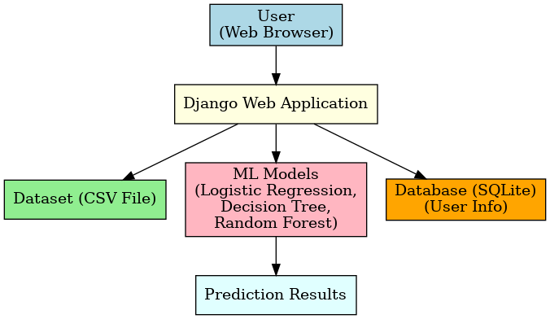
Architecture DIAGRAM
The system architecture is designed around a web interface where users interact through registration, login, and prediction functionalities. This ensures controlled access.
The Django backend handles all requests, including dataset viewing, training machine learning models, and returning prediction results to the user.
The dataset is stored in CSV format and read dynamically whenever training is required, ensuring accuracy and consistency in experiments.
The database stores only user information and account status, while trained models are kept in memory for lightweight operation and faster results.

Slide 10
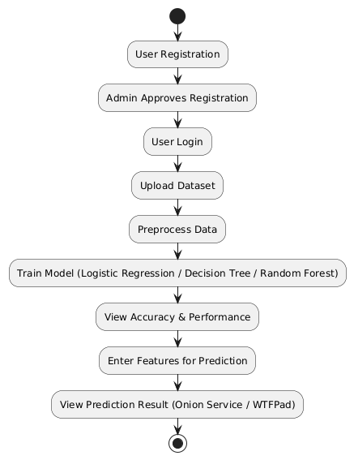
UML DIAGRAM
The activity diagram starts with the User registration and login process, where users enter details and wait for admin approval.
If the Admin approves, the user gains access to the main system functions such as dataset viewing, model training, and prediction.
The training activity involves selecting algorithms (Logistic Regression, Decision Tree, Random Forest) and evaluating them on the dataset.
The prediction activity allows the user to input six features (f1–f6) and obtain results (Onion Service or WTFPAD), completing the workflow.

Slide 11
Testing
Unit Testing: Focused on validating each function such as registration form validation, dataset loading, and prediction logic individually.
Integration Testing: Ensured smooth communication between modules, for example, between dataset access and the training module.
System Testing: Verified complete workflows such as user login → dataset view → training → prediction to ensure end-to-end functionality.
Validation Testing: Applied checks for user input fields like name, email, mobile, and password to ensure correctness and prevent invalid entries.

Slide 12
Future scope
More algorithms such as KNN, Naive Bayes, and SVM can be integrated into the system to compare classification performance across diverse models.
Users should be given the ability to upload and train models on their own datasets, making the platform more flexible and general-purpose.
Training results and prediction histories can be stored in the database, providing long-term tracking and detailed analysis of system performance.
Real-time classification of live Tor traffic can be integrated into the system, making it a powerful tool for practical darknet monitoring.

Slide 13
conclusion
I successfully implemented a system that classifies Onion Service traffic against WTFPAD modified traffic using machine learning techniques.
Logistic Regression, Decision Tree, and Random Forest models were tested and compared, demonstrating good performance in terms of accuracy and precision.
A Django-based web interface was developed, providing user registration, dataset viewing, training, and prediction features in a single platform.
This work demonstrates the feasibility of machine learning for darknet traffic analysis and creates a foundation for future research and real-time applications.

Slide 14
REFERENCES
Panchenko, A. et al. (2016). Website Fingerprinting at Internet Scale. Network and Distributed System Security Symposium (NDSS).
Juarez, M. et al. (2016). Toward an Efficient Website Fingerprinting Defense. European Symposium on Research in Computer Security (ESORICS).
Sirinam, P. et al. (2018). Deep Fingerprinting: Undermining Website Fingerprinting Defenses with Deep Learning. CCS, ACM.
Rimmer, V. et al. (2018). Automated Website Fingerprinting through Deep Learning. USENIX Security Symposium.
Hayes, J. & Danezis, G. (2017). k-Fingerprinting: A Robust Scalable Website Fingerprinting Attack. USENIX Security Symposium.
Tools Used: Python, Django, Pandas, Scikit-Learn, Matplotlib.

Slide 15
THANK YOU

