Slide 1
Test Automation Framework
Framework is a constructive blend of various guidelines, coding standards, concepts, processes, practices, project hierarchies, modularity, reporting mechanism, test data injections etc. to pillar automation testing.
A framework is considered to be a combination of set protocols, rules, standards and guidelines that can be incorporated or followed as a whole so as to leverage the benefits of the scaffolding provided by the Framework.
The advantages can be in different forms like ease of scripting, scalability, modularity, understandability, process definition, re-usability, cost, maintenance etc . Thus, to be able to grab these benefits, developers are advised to use one or more of the Test Automation Framework.

Slide 2
Advantage of Test Automation framework
Reusability of code
Create one time and execute multiple times with less or no maintenance
Automation testing is faster in execution
Maximum coverage
It helps to increase the test coverage
Recovery scenario
It is mostly used for regression testing. Supports execution of repeated test cases
Low-cost maintenance
Cheaper compared to manual testing in a long run
Automated testing is more reliable, more powerful and versatile
Minimal manual intervention
Test scripts can be run unattended
Enables parallel execution in combination of different OS and browser environments
Easy Reporting
It generates automatic reports after test execution

Slide 3
Agenda
Different Types of Frameworks
Overview on Frameworks
Linear Framework
Data Driven Framework
Module Driven Framework
Keyword Driven Framework
Hybrid Testing Framework

Slide 4
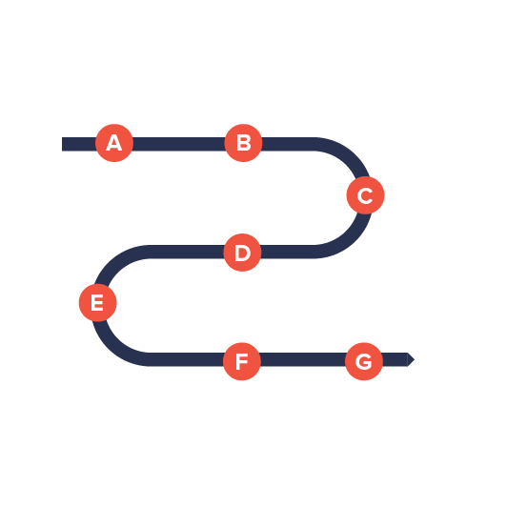



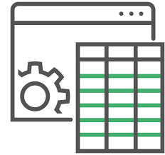
Overview on Frameworks
Linear Framework
Script written in Step by Step Manner
No functions Created
Data is hard coded
Modular Framework
All Test Cases are analyzed to find reusable flows
Functions are created and then stored in external function library called test scripts
Data is hard coded
Keyword Driven Framework
Various keywords can be created and different functions can be associated to these keywords
Function library is created that contains the logic to read the keywords
Hybrid Framework
Combination of different features of any framework
Data Driven Framework
Data is not hard coded in test scripts
It is stored in some external sources like excel sheets , CSV files… ie.
Test Script first connects to that file and then extracts data from it
Same script can be run multiple times with different sets of data

Slide 5
Module Driven Framework

Slide 6
Module 1
Module 2
Large Test Script
Module 3

Slide 7
Module Driven Framework
Most of the Web Applications have some set of Actions which are always executed in certain Order or Sequence
Set of Actions are always executed in Sequence of Action
Every time we have writing those actions again and again in our test
Other than that , we can integrate those actions in to a method and then calling that method in our test script.
Modularity avoids duplicity of code.
In future if there is any change in the series of action, all you have to do is to make changes in your main modular method script. No test case will be impacted with the change.
Example:-
To Automate Modules which are inside Gmail Login Page Every time you have to Repeat Following Actions Sequence
Navigate to Gmail Link
Fill User Name
Click Next
Fill Password
Click Login
Compose
Contacts
Sent Mail
Google Accounts

Slide 8
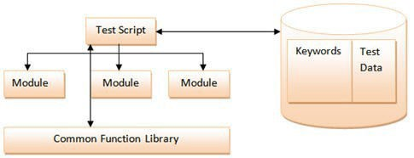
Hybrid Testing Framework

