Slide 1


CMR COLLEGE OF ENGINEERING & TECHNOLOGY Kandlakoya, Medchal, Hyderabad - 501401 Department Of Computer Science & Engineering
COMPUTERIZED LIBRARY MANAGEMENT SYSTEM
Batch-16
19H51A0531 - B.SWATHI
19H51A0535 - D.SAHITHI
19H51A0542 - J.SHYAM KUMAR
Under esteemed guidance
Dr. K.L.S Soujanya

Slide 2
CONTENTS
►Abstract
►Objectives
►Introduction
►Existing solutions
►Proposed solution
►Flow chart
►Method description
►Implementation
►Result

Slide 3
ABSTRACT
Manual process of keeping student book records, account details, managing is very difficult. To eliminate this manual system, Computerized Library management system is the project which aims in developing a computerized system to maintain all the daily work of library. It is used by librarian to manage the library using a computerized system where he/she an record various transactions like issue of books, return of books, addition of new books, addition of new users etc. It will handle all the current issues faced by the students and by its admin personnal.To store all the information in the database from where we can run the queries and get the results. Overall this project of ours is being developed to help the students to view and search the books, maintain the library in the best way possible and also reduce the human effort.

Slide 4
OBJECTIVES
The main objectives of this project is :
To handle activites of library.
To provide easy system circulation using computers rather than writing system.
Giving access to students to make their part of activity easier.
The software keeps track of all the information about the books and their complete details.

Slide 5
INTRODUCTION
Managing a library requires knowledge of library management and skills to perform the activities. The task involves planning, decision making, organising, collecting information, controlling and monitoring the various functions. Library plays an important role in all schools and colleges. It is an important part of every school and college, it helps the librarian to keep records of available books as well as issued books.The activities of book cataloging, indexing, circulation recording and checking are done by the software. Such software eliminates the need for repetitive manual work and minimizes the chances of errors. The automated system saves a considerable amount of time as opposed to the manual system

Slide 6

EXISTING SOLUTIONS
►Manual Library Management System
Manual library management systems are vulnerable to human error. For instance, a librarian who misfiles borrower’s records or indexes a book incorrectly slows down the process and wastes employee’s time. Manual systems are also slow to operate, unable to store large amounts of data efficiently. With manual systems staff spends a lot of their time on mechanical, clerical tasks rather than liaising with library visitors. On a simple level, locating a precise book within the local library system is time consuming without a linked computer network. With a manual operating system librarian relay on regular contact with their members and generally communicate by mail.

Slide 7
Disadvantages :
It takes more effort and physical space to keep track of information and to keep the details secure.
When the mistakes or corrections are needed, often a manual transaction must be completely redone rather than just updated.
Time consuming.
Duplication of data entry.

Slide 8

PROPOSED SOLUTION
►COMPUTERIZED LIBRARY MANAGEMENT SYSTEM
A library management system keeps track of the books present in the library. It is a software that helps to maintain a database that is useful to enter new books & record books borrowed by the members, with the respective names of members. Moreover, it also reduces the manual record burden of the librarian.Our solution allows the librarian to maintain library resources in a more operative manner using six modules such as Add book details, Delete book, Issue book, Return book, Search book and students can access search and view options that will help to save their time. Library management system is also useful for students as well as a librarian to keep the constant track of the availability of all books.

Slide 9
MODULES DESCRIPTION:
Library Registration:
The first procedure is the registration of the people who arrive to the library. The registration contains fields like enter the name, id, branch, department, password, date of joining and salary.
Login registration:
The administrator has provide the authority to login directly after the registration. The login fields contains name, id, password, role.
Add books:
Admin has the authority to add, issue, delete, view, search of book available to/from the system. The software keeps track of all the information about the books in the library.

Slide 10
Delete books:
Admin has the authority to delete a book.
Issue books:
Admin has the authority to issue books to the students. Issue book contain fields like employee id, student id, book id.
Search book:
Admin and the students has the authority to search the books.
View book list:
Admin and students has the authority to view the books.

Slide 11
Advantages :
It offers 24*7 access to the library resources.
Provides functionalities like acquisition, cataloguing, secure and efficient library database management.
Provides greater efficiency of work processes & saves time of librarian.
Saves human effort and time.

Slide 12
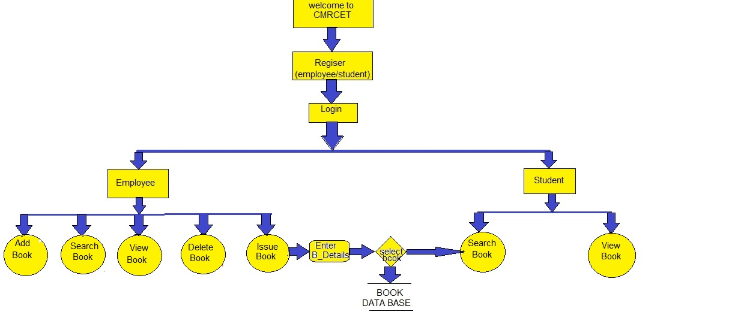
PROPOSED SYSTEM ARCHITECTURE

Slide 13
METHOD DESCRIPTION
The software built to handle the primary housekeeping functions of a library. Libraries rely on library management systems to manage asset collections.
We focused on the following set of requirements while designing the Computerized Library Management System :
Any library member should be able to search books by their title, author, subject category.
Each book will have a unique identification number and other details including a rack number which will help to physically locate the book.
The system should be able to retrieve information like who took a particular book or what are the books checked-out by a specific library member.
There should be a maximum limit (5) on how many books a member can check-out.
The system should be able to change the status whenever the reserves the books.

Slide 14
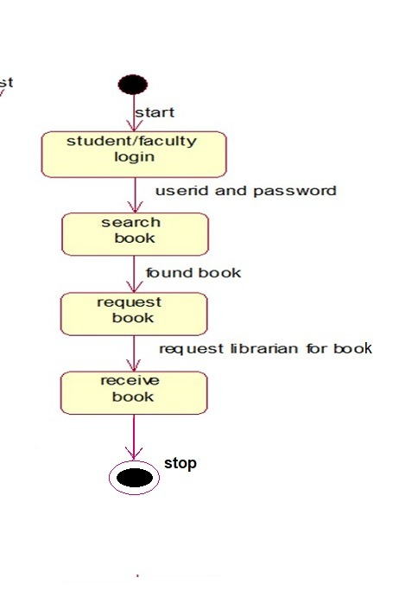
FLOW CHART

Slide 15
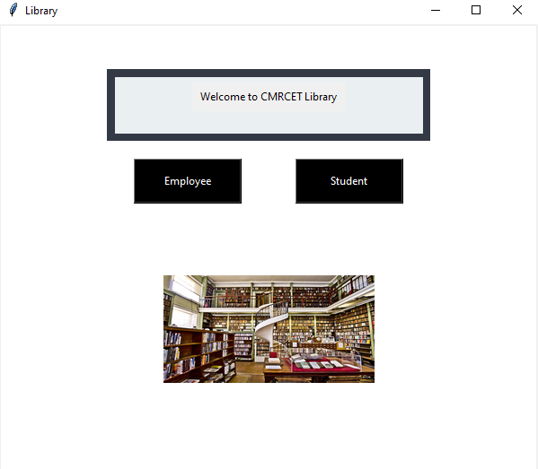
IMPLEMENTATION
1st page : WELCOME TO CMRCET LIBRARY

Slide 16
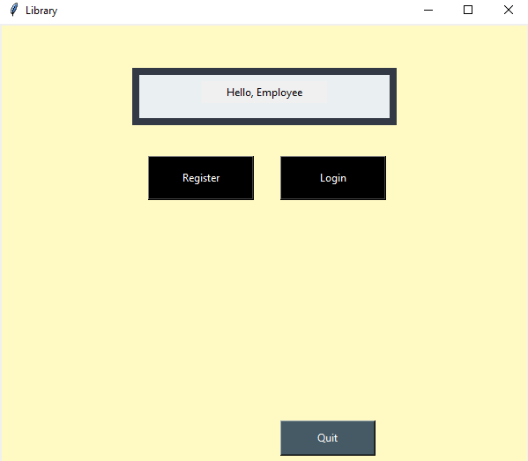
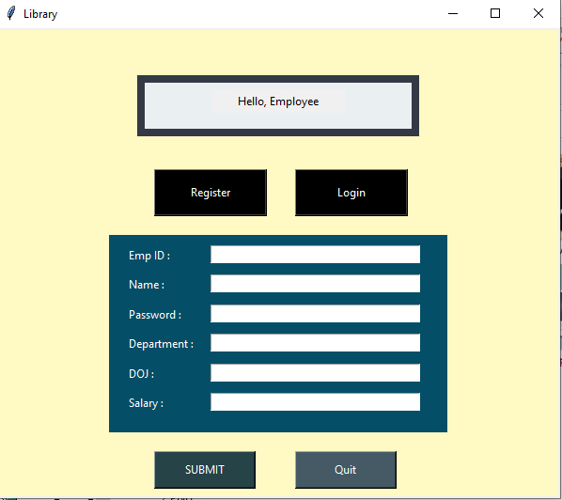
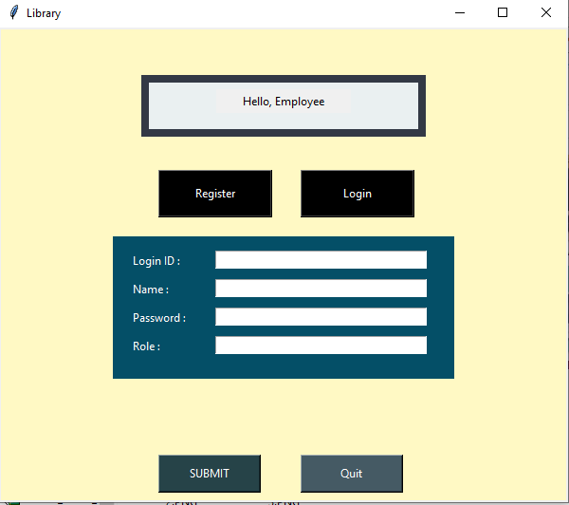
2nd page :
The employee and student
has access to register.
3rd page :
If there are registered
then they can login
directly.

Slide 17
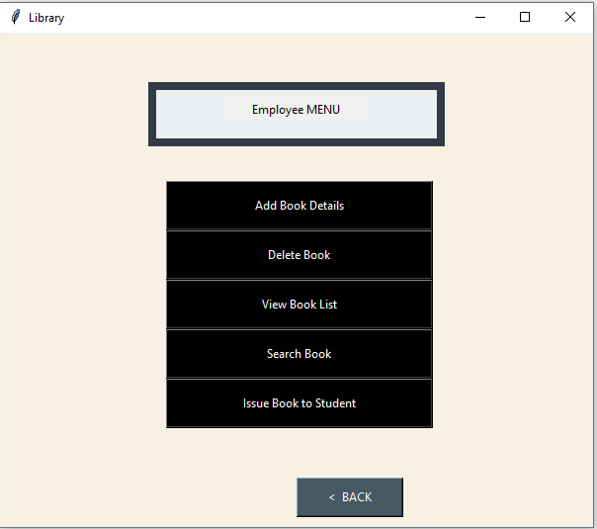
4th page :
Emloyee can access following like,
Add book details
Delete book
View book list
Search book
Issue book to student
5th page :
By selecting the above options
the particular field will open.

Slide 18
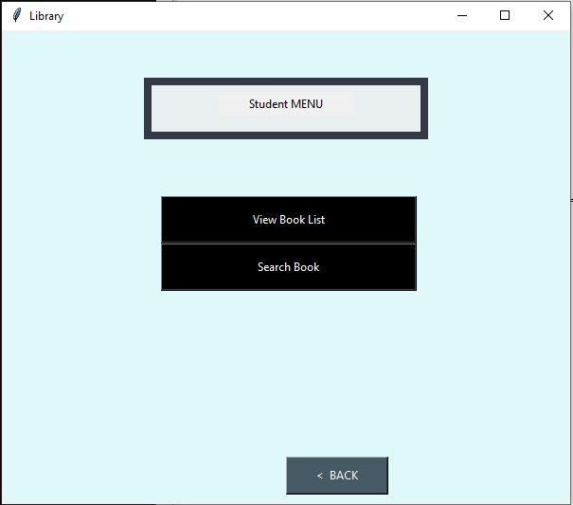
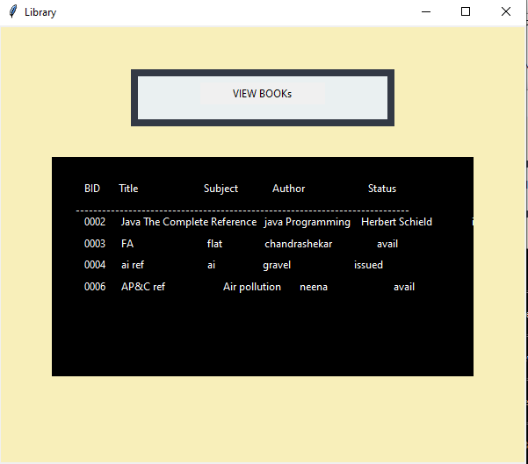
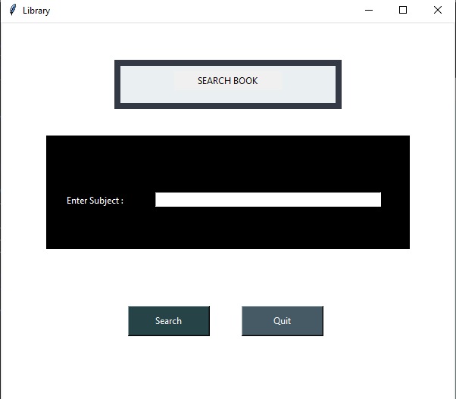
6th page :
Students has access to view the book list
and search book.

Slide 19
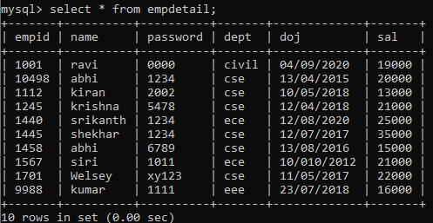
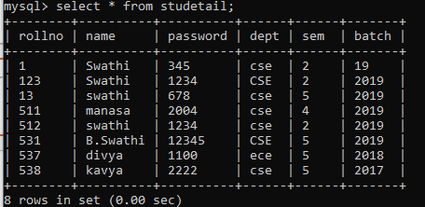
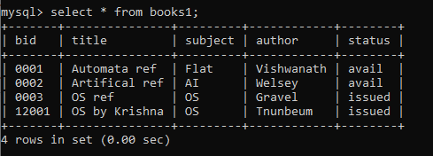
RESULT
The output of the data been displayed in the following manner where the data entry and the data view is more easy and efficient.

Slide 20
CONCLUSION
Computerized Library Management has been created keeping in mind the needs of small and medium scale libraries. It’s efficient software that includes all the basic functionalities like making data entries for new books, registering a new user, editing and deleting records that are required for smooth functioning of a library. Additionally the user login and book history are also stored and can be accessed by the administrator. It also facilitates the librarian to create new user groups and Apart from this the users are also given the rights to not only keep track of the books ,can search for the books that interest them.

Slide 21
REFERENCES
Google for Problem solving
https://www.tutorialspont.com/um/uml modeling_types
https://www.w3schools.com/sql/
https://www.tutorilspoint.com/mysql/
https://www.educative.io/courses/grokking-the-object-oriented-design-interview/RMlM3NgjAyR

Slide 22


