Slide 1
K-Means Clustering
Group-2
Thejaswi S
Samir K
Swathi G
Vatsalya k
Sruthi N

Slide 2
Overview of Clustering
The task of grouping data points based on their similarity with each other is called Clustering or Cluster Analysis. .
Defined under Unsupervised Learning, which derives insights from unlabeled data without a target variable.
Forms groups of homogeneous data points from a heterogeneous dataset.
Evaluates similarity between points using metrics such as: Euclidean Distance, Cosine Similarity, Manhattan Distance.

Slide 3
Types of clustering
Centroid-based Clustering (Partitioning methods):
Groups data based on proximity, using metrics like Euclidean Distance.
Example algorithms: K-Means, K-Medoids.
Density-based Clustering (Model-based methods):
Finds clusters based on data density, automatically determining cluster size.
Example algorithm: DBSCAN.
Connectivity-based Clustering (Hierarchical clustering):
Builds clusters hierarchically, creating a dendrogram (tree structure).
Two approaches: Agglomerative (Bottom-Up) Divisive (Top-Down)
Distribution-based Clustering:
Groups data points based on statistical probability distributions.
Example: Gaussian Mixture Model

Slide 4
K-Means clustering:
K-means clustering is an unsupervised machine learning algorithm used to partition a dataset into K clusters, where each data point belongs to the cluster with the nearest mean.
It iteratively assigns each point to the closest cluster center, recalculates the cluster centers, and repeats the process until convergence.
The goal of clustering is to divide a dataset into groups (clusters) such that:
Data points within the same group are more similar to each other.
Data points from different groups are more different from each other.
It’s about grouping data based on similarity and difference to reveal patterns or insights in the data.

Slide 5
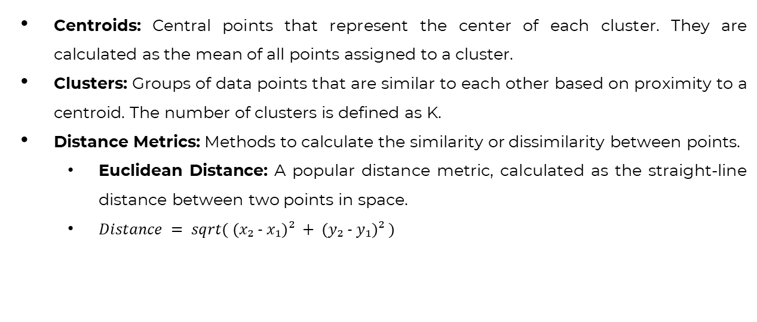
Key Concepts
Centroids: Central points that represent the center of each cluster. They are calculated as the mean of all points assigned to a cluster.
Clusters: Groups of data points that are similar to each other based on proximity to a centroid. The number of clusters is defined as K.
Distance Metrics: Methods to calculate the similarity or dissimilarity between points.
Euclidean Distance: A popular distance metric, calculated as the straight-line distance between two points in space.
$Distance = sqrt( (x₂ - x₁)² + (y₂ - y₁)² )$

Slide 6
Algorithm Workflow:
Step-1: Select the number K to decide the number of clusters.
Step-2: Select random K points or centroids. (It can be other from the input dataset).
Step-3: Assign each data point to their closest centroid, which will form the predefined K clusters.
Step-4: Calculate the variance and place a new centroid of each cluster.
Step-5: Repeat the third steps, which means reassign each datapoint to the new closest centroid of each cluster.
Step-6: If any reassignment occurs, then go to step-4 else go to FINISH.
Step-7: The model is ready.

Slide 7
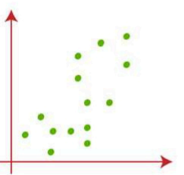
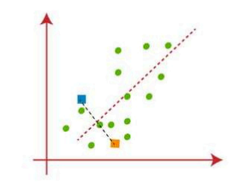
Suppose we have two variables, M1 and M2, represented in the scatter plot on the right. We aim to divide the dataset into K=2 clusters.
To start, we randomly select two points as centroids, which are not part of the dataset. Next, we assign each data point to its nearest centroid by calculating the distance between the points.
A median line is drawn between the centroids to help in this assignment.

Slide 8
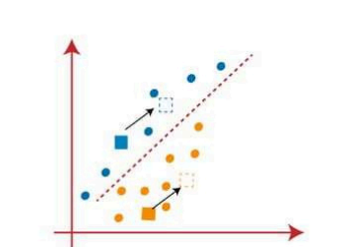
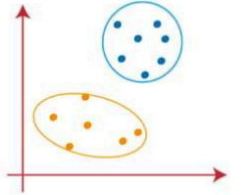
The center of gravity of the assigned data points is calculated to determine new centroids.
The assignment process is repeated, and new centroids are found.
Data points are reassigned to the closest centroid.
The process continues until no data points switch clusters, forming the final clusters.
The assumed centroids are removed, and the two final clusters are formed.

Slide 9
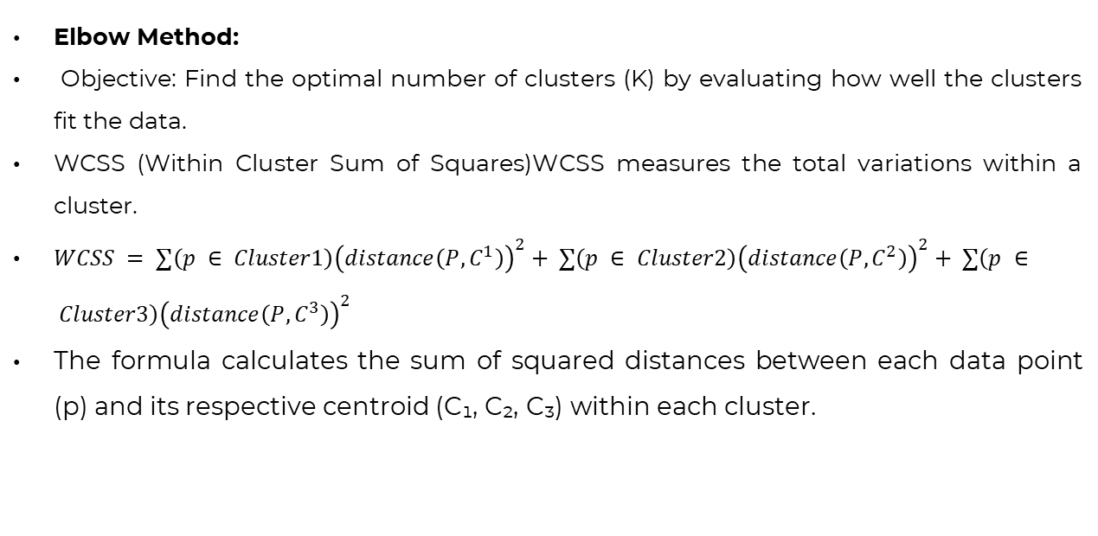
Choosing the Number of Clusters (K)
Elbow Method:
Objective: Find the optimal number of clusters (K) by evaluating how well the clusters fit the data.
WCSS (Within Cluster Sum of Squares)WCSS measures the total variations within a cluster.
$WCSS = ∑\left(p ∈ Cluster1\right){\left(distance\left(P, C^{1}\right)\right)}^{2}+ ∑\left(p ∈ Cluster2\right){\left(distance\left(P, C^{2}\right)\right)}^{2}+ ∑\left(p ∈ Cluster3\right){\left(distance\left(P, C^{3}\right)\right)}^{2}$
The formula calculates the sum of squared distances between each data point (p) and its respective centroid (C₁, C₂, C₃) within each cluster.

Slide 10
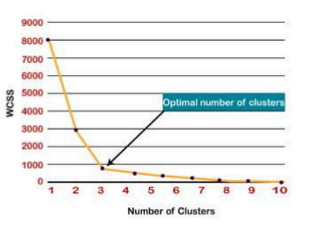
Choosing the Number of Clusters (K)
Steps:
Perform K-means clustering on the dataset for different K values (typically from 1 to 10).
Calculate WCSS for each K value.
Plot WCSS values against the number of clusters (K).
Identify the "elbow" point in the graph (sharp bend).The K value corresponding to the "elbow" is considered optimal.

Slide 11
Advantages
Simplicity and Efficiency:
Easy to implement
Computationally efficient for large datasets
Scalability:
Handles large datasets well
Versatility:
Suitable for various data types.
Works well with well-separated clusters.
Flexibility:
Can be used for market segmentation, anomaly detection, etc.

Slide 12
Disadvantages
Choosing the Right K:
The optimal number of clusters (K) is hard to determine.
Sensitive to Initial Centroids:
The algorithm can converge to different solutions depending on the initial centroids.
Assumes Spherical Clusters:
Performs poorly when clusters are non-spherical or have different sizes and densities.
Sensitive to Outliers:
Outliers can significantly affect the clustering results.

Slide 13
Applications
Customer Segmentation:
Grouping customers based on purchasing behavior for targeted marketing.
Image Compression:
Reducing the number of colors in an image for better compression efficiency.
Document Clustering:
Categorizing text documents into topics for easier management and retrieval.
Anomaly Detection:
Identifying outliers or unusual data points in datasets, such as fraud detection.
Market Basket Analysis:
Grouping items that are frequently bought together for recommendation systems.

Slide 14
Comparison with Other Clustering Methods

Slide 15
Conclusion
K-means Clustering is a powerful tool for grouping data into meaningful clusters.
It is simple, easy to implement, and widely used in practice for tasks such as segmentation and anomaly detection.
Choosing K (number of clusters) is a critical step; methods like the Elbow Method can help.
While efficient for large datasets, K-means has limitations like sensitivity to initial centroids and assumptions about cluster shape.
Despite its limitations, K-means remains a go-to algorithm for unsupervised learning and exploratory data analysis.

