Slide 1
ENHANCED DATA RATE USING SVD-BASED HYBRID PRECODING IN 6G COMMUNICATIONS

Slide 2
CONTENTS
ABSTRACT
INTRODUCTION
EXISTING METHODOLOGY
BLOCK DAIGRAM
DESIGN OF PROPOSED SOLUTION
COMPARISON TABLE
REQUIREMENTS
REFERENCES
CONCLUSION

Slide 3
ABSTRACT
Hybrid precoding (HPC) helps improve signal quality and reduce hardware costs in millimeter-wave (mmWave) MIMO systems. However, a problem called beam squint affects wideband systems, causing signal misalignment across different frequencies. This paper proposes a new HPC method that corrects beam squint using advanced signal processing techniques.
Our approach improves signal strength, reduces errors, and works better than existing methods. Simulations confirm that the proposed solution enhances data transmission while keeping power usage and complexity low.

Slide 4
INTRODUCTION
Millimeter-wave (mmWave) MIMO is essential for high-speed wireless communication in 5G and future networks. However, beam squint causes signals at different frequencies to misalign, reducing efficiency.
To address this, Hybrid Precoding (HPC) combines analog and digital processing to enhance signal quality and lower hardware costs.
This project improves HPC to reduce beam squint effects, ensuring better signal transmission, higher data rates, and energy efficiency.
The proposed method enhances communication reliability in wideband mmWave MIMO systems, making them more effective for future wireless networks.

Slide 5
EXISTING METHODOLOGY
1.Manifold Optimization(MO):
The beam direction varies across subcarriers in wideband systems, causing beam squint.
MO assumes a fixed beam direction, resulting in reduced spectral efficiency.
High computational complexity makes it impractical for real-time systems
2.Array Vector (AV):
Slow convergence due to iterative optimization.
Poor performance in beam squint scenarios.
Highly sensitive to the initial value of precoding matrices

Slide 6
3.Multi-Valued Vector Modulation (MVVM)
High computational complexity
Unable to track frequency variations across subcarriers.
Low energy efficiency.
4.Full Digital Precoding
Extremely high hardware cost due to separate RF chains for each antenna.
High power consumption.
Impractical for massive MIMO systems.

Slide 7
Input signal
(S[K],H[K])
Analog Precoding(FRF)
Digital Precoding(FBB)
Antenna Array
(Transmit Signal)
Signal Recovery
(Received data)
Receiver
Wireless Channel
(Signal Transmission)
Hybrid Precoding Block Diagram

Slide 8
PROPOSED SOLUTION
1.Signal transmission in mmWave MIMO
This equation models how the transmitted signal is processed through the channel.

Slide 9
2.Analog Precoding( )
Ensures all subcarriers receive a strong signal, reducing beam squint.
Maximizes the weakest subcarrier gain to stabilize beam alignment.
3.Equivalent Channel matrix for Digital Precoding:
Modifies the channel matrix to align with the effect of analog precoding.
Ensures the digital precoder operates optimally in the modified channel.

Slide 10


4.Using SVD for Optimal Precoding
Breaks the equivalent channel matrix into useful components.
V[k] is used for constructing the digital precoder.
5. Final Digital Precoder ( )
Ensures optimal signal transmission by selecting the best signal paths.
Improves spectral efficiency while keeping computational complexity low.

Slide 11
6. Achievable Sum Rate (ASR)
Measures system efficiency by calculating the data transmission rate.
Shows that our method improves data rate while using less power.

Slide 12
Comparison: Existing vs Proposed Method
Existing Methods | Proposed Method
Poor to Moderate Beam Squint Handling | Excellent Beam Squint Handling
ASR at 0.5 GHz: ~2.9 to 4.7 bps/Hz | ASR at 0.5 GHz: ~4.8 bps/Hz
ASR at 3.0 GHz: ~1.2 to 2.7 bps/Hz | ASR at 3.0 GHz: ~2.8 bps/Hz
ASR at 30 dB SNR: ~6.0 to 9.5 bps/Hz | ASR at 30 dB SNR: ~10 bps/Hz
Low to Moderate Energy Efficiency | High Energy Efficiency
High Hardware Cost | Low Hardware Cost
High Complexity | Moderate Complexity
Slow Convergence | Fast Convergence (200–300 iterations)
Average Wideband Performance | Best for 6G Wideband MIMO

Slide 13

REQUIREMENTS
Used for signal processing, precoding algorithms, and plotting results.

Slide 14
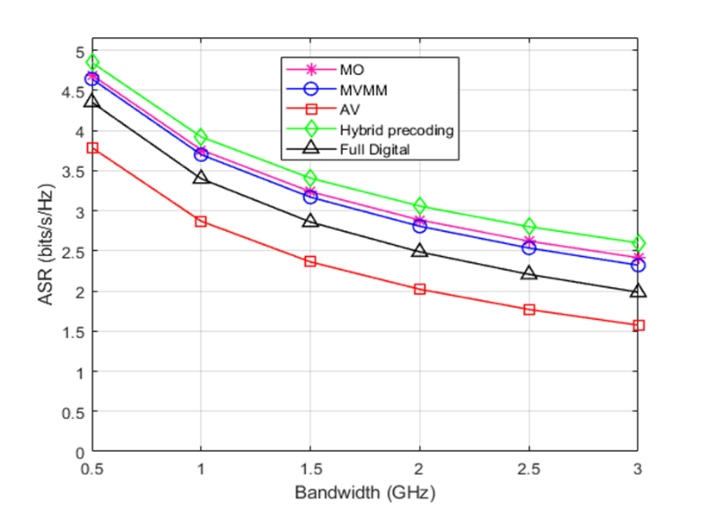
RESULTS
ASR decreases with increasing bandwidth – At 0.5 GHz, ASR is highest (~4.8 bits/s/Hz for hybrid precoding), but it drops to ~2.8 bits/s/Hz at 3 GHz.
Hybrid precoding performs best – It maintains the highest ASR across all bandwidths, making it ideal for 6G high-data-rate applications
Fig:1

Slide 15
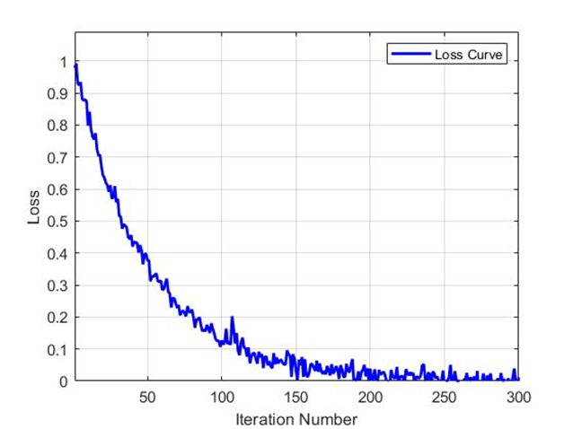
Loss decreases as iterations increase.At the start (iteration 0), the loss is around 1, but it gradually decreases and stabilizes near 0 after 200 iterations.
Fast drop initially, then slow convergence The loss reduces quickly in the first 50 iterations, then decreases gradually with minor fluctuations before stabilizing.
Fig:2

Slide 16
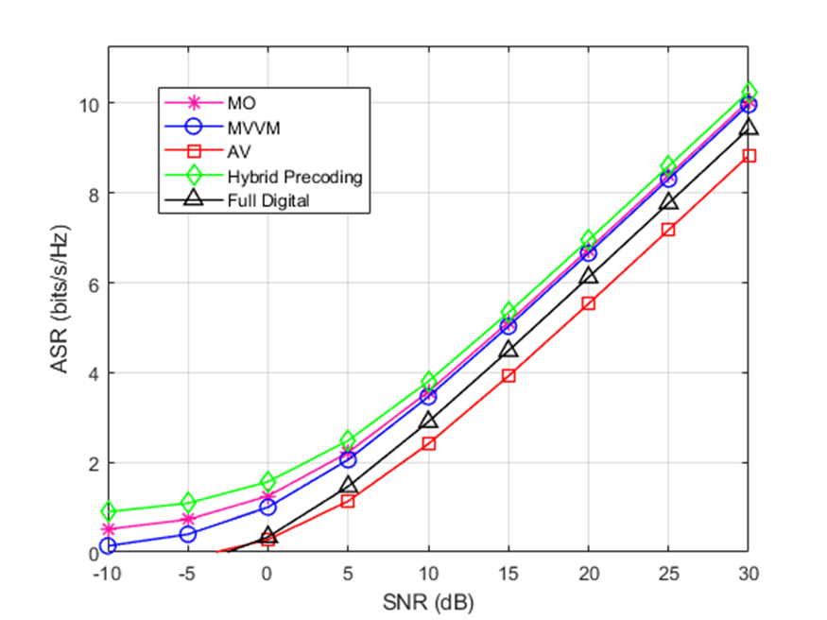
ASR increases as SNR increases – At -10 dB, ASR is very low (~0 bits/s/Hz), but as SNR reaches 30 dB, ASR increases to around 10 bits/s/Hz for hybrid precoding.
Hybrid precoding performs the best – It achieves the highest ASR across all SNR values, followed by the proposed method, full digital, and AV, which performs the worst.
Fig:3

Slide 17
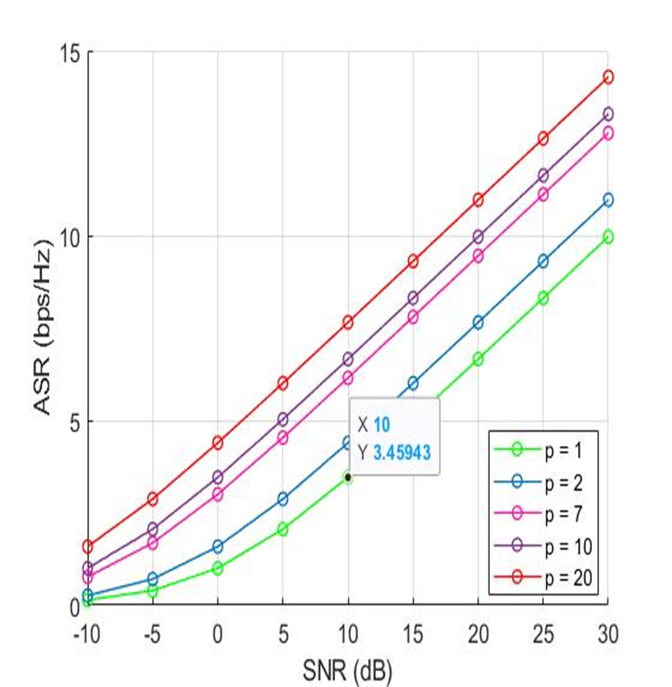
ASR increases with SNR – At -10 dB, ASR is close to 0, but at 30 dB, it reaches around 14 bps/Hz for p=20.
Higher p values achieve better ASR – As p increases from 1 to 20, ASR improves significantly across all SNR values, with p=20 performing the best.
Fig:4

Slide 18
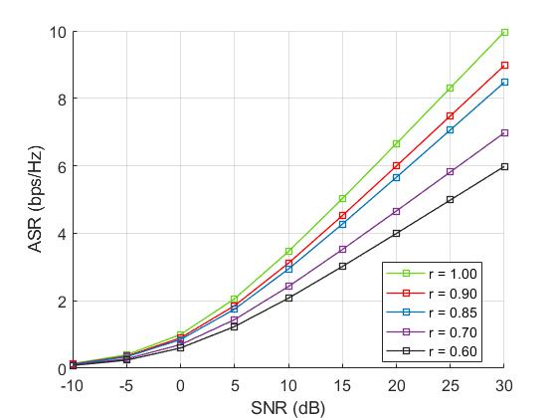
ASR increases with SNR – At low SNR (-10 dB), all curves have nearly the same ASR, close to 0. As SNR increases to 30 dB, ASR improves significantly, with the highest value reaching around 9 bps/Hz for r=1.00.
Higher r values result in better ASR.The ASR performance improves as r increases from 0.60 to 1.00, with r=1.00 consistently achieving the highest ASR across all SNR values.
Fig:5

Slide 19
REFERENCES
[1] Wang, T., Chen, J., Li, Y., & Zhang, R. “Hybrid Precoding for Millimeter Wave MIMO Systems: A Deep Learning Approach” - 2022.
[2] Zhang, X., Dai, L., Wang, B., Chen, S., & Yu, X. “Low-Complexity Hybrid Precoding in Massive MIMO Systems for 6G Applications” - 2021.
[3] Alkhateeb, A., El Ayach, O., Leus, G., & Heath, R. W. “Channel Estimation and Hybrid Precoding for Millimeter Wave Cellular Systems” - 2020.
[4] Han, S., I, C., Xu, Z., & Rowell, C. “Large-Scale Antenna Systems with Hybrid Analog and Digital Beamforming for Millimeter Wave 5G” - 2019.
[5] Gao, X., Dai, L., & Wang, Z. “Fast Hybrid Precoding Algorithms for 6G mmWave MIMO Systems” - 2018.
[6] Chen, J., Zhang, L., Wang, Y., & Ma, X. “Sparse Hybrid Precoding for 6G Wireless Networks: A Compressive Sensing Approach” - 2018.
[7] Yu, X., Xu, J., Sun, Y., & Dai, L. “Hybrid Precoding Techniques for 6G mmWave Massive MIMO Systems” - 2017.
[8] He, X., Wang, L., & Zhang, J. “Energy-Efficient Hybrid Beamforming for 6G Networks with Large-Scale Antenna Arrays” - 2016.

Slide 20
CONCLUSION
The proposed SVD-based Hybrid Precoding effectively mitigates beam squint and improves spectral efficiency, making it ideal for wideband mmWave MIMO systems.
It offers higher data rates, better energy efficiency, and lower hardware cost compared to existing methods, making it suitable for future 6G communications.

Slide 21
Thank You

