Slide 1
SUPPLY CHAIN ANALYSIS
SUBMITTED BY: CHILAKALA SWATHI
TOOL USED: MYSQL & POWER BI
PROJECT: CDACL-003 SUPPLY CHAIN ANALYSIS

Slide 2
Project objective
Analyze the supply chain performance using MYSQL and Power BI.
Monitor key performance indicators (KPIs) such as revenue, product sales, shipping cost, production volume, and defect rate.
Compare product performance across different product types.
Evaluate logistics, inventory, and quality performance.
Provide business insights to support better decision-making.

Slide 3
Data set information
Project Name: Supply chain analysis
Data source: MYSQL Database
Visualization Tool: Microsoft Power BI
Total records: 100
Total tables: 2
Main tables: supply chain data, supplier performance

Slide 4
Data Cleaning & DAX Measures
Data cleaning
Checked data types.
Checked null values.
Checked duplicate records.
Validated the dataset before analysis.
DAX Measures
Total revenue & total products sold
Average shipping cost & average manufacturing cost
Average defect rate & total production volume
Total order quantity & average lead time

Slide 5
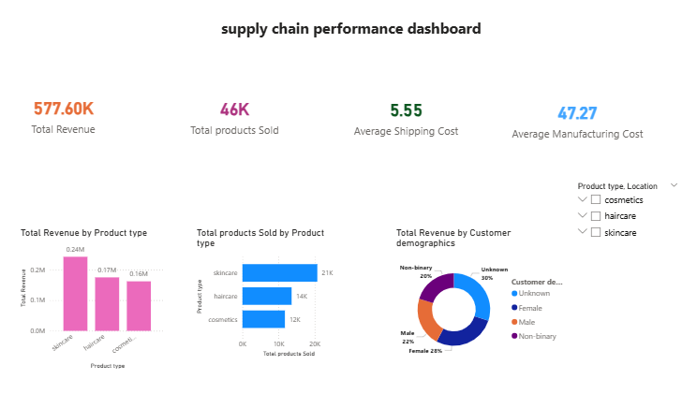
Supply chain performance dashboard
Key insights:
Total revenue: 577.60K
Total products sold: 46K
Avg shipping cost: 5.55
Avg manufacturing cost:47.27
Haircare generated the highest revenue.
Unknown customer demographics contributed the highest revenue share (30%).

Slide 6
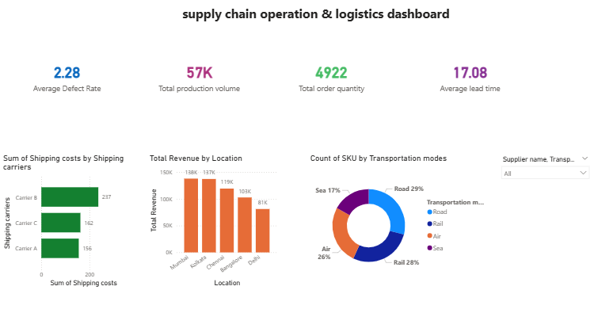
Operations & logistics dashboard
Key insights:
Average defect rate: 2.28
Total production volume: 57K
Total order quantity: 4,992
Avg lead time: 17.08
Road transportation has the highest share (29%).
Shipping cost vary across different carriers.

Slide 7
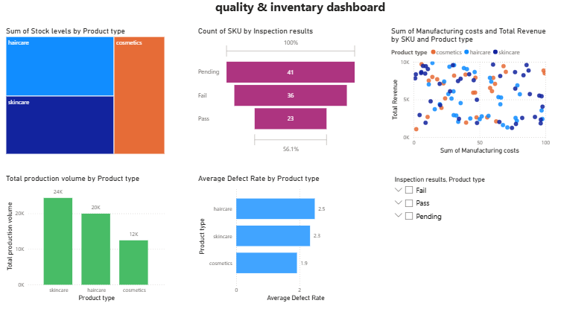
Quality & inventory dashboard
Key insights:
Haircare has the highest stock level.
Inspection results 41 pending, 36 fail, 23 pass.
Haircare has the highest production volume.
Defects rates vary across different product types.
Manufacturing cost and revenue can be compared using the scatter chart.

Slide 8
Comparison Report
Product comparison:
Haircare generated the highest revenue.
Haircare achieved the highest production volume.
Skincare showed comparatively lower performance.
Transportation comparison:
Road transportation has the highest usage (29%)
sea transportation has the lowest usage (17%)
Quality comparison:
pending inspections (41) are higher than pass (23).
Defect rates vary across product categories.

Slide 9
Diagnostic Report
Issues identified:
41 products are pending quality inspection.
36 products failed the inspection process.
Shipping costs vary across different carriers.
Product performance differs across product categories.
Recommendations:
Improve the quality inspection process.
Reduce defect rates through better quality control.
Optimize shipping carrier selection to reduce logistics costs.
Monitor KPIs regularly using Power BI dashboards.

Slide 10
Analysis Report
The company achieved strong revenue and sales performance.
Haircare emerged as the best-performing product category.
Transportation and logistics operations are functioning effectively.
Quality inspection results indicate areas for improvement.
The dashboard provide valuable insights for monitoring supply chain performance.
Data-driven decision-making can improve overall business efficiency.

Slide 11
conclusion
the supply chain analysis project was successfully completed using MYSQL and Power BI.
interactive dashboards were developed to visualize and monitor key business performance.
The project improved understanding of supply chain operations through data visualization.
The project demonstrates how Power BI can support effective business monitoring and decision-making.

