Slide 1
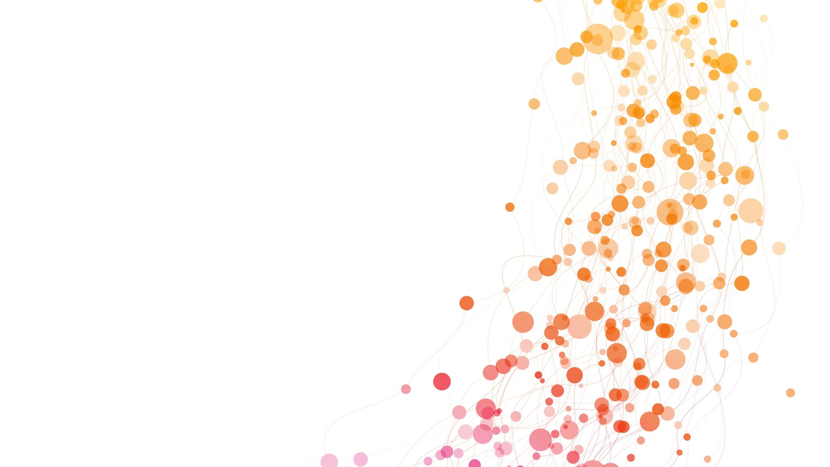
LIDC-IDRI Malignancy-3 Analysis
Swathi Gopal

Slide 2
AGENDA
Dataset Description
Dataset DICOM and XML Mapping
Extracting Nodule Radiomics Features Using Pylidc
Extracting Nodule 3D Image Feature Using CNN
Nodule Distribution Statistics
Preparing Knowledge Completion Graph (KCG)
Malingnancy-3 Classification Using GNN
GNN, SVM and KNN Comparison
Future Work
Reference

Slide 3
DATASET DESCRIPTION
Dataset Contains the CT Scan Images of 1018 patients.
The CT scan data is a 3D scan, which contains many slices of individual 2D cross-sectional images that stack to form each patient's full 3D CT volume.
Each image is in DICOM format.
Every patient CT scan record is analyzed by 4-5 Radiologist.
The Radiologist provided analysis is recorded in an XML format.
There is Unique Identification Number to map between the corresponding patient CT Image and XML Description provided by the Radiologist.
DICOM files contain few features describing basic patient information and the patient position on performing the CT scan, which is relatable while analyzing the nodule position.

Slide 4
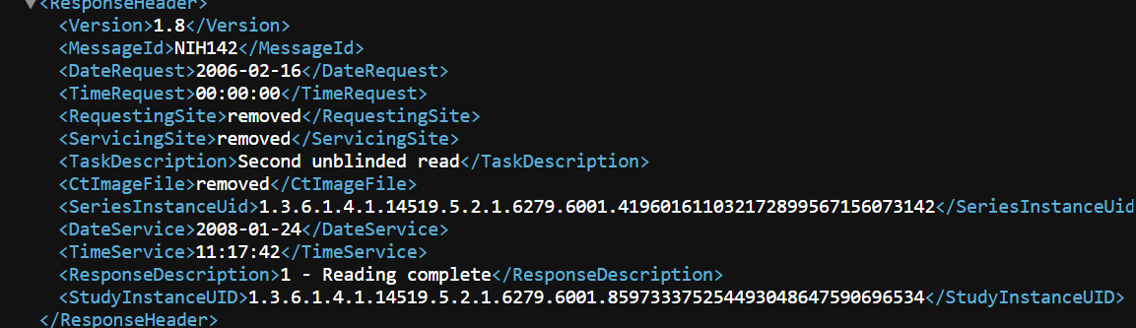
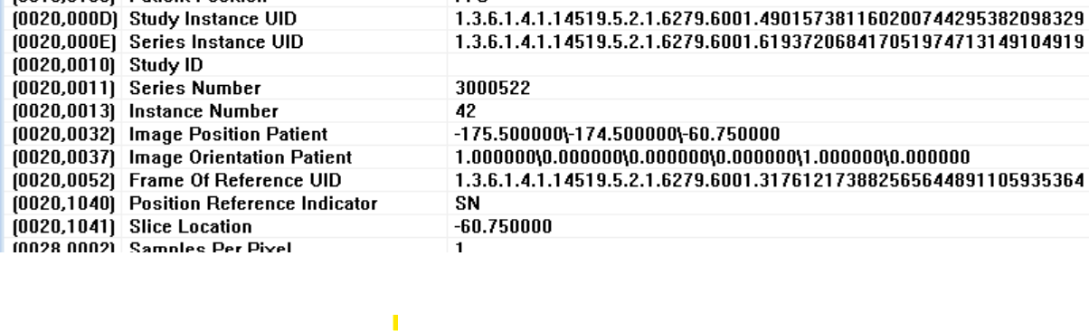
Dataset DICOM and XML Mapping

Slide 5
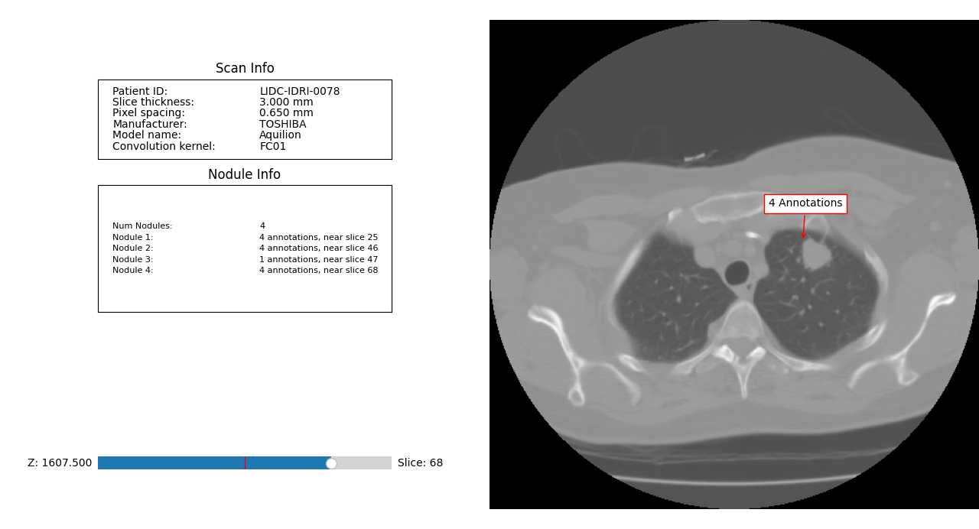
Extracting Nodule Radiomics Features Using Pylidc

Slide 6
Extracting Nodule Radiomics Features Using Pylidc Contd..
LIDC semantic annotation
Malignancy
Texture
Spiculation
Lobulation
Margin
Sphericity
Subtlety
Measurable geometry and CT intensity
Diameter in mm
Log Volume mm3
HU mean
HU std
position information
Centroid x
Centroid z

Slide 7
Extracting Nodule 3D Image Feature Using CNN
Selected Nodules that are examined by 3 or more than 3 Radiologist.
Many Nodules have a single radiologist provided analysis information, which indicates the lower confidence level, Hence the Nodules with lower confidence is not considered.
There were 1392 Nodules identified for the 1018 patients.
Extracted the relevant DICOM images for processing.
The Nodule 3D mask information, containing the height, Depth and Width (32x32x32) is extracted from the radiologist analysis and provided to the CNN.

Slide 8
Extracting Nodule 3D Image Feature Using CNN Contd..
32 is the patch size of each nodule dimension observed in the particular slice of CT scan.
Using the CNN model extracted 64-dimensional features for each of the nodule DICOM image provided.
There are a total of 77 features, 13 radiomics features and 64 nodule image features.

Slide 9
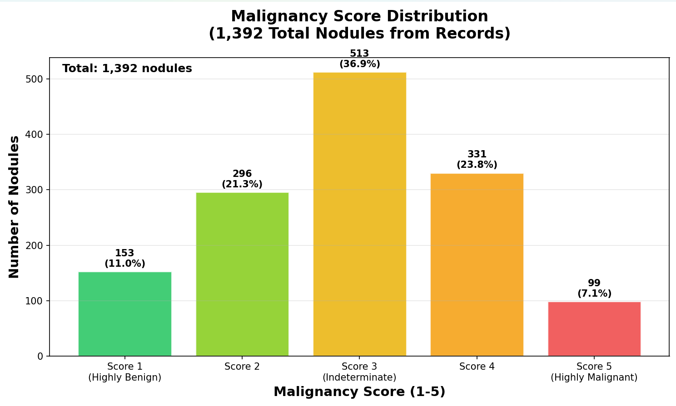
Nodule Distribution Statistics
Identified 1392 Nodules which can be processed with 3 or more than 3 radiologist analyzed.

Slide 10
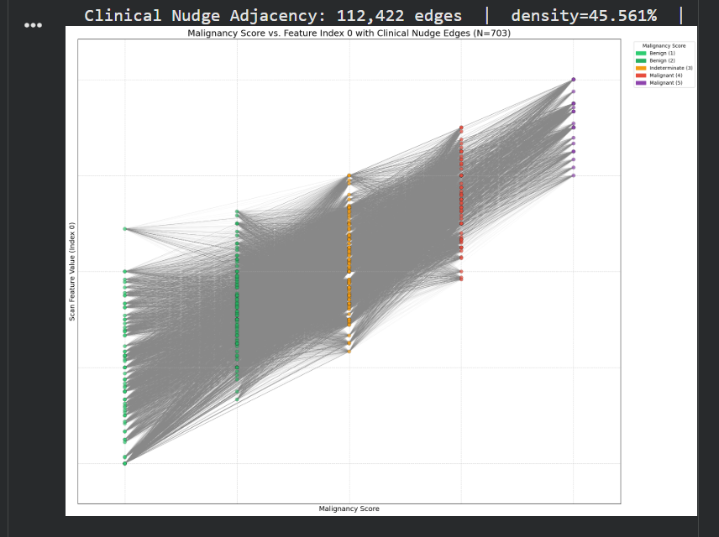
Preparing Knowledge Completion Graph (KCG)
KG adjacency: 113,394 edges: This indicates the total number of unique connections found between the 703 patient scans based on the defined criteria.
density=46.0%: This means that 46% of all possible connections between patient scans are present in the knowledge graph. This is quite a dense graph, which is why visualizing the entire graph directly is challenging.
avg_deg=322.6: On average, each patient scan is connected to approximately 322 other patient scans in the graph

Slide 11
Preparing Knowledge Completion Graph (KCG) Contd..
Knowledge Graph (KG) is constructed based on the input vector, the 13 radiomics features.
KG completes the graph based on the similarities observed between two nodules.
If the two nodules share enough clinical attributes (based on the weighted sum or the directed count), the edge is drawn between them.
Since the Radiomics features provided does not vary much there is a high chance of obtaining a highly dense network, hence a threshold is used to distinguish and consider only highly connected nodules.
The knowledge graph alone is not sufficient for finding the relation between similar nodules, the missing part is the original CT image scan structure similarity analysis.

Slide 12
Preparing Knowledge Completion Graph (KCG) Contd..
GPS Embeddings Core Embedding approach
In the Knowledge graph only Radiomics features encoding is considered whereas the GPS Embeddings consider the positional encoding of the nodules in the entire patient space.
Identify the structural similarity and form the edges or the connection between any two nodules.
GPS Embedding uses the transformer architecture which the global attention mechanism where the attention is provided All to All nodules.
GPS Encoding Solves two major problems “Over-Smoothing” and “Over-Squashing” which is observed from regular Knowledge graph.

Slide 13
Preparing Knowledge Completion Graph (KCG) Contd..
Introduced Laplacian Eigenvectors
Laplacian Eigenvectors act as a "spatial anchor," giving each nodule a unique ID based on its position in the graph.
Capturing Multi-Scale Topology, helps in connecting both the "forest" (global clusters) and the "trees" (local similarities). Also, these vectors specify the commuting distance between any two nodules considered.
L = D – A
where D is degree matrix, considering the diagonal element is the sum of the Dii-th row of and A is the Adjacency matrix.
Combined the Knowledge graph embedding and Graph GPS embedding formed the 32-dimensional hybrid embedding and used in the GNN.

Slide 14
Preparing Knowledge Completion Graph (KCG) Contd..
Base GPS Layer Consists of 3 Layers (Input: 13 - Radiomics feature and CT image, output: 32D hybrid embeddings )
Local Message Passing Layer
Global Attention Layer (Transformer)
Normalization Layer (batch normalization, Graph cluster processing approach)

Slide 15
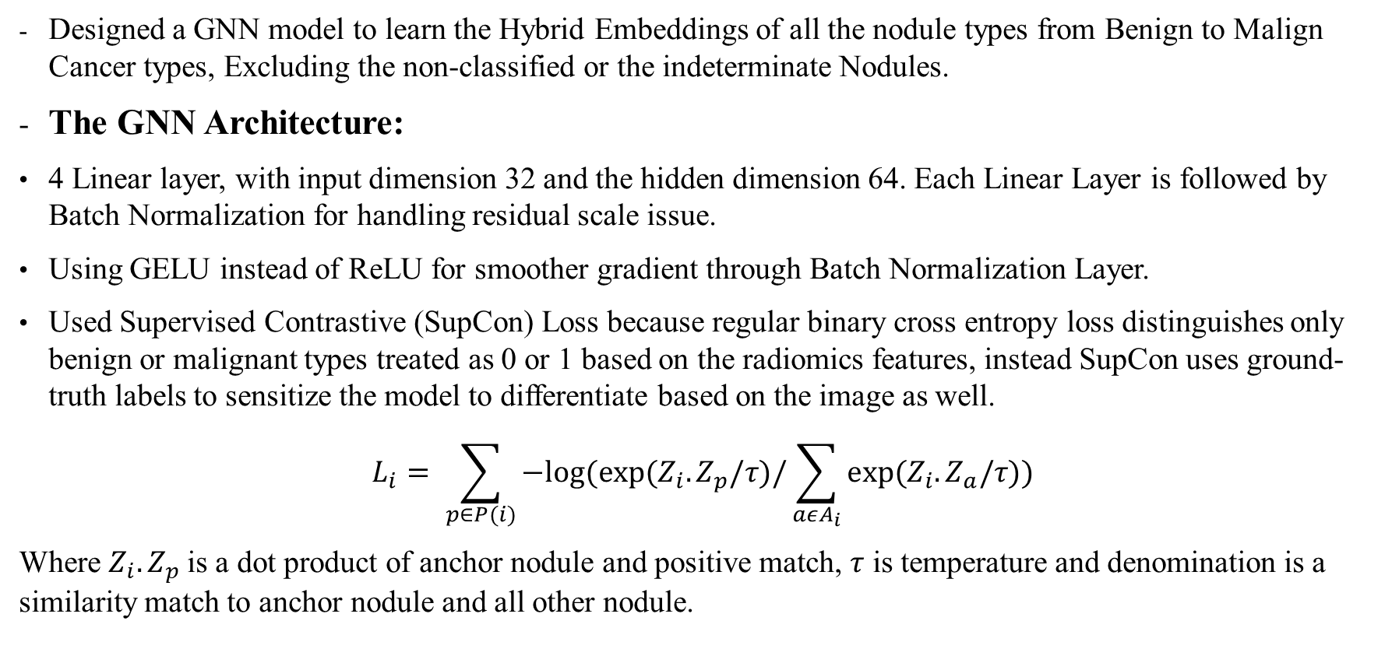
Malingnancy-3 Classification Using GNN
Designed a GNN model to learn the Hybrid Embeddings of all the nodule types from Benign to Malign Cancer types, Excluding the non-classified or the indeterminate Nodules.
The GNN Architecture:
4 Linear layer, with input dimension 32 and the hidden dimension 64. Each Linear Layer is followed by Batch Normalization for handling residual scale issue.
Using GELU instead of ReLU for smoother gradient through Batch Normalization Layer.
Used Supervised Contrastive (SupCon) Loss because regular binary cross entropy loss distinguishes only benign or malignant types treated as 0 or 1 based on the radiomics features, instead SupCon uses ground-truth labels to sensitize the model to differentiate based on the image as well.
$$L_{i}= \sum_{p∈P(i)}{−log⁡(exp⁡(Z_{i}.Z_{p}/τ)/\sum_{aεA_{i}}{exp⁡(Z_{i}.Z_{a}/τ))}}$$
Where $Z_{i}.Z_{p}$is a dot product of anchor nodule and positive match, $τ$ is temperature and denomination is a similarity match to anchor nodule and all other nodule.

Slide 16
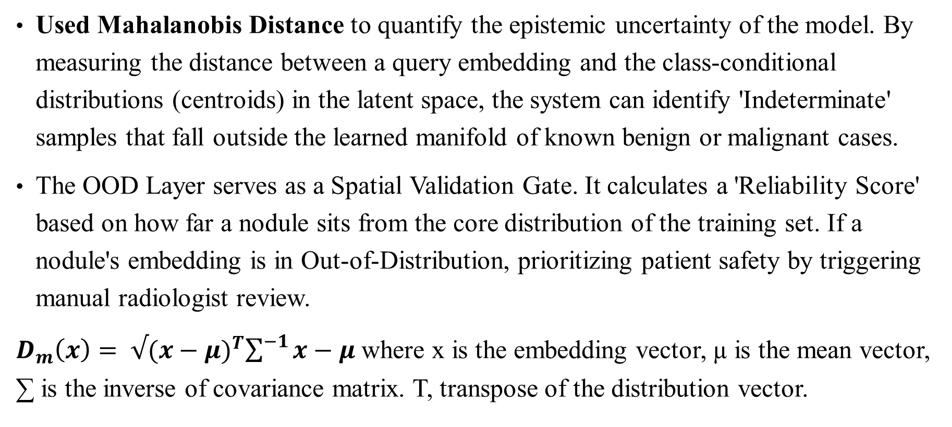
Malingnancy-3 Classification Using GNN Contd...
Used Mahalanobis Distance to quantify the epistemic uncertainty of the model. By measuring the distance between a query embedding and the class-conditional distributions (centroids) in the latent space, the system can identify 'Indeterminate' samples that fall outside the learned manifold of known benign or malignant cases.
The OOD Layer serves as a Spatial Validation Gate. It calculates a 'Reliability Score' based on how far a nodule sits from the core distribution of the training set. If a nodule's embedding is in Out-of-Distribution, prioritizing patient safety by triggering manual radiologist review.
$D_{m}\left(x\right)= √{(x−μ)}^{T}\sum^{−1}{x−μ}$ where x is the embedding vector, µ is the mean vector, ∑ is the inverse of covariance matrix. T, transpose of the distribution vector.

Slide 17
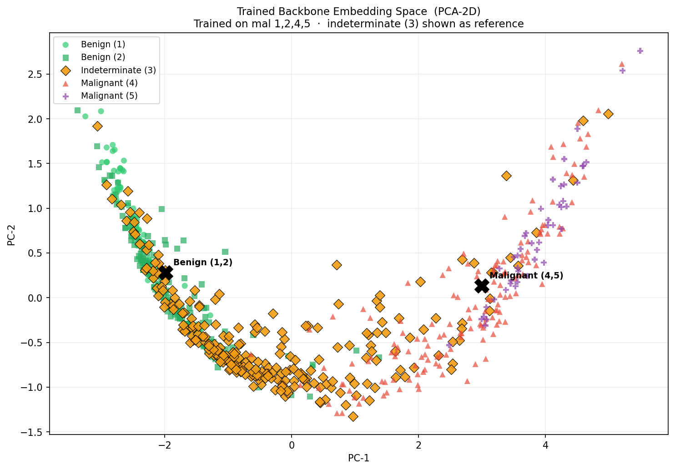
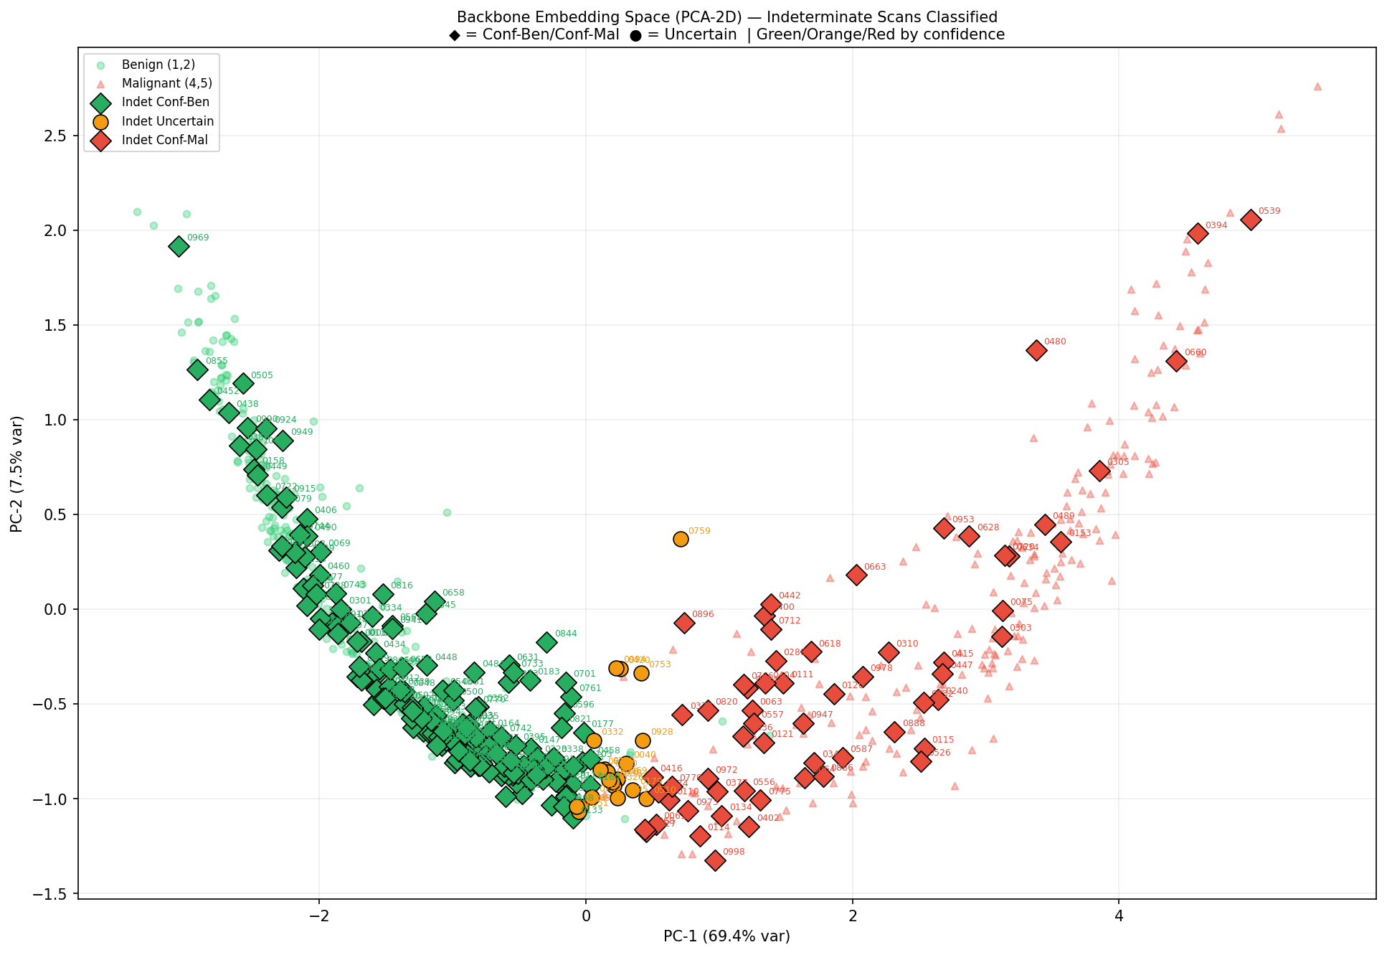
Malingnancy-3 Classification Using GNN Contd…
Original Embedding Space, Compressed Dimension using PCA
Embedding Indeterminate classification, Compressed Dimension using PCA

Slide 18
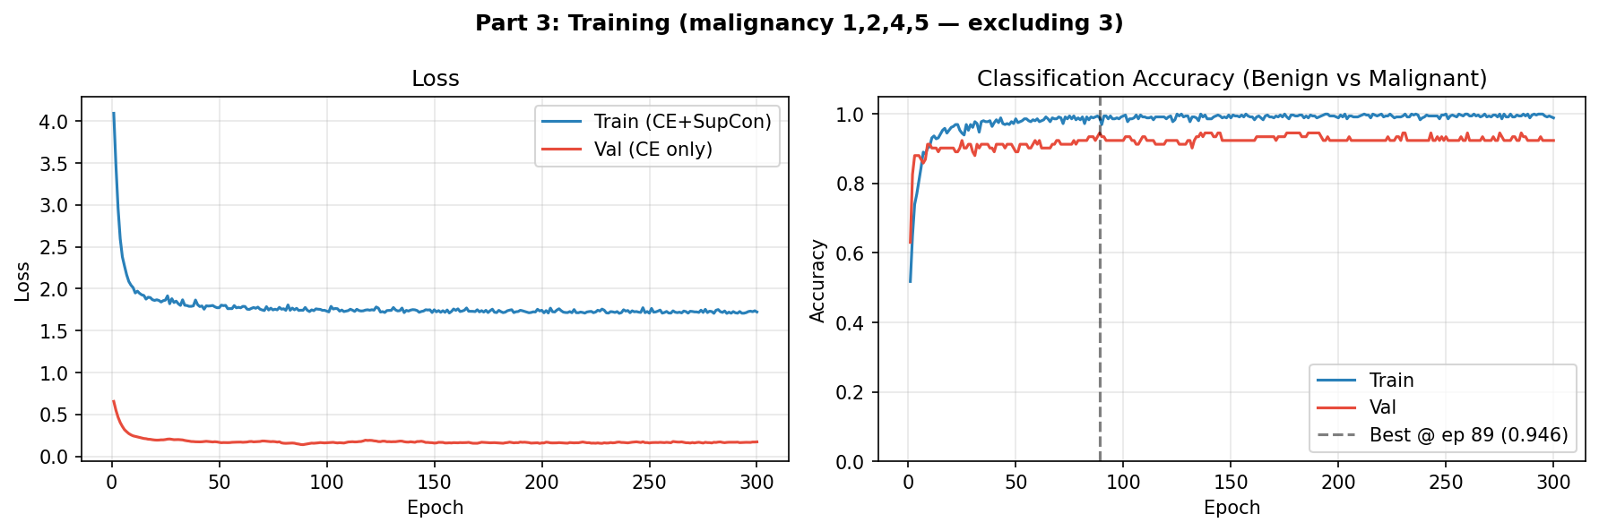
Malingnancy-3 Classification Using GNN Contd…

Slide 19
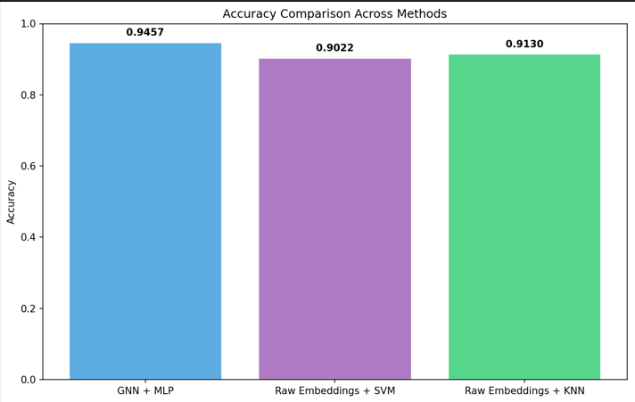
Comparison between GNN and SVM

Slide 20
Future Work
Explore different similarity measures like, Euclidean, Cosine, etc
Explore other Classifier Methods like Random Forest, Logistic Regression, XGBoost etc..
Handle Different Datasets
Explore U-Net modal & MedicalCLIP
Handle Nodules Reviewed by single Radiologist
Extract the relational data based on the patient meta data.

Slide 21
References
Peeters, D., Venkadesh, K. V., Dinnessen, R., Saghir, Z., Scholten, E. T., Vliegenthart, R., Prokop, M., & Jacobs, C. (2025). Towards safe and reliable deep learning for lung nodule malignancy estimation using out-of-distribution detection. Computers in Biology and Medicine, 186, Article 109633. https://doi.org/10.1016/j.compbiomed.2024.109633
Armato, S. G., McLennan, G., Bidaut, L., McNitt-Gray, M. F., Meyer, C. R., Reeves, A. P., ... & Clarke, L. P. (2011). The lung image database consortium (LIDC) and image database resource initiative (IDRI): a completed reference database of lung nodules on CT scans. Medical physics, 38(2), 915-931. https://www.cancerimagingarchive.net/collection/lidc-idri

Slide 22
THANK YOU

