Slide 1

Student Examination Score Prediction System
Using Machine Learning and Academic History Analytics to Forecast Student Performance
ACADEMIC AI PROJECT
PREDICTIVE ANALYTICS
EDUCATIONAL TECHNOLOGY

Slide 2

The Academic Challenge
Every semester, educators face a critical blind spot: which students will struggle — and why? Without predictive insight, interventions arrive too late, often after failure has already occurred.
Reactive Support
Fragmented Data
Interventions typically happen after poor results, missing the window for meaningful impact.
Attendance, assignments, and behavior data exist in silos, rarely analyzed together.
One-Size-Fits-All
Generic teaching approaches fail to address individual student learning patterns and risks.

Slide 3

Project Objectives
This system bridges the gap between raw academic data and actionable educator insight through four core goals.
1
2
Predict Scores Accurately
Identify At-Risk Students
Forecast future examination scores using ML models trained on academic history and study behavior.
Flag students requiring early academic intervention before performance declines.
3
4
Generate Predictive Reports
Enable Personalized Mentoring
Deliver dashboards and summaries to faculty and administrators for data-driven decisions.
Support tailored student guidance through behavior analytics and performance trends.

Slide 4
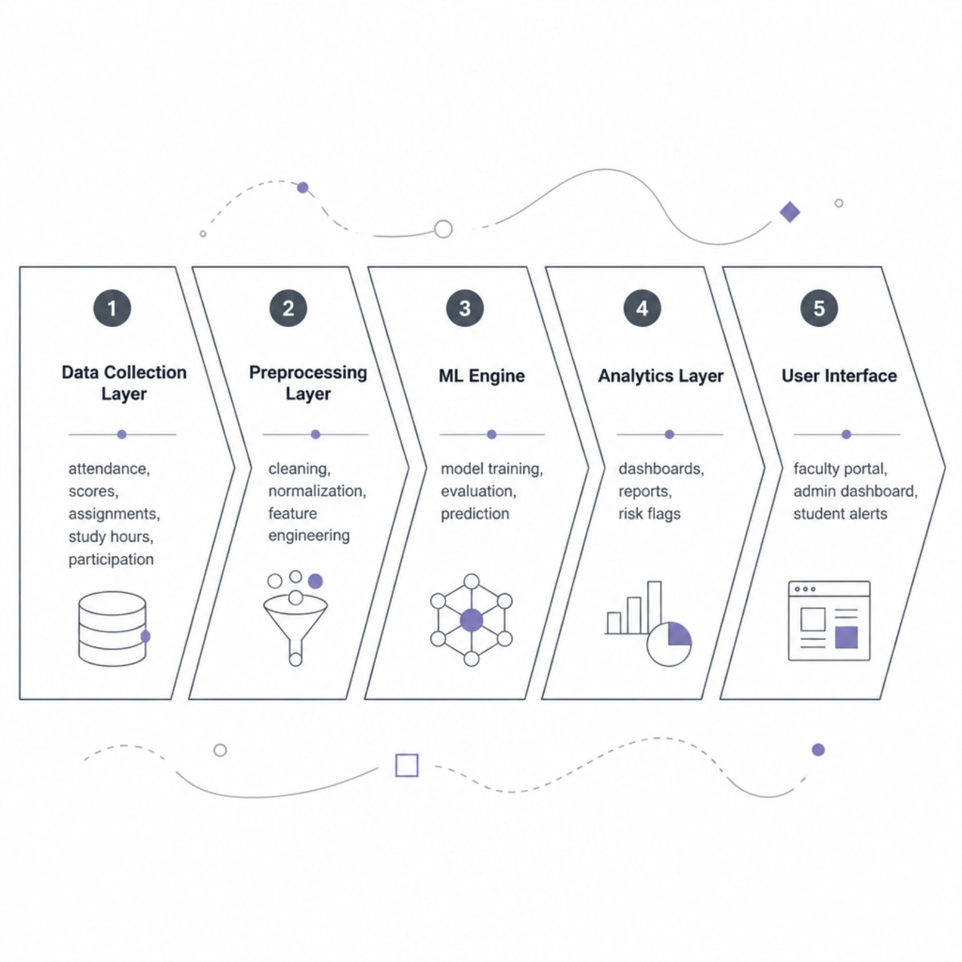
System Architecture Overview
End-to-End Pipeline
The system flows from raw institutional data through intelligent processing to actionable educator insights. Each layer is modular, enabling independent scaling and maintenance.
Data Collection: Integrates with SIS, LMS, and manual inputs
ML Engine: Supports multiple algorithms with auto-selection
Analytics: Real-time dashboards with drill-down capability
Security: Role-based access and encrypted data storage

Slide 5



Data Inputs & Feature Engineering
Input Data Sources
Academic History: Previous exam scores, GPA trends, subject-wise performance
Behavioral Signals: Attendance rate, assignment submission patterns, study hours logged
Classroom Engagement: Participation frequency, quiz scores, peer interaction metrics
Feature Engineering: Rolling averages, score velocity, attendance decay, and engagement indices are derived to improve model sensitivity.

Slide 6

Machine Learning Workflow
Feature Selection
Model Training
Importance ranking and reduction.
Train regression and classification models.
Data Preprocessing
Prediction Output
Cleaning, normalization, encoding steps.
Score forecasts, classifications, intervals.
The pipeline supports multiple algorithms — Linear Regression, Random Forest, Gradient Boosting, and Neural Networks — with automated evaluation to select the best-performing model for each student cohort.

Slide 7
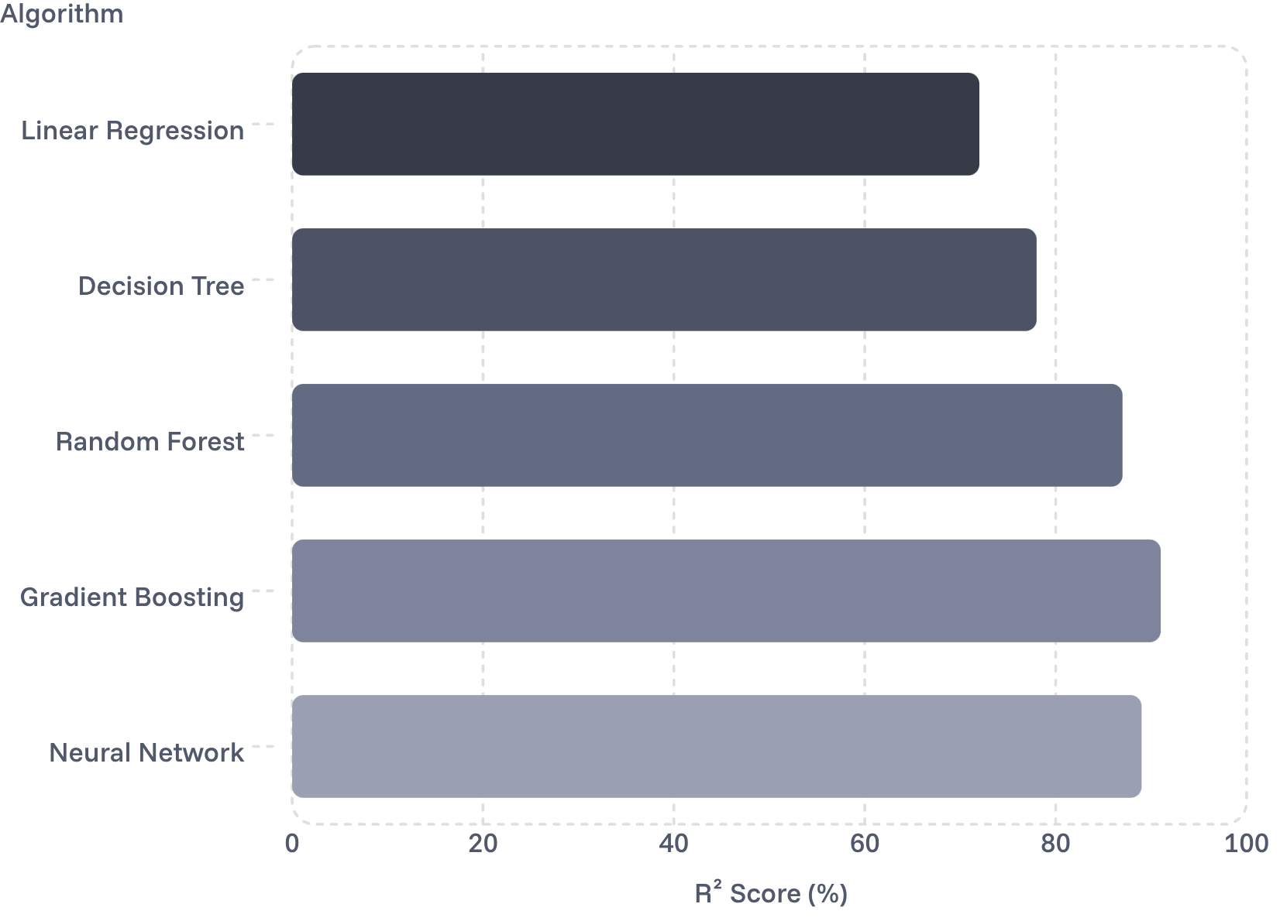
Model Performance & Evaluation
Expected Model Accuracy
Gradient Boosting and ensemble methods consistently outperform baseline models, achieving 90%+ R² scores on structured academic datasets.
MAE Target
Risk Detection
±4 points on a 100-point scale
85%+ recall on at-risk classification

Slide 8
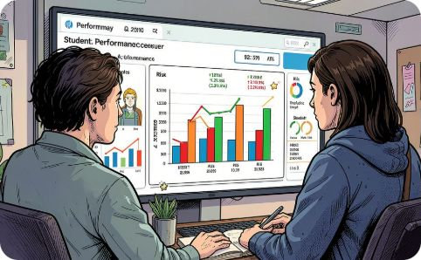
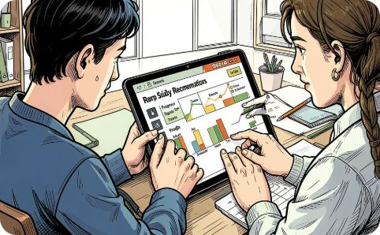
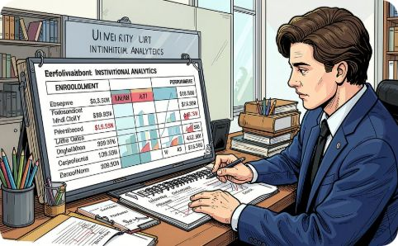
Analytical Dashboards & Key Features
Faculty Dashboard
Student Insights
Admin Reports
Real-time score predictions, at-risk alerts, and class-wide performance trends in a single view.
Personalized feedback reports showing predicted scores, improvement areas, and study recommendations.
Institutional summaries, cohort comparisons, and longitudinal trend analysis for strategic planning.

Slide 9
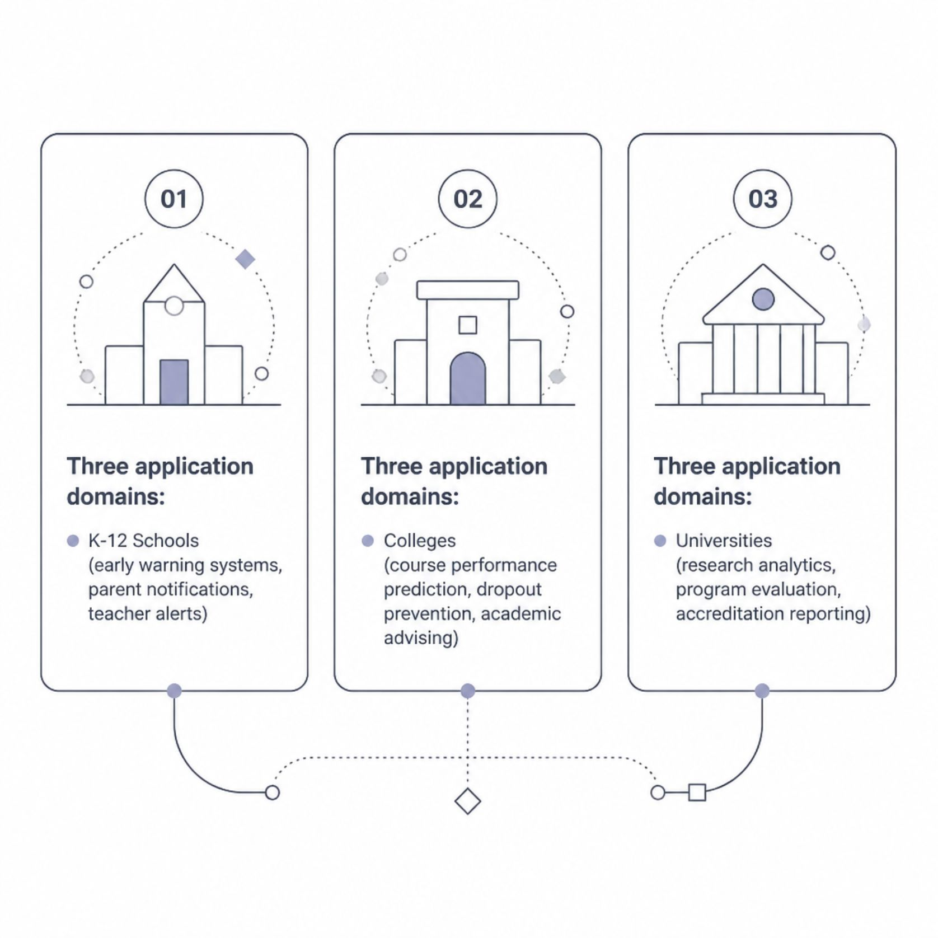

Security, Scalability & Real-World Applications
Platform Strengths
🔒 Security
📈 Scalability
Role-based access control, encrypted data storage, and FERPA/GDPR compliance built in.
Cloud-native architecture supports hundreds of institutions, from small schools to large universities.
🌐 Integration
APIs connect with existing SIS, LMS, and HR systems for seamless data flow.

Slide 10

Conclusion & Future Vision
This system transforms how educators understand and support student success — moving from reactive remediation to proactive, data-driven mentorship.
Current Capabilities
Near-Term Enhancements
Score prediction, risk flagging, dashboards, and reporting for schools and colleges.
NLP for feedback analysis, mobile app, and integration with video learning platforms.
Long-Term Vision
Adaptive learning pathways, cross-institutional benchmarking, and AI-powered tutoring recommendations.

