Slide 1

Introduction to Machine Learning
Understanding the fundamentals of machine learning.
Exploring various algorithms and their applications.
Ethical considerations in machine learning practices.
Notes:
This slide serves as the title page for the presentation on Machine Learning. It outlines the core topics that will be discussed, including a fundamental understanding of machine learning, various algorithms, and the ethical implications of their use.

Slide 2
Understanding Machine Learning
Machine learning enables systems to learn from data.
It improves over time with more data and experience.
Applications include image recognition, natural language processing, and more.
Types include supervised, unsupervised, and reinforcement learning.
Ethics and bias in machine learning are critical considerations.
Notes:
This slide provides an overview of machine learning, highlighting its ability to learn from and improve with data. It also covers key applications like image recognition and natural language processing. Additionally, the slide discusses the main types of machine learning: supervised, unsupervised, and reinforcement learning, while also emphasizing the importance of considering ethical implications and biases.

Slide 3

Diverse Applications of Machine Learning
Machine learning enhances image and speech recognition systems.
Used in finance for fraud detection and risk assessment.
Recommendation engines optimize customer experience in e-commerce.
In healthcare, it aids in diagnostics and personalized treatment.
Machine learning powers autonomous vehicle navigation and safety.
Notes:
This slide highlights the diverse applications of machine learning across various industries. From improving image and speech recognition to enhancing e-commerce through recommendation systems, machine learning is revolutionizing sectors. In healthcare, it assists in diagnostics, while its role in autonomous vehicles demonstrates its impact on safety and navigation.

Slide 4

Exploring Types of Machine Learning
Machine learning can be categorized into three main types.
Supervised learning requires labeled data for training.
Unsupervised learning detects patterns in unlabeled data.
Reinforcement learning involves learning from actions and rewards.
Each type has unique algorithms and applications.
Notes:
In machine learning, there are primarily three types: supervised, unsupervised, and reinforcement learning. Supervised learning uses labeled data to train models, while unsupervised learning looks for hidden patterns in data without labels. Reinforcement learning focuses on learning optimal actions through trial and error, often using rewards to guide the learning process.

Slide 5

Linear Regression Unveiled
Linear regression predicts outcomes based on input features.
It assumes a linear relationship between dependent and independent variables.
Ordinary Least Squares minimizes the error in predictions.
Linear regression can be extended to multiple variables.
It's widely used in finance, economics, and social sciences.
Notes:
Linear regression is a fundamental statistical method used for forecasting and prediction. It helps us understand the relationship between a dependent variable and one or more independent variables. By fitting a line through the data points, it allows us to make predictions, which can be immensely valuable in various fields such as finance and social sciences.

Slide 6

Understanding Regularization Techniques
Regularization prevents overfitting in machine learning models.
Common techniques include L1 regularization (Lasso) and L2 regularization (Ridge).
Regularization adds a penalty term to the loss function.
It improves model generalization by controlling complexity.
Choosing the right regularization strength is crucial for performance.
Notes:
Regularization techniques are essential for improving the generalization of machine learning models. L1 regularization can lead to sparse solutions, while L2 regularization tends to distribute weight more evenly. Adding a penalty term to the loss function helps prevent overfitting, balancing accuracy with model complexity. Understanding how to tune these techniques is vital for optimal model performance.

Slide 7

Logistic Regression Basics
Logistic regression models binary outcomes.
It estimates probabilities using a logistic function.
The output is a value between 0 and 1.
Commonly used in binary classification tasks.
Assumes a linear relationship between features.
Notes:
Logistic regression is a fundamental statistical method used for binary classification. It estimates the probability of a binary outcome based on one or more predictor variables by applying a logistic function. With its assumption of a linear relationship between features and the log-odds of the outcome, logistic regression remains a popular choice for various classification tasks.

Slide 8
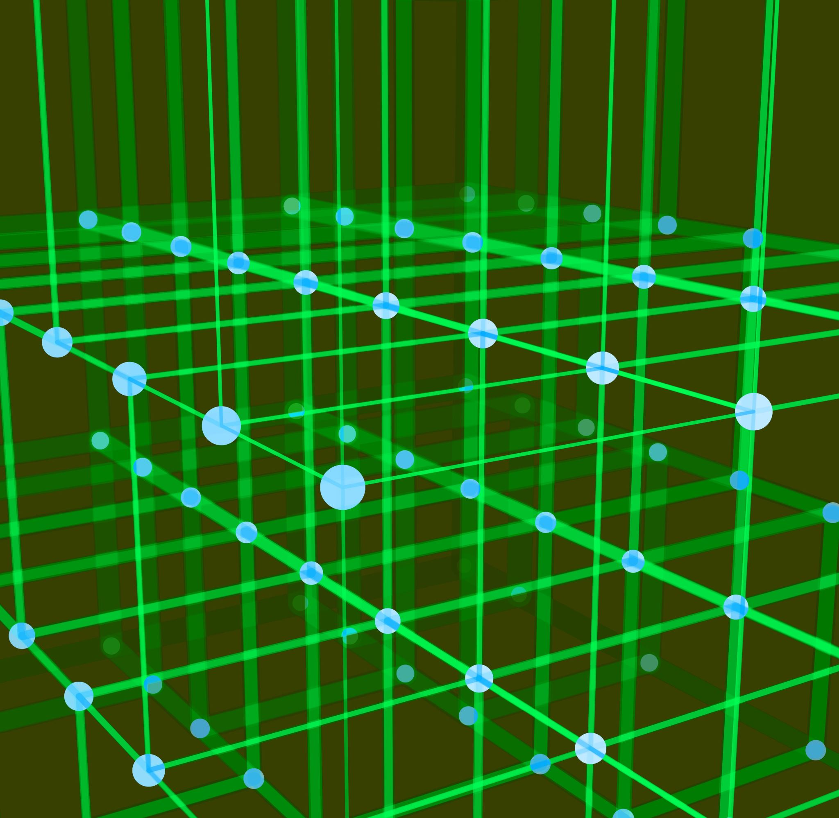
Diving Deeper into Machine Learning Algorithms
Supervised learning uses labeled data for training models.
Unsupervised learning finds hidden patterns in unlabeled data.
Reinforcement learning optimizes actions based on rewards.
Common algorithms include decision trees, SVMs, and neural networks.
Model evaluation is crucial for understanding performance.
Notes:
This slide explores various machine learning algorithms in detail. Supervised learning requires labeled data for training, while unsupervised learning detects patterns in data without labels. Reinforcement learning focuses on learning optimal actions through rewards. Key algorithms like decision trees, support vector machines (SVMs), and neural networks are essential for different problems. It's important to evaluate models to assess their effectiveness and applicability.

Slide 9
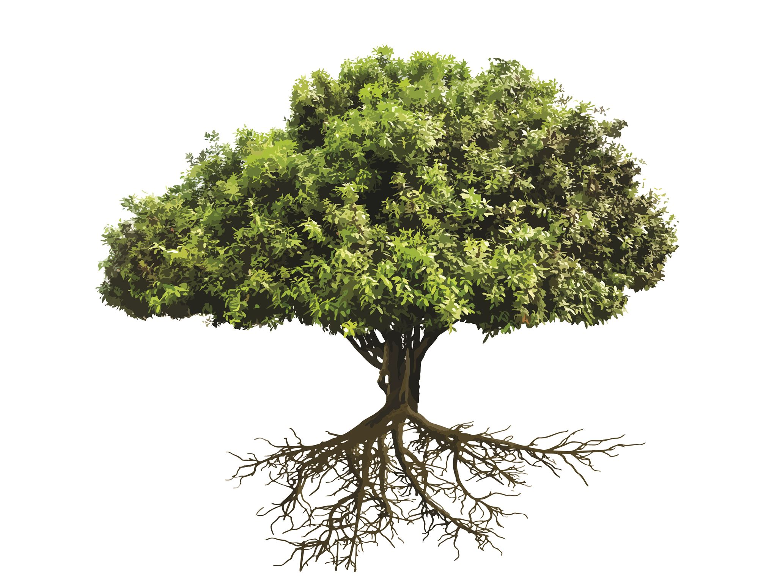
Decision Trees Explained
Decision trees use a tree-like model for decisions.
Each internal node represents a test on an attribute.
Branches represent the outcome of tests, leading to final decisions.
They are simple to interpret and visualize.
Commonly used in classification and regression tasks.
Notes:
Decision trees are a popular algorithm due to their simplicity and interpretability. They work by splitting the data into subsets based on feature values, which allows them to create a model that can predict outcomes. This method is widely used in both classification and regression problems, and their visual representation helps in understanding the decision-making process.

Slide 10

Random Forests Overview
Random forests combine multiple decision trees.
Each tree is trained on a random subset of data.
They reduce overfitting compared to individual trees.
Feature randomness adds diversity to the model.
Effective in classification and regression tasks.
Notes:
Random forests are an ensemble learning method that combines predictions from multiple decision trees to improve accuracy and reduce overfitting. By training each tree on a random subset of the data and selecting a random subset of features for splitting, random forests create a diverse set of models, leading to robust performance in both classification and regression problems.

Slide 11

Enhancing Model Performance with Bagging and Boosting
Bagging reduces variance by training multiple models independently.
Boosting reduces bias by training models sequentially.
Random forests exemplify the bagging technique.
AdaBoost adjusts weights based on previous errors.
Both methods improve predictive accuracy in different ways.
Notes:
This slide explores the essential concepts of bagging and boosting in machine learning. Bagging aims to reduce variance, making models more stable and reliable, while boosting focuses on reducing bias, enhancing the model's ability to learn from errors. By combining these methods, we can significantly improve the overall performance of our predictive models.

Slide 12
Bagging vs. Boosting: Key Differences
Both bagging and boosting are ensemble methods.
Bagging reduces variance, boosting reduces bias.
Bagging trains models independently, boosting sequentially.
Random forests are an example of bagging.
Boosting algorithms include AdaBoost and Gradient Boosting.
Notes:
In this slide, we differentiate between bagging and boosting, highlighting their unique characteristics. Bagging focuses on reducing variance by training models independently on random subsets of data, while boosting aims to reduce bias by training models sequentially, where each new model focuses on the errors of the previous ones. Random forests exemplify bagging, whereas AdaBoost and Gradient Boosting are prominent boosting algorithms.

Slide 13

AdaBoost: Boosting Performance
AdaBoost stands for Adaptive Boosting, enhancing weak classifiers.
It combines multiple weak models to form a strong learner.
Weights are adjusted based on classification errors.
Sensitive to noisy data and outliers.
Effective for binary classification tasks and can be extended.
Notes:
AdaBoost, or Adaptive Boosting, is a powerful ensemble technique that improves the performance of weak classifiers by combining them into a single strong learner. It works by adjusting the weights of misclassified data points, thereby focusing more on challenging instances. While effective in many scenarios, it can be sensitive to noise and outliers, which may impact its performance.

Slide 14

Support Vector Machines (SVM)
SVM finds the optimal hyperplane for classification.
It maximizes the margin between classes.
Kernel tricks allow SVM to handle non-linear data.
Useful in high-dimensional spaces.
Robust against overfitting in high dimensions.
Notes:
Support Vector Machines are powerful classifiers that work by identifying the hyperplane that best separates the classes in the dataset. By maximizing the margin between different classes, SVMs provide strong generalization capabilities, particularly in high-dimensional spaces. The use of kernels allows SVMs to classify non-linear data effectively, making them versatile for various applications.

Slide 15

K-Nearest Neighbors (KNN) Explained
KNN is a simple, instance-based learning algorithm.
It classifies based on the majority class of neighbors.
Distance metrics determine neighbor proximity.
Sensitive to irrelevant features and feature scaling.
Useful for both classification and regression.
Notes:
K-Nearest Neighbors is an intuitive algorithm that classifies data points based on the majority class of their 'k' nearest neighbors. It employs distance metrics, such as Euclidean distance, to identify neighbors. While KNN is simple and effective in many scenarios, it can be sensitive to the presence of irrelevant features and requires careful feature scaling to perform optimally.

Slide 16

XGBoost: A Powerful Boosting Technique
XGBoost stands for Extreme Gradient Boosting.
It is an efficient implementation of gradient boosting algorithms.
It regularly wins machine learning competitions due to its performance.
XGBoost handles sparse data and missing values effectively.
Hyperparameter tuning is crucial for optimal performance.
Notes:
XGBoost, or Extreme Gradient Boosting, is a highly efficient and effective machine learning algorithm. It combines the strengths of traditional gradient boosting models while addressing their limitations. Known for its speed and performance, it excels in handling sparse data and missing values, making it a popular choice in data science competitions. Proper hyperparameter tuning can significantly enhance its performance.

Slide 17

Evaluation Metrics for Classification Algorithms
Accuracy measures the overall correctness of the model.
Precision indicates the proportion of true positive results.
Recall evaluates the model's ability to find all relevant instances.
F1 Score balances precision and recall in one metric.
ROC-AUC assesses the model's performance across various thresholds.
Notes:
In this slide, we explore essential evaluation metrics for classification algorithms. Accuracy provides a simple measure of correctness, while precision and recall reveal the model's effectiveness in handling positive instances. The F1 Score offers a balance between precision and recall, essential for imbalanced datasets. Lastly, the ROC-AUC metric helps visualize performance across different classification thresholds.

Slide 18

Understanding Regression Metrics
Mean Absolute Error (MAE) measures average prediction error.
Mean Squared Error (MSE) squares the error for greater weight.
Root Mean Squared Error (RMSE) offers error in original units.
R-squared indicates the proportion of explained variance.
Adjusted R-squared accounts for the number of predictors.
Notes:
This slide covers essential metrics used for evaluating regression models. Mean Absolute Error (MAE) provides a straightforward measure of errors, while Mean Squared Error (MSE) emphasizes larger errors. RMSE is useful as it presents the error in the same unit as the target variable. R-squared and Adjusted R-squared give insights into how well the model explains the variance in the data, adjusting for the number of predictors.

Slide 19
Mastering Hyperparameter Tuning
Hyperparameter tuning optimizes model performance.
Involves selecting the best parameters for algorithms.
Common techniques include grid search and random search.
Bayesian optimization is an advanced method.
Tuning can significantly reduce overfitting and improve accuracy.
Notes:
Hyperparameter tuning is crucial for enhancing the performance of machine learning models. It involves adjusting the hyperparameters, which are settings that determine the learning process. Techniques like grid search systematically evaluate combinations, while random search introduces randomness to explore the hyperparameter space. Advanced methods such as Bayesian optimization can find optimal parameters more efficiently, ultimately leading to better model accuracy and reduced overfitting.

Slide 20

Grid Search vs Random Search: Optimizing Hyperparameters
Grid search exhaustively tests all combinations of parameters.
Random search samples random combinations within defined limits.
Grid search can be computationally expensive for large parameter spaces.
Random search often finds optimal parameters faster with less computation.
Choosing the right method depends on the specific problem and resources.
Notes:
In hyperparameter tuning, grid search evaluates every possible combination of parameters, leading to thorough but potentially slow optimization. Random search, on the other hand, selects random combinations, which can be more efficient, particularly in larger spaces. The choice between these methods should consider the computational resources available and the problem's complexity.

