Slide 1
Library management system
Developed By G. Sravani TR-580 K. Swathi TR-581 P. Gouri shiva prasad TR-583 G. Yeshwanth TR-584
Trained by Anuj Sharma

Slide 2
AGENDA
Introduction
Problem Statement
Project Objectives
Technology Stack
System Architecture
Database Design
System Modules
Results
Advantages
Future Scope
Conclusion

Slide 3
Introduction
Overview
The Library Management System is a web-based application designed to automate library operations such as book management, borrowing, returning, fine calculation, and user account management.
Purpose
Reduce manual work
Manage books efficiently
Improve user experience
Track borrowing activities

Slide 4
Problem Statement
Existing System Challenges
Manual record maintenance
Difficulty tracking issued books
Time-consuming search process
Errors in fine calculations
Poor inventory management
Proposed Solution
A centralized digital platform for managing library resources and user activities.

Slide 5
System Features
User Authentication
Dashboard Overview
Book Management
Search & Filter Books
Borrow Books
Return Books
Fine Management
Wishlist Management
User Profile Management
Dark/Light Theme Support

Slide 6
Technology Stack
Frontend
React.js
HTML5
CSS3
JavaScript
Backend
Spring Boot 3
Database
MySQL
Tools
Intellij Idea
Git & GitHub
Postman

Slide 7
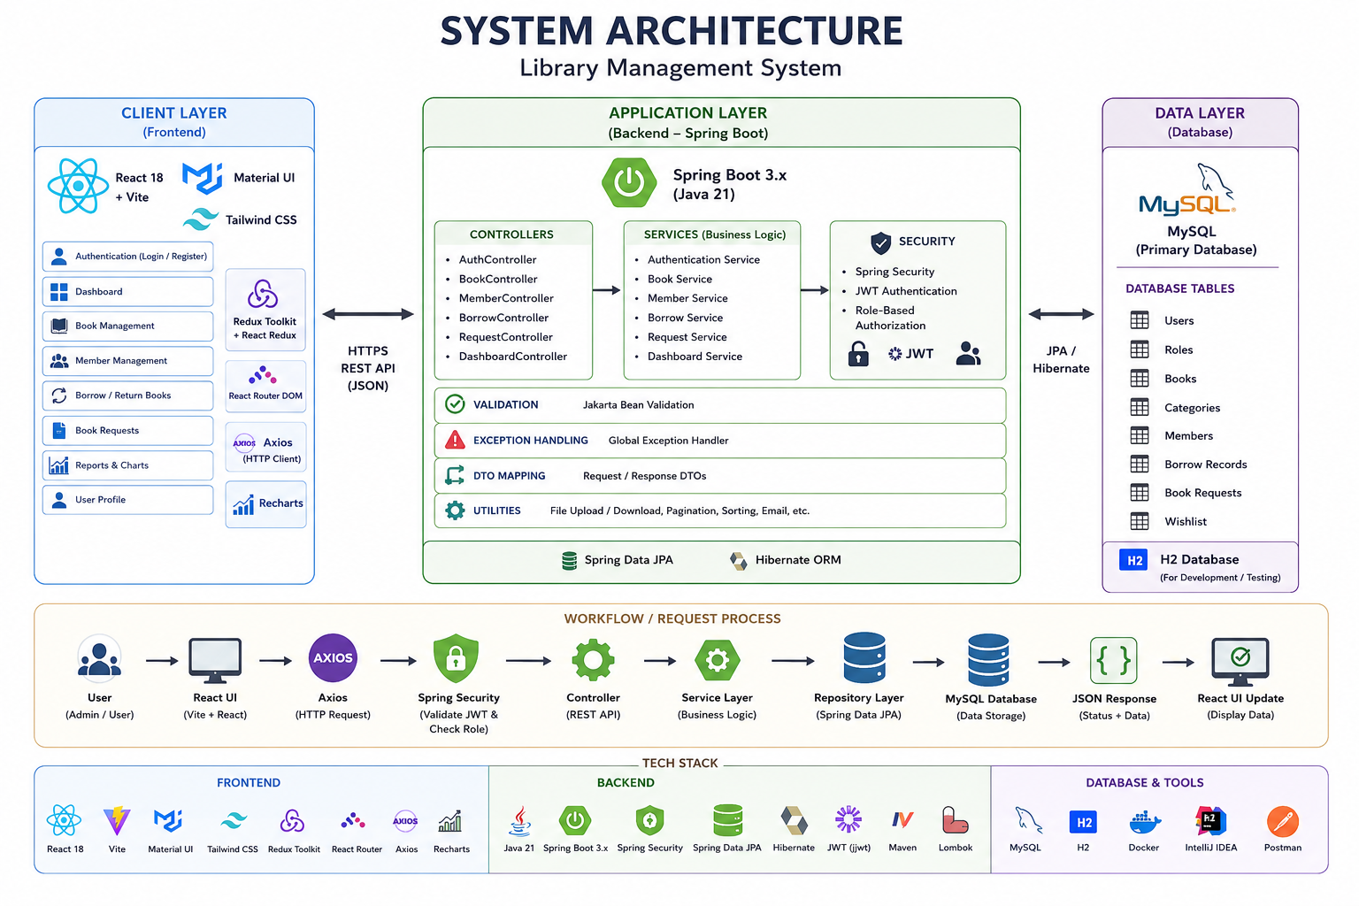
System Architecture

Slide 8
Modules of the System
Admin Module
Manage books
Manage users
Monitor borrow records
Manage fines
User Module
Search books
Borrow books
Return books
Add to wish list
View profile

Slide 9
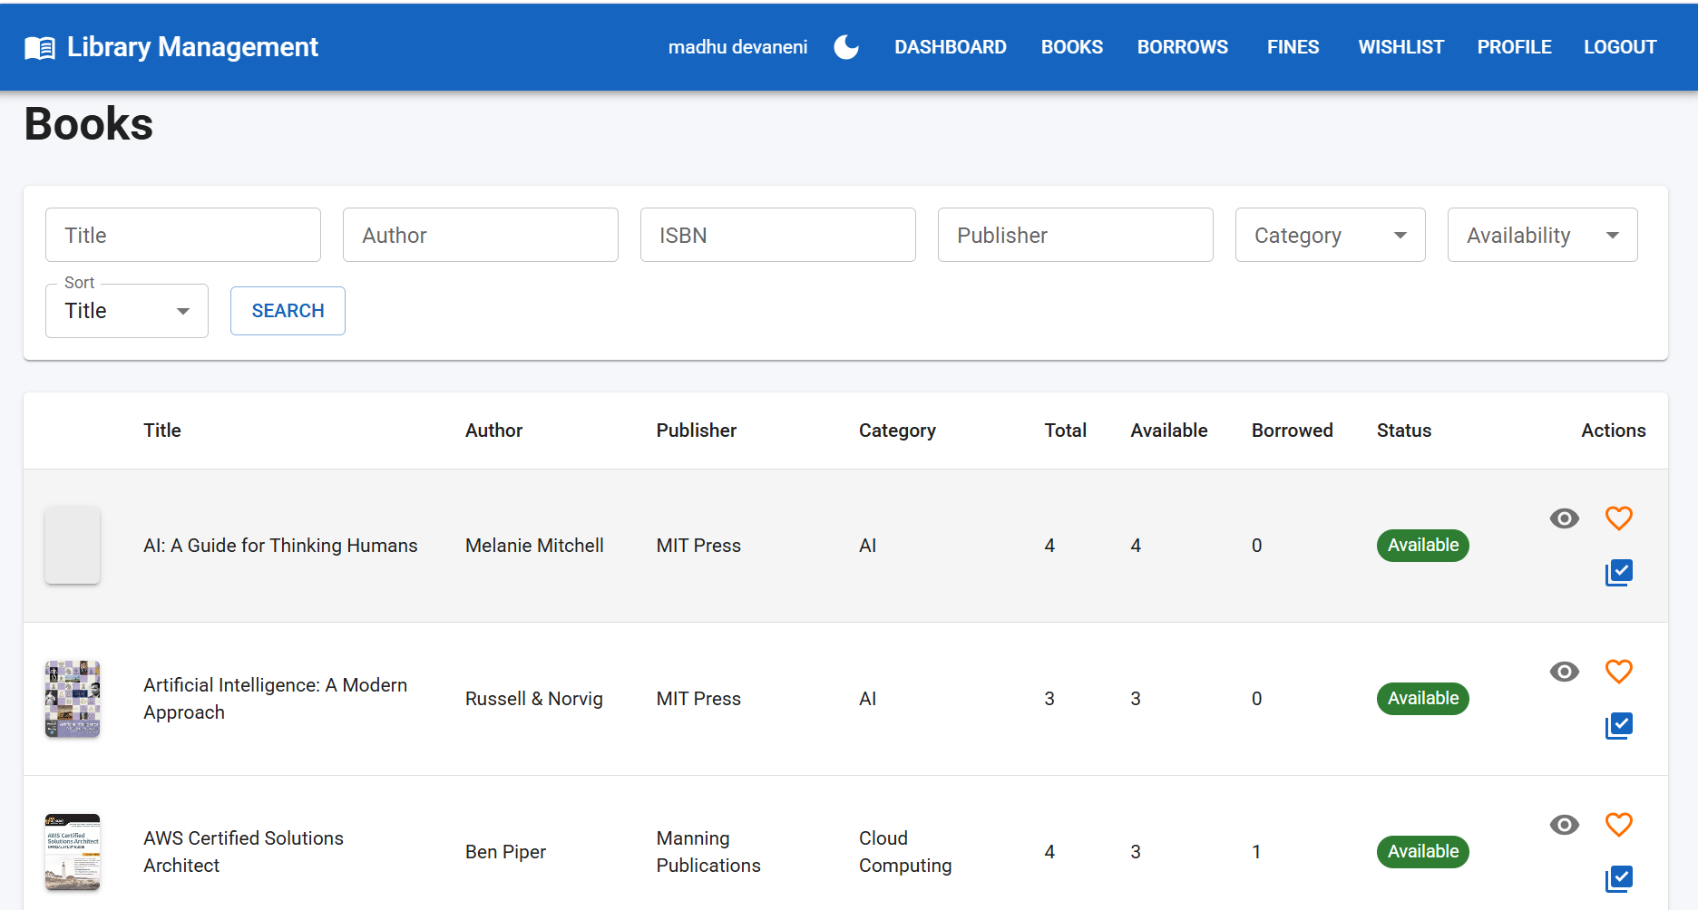
User Dashboard

Slide 10
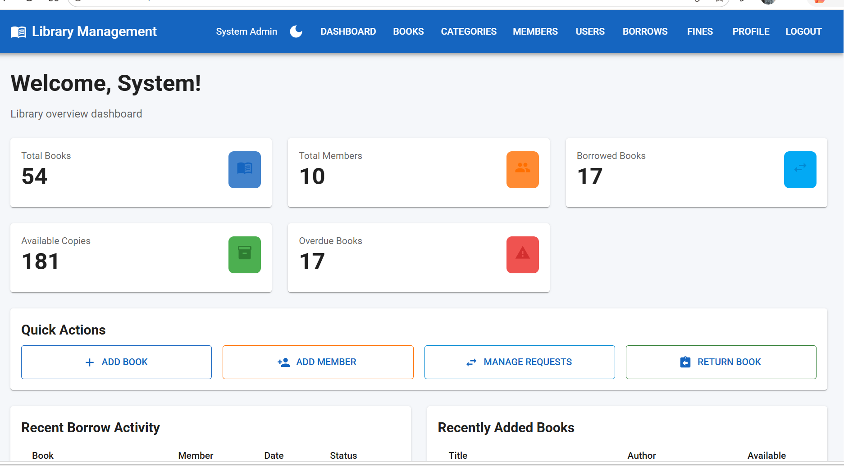
Admin dashboard

Slide 11
Advantages
Easy book tracking
Faster searching
Accurate fine calculation
Improved user experience
Reduced paperwork
Secure data management
Real-time availability updates

Slide 12
Future Enhancements
QR Code Based Issue/Return
Barcode Integration
Email Notifications
Mobile Application
Online Fine Payment

Slide 13
Conclusion
The Library Management System successfully digitizes library operations by providing efficient book management, borrowing, return tracking, fine management, and user-friendly access to resources. The system improves productivity, accuracy, and overall library service quality.

Slide 14
THANK YOU

