Slide 1
Video Summarization

Slide 2
Introduction
According to Cisco, video content will make up 82% of all internet traffic by 2022, up from 75% in 2017.
It is estimated that by 2025, the amount of video content uploaded to the internet every second will take an individual over 5 million years to watch.
In a survey conducted by HubSpot, it was found that 54% of consumers want to see more video content from brands and businesses they support.
According to Facebook, 500 million people watch videos on their platform every day.
A study conducted by Microsoft found that humans have an attention span of just 8 seconds, which is lower than that of a goldfish.
Notes:
These statistics highlight the overwhelming amount of video content that is available online and the importance of having an effective method of summarizing it. It also shows that the demand for video content is high and that users have a limited attention span, making it crucial to provide them with relevant and concise content.
Suppose you want to learn how to bake a cake and you search for a video tutorial on YouTube. You come across multiple videos that show you how to bake a cake, but each video has a different length and covers various aspects of the process. Some videos might show you the entire baking process from start to finish, while others might focus on specific steps or techniques. If you have limited time or attention span, watching all these videos might be overwhelming and time-consuming.

Slide 3
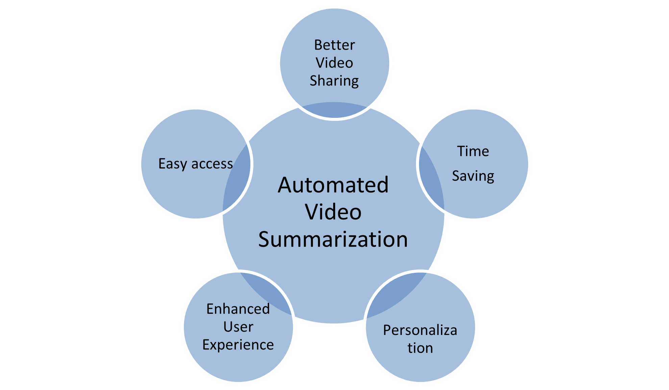
Need for Automated Video Summarization
Notes:
In this scenario, video summarization can be useful as it provides a concise overview of the video's content, enabling you to quickly understand the important aspects of the process. This way, you can save time and effort by only watching the relevant parts of the video, thereby enhancing your overall user experience.

Slide 4
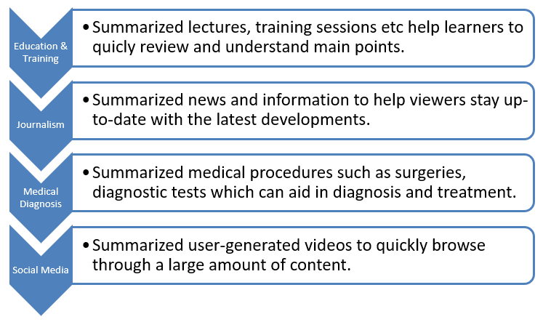
Applications
Notes:
Video summarization has various applications in different fields, some of them are:
Entertainment: Video summarization can be used to create highlights or recaps of sporting events, concerts, and other live performances. It can also be used to create trailers and teasers for movies and TV shows.
Surveillance and Security: In surveillance and security systems, video summarization can be used to quickly identify events of interest from a large amount of video footage, such as criminal activity or security breaches.
Education and Training: Video summarization can be used to create summaries of lectures, training sessions, and educational videos, which can help learners to quickly review and understand the main points.
Journalism: In news reporting, video summarization can be used to create summaries of news events, making it easier for viewers to stay up-to-date with the latest developments.
Medical Diagnosis: Video summarization can be used to create summaries of medical procedures, such as surgeries or diagnostic tests, which can aid in medical diagnosis and treatment.
Social Media: Video summarization can be used in social media platforms to generate summaries of user-generated videos, making it easier for users to quickly browse through a large amount of content.
These are just a few examples of the many applications of video summarization.

Slide 5
Limitations of Existing work
Lack of diversity
Subjectivity
Limited context
Scalability
Generalization
Notes:
Lack of diversity: Many existing methods tend to select only a few representative frames or shots, leading to a lack of diversity in the summary.
Subjectivity: Summarization is inherently subjective, and different users may have different preferences and requirements for the summary.
Limited context: Most existing methods focus only on visual content and may not take into account audio, textual, or contextual information.
Scalability: Some methods may not be scalable to large video datasets, requiring significant computational resources.
Generalization: Some methods may not generalize well to different video genres or styles, making them less versatile.

Slide 6
Proposed Approach
Focuses on both Video-to-Video and Video-to-text summarization.
Using K-means clustering and Long Short-Term Memory (LSTM) to generate summarized videos.
Evaluating the performance by testing on SumMe dataset
Exploring the generalizability by testing the proposed approach on multiple datasets with varying characteristics.

Slide 7
Methodology (Unsupervised)
Data Collection
Feature Extraction
Clustering
Summary Generation
Creating Keyshots using Keyframes
Keyframe Extraction

Slide 8
Data Collection : SumMe dataset (Size: 2.2 GB)
The SumMe dataset is a benchmark dataset for video summarization.
It consists of 25 videos of different lengths and topics, along with their human-created summaries.
The videos were recorded using a variety of devices, including smartphones, tablets, and cameras, and cover different scenarios such as sports, music, and tourism.
Yhttp://classif.ai/dataset/ethz-cvl-video-summe/
Notes:
The SumMe dataset is a benchmark dataset for video summarization.
It consists of 25 videos of different lengths and topics, along with their human-created summaries.
The videos were recorded using a variety of devices, including smartphones, tablets, and cameras, and cover different scenarios such as sports, music, and tourism.
Each video in the SumMe dataset is accompanied by a set of keyframes and shot boundaries, which can be used as ground truth for video summarization algorithms.
The dataset also includes annotations of interestingness scores for each shot, which can be used to evaluate the performance of summarization algorithms.
The SumMe dataset was created by researchers at the University of Trento and the University of Verona in Italy and was released in 2015.
It has since become a popular benchmark dataset for video summarization research, and has been used to evaluate a wide range of summarization algorithms, including both supervised and unsupervised approaches.
The SumMe dataset provides a valuable resource for developing and evaluating video summarization algorithms and has helped to advance the state-of-the-art in this field.

Slide 9
Feature Extraction
RGB values for every frame
Motion (both direction and magnitude)

Slide 10
Clustering: K-Means Clustering
Initialization
Assigning data points to clusters
Updating centroids
Repeating steps 2 and 3
Output
Randomly select k points from the dataset as the initial centroids.
For each data point, calculate the distance to each centroid and assign it to the cluster associated with the closest centroid.
Calculate the new centroid for each cluster as the mean of all the data points assigned to that cluster.
Repeat steps 2 and 3 until the centroids no longer change or a maximum number of iterations is reached.
The final k clusters and their respective centroids.
Notes:
K-means clustering is an unsupervised machine learning algorithm used for partitioning a dataset into k clusters based on similarity in the data points. This algorithm works by iteratively assigning each data point to the closest centroid and then updating the centroid based on the new members in the cluster until convergence. This algorithm is widely used for clustering and has many practical applications, such as image segmentation, customer segmentation, and anomaly detection. However, it has some limitations, such as its sensitivity to initialization and the need to specify the number of clusters k in advance.

Slide 11
Keyframe Extraction
The frames that are closest to the centroids obtained from K-means clustering are selected as keyframes. The number of keyframes selected can be based on video length or a fixed number.

Slide 12
Creating Keyshots using Keyframes
Keyframe-based shot selection: Keyframes are used as reference frames to select keyshots. A keyshot is typically defined as the shot that contains the keyframe. This is done by finding the shot boundaries that surround the keyframe and selecting the shot that contains the most representative visual content.
Keyshots with duplicate frames are removed.

Slide 13
Summarization
The Keyshots are then sorted in temporal order and combined into a gif format.
This can be done using the timestamps associated with the keyshots or by manually ordering them based on their content.

Slide 14
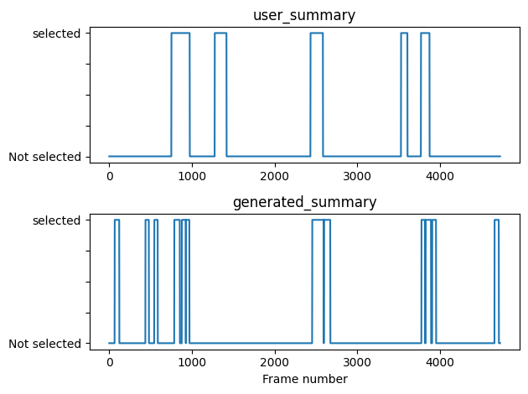
Evaluation

Slide 15
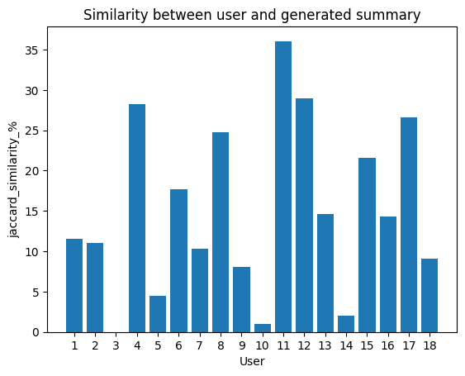
Evaluation

Slide 16
Supervised Learning
Algorithms are trained using labeled data.
No. of classes is known
Desired output is given
We can test our model unlike unsupervised learning
Highly accurate
Notes:
https://www.geeksforgeeks.org/supervised-unsupervised-learning/

Slide 17
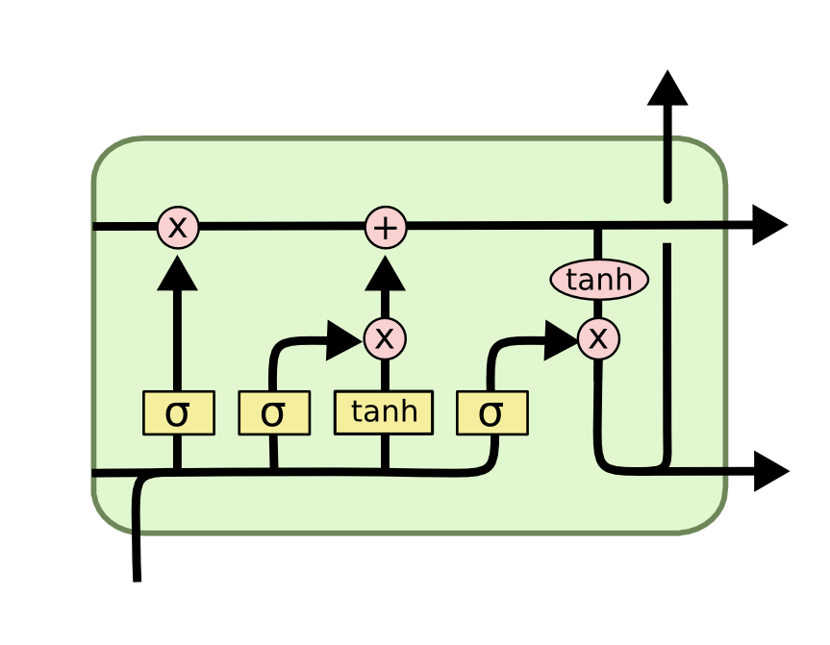
Long Short Term Memory

Slide 18
Model Summary
Model: "sequential"
Layer (type) | Output Shape | Param #
conv1d (Conv1D) | (None, 1, 64) | 384
max_pooling1d (MaxPooling1D) | (None, 1, 64) | 0
dropout (Dropout) | (None, 1, 64) | 0
lstm (LSTM) | (None, 1, 32) | 12416
dropout_1 (Dropout) | (None, 1, 32) | 0
lstm_1 (LSTM) | (None, 16) | 3136
dropout_2 (Dropout) | (None, 16) | 0
dense (Dense) | (None, 1) | 17
Total params | 15953
Trainable params | 15953
Non-trainable params | 0

Slide 19
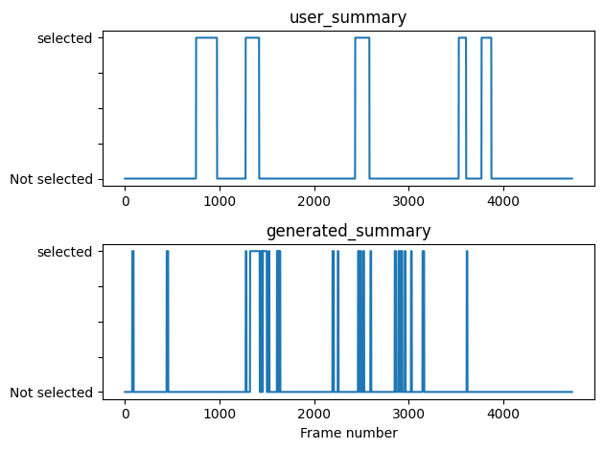
Evaluation

Slide 20
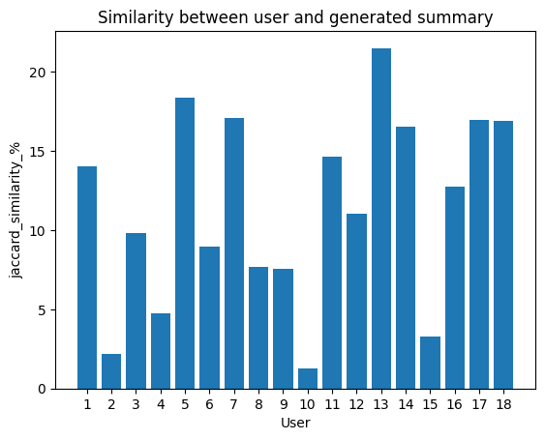
Evaluation

Slide 21
Metrics
Weighted metrics
Precision | 0.79
Recall | 0.85
f1-score | 0.80

Slide 22
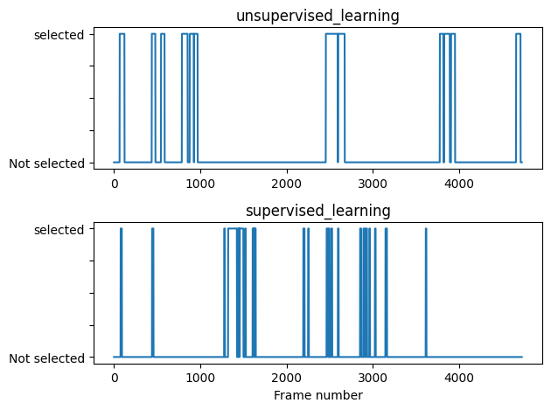
Comparison

Slide 23
Future work
Enhancing the performance by training the models on other diverse datasets.
Video-to-text summarization.
Taking feedback from the user about summarized video to improve the model further.

