Slide 1
ANDROID – PART 7
BROADCAST RECEIVER, NOTIFICATION, SERVICES, ASYNC TASKS

Slide 2
BROADCAST RECEIVER
Broadcast in android is the system-wide events that can occur when the device starts, when a message is received on the device or when incoming calls are received, or when a device goes to airplane mode, etc. Broadcast Receivers are used to respond to these system-wide events. Broadcast Receivers allow us to register for the system and application events, and when that event happens, then the register receivers get notified. There are mainly two types of Broadcast Receivers:
Static Broadcast Receivers: These types of Receivers are declared in the manifest file and works even if the app is closed.
Dynamic Broadcast Receivers: These types of receivers work only if the app is active or minimized.

Slide 3
android.intent.action.BATTERY_LOW : | Indicates low battery condition on the device.
android.intent.action.BOOT_COMPLETED | This is broadcast once after the system has finished booting
android.intent.action.CALL | To perform a call to someone specified by the data
android.intent.action.DATE_CHANGED | Indicates that the date has changed
android.intent.action.REBOOT | Indicates that the device has been a reboot
android.net.conn.CONNECTIVITY_CHANGE | The mobile network or wifi connection is changed(or reset)
android.intent.ACTION_AIRPLANE_MODE_CHANGED | This indicates that airplane mode has been switched on or off.

Slide 4
NOTIFICATION
Notification is a kind of message, alert, or status of an application (probably running in the background) that is visible or available in the Android’s UI elements. This application could be running in the background but not in use by the user. The purpose of a notification is to notify the user about a process that was initiated in the application either by the user or the system. This article could help someone who’s trying hard to create a notification for developmental purposes.
Notifications could be of various formats and designs depending upon the developer. In General, one must have witnessed these four types of notifications:

Slide 5
Status Bar Notification (appears in the same layout as the current time, battery percentage)
Notification drawer Notification (appears in the drop-down menu)
Heads-Up Notification (appears on the overlay screen, ex: Whatsapp notification, OTP messages)
Lock-Screen Notification (I guess you know it)

Slide 6
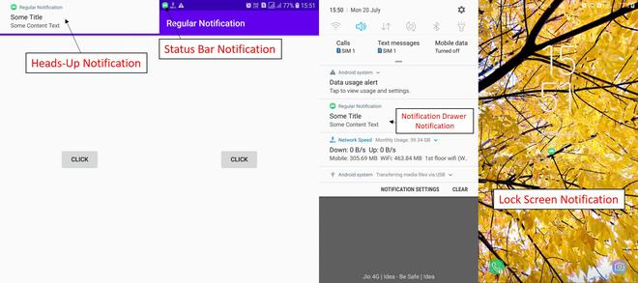

Slide 7
SERVICES
A Service is an application component that can perform long-running operations in the background, and it doesn't provide a user interface. It can run in the background, even when the user is not interacting with your application. These are the three different types of services:
Foreground Service: A foreground service performs some operation that is noticeable to the user. For example, we can use a foreground service to play an audio track. A Notification must be displayed to the user.
Background Service: A background service performs an operation that isn’t directly noticed by the user. In Android API level 26 and above, there are restrictions to using background services and it is recommended to use WorkManager in these cases.
Bound Service: A service is bound when an application component binds to it by calling bindService(). A bound service offers a client-server interface that allows components to interact with the service, send requests, receive results. A bound service runs only as long as another application component is bound to it.

Slide 8
ASYNC TASK
Android AsyncTask is an abstract class provided by Android which gives us the liberty to perform heavy tasks in the background and keep the UI thread light thus making the application more responsive. Android application runs on a single thread when launched. Due to this single thread model tasks that take longer time to fetch the response can make the application non-responsive. To avoid this we use android AsyncTask to perform the heavy tasks in background on a dedicated thread and passing the results back to the UI thread. Hence use of AsyncTask in android application keeps the UI thread responsive at all times.

Slide 9
METHODS – ASYNC TASK
doInBackground() : This method contains the code which needs to be executed in background. In this method we can send results multiple times to the UI thread by publishProgress() method. To notify that the background processing has been completed we just need to use the return statements
onPreExecute() : This method contains the code which is executed before the background processing starts
onPostExecute() : This method is called after doInBackground method completes processing. Result from doInBackground is passed to this method
onProgressUpdate() : This method receives progress updates from doInBackground method, which is published via publishProgress method, and this method can use this progress update to update the UI thread
The three generic types used in an android AsyncTask class are given below :
Params : The type of the parameters sent to the task upon execution
Progress : The type of the progress units published during the background computation
Result : The type of the result of the background computation

