Slide 1
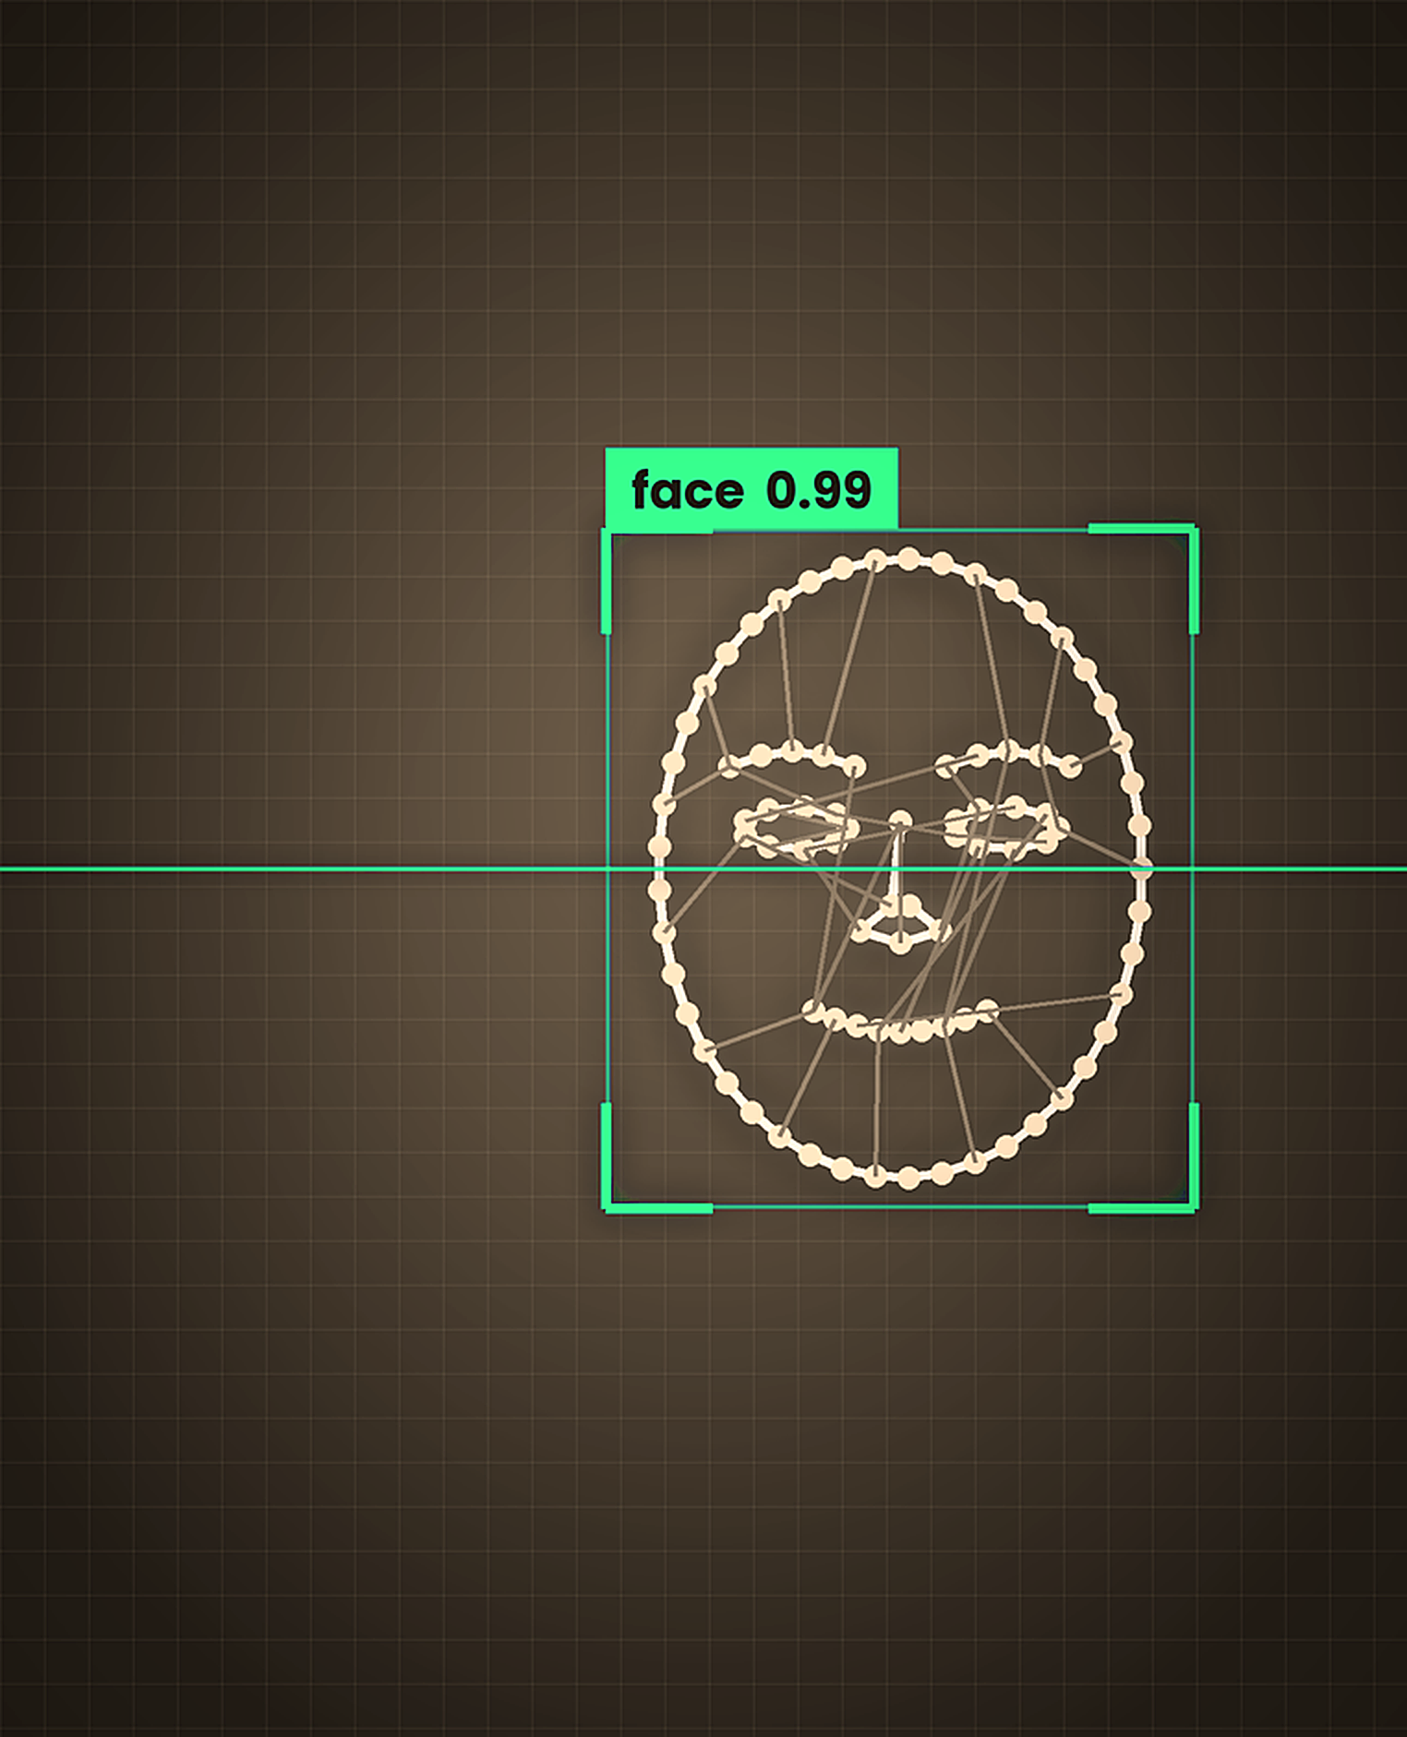
REAL-TIME FACE DETECTION
OPENCV
A PYTHON PROJECT DEMONSTRATION
Swathi Priya Kondeti

Slide 2
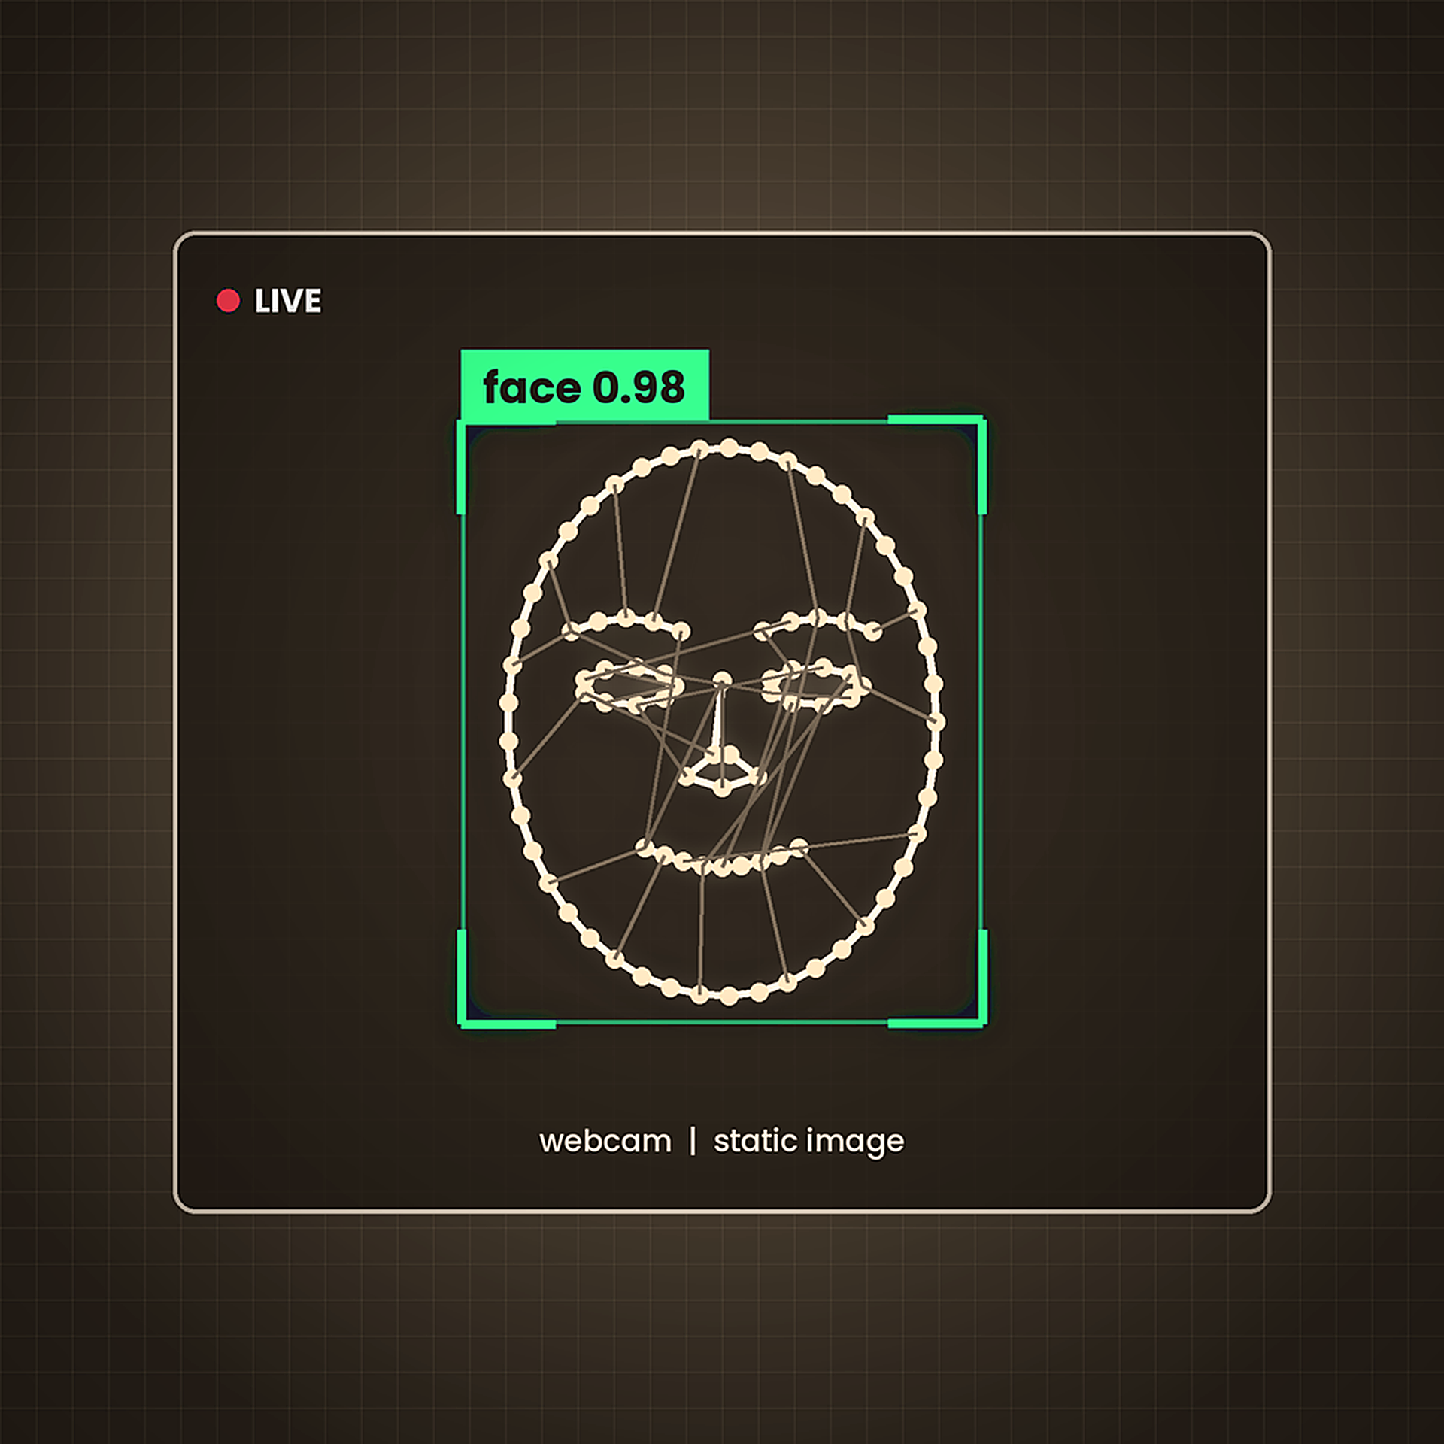
Overview
Project
This project implements a real-time face detection system in Python using OpenCV. It detects human faces from a live webcam feed and from static images.
It demonstrates core Computer Vision and image-processing fundamentals.

Slide 3
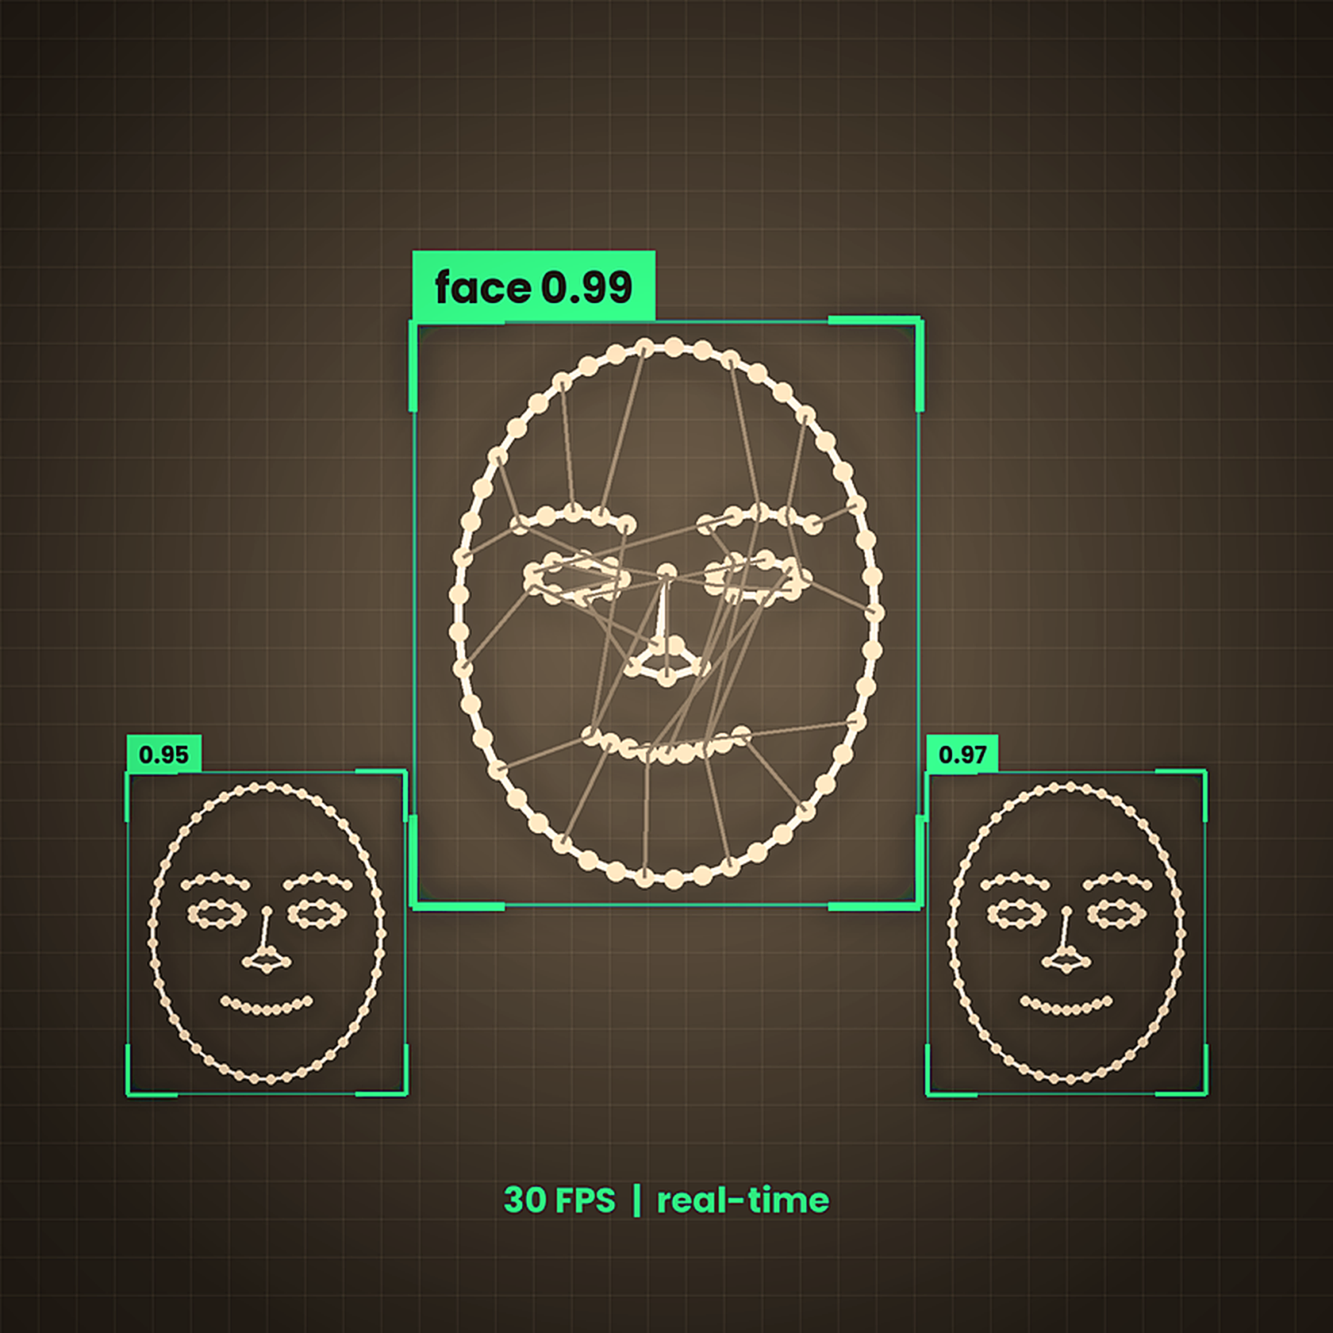
Key Features
of the System
Real-Time Detection
Detects faces instantly from a live webcam feed or static images, with immediate visual feedback.
Haar Cascade Classifier
Uses OpenCV's pre-trained Haar Cascade for fast, efficient and accurate face detection.
Beginner-Friendly
Clean, simple Python code that is ideal for learning computer vision fundamentals.

Slide 4
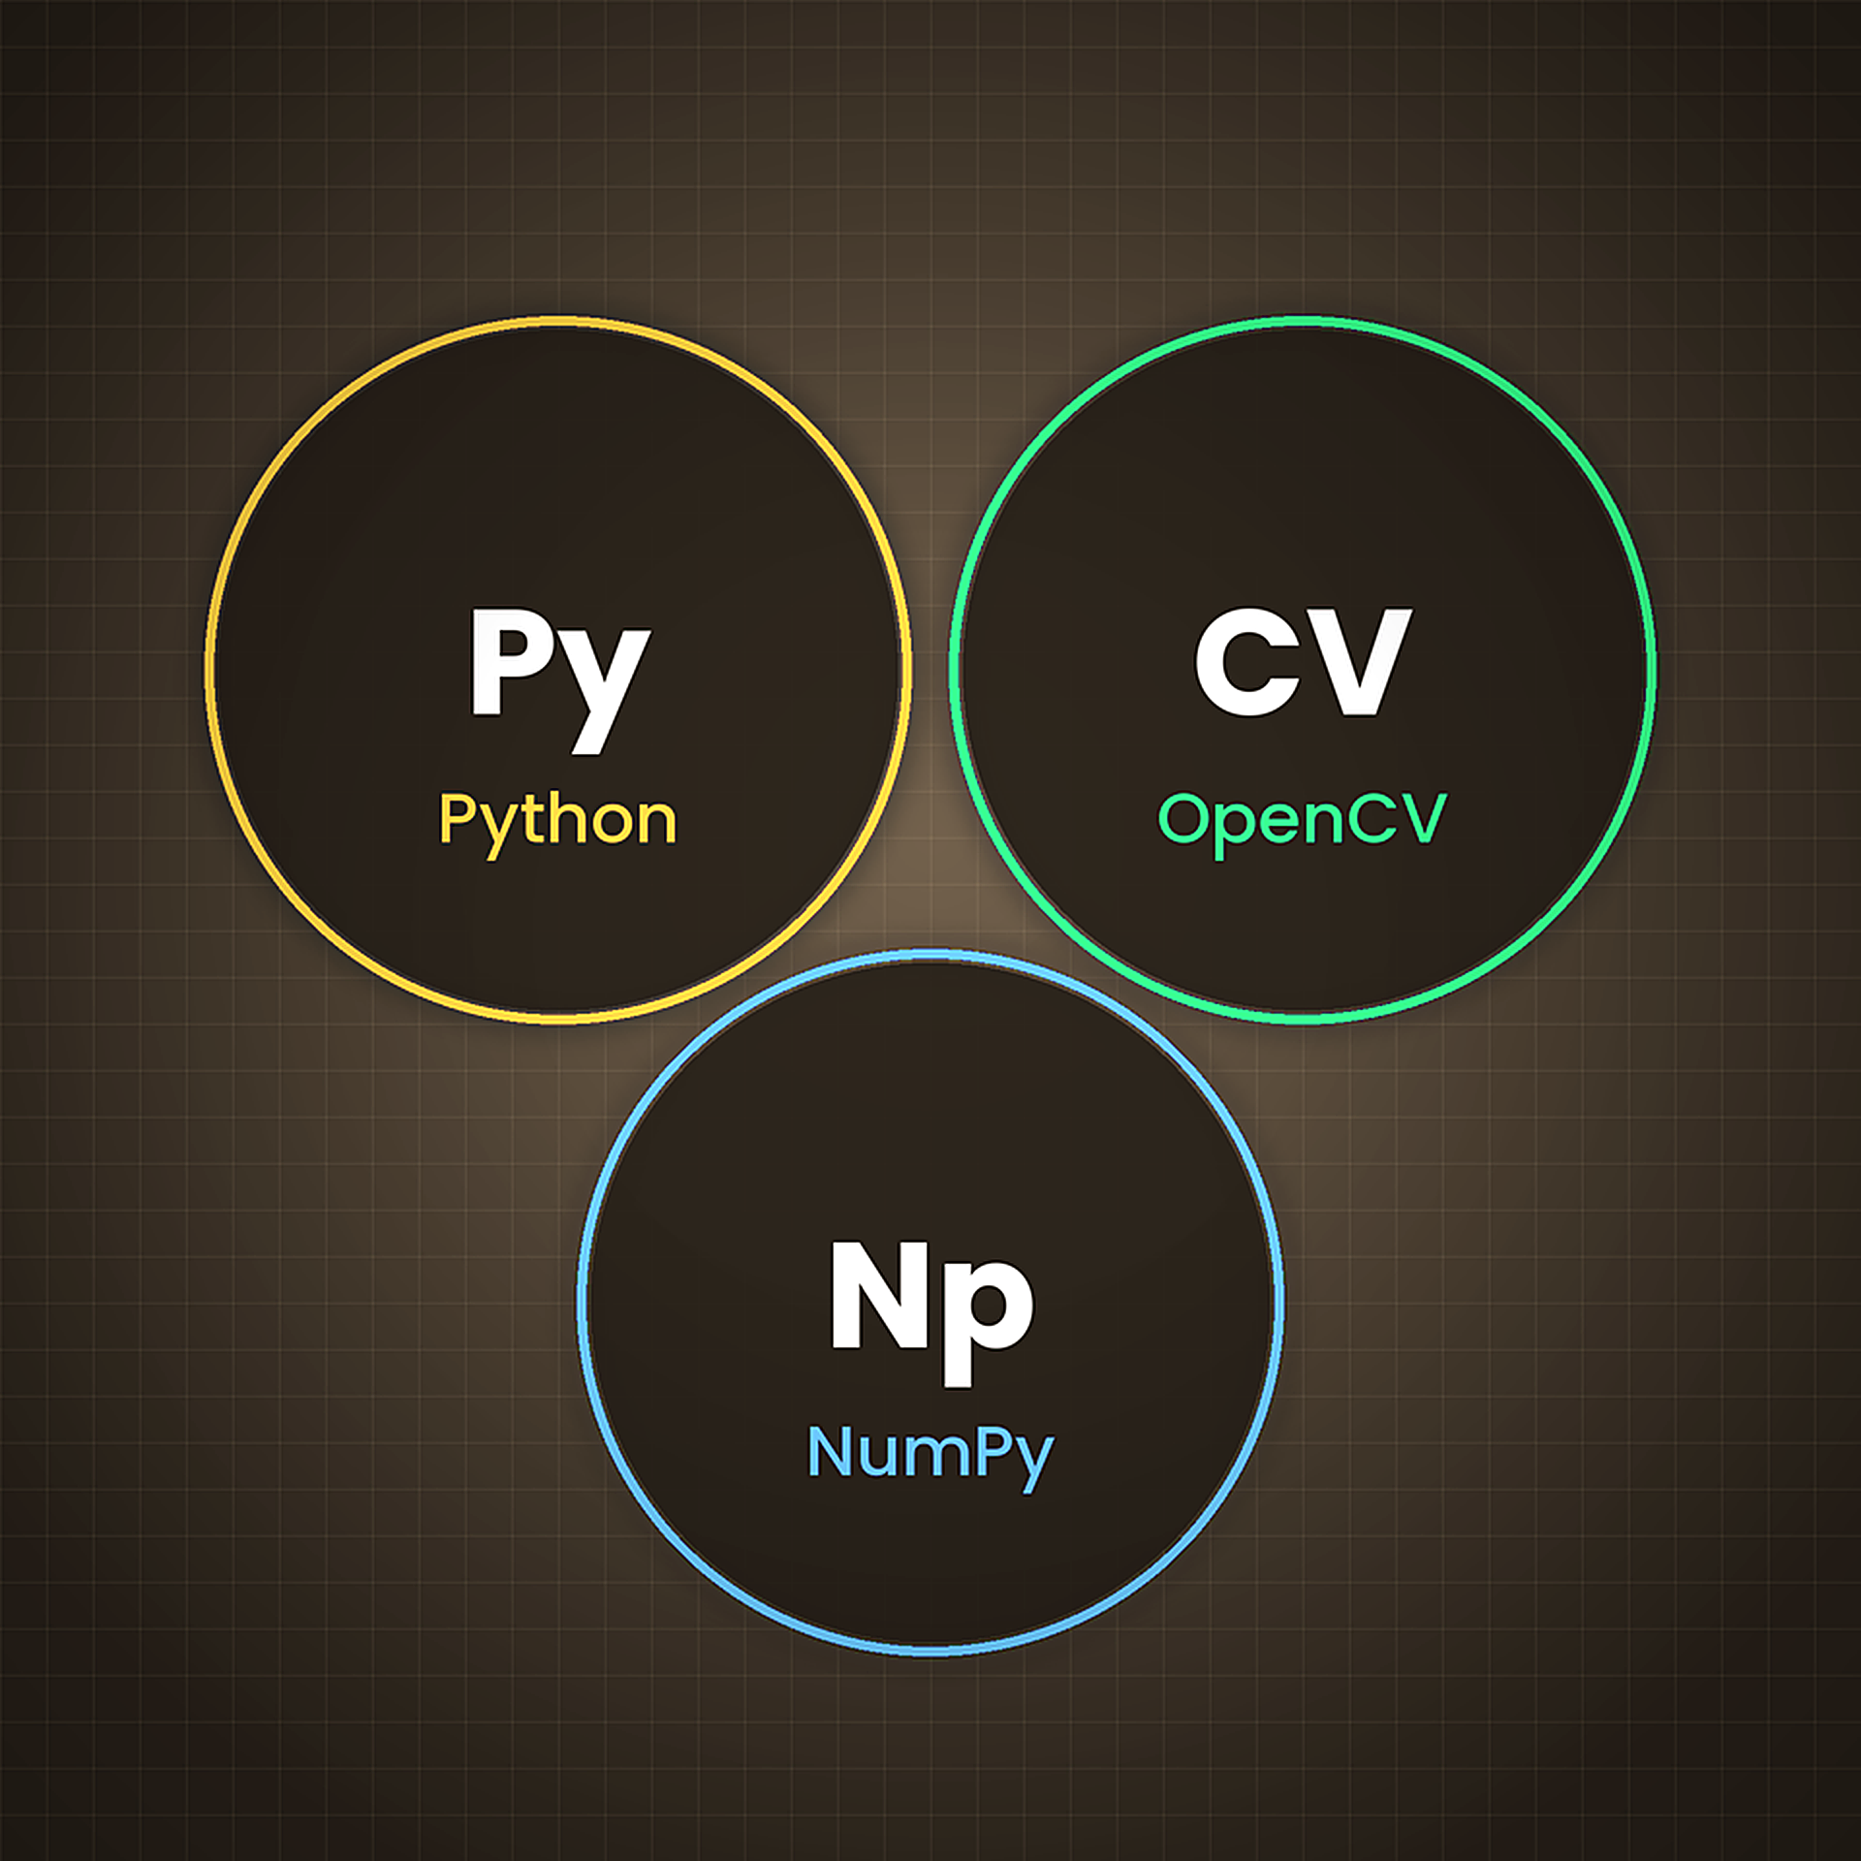
Technologies
Used
Python & OpenCV
Python serves as the core programming language, while OpenCV provides powerful computer vision capabilities for image processing and face detection.
NumPy
NumPy provides essential numerical computing support, enabling efficient array operations and mathematical computations for image data.

Slide 5
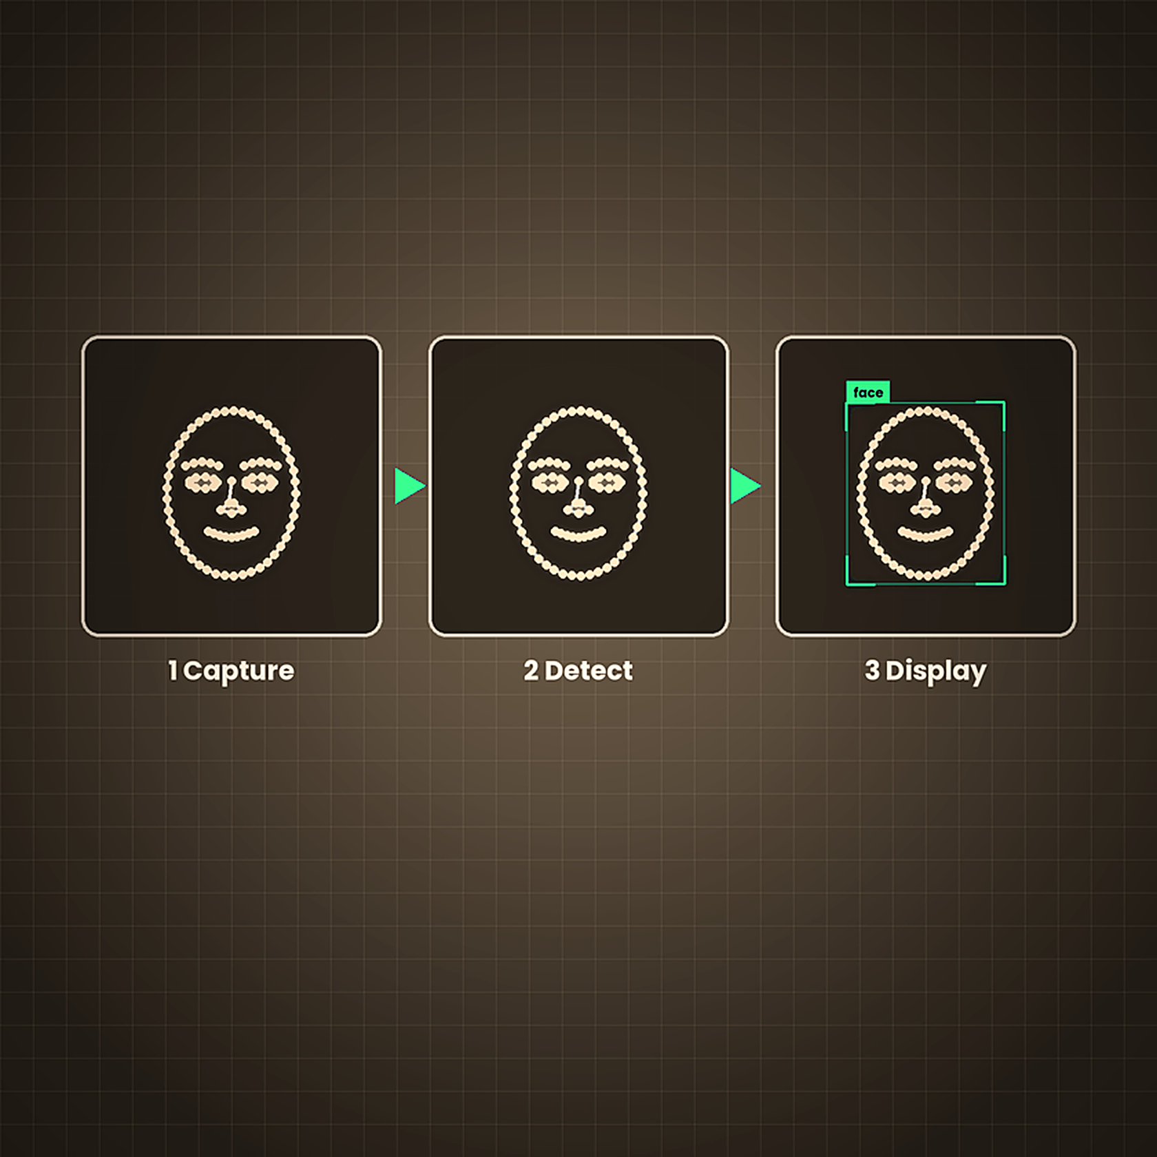
How It Works
Process Flow
Phase 1: Input Capture & Preprocessing
Capture input from webcam or load a static image, then convert it to grayscale for efficient processing.
Phase 2: Face Detection
Apply the Haar Cascade classifier algorithm to scan the grayscale image and detect facial regions.
Phase 3: Output & Display
Draw bounding rectangles around each detected face and display the processed output in real-time.

Slide 6
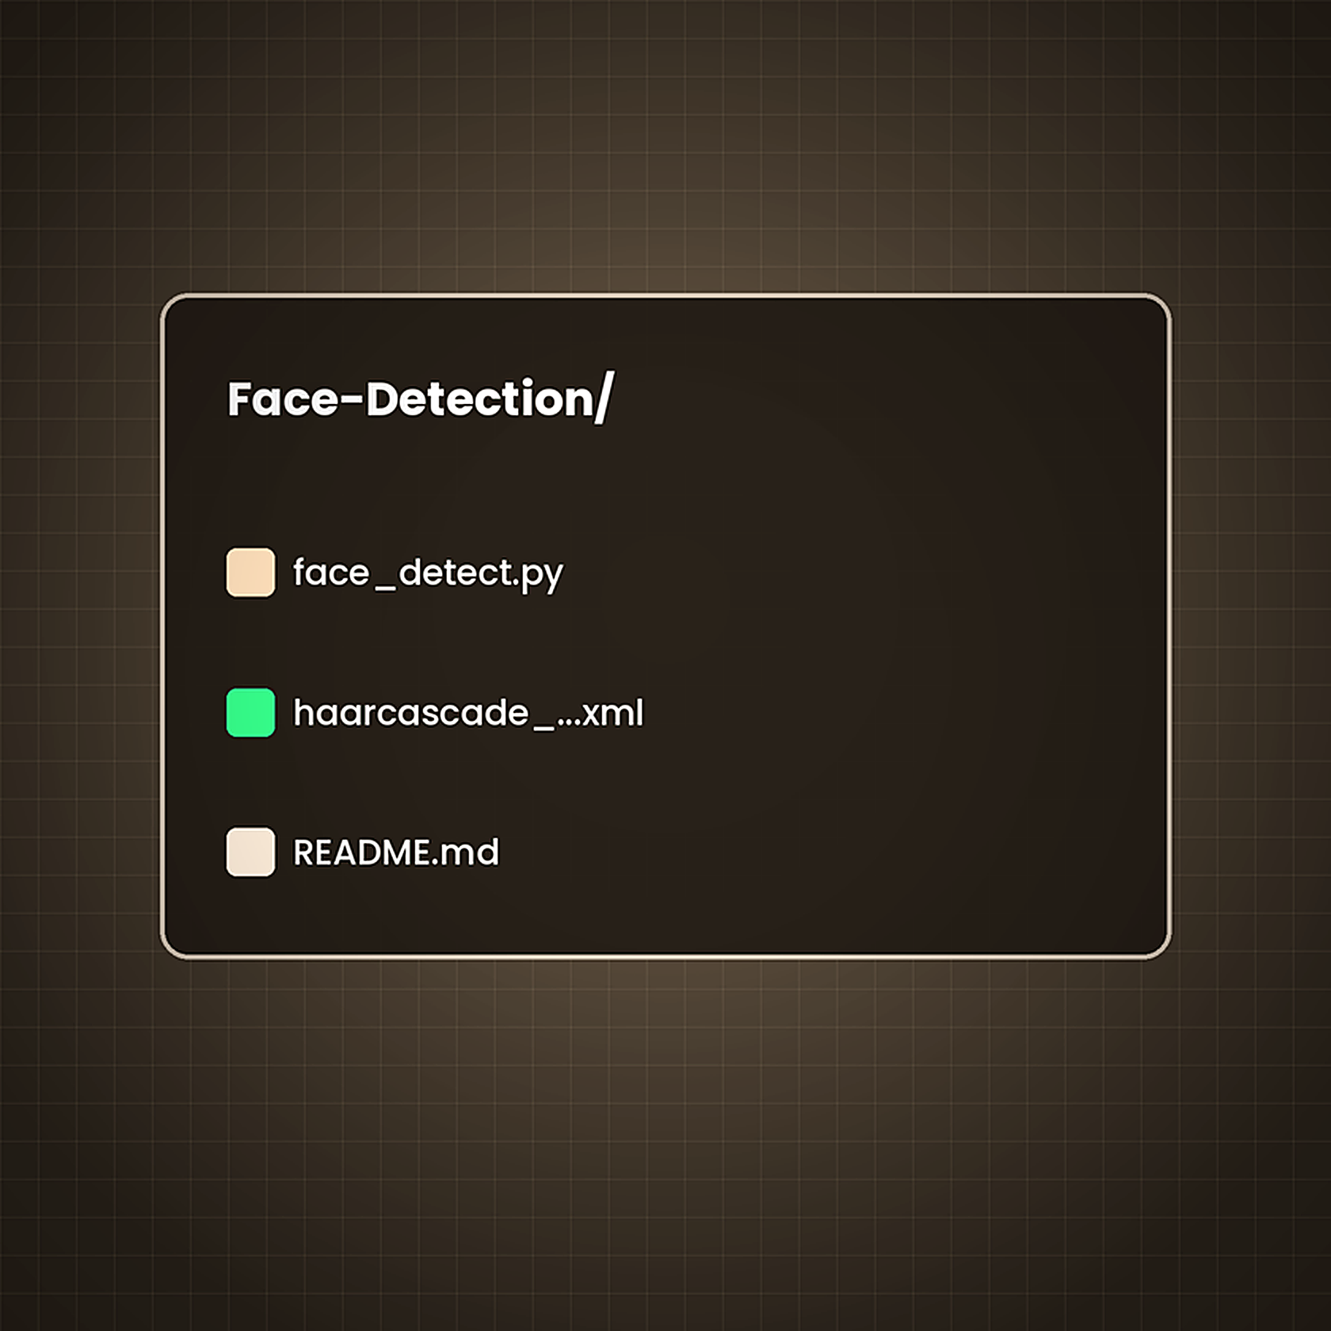
Project Structure
and Key Files
Folder Organization
Face-Detection/
├── haarcascade_frontalface_default.xml
├── face_detect.py
└── README.md
File Descriptions
haarcascade_frontalface_default.xml: pre-trained face classifier
face_detect.py: main Python script
README.md: project documentation

Slide 7
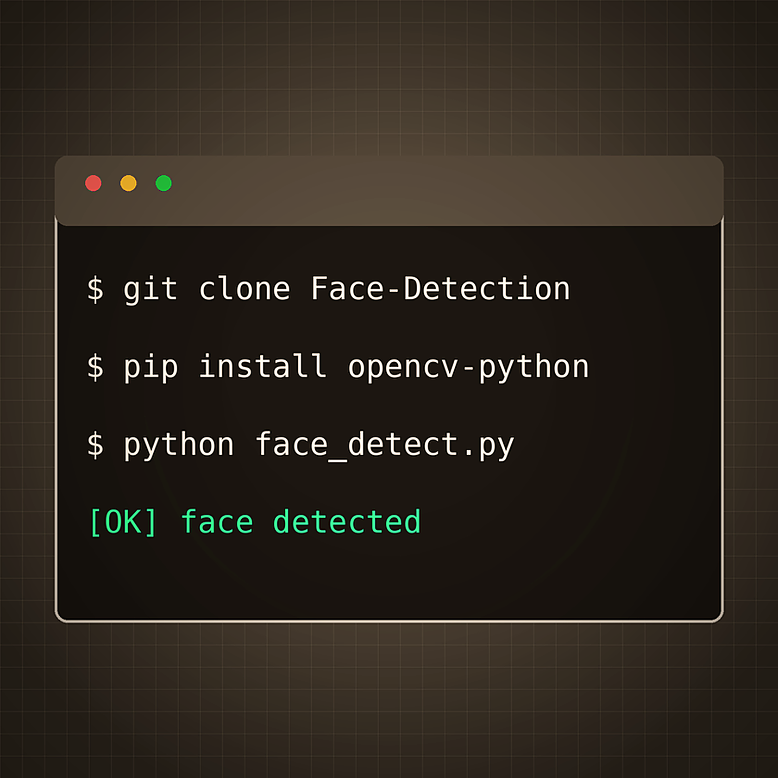
Installation & Setup
Guide
Step 1: Clone Repository
git clone https://github.com/SW/Face-Detection.git
Step 2: Install Dependencies
pip install opencv-python numpy
Step 3: Run the Project
cd Face-Detection
python face_detect.py

Slide 8
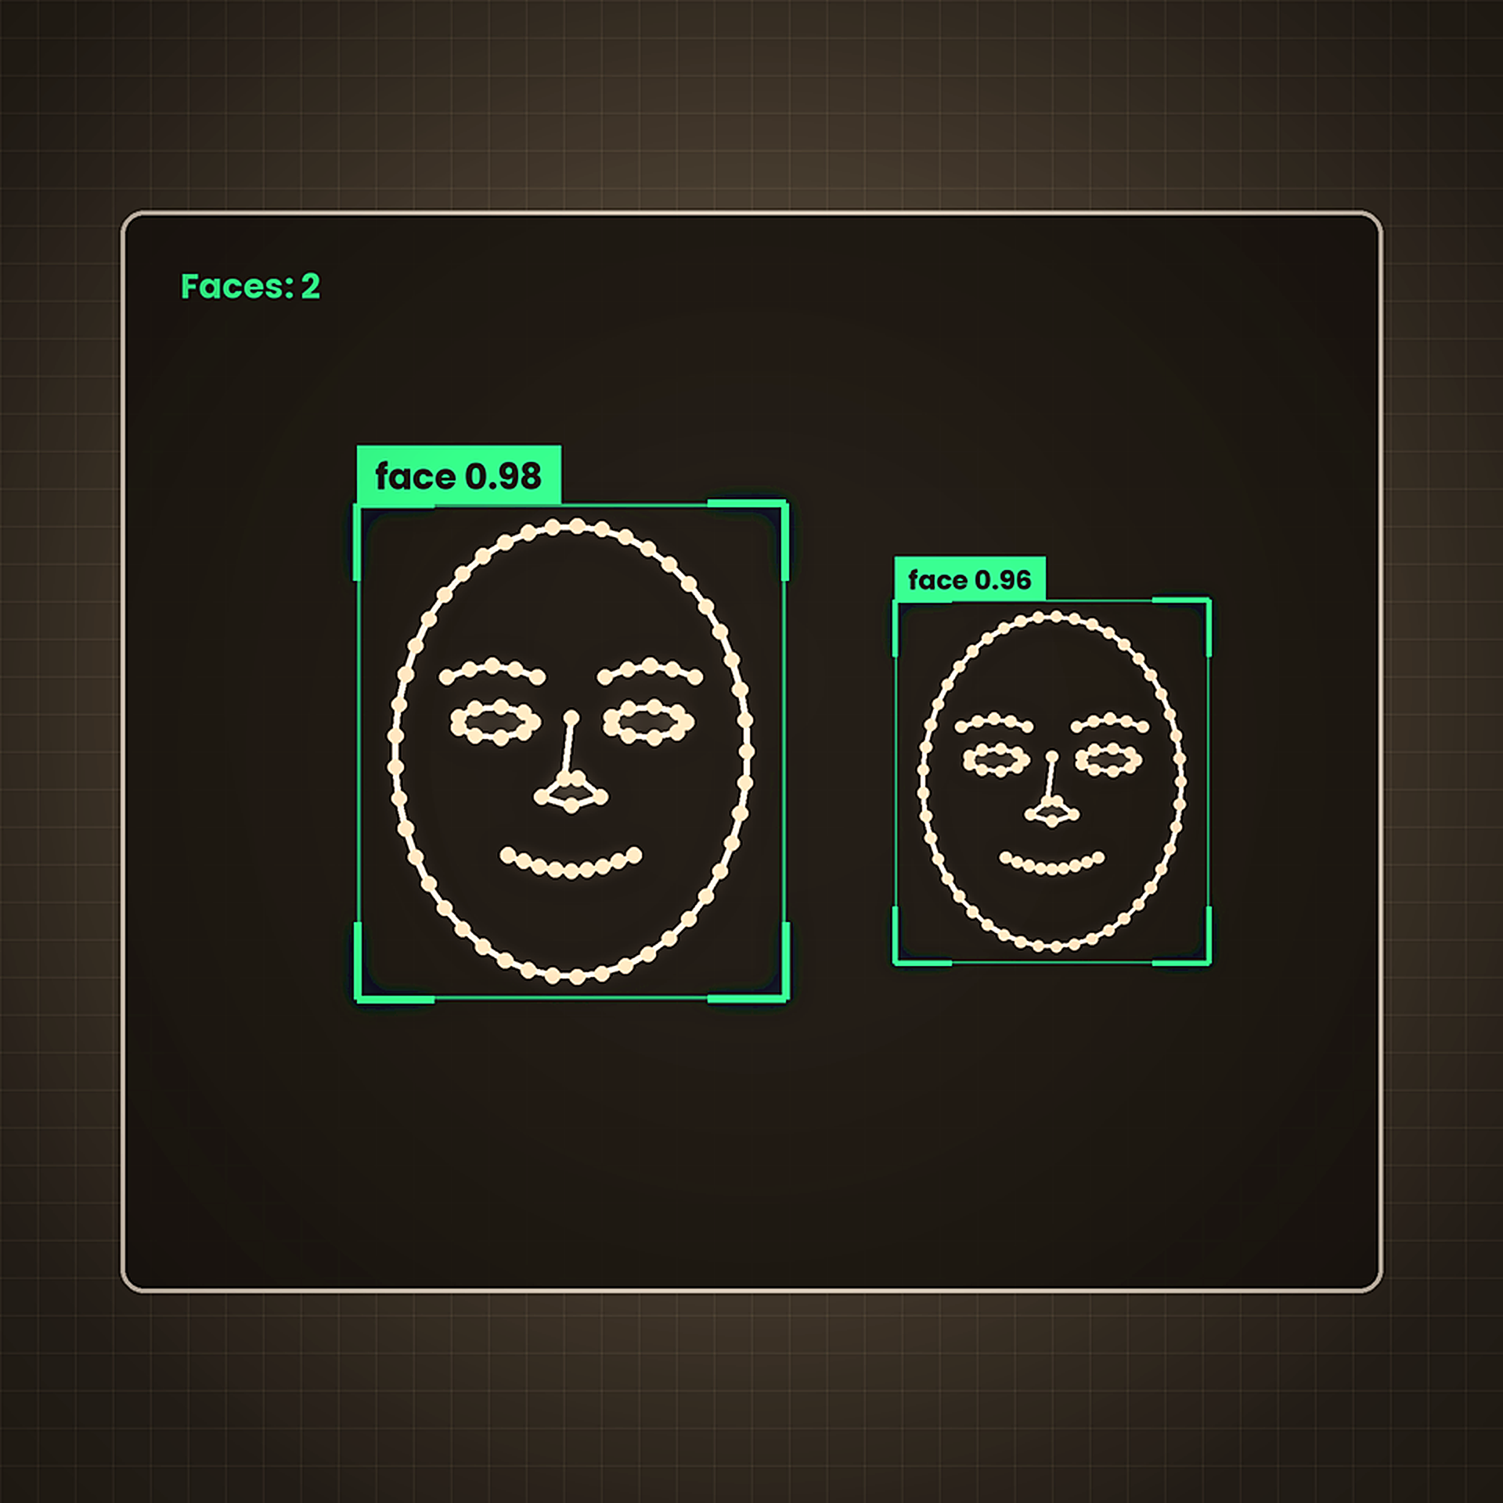
Output
Demonstration
Detects faces in real time and draws a rectangle around each one.
Green bounding boxes mark every face region with high accuracy and minimal latency.

Slide 9
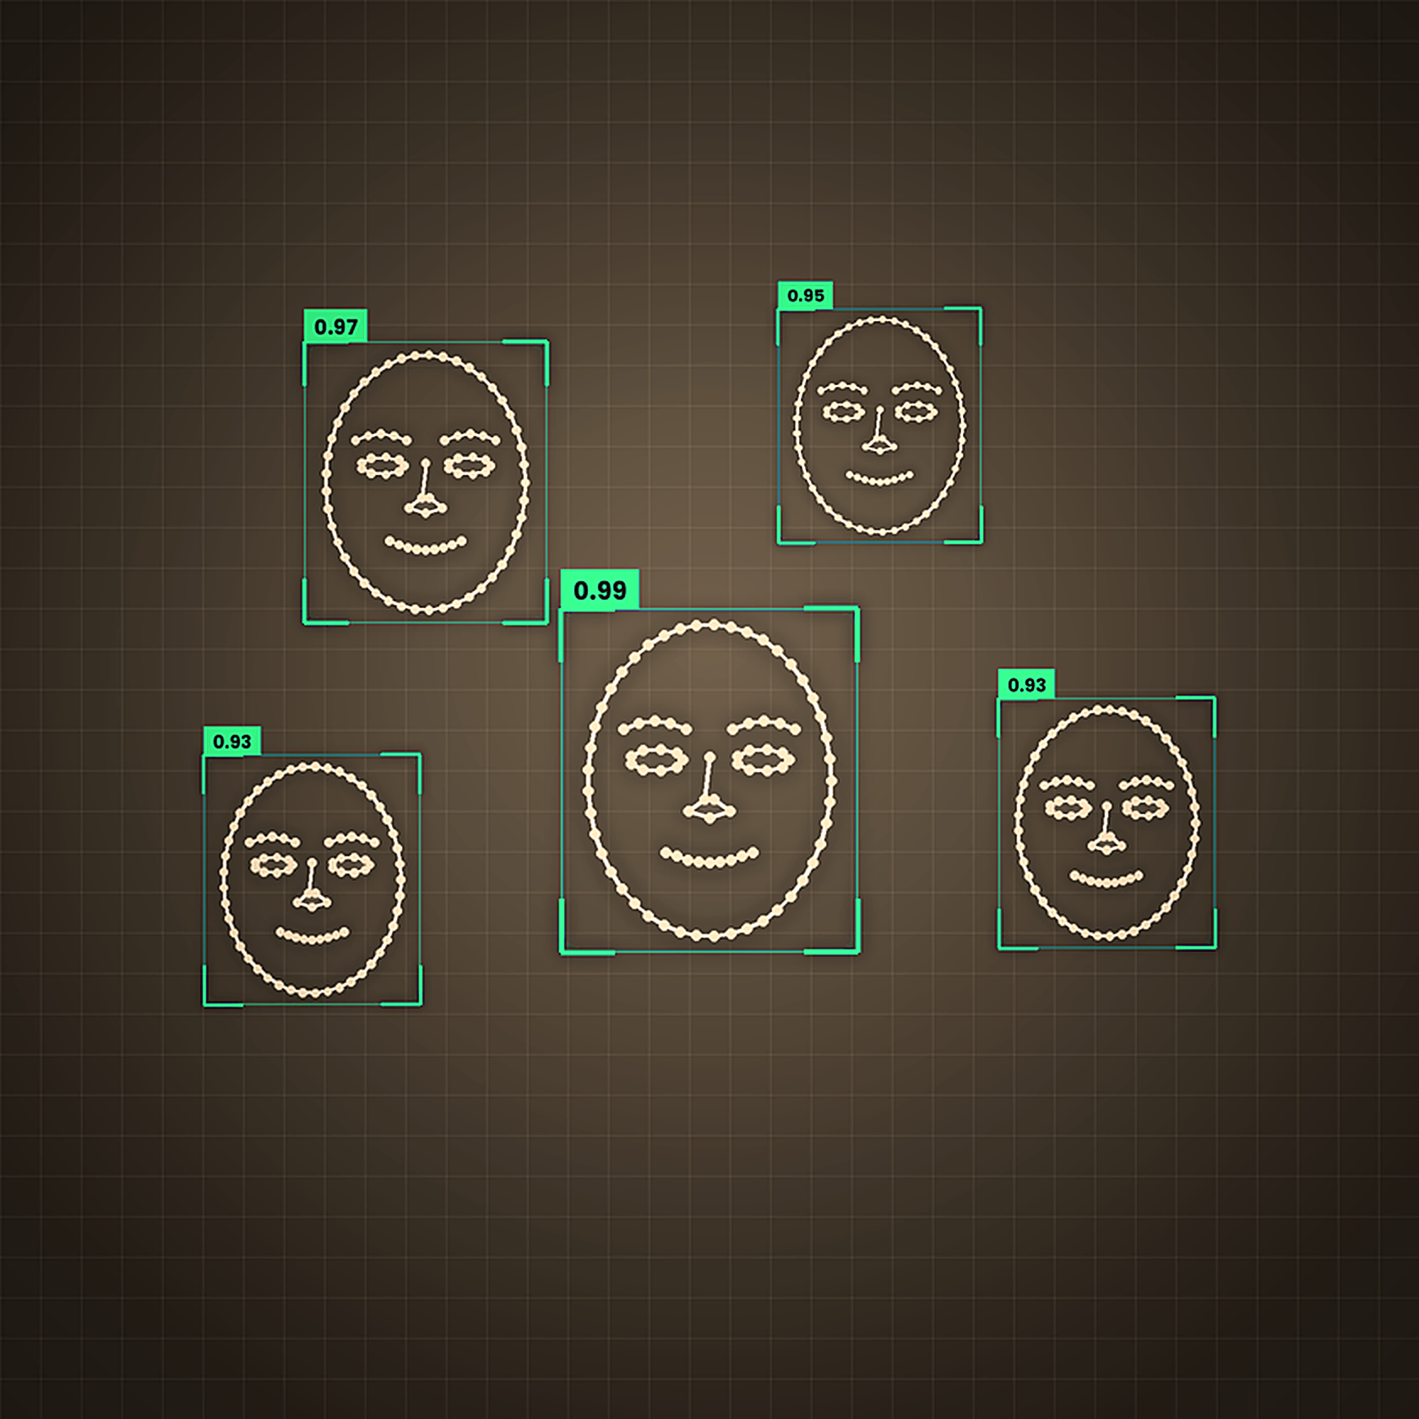
Applications
Real-World Uses
Security & Surveillance
Monitor public spaces, detect intruders, and enhance security systems with automated face detection.
Attendance & Face Unlock
Automate attendance tracking in schools and offices, and enable secure device authentication.
Video Monitoring
Real-time analysis of video feeds for crowd management, traffic monitoring, and smart city applications.

Slide 10
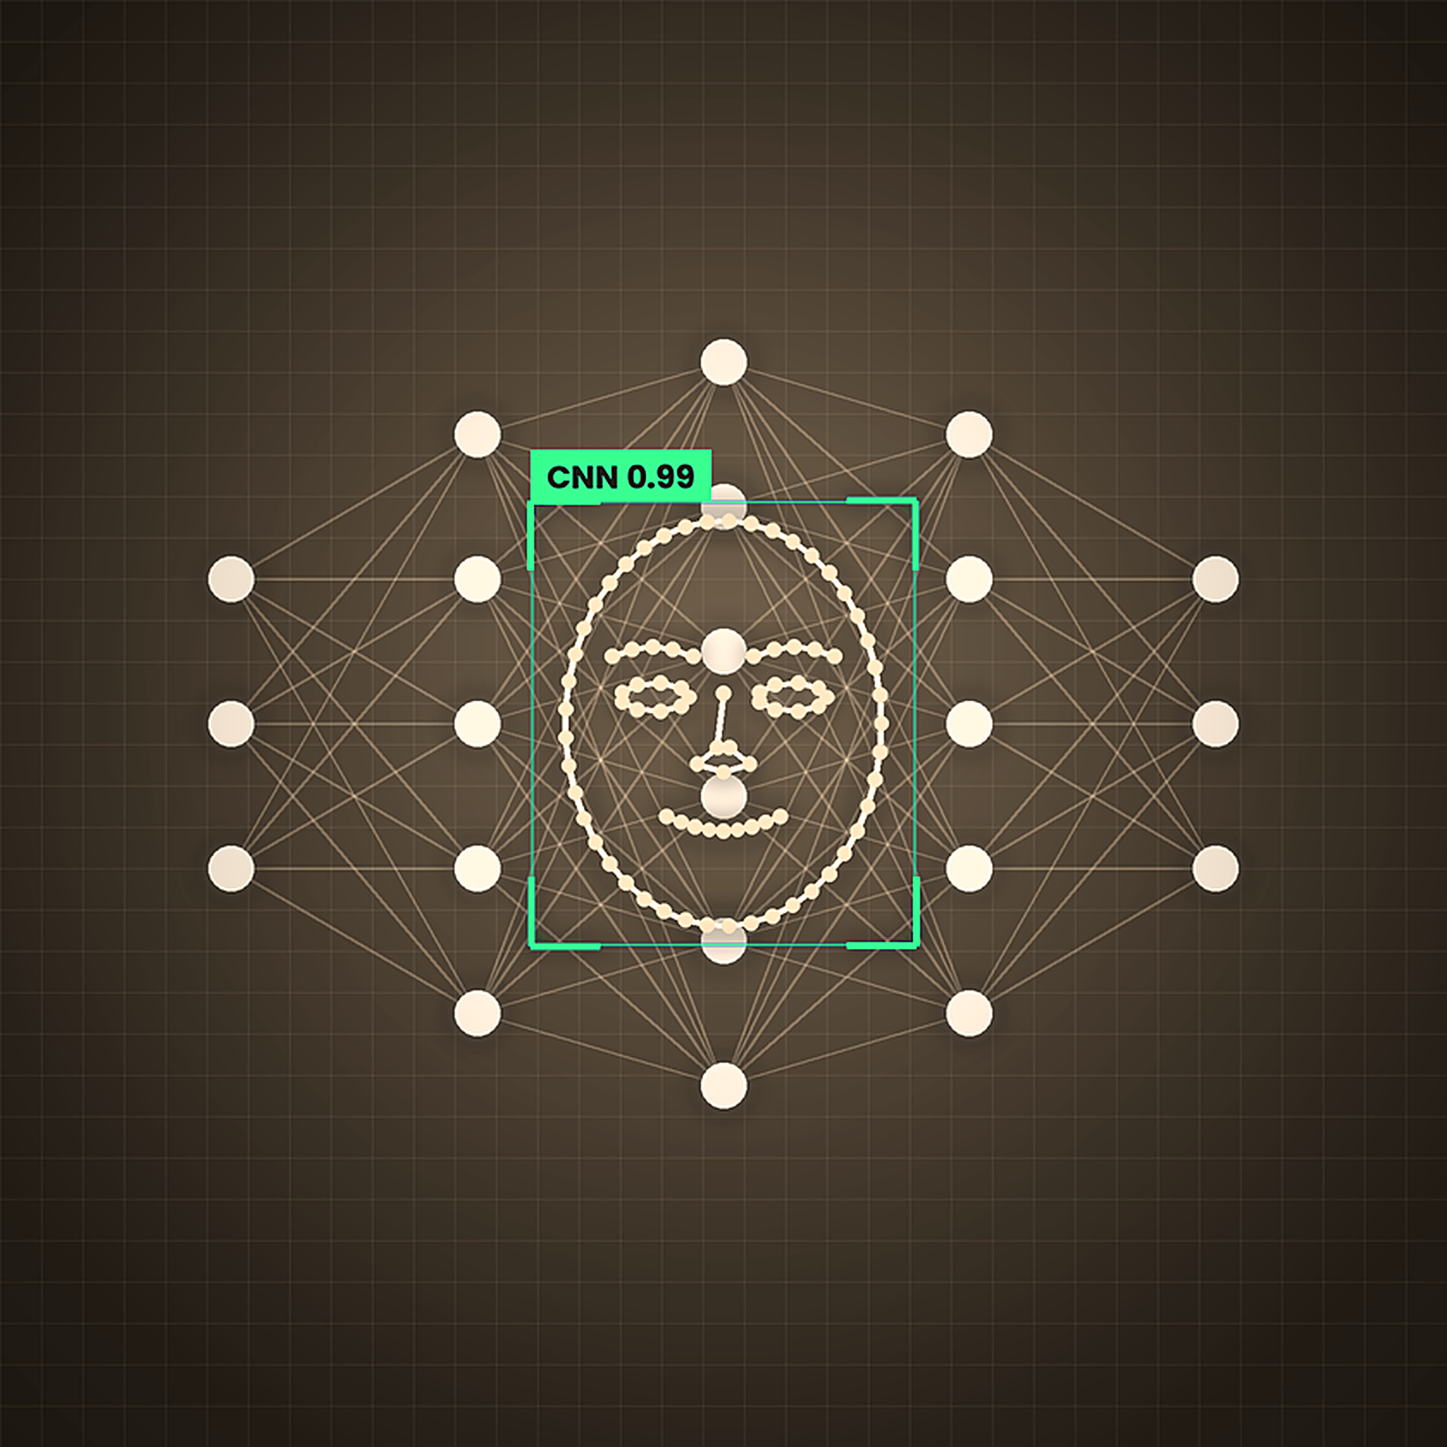
Future Enhancements
and Improvements
Face Recognition Integration
Add face recognition to identify individuals and store detected faces in a database for retrieval.
Deep Learning Models
Improve detection accuracy by implementing advanced deep learning models like CNNs.
GUI-Based Interface
Develop a user-friendly graphical interface for easier interaction and configuration options.

Slide 11
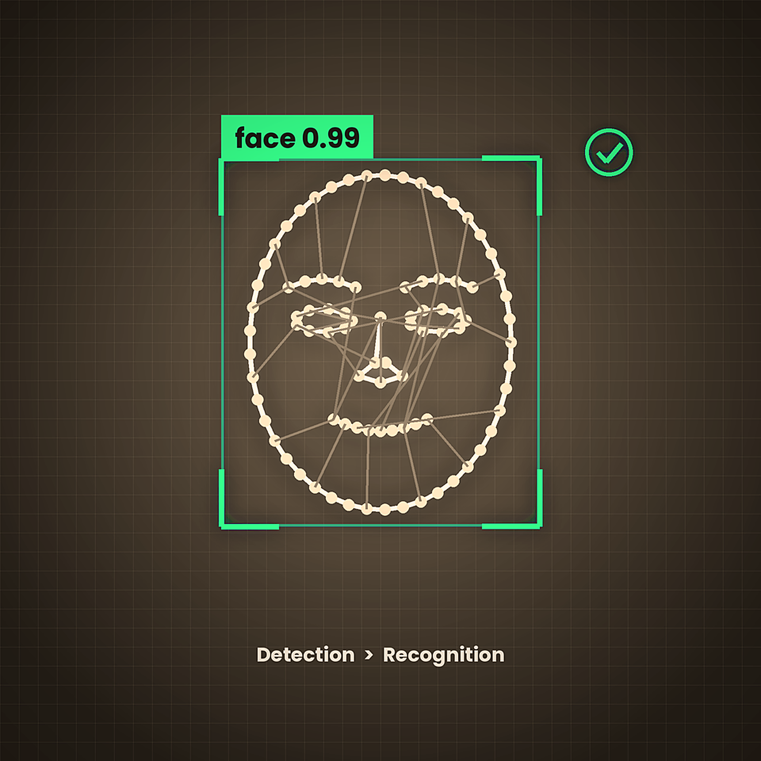
Conclusion
& Thank You
This project efficiently implements real-time face detection using OpenCV, laying a foundation for advanced AI systems like face recognition and biometric authentication.
Thank you! Questions welcome.

