Slide 1

STUDENT DETAILS
REBBAVARAPU.SWATHI
20761A05H7
LAKIREDDY BALIREDDY COLLEGE OF ENGINNEING

Slide 2

PROJECT TITLE
CREATING
A
PORTFOLIO

Slide 3

AGENDA
you need a portfolio website to showcase your work. Whether you’re an individual, a small team of two or a company of ten people, it’s crucial that you have a unique online approach. A website portfolio will help you stand out from the crowd, show your uniqueness, build trust, and make sure that others can actually find you.
This Photo by Unknown Author is licensed under CC BY-SA-NC

Slide 4

PROJECT OVERVIEW
If you are a web developer or a web designer, it is essential for you to have a portfolio website. It lets you provide information about yourself and showcase your best work with your relevant skills and experience.

Slide 5

WHO ARE THE END USERS OF THIS PROJECT?
A portfolio website is the ultimate way to showcase your work and let others reach out for you. It is your bread and butter if you are a freelancer in whatever sphere.
A portfolio website presents your professionalism and dedication to the craft better and more clearly than any CV. You don’t just tell, you show actual cases and examples which speak volumes. Moreover, owing to the portfolio website, you can show your mature and sophisticated approach to selling your work along with yourself

Slide 6

SOLUTION
Creating a portfolio website is the best way to show off your work and attract new clients. A well-designed website will provide potential clients with a clear overview of your skills and experience, as well as examples of your past work. This is an essential tool for any freelancer or small business, as it allows clients to see exactly what you can offer them before making a decision.
A portfolio website can also be used to prove your skills to potential employers. If you’re looking for a new job, a well-presented online portfolio can show your potential boss that you have the skills and experience for the role.

Slide 7
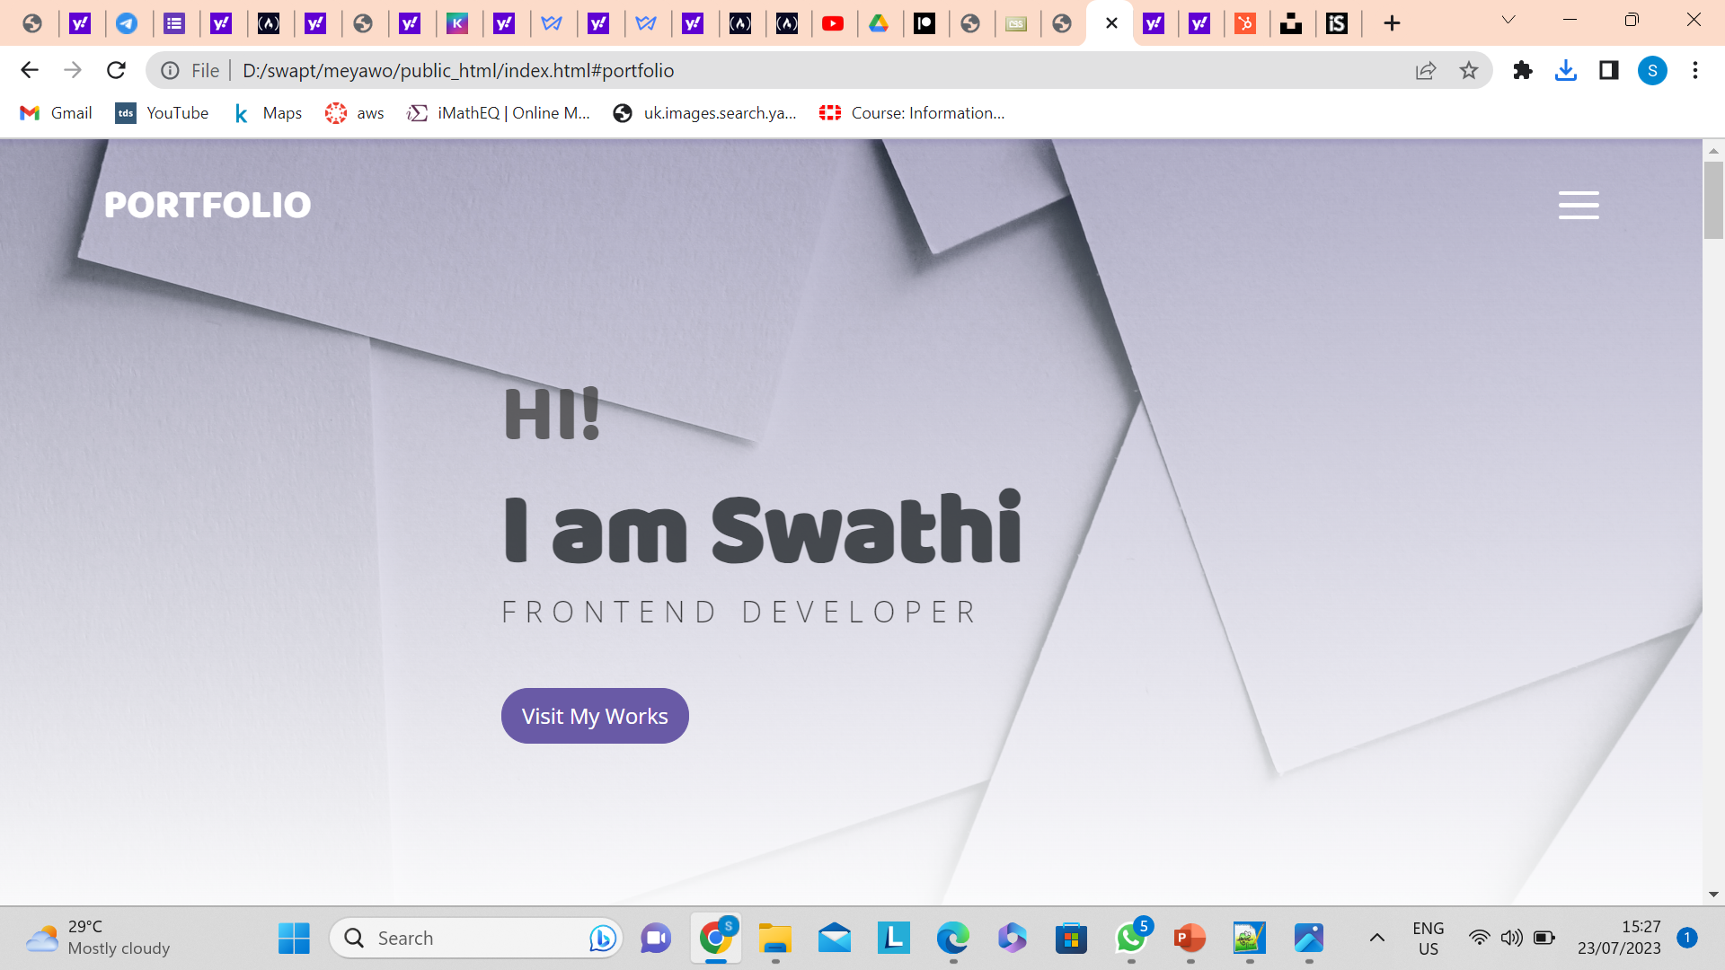
PROJECT CUSTOMIZATION
The folder structure consists of index.html, style.css, and script.js files and an images folder. We'll write all CSS in the style.css file and the JavaScript in the script.js file .
In the index.html file, you can see the HTML boilerplate code with the Bootstrap CDN, and a link to the external style sheet and JavaScript.
Here, the script.js file is loaded after loading all the HTML code.

Slide 8
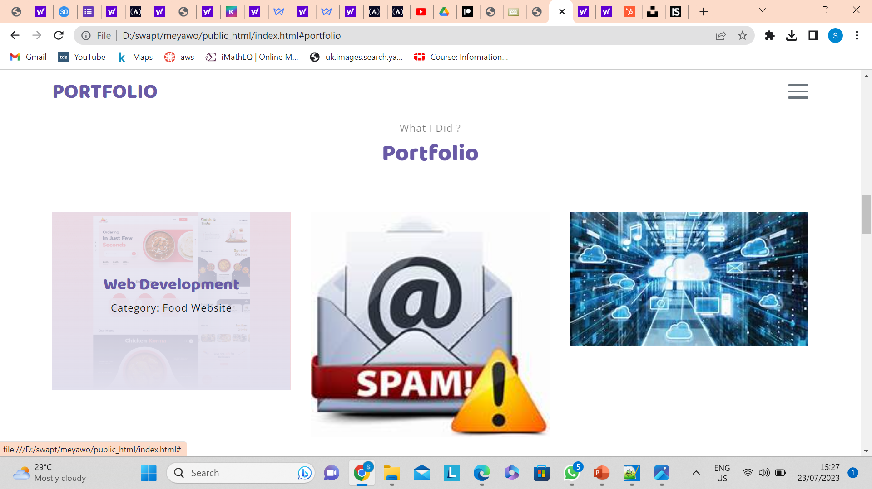
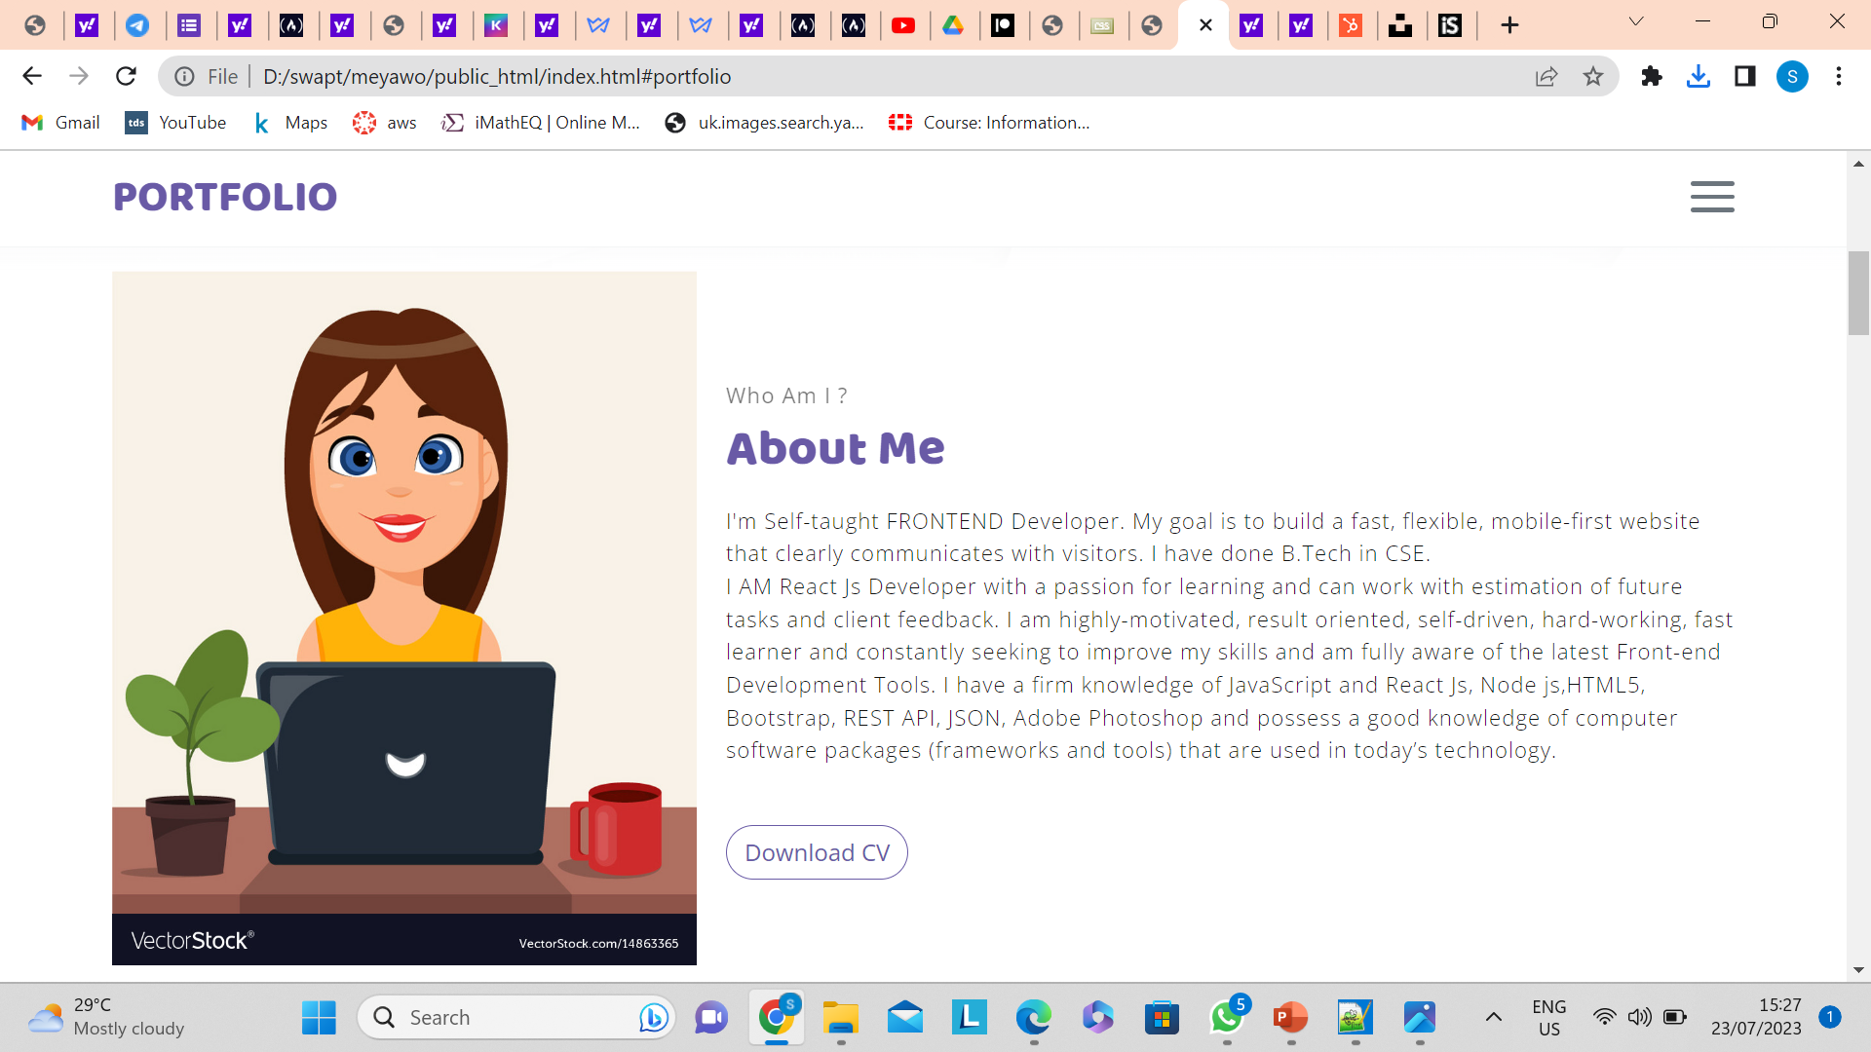
MODELLING

Slide 9
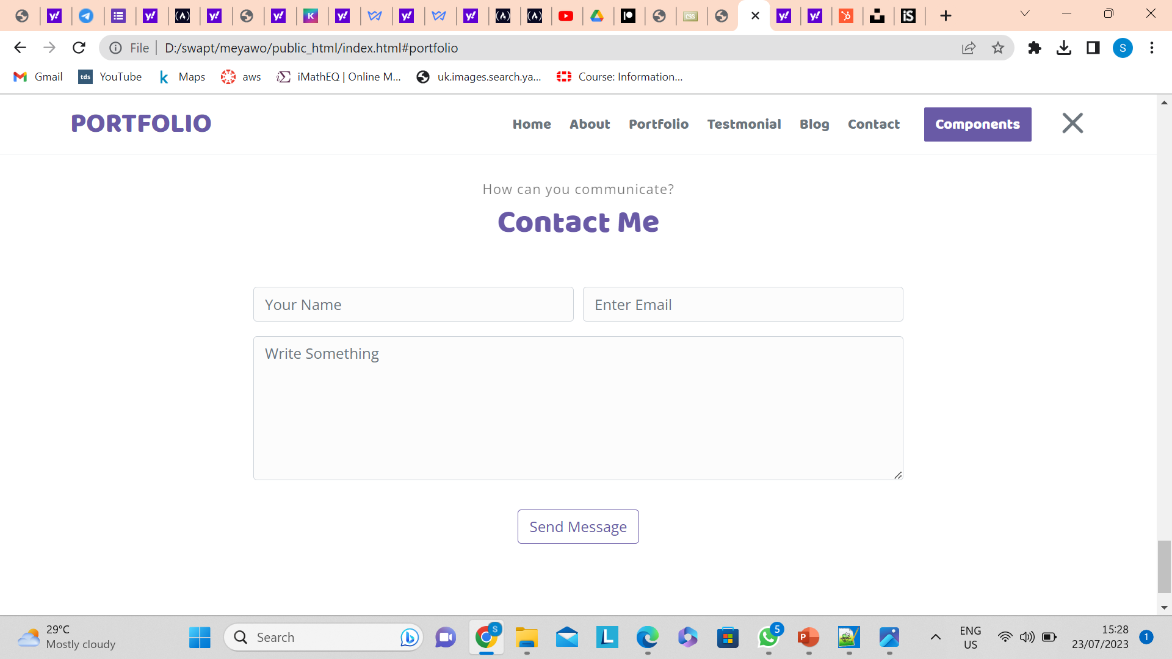
RESULTS
Portfolio makes you easily searchable on search engines like Google
Portfolio lets hiring managers find you instead of you reaching out to them
Portfolio provides a platform to showcase your relevant skills and experience
Portfolio shows your personality

Slide 10
LINKS
https://github.com/swathirebbavarapu/Front-end

