Slide 1
Credit One
Loan Default Risk Analysis

Slide 2
A written statement of the goal
To decrease the number of loan defaulters by creating a system that would help loan officers identify a good loan versus a bad loan ,before approving or rejecting a loan

Slide 3
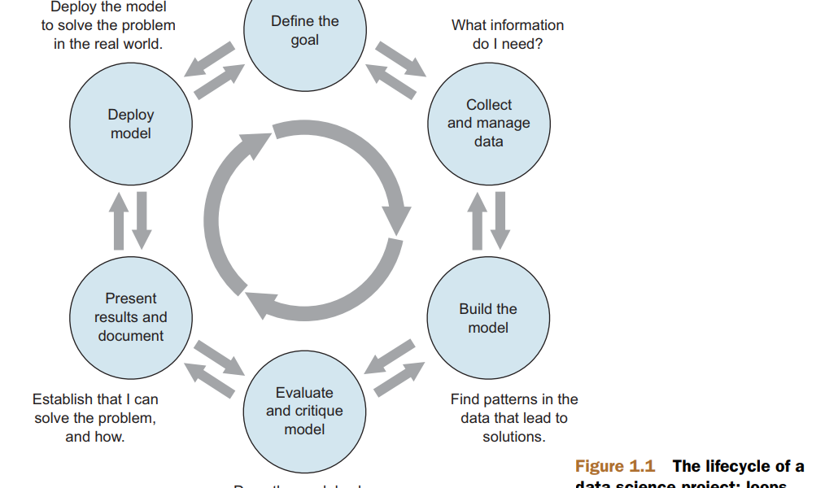
A well-defined data science process framework and the reasons you are proposing it
Framework One - Zumel and Mount
Helps build the model step by step in a well defined process and allows the analysts to reiterate the steps.

Slide 4
A well-defined data science process framework and the reasons you are proposing it
Define the goal The first step in a data science process is to define a measurable and quantifiable goal.
Why do the stakeholders want to do the project?
Over the past year or so Credit One has seen an increase in the number of customers who have defaulted on loans they have secured from various partners, and Credit One, as their credit scoring service, could risk losing business if the problem is not solved right away
What do they need from it?
Identify the pattern leading to loan defaulters to help the employees identify exactly the good loans and bad loands while processing the applications
Why is their current solution inadequate?
As there is an increase in the loan defaulters and the company is on the verge of losing business.
What resources do you need?
Existing data sets, Python, sample data modelling research papers online
How will the result of your project be deployed?
In Git hub

Slide 5
A well-defined data science process framework and the reasons you are proposing it
Collect and manage data This step includes identifying the data you need, then exploring and conditioning it. This is often the most time consuming step.
What data is available?
25 attributes with 30000 records
Will it help to solve the problem? Is it enough?
Yes but will have to do null hypothesis testing and feature engineering to test more
Is the data quality good enough?
Yes might have to bin the data on features such as Age and Limit Balance to reduce the no of continuous variables
Build the model Here is where you try to extract useful insights from the data in order to achieve your goals.
Which techniques might I apply to build the model?
PCA,RFE,identifying variance, one hot encoding, label encoding
How many techniques should I apply?
Not sure

Slide 6
A well-defined data science process framework and the reasons you are proposing it
Evaluate and critique the model Once you have derived a model, you need to determine whether it meets your goals. If not, it’s time to loop back to the modeling step.
Is the model accurate enough to meet the stakeholders’ needs?
Yes ,If the model supports the desired goal set by the client
Does it perform better than “the obvious guess” and any techniques being used currently?
Yes it is better than random/obvious guess
Do the results of the model make sense in the context of the real-world problem domain?
Yes if the model is built properly after clearly understanding the data and

Slide 7
A well-defined data science process framework and the reasons you are proposing it
Present results and document Once you have a model that meets your criteria, you will present your results to your project sponsor and other stakeholders.
How should stakeholders interpret the model?
Need to create visualizations to showcase the most interesting findings and recommendations
How confident should they be in its predictions?
The stakeholders should understand that it takes time and effort to create good models.They should relay on the predictions although we cannot guarantee that it is 100% accurate as it is better than having no predictive analytics done. The team should also dive into deep learning such as using tensor flows and keras to reduce the marginal errors the systems build without it
When should they potentially overrule the model’s predictions?
No only when they do not achieve the growth or the expectations set as promised by the team based on the predictions and forecasting.

Slide 8
A well-defined data science process framework and the reasons you are proposing it
Deploy and maintain the model Finally the model is put into But you still need to ensure that the model will run smoothly. In many cases this requires enhancement of the requirements based on customer feedback or in some cases fixing bugs.
How is the model to be handed off to “production”?
The model will be deployed to testing environment to check for any errors. If there is any, it will be reverted back to the team to fix the errors. Once it is free of any errors and is working properly it will be deployed to production
How often, and under which circumstances, should the model be revised?
If the model is not making accurate prediction on the actual data set and also if the results donot match the loan officer’s intuition. We will have to make sure that intuitions are mostly right to wrong to match it up with the model’s output.

Slide 9
An explanation of how you will manage the data for the project
First Data Cleaning and Extraction
Feature Engineering
Performing PCA ,RFE to reduce dimensionality
Train and test the models
Perform PCA ,RFE again to increase the Accuracy and Kappa values
Apply the model on actual data set.
Create charts graphs to provide the data to the business users .

Slide 10
Any known issues with the data and how you plan to address them
1.Continous Variables
-Certain features such as Age and Limit balance needs to be disretized
2. Too Many Features
Identify important features and use only that to perform the data modelling

Slide 11
A flowchart visualizing the detailed process
Identify the business goals and expectaitons
Manage,clean and extract data
Feature Engineering ( feature scaling ,PCA,RFE)
Building the models
Evaluate and improve the model
Create charts and graphs to provide the statistics and recommendations to the business users.

Slide 12
Any initial insights you can glean from your quick look at the data
Data Cleaning is mandatory
Need to find the important features that are being missed currently leading to bad loans.

