Slide 1
Trade-Position Rest API
Naga Swathi Sariputi

Slide 2
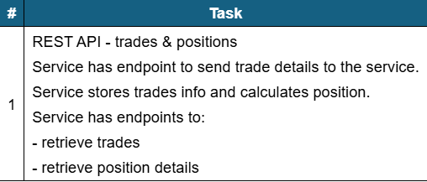
Problem Statement
REST API - trades & positions
Service has endpoint to send trade details to the service.
Service stores trades info and calculates position.
Service has endpoints to:
- retrieve trades
- retrieve position details

Slide 3
Solution
RESTful Trade and Position Management service built using ASP.NET Core and SQL Server. It allows clients to submit trades, persist them in a database, and calculate positions at the Account–Asset level.
Once the Trade is added, automatically position is calculated and stored.
Positions are calculated by aggregating all trades for a given Account + Asset:
BUY trades increase quantity
SELL trades decrease quantity
NetQuantity = TotalBuyQuantity − TotalSellQuantity
AveragePrice is calculated using a weighted average for BUY trades
Market price is intentionally excluded (not available)

Slide 4
Position Calculation
=> NetQuantity = Σ (BUY qty) - Σ (SELL qty)
=> NewAvgPrice = (OldQty * OldAvgPrice + BuyQty * BuyPrice) / (OldQty + BuyQty)
=> RealizedPnL += SellQty * (SellPrice - AvgPrice)
=> notional_value = ABS(net_quantity * avg_price)
=> IF net_quantity = 0 position_status = 'CLOSED' ELSE position_status = 'OPEN'

Slide 5
Tech Stack Used
ASP.NET Core
C#, Fluent Validators, API Versioning, Swagger
Rest API,
MS SQL Server
GitHub, Relational data modelling, Error Handling

Slide 6
SetUp and Execution
1. Clone the repository: git clone https://github.com/swathisariputi/Trade-Position.git
2. Checkout to develop-2025-dec branch
3. Update SQL Server connection string in TradeRepository
4. Run Database scripts on your server
5. Install the dependent libraries from Nuget Package Manager
6. Run the application
7. It launches the local host UI in the browser: https://localhost:{port}/swagger
8. Now hit the APIs to validate

Slide 7
Working Solution Screenshots

Slide 8
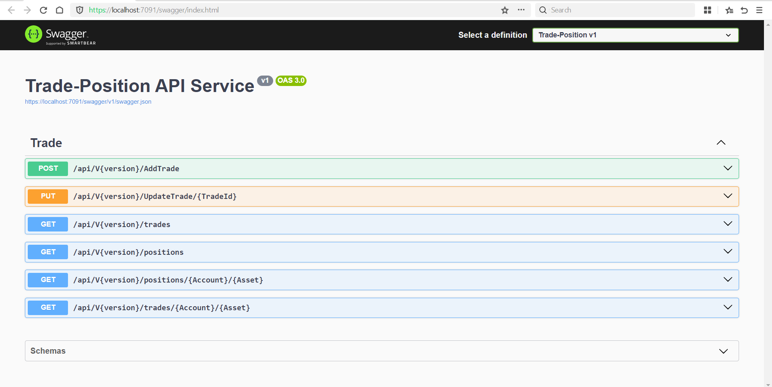

Slide 9
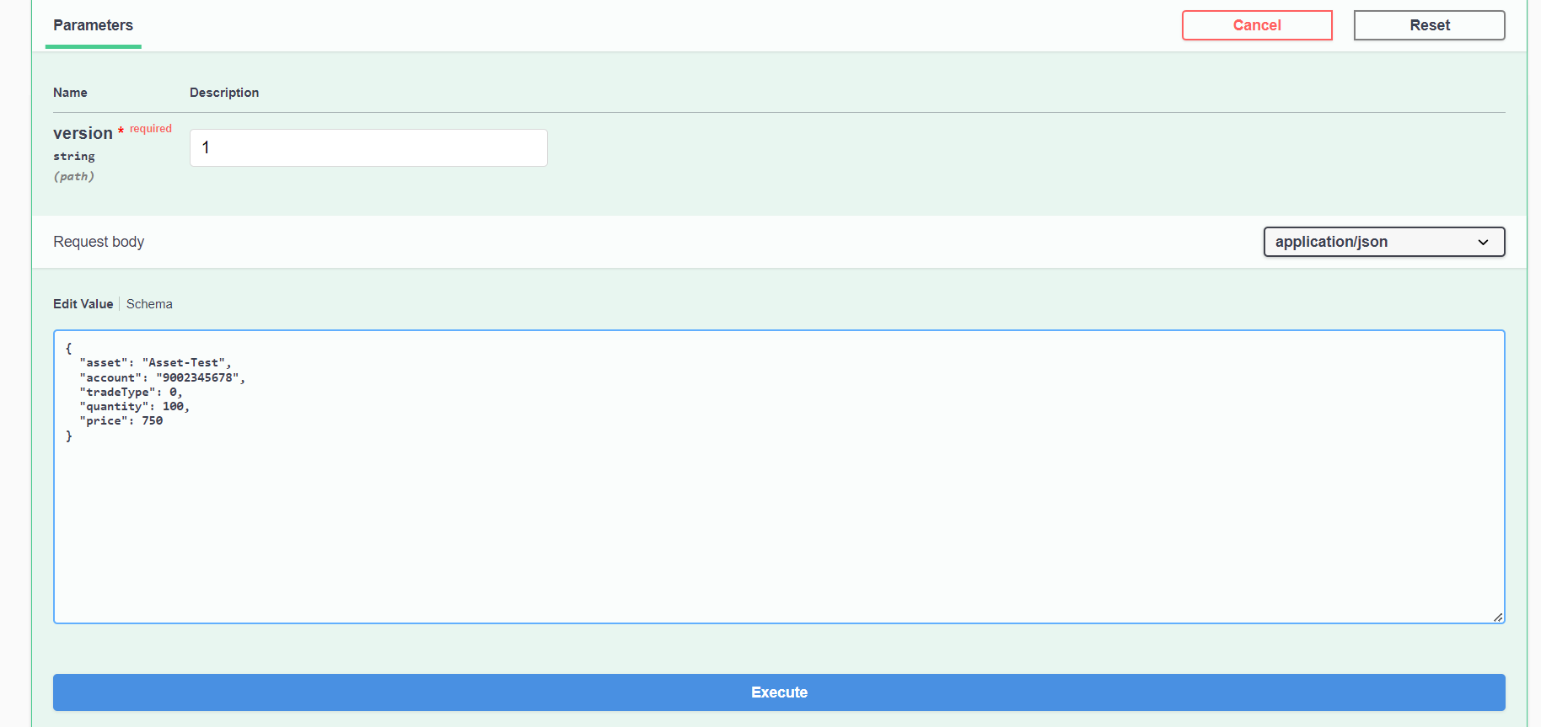
Request to add trade details

Slide 10
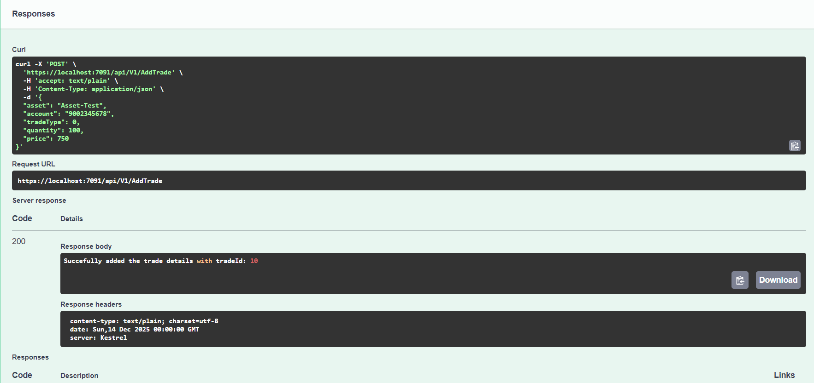
Postman sample request and response

Slide 11
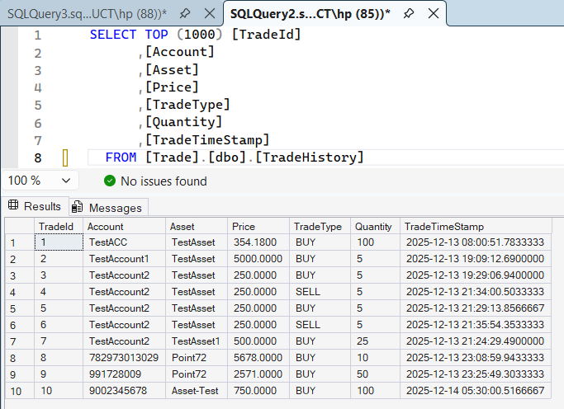
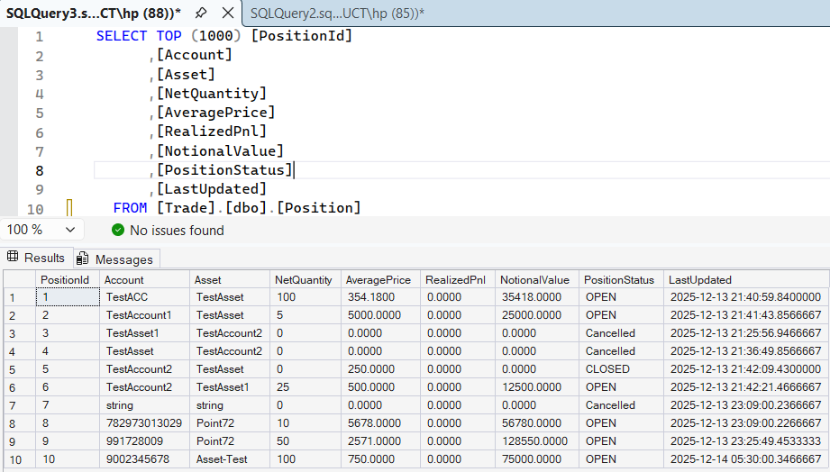
Database Persisted with Trade info and calculated Position

Slide 12
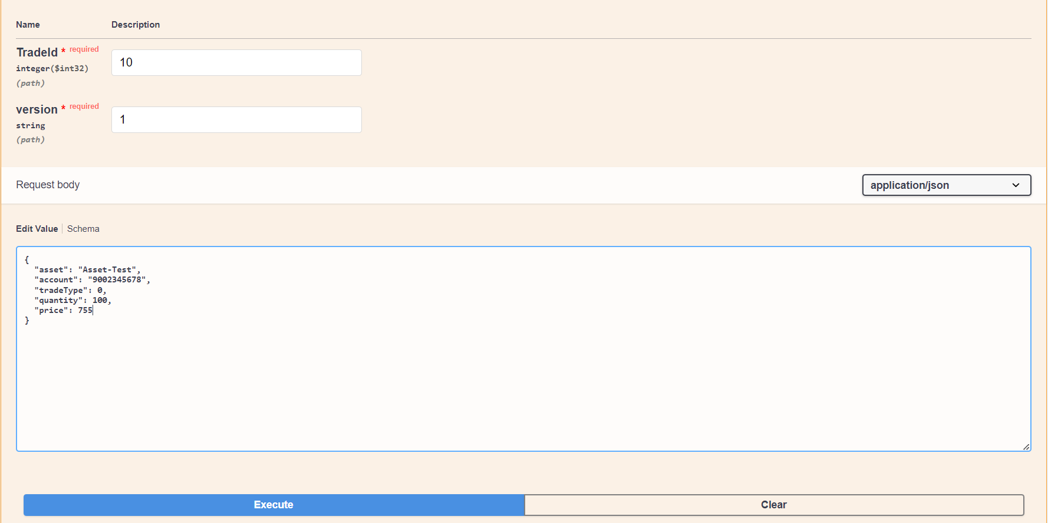
Request to update trade details

Slide 13
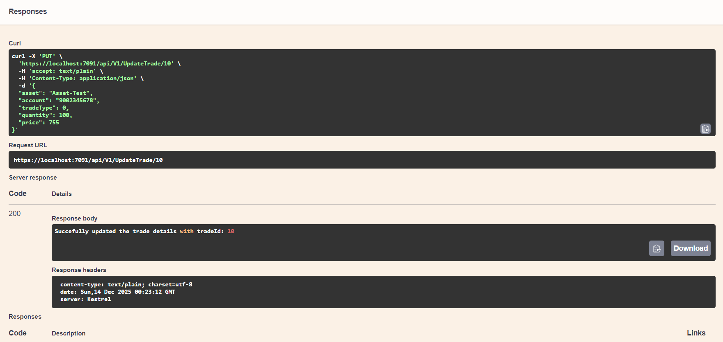
Postman sample request and response

Slide 14
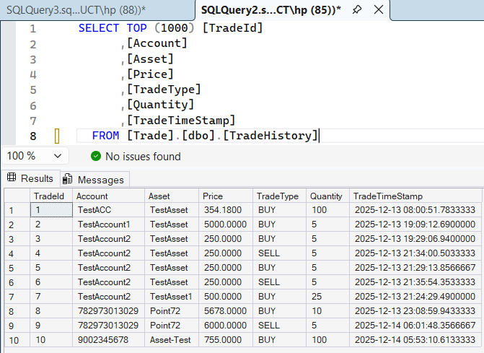
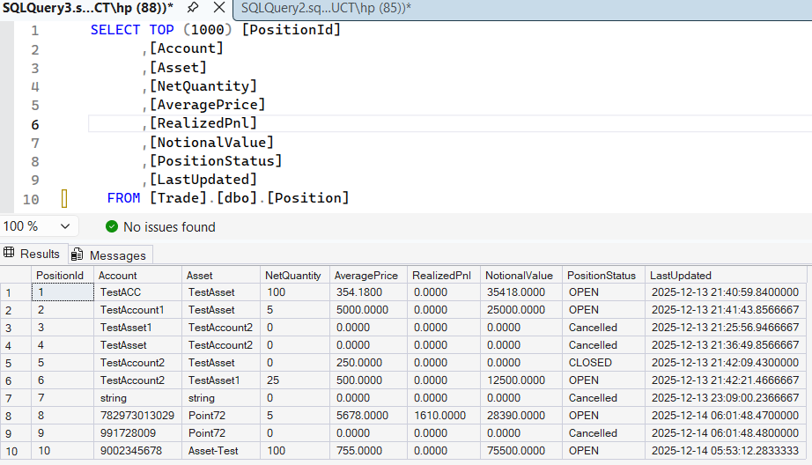
Database Persisted with Trade info and re-calculated Position

Slide 15
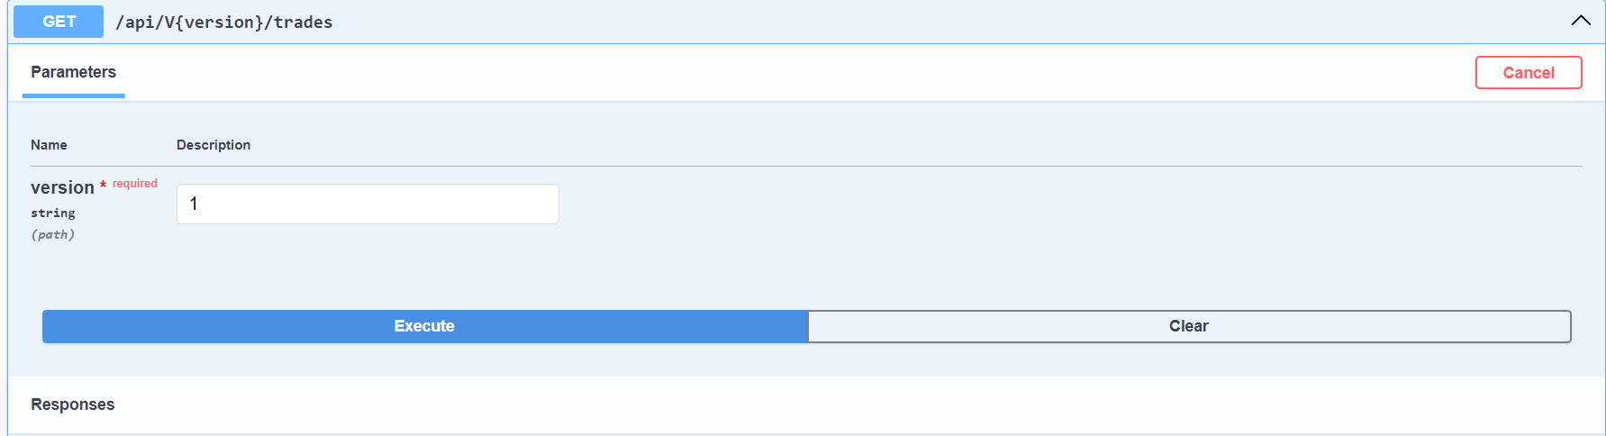
Request to get trades

Slide 16
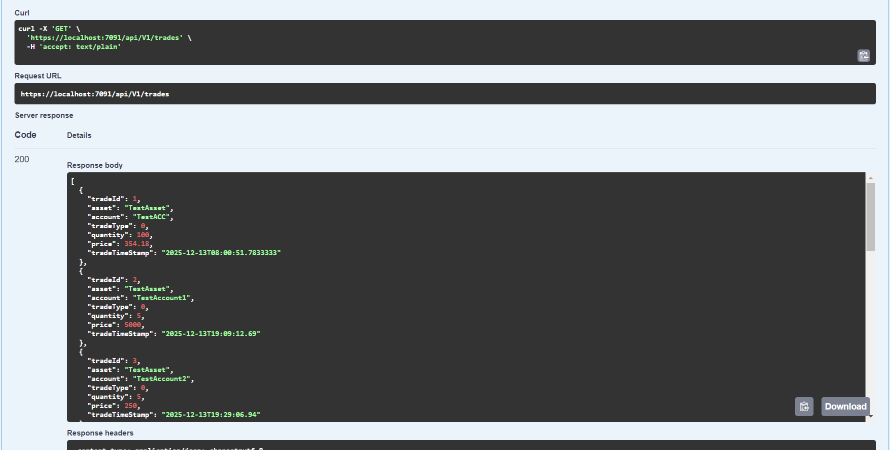
Postman sample request and response

Slide 17
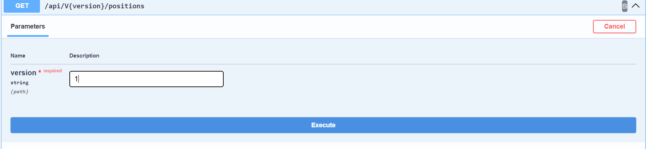
Request to get positions

Slide 18

Postman sample request and response

Slide 19
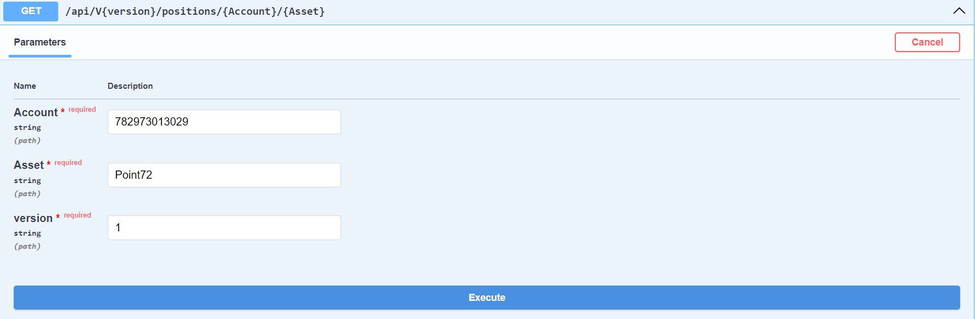
Request to get position for an asset of an account

Slide 20
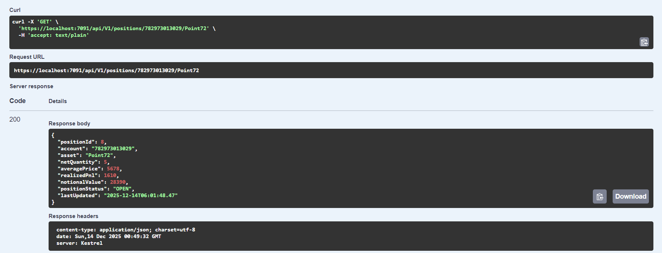
Postman sample request and response

Slide 21
Request to get the trades for an asset of an account

Slide 22
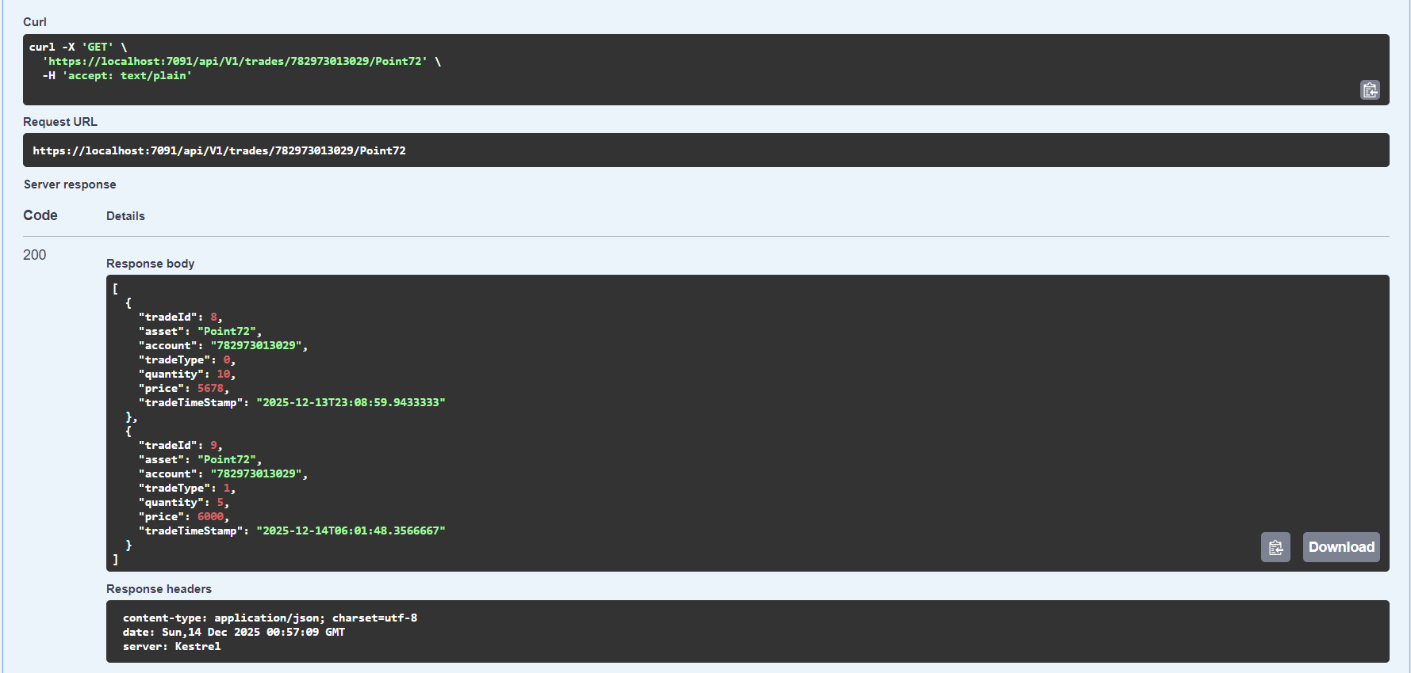
Postman sample request and response

Slide 23
Future Scope
1. Web UI / Dashboard - React frontend
2. Add authentication - JWT Authentication, Scoped Access
3. Add Test Coverage - xunit tests
4. Position Reporting & Analytics - get account summary, performance
5. Market Price integration & Profit/Loss calculation
6. Adapt CI/CD pipeline
7. Enhance code quality - no code smells & no vulnerabilities

Slide 24

Contact
Naga Swathi Sariputi
swathisariputi22@gmail.com
+91 8919674844

