Slide 1
Stock Market Sentiment Analysis
USING MACHINE LEARNING
Presented By
SWATHI.G
CSE
Guided By: Dr.T.Jackulin
Associate Professor
Department of Computer Science and Engineering
Panimalar Engineering College

Slide 2
Abstract
Predicting stock market prices has been a topic of interest among both analysts and researchers for a long time. Stock prices are hard to predict because of their high volatile nature which depends on diverse political and economic factors, change of leadership, investor sentiment, and many other factors. Predicting stock prices based on either historical data or textual information alone has proven to be insufficient.
Existing studies in sentiment analysis have found that there is a strong correlation between the movement of stock prices and the publication of news . Several sentiment analysis studies have been attempted at various levels using algorithms such as support vector machines, naive Bayes regression, and deep learning.
The accuracy of deep learning algorithms depends upon the amount of training data provided. However, the amount of textual data collected and analyzed during the past studies has been insufficient and thus has resulted in predictions with low accuracy. In our paper, we improve the accuracy of stock price predictions by gathering a large amount of time series data and analyzing it in relation to related news articles

Slide 3
Introduction | 04
Research Objectives | 08
Literature Review | 10
Problem Findings | 13
Research Methodologies – Contribution | 24
Conclusion | 28
References | 30
AGENDA

Slide 4
Introduction
There are many factors that influence stock market prices. One of those factors is investor’s reaction to financial news and day to day events. Nowadays, news availability has increased dramatically. It is hard for investors to decide the trend of stock prices based on the huge amount of news. So, an automated system to predict future stock prices will be helpful for investors. An automated system can gather financial news related to the companies of interest in real time and can execute a machine learning model on those data, along with historical stock price information, to predict price.
For years, research has been done on predicting stock prices either based on historical stock price data alone or by using textual data and historical data. Some of the previous works used Twitter sentiments, financial blogs, or news articles as the textual data. In our work, we use financial news articles from well-known sources to avoid fake news that may be prevalent on media. We have used past stock prices and current day financial news to predict current day closing stock price. We believe that this approach is better because financial news related to the company has a significant effect on its stock price.

Slide 5
Overview:
Existing studies in sentiment analysis have found that there is a high association between the movement of stock values and the release of news pieces, according to existing sentiment research studies.
Several sentiment analysis research employing techniques such as support vector machines, naive Bayes regression, and deep learning have been attempted at various levels.
The amount of training data supplied determines the accuracy of deep learning algorithms.
However, the amount of textual data gathered and processed in previous research was insufficient, resulting in low-accuracy predictions.

Slide 6
Problem Definition
Predicting the stock market has been the bane and goal of investors since its inception. Every day billions of dollars are traded on the stock exchange, and behind every dollar is an investor hoping to make a profit in one way or another.
Entire companies rise and fall daily depending on market behavior.
If an investor is able to accurately predict market movements, he offers a tantalizing promise of wealth and influence

Slide 7

RESEARCH OBJECTIVES

Slide 8
Research Objectives
To predict stock price using News Headlines , Based on polarity score it is classified into negative or positive outcome.

Slide 9

LITERATURE REVIEW

Slide 10
LITERATURE SURVEY
The majority of stock prediction methods are based on stock technical and fundamental assessments. According to recent studies, there is a high association between news stories about a firm and its stock price fluctuations.
In 2015 , Alostad and Davulcu used hourly stock prices of 30 stocks and online stock news articles from the NASDAQ website. They collected tweets related to those 30 stocks for a period of six months. [1]
In 2015 , X. Li, H. Xie, Y. Song, S. Zhu, Q. Li, and F. L. Wang gathered data from the Hong Kong stock exchange over five years. They collected financial news stories from the same time period to see if there was a link between the articles and stock market changes. They gathered the open, high, close, and low stock prices for each firm on a given trading day. To extract characteristics, the collected articles were processed in a variety of methods. [2]
In 2016, D. Duong, T. Nguyen, and M. Dang did some of the text pre-processing processes utilised in several works include removing HTML elements ,tokenizing sentences, noun phrasing ,document weighting ,TFIDF and extraction of named entities. [3]

Slide 11
LITERATURE SURVEY
In 2017, Y. Wang, D. Seyler, S. K. K. Santu, and C. Zhai started the n-gram document matrix, stock price direction for each hour, and weight of each document were all subjected to logistic regression. Experiments also revealed that extracting document-level sentiment does not improve prediction accuracy considerably. Random forest, naïve Bayesian, and evolutionary algorithms have all been used to forecast stock price and direction in earlier studies.[4]
In 2017, Y. Shynkevich, T. McGinnity, S. A. Coleman, A. Belatreche, and Y. Li carried Forecasting price movements using technical indicators ,Investigating the impact of varying input window length,After eliminating stop-words, whitespace, punctuations, and numerals,retrieved N-gram characteristics.[5]
In 2017 , R. P. Schumaker and H. Chen ,They used OpenNLP to extract sentences from each document and constructed final features into a document matrix. They then used the SentiStrength package to identify sentiment using the Loughran and McDonald Financial Sentiment Dictionaries.[6]

Slide 12

PROBLEM FINDINGS

Slide 13
Problem Findings
01
02
03
04
05
Stock price is directly correlated with news headlines and many other factor.
Used polarity score based on the positivity of news which gives the accurate result.
Accuracy and Specificity are less when unstructured data is used
Intensity is low while using sarcastic comments
Error Rate is high.

Slide 14

DATASETS

Slide 15
Description of the Stock Headlines Dataset
Data Set | No. of column | Missing values
DATE | 1 | yes
LABEL BASED ON STOCK PRICE INCREASE OR DECREASE | 1 | yes
NEWS HEADLINES | 25 | yes

Slide 16
Stock Headlines Dataset Attributes
S.No. | Attribute | Domain
1 | Date | Date of Telecasted News Headline
2 | Label | 0,1
3 | News Headline | (3-27) Headline of different outcome from global source
4 | Class: | (0 for Increase, 1 for Decrease)

Slide 17
Activity Diagram

Slide 18
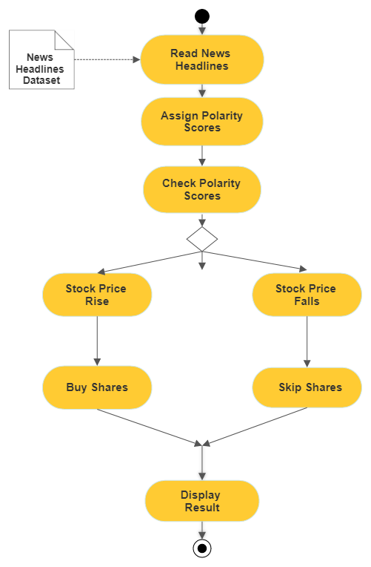

Slide 19
Use Case Diagram

Slide 20
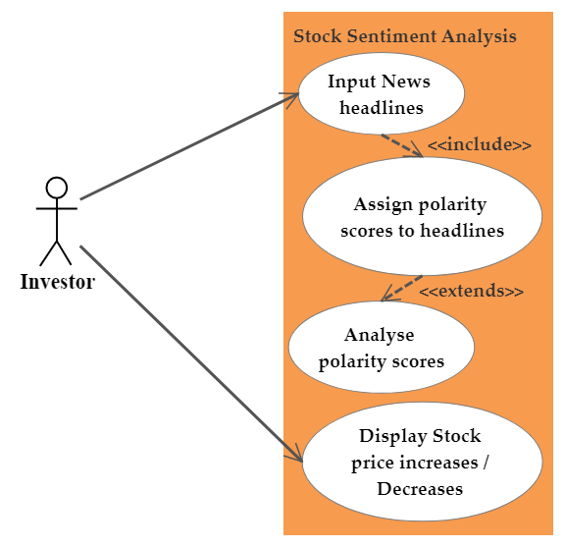

Slide 21
Research Contributions
(To intimate best time to buy stock)
High polarity score
Low polarity score(further fall expected)
Sell the share
Buy if it tends to increase (best time to buy huge stock)
Buy Stock

Slide 22
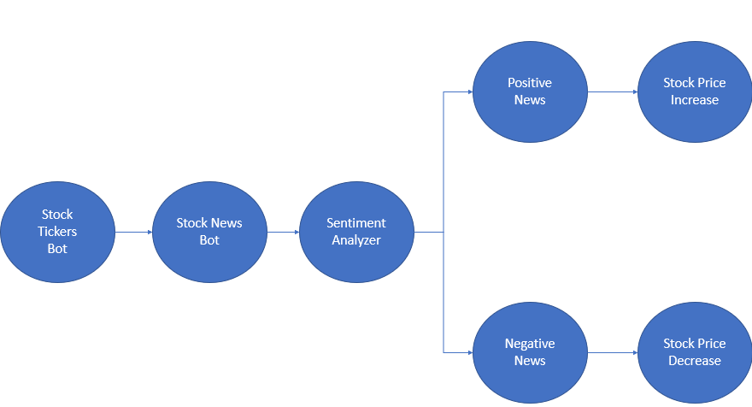
Frame work

Slide 23
Procedure for prediction
Step 01 Training the dataset features.
Step 03 Assign polarity score
.
Step 05 Evaluate and compare
Step 07 If polarity score is low or still don’t buy or time to sell stock
Step 09 Populate the best solution and train the model based on it
01
02
03
05
06
07
09
04
08
Step 06 If polarity score high buy stock
Step 02 Read news headlines from data set
Step 08 Repeat the steps 3 to 7 up to satisfaction or iteration is completed.
Step 04 Check polarity score

Slide 24
CONTRIBUTION - 1
Prediction of Stock price

Slide 25
Comparison of Various Techniques for News Headline Dataset
Technique | Recall | Precision | Accuracy
Random forest classifier | 0.89 | 0.83 | 85.19%
Multinomial naïve bayes | 0.83 | 0.85 | 83.86
Logistic Regression | 0.85 | 0.87 | 85.98%

Slide 26
COMPARISON OF ALL PERFORMANCE ANALYSIS OUTCOME

Slide 27
Existing System Human Intelligence
In an efficient market, stock prices would be determined primarily by fundamentals, which, at the basic level, refer to a combination of two things:
An earnings base, such as earnings per share (EPS)
A valuation multiple, such as a P/E ratio
A third market consists of trading conducted by non-exchange member broker-dealers and institutional investors of exchange-listed stocks.

Slide 28
Proposed system
Professional traders spend much of their time trying to anticipate the next news cycle, so that they can buy or sell stocks before the real numbers are released. The dataset in consideration is a combination of the world news headlines and stock price shifts.
Instead of going through each headline for every stock that you're interested in, you can use Python to parse the website data and perform sentiment analysis (by assigning a polarity score) for every headline and then average it over a period of time.
So here class 1 denotes the bullish market and class 0 denotes bearish or static market.

Slide 29
Test Case
1. # Predicting values
row = randint(0,sample_test.shape[0]-1)
sample_news = sample_test[row]
print('News: {}'.format(sample_news))
if stock_prediction(sample_news):
print('Prediction: The stock price will remain the same or will go down.')
else:
print('Prediction: The stock price will go up!')
News: Report: 45 ISIS fighters die after eating 'poisoned' iftar meal
Prediction: The stock price will remain the same or will go down.

Slide 30
Test Case
2. # Predicting values
row = randint(0,sample_test.shape[0]-1)
sample_news = sample_test[row]
print('News: {}'.format(sample_news))
if stock_prediction(sample_news):
print('Prediction: The stock price will remain the same or will go down.')
else:
print('Prediction: The stock price will go up!')
News: China announces sanctions on North Korea
Prediction: The stock price will go up!

Slide 31

CONCLUSION

Slide 32
Conclusion
In this work, we used machine learning techniques to forecast stock prices in this study. The findings imply that stock prices and financial news stories have a strong association. We used logistic regression, multinomial naive bayes, and random forest classification to create prediction models.
The sentiment ratings derived from news item analysis are a significant indication of stock movement and may be utilised to successfully leverage short-term trend prediction. We believe this is why the model is able to reach a 85.98 % accuracy.
Finally, using stock prices and a sentiment analysis model based on social media and news data, a hybrid model using traditional statistical classification models such as Auto Regressive Integrated Moving Average (ARIMA) and machine learning models such as the long short-term memory (LSTM) neural network model may provide more accurate predictions of long and short-term stock price movements.

Slide 33

References

Slide 34
References
[1] H. Alostad and H. Davulcu, “Directional prediction of stock prices using breaking news on twitter,” in 2015 IEEE/WIC/ACM International Conference on Web Intelligence and Intelligent Agent Technology (WIIAT), vol. 1, Dec 2015, pp. 523–530.
[2] X. Li, H. Xie, Y. Song, S. Zhu, Q. Li, and F. L. Wang, “Does summarization help stock prediction? a news impact analysis,” IEEE Intelligent Systems, vol. 30, no. 3, pp. 26–34, May 2015
[3] D. Duong, T. Nguyen, and M. Dang, “Stock market prediction using financial news articles on ho chi minh stock exchange,” in Proceedings of the 10th International Conference on Ubiquitous Information Management and Communication, ser. IMCOM ’16. New York, NY, USA: ACM, 2016, pp. 71:1–71:6. [Online]. Available: http://doi.acm.org/10.1145/2857546.2857619
[4] Y. Wang, D. Seyler, S. K. K. Santu, and C. Zhai, “A study of feature construction for text-based forecasting of time series variables,” in Proceedings of the 2017 ACM on Conference on Information and Knowledge Management, ser. CIKM ’17. New York, NY, USA: ACM, 2017, pp. 2347–2350
[5] Y. Shynkevich, T. McGinnity, S. A. Coleman, A. Belatreche, and Y. Li, “Forecasting price movements using technical indicators: Investigating the impact of varying input window length,” Neurocomputing, vol. 264, pp. 71 – 88, 2017, machine learning in finance.
[6] H. D. Huynh, L. M. Dang, and D. Duong, “A new model for stock price movements prediction using deep neural network,” in Proceedings of the Eighth International Symposium on Information and Communication Technology, ser. SoICT 2017. New York, NY, USA: ACM, 2017, pp. 57–62.
[7] R. P. Schumaker and H. Chen, “Textual analysis of stock market prediction using breaking financial news: The azfin text system,” ACM Trans. Inf. Syst., vol. 27, no. 2, pp. 12:1–12:19, Mar. 2009. [Online]. Available: http://doi.acm.org/10.1145/1462198.1462204 [8] A. de Myttenaere, B. Golden, B. L. Grand, and F. Rossi, “Mean absolute percentage error for regression models,” Neurocomputing, vol. 192, pp. 38 – 48, 2016, advances in artificial neural networks, machine learning and computational intelligence

Slide 35
THANK YOU

