Slide 1

Digital PORTFOLIO

Slide 2
DIGITAL PORTFOLIO
STUDENT NAME :SWATHI S
REG NO AND NMID :2422K1608 AND asbru4q2422k1608
DEPARTMENT :COMPUTER SCIENCE
COLLEGE :KSG COLLEGE OF ARTS AND SCIENCE
UNIVERSITY :BHARATHIAR UNIVERSITY

Slide 3
STUDENT PORTFOLIO
Using frontend development

Slide 4
AGENDA
1.Problem Statement 2.Project Overview 3. End Users 4. Tools and Technologies 5.Portfolio design and Layout 6. Features and Functionality 7.Results and Screenshots 8.Conclusion 9.Github Link

Slide 5
PROBLEM STATEMENT
Create a digital portfolio showcasing projects, skills, and experiences in a visually appealing and user-friendly format, highlighting accomplishments and expertise.

Slide 6
Project overview
Showcasing Work Effectively display projects, skills, and experiences in a visually appealing format. User Experience Create an intuitive and user-friendly interface for easy navigation and engagement. Personal Branding Highlight accomplishments, expertise, and personal brand to attract opportunities or clients.

Slide 7
End users
Professionals: Individuals showcasing their work, skills, and experiences to potential employers, clients, or collaborators. Students :Students demonstrating their projects, achievements, and skills to educators, potential employers, or academic institutions. Creative Freelancers: Freelancers highlighting their projects, expertise, and accomplishments to attract new clients or projects.

Slide 8
Tools and techniques
Website Builders: Platforms like Wix, Squarespace, or WordPress to create custom websites showcasing work and projects. Content Management Systems (CMS): Tools like WordPress or Joomla to manage and update portfolio content efficiently. Design and Multimedia Tools: Software like Adobe Creative Cloud (Photoshop, Premiere Pro, etc.) to create visually appealing graphics, videos, and other multimedia content for the portfolio.

Slide 9
Portfolio designS and layouts
Clear Navigation: Simple and intuitive navigation to help visitors easily find and view projects and information. Visual Hierarchy: Organizing content using size, color, and layout to draw attention to key projects and accomplishments. Consistent Branding: Applying consistent typography, color schemes, and visual elements to reinforce personal or professional branding throughout the portfolio.

Slide 10
Features and functionality
Responsive Design: Ensuring the portfolio is accessible and visually appealing across various devices and screen sizes. Project Filtering and Categorization: Organizing projects by categories, tags, or types to make it easy for visitors to find specific content. Interactive Elements: Incorporating features like animations, hover effects, or lightbox galleries to enhance user engagement and showcase work in an immersive way.

Slide 11

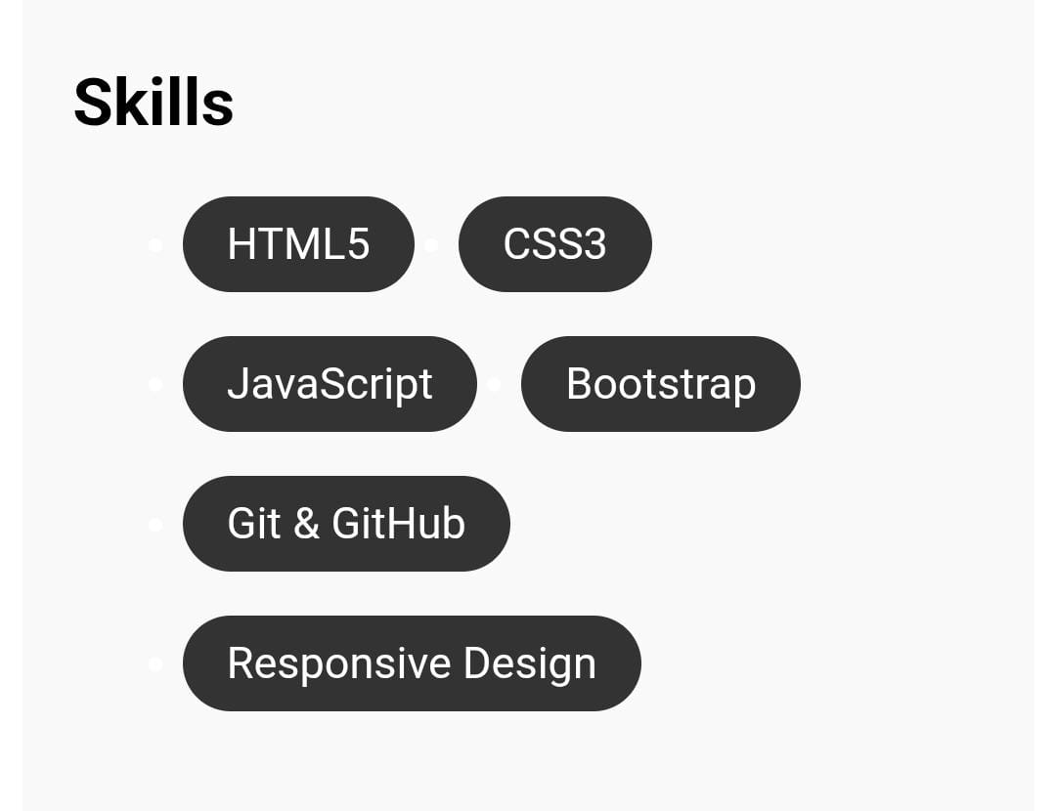
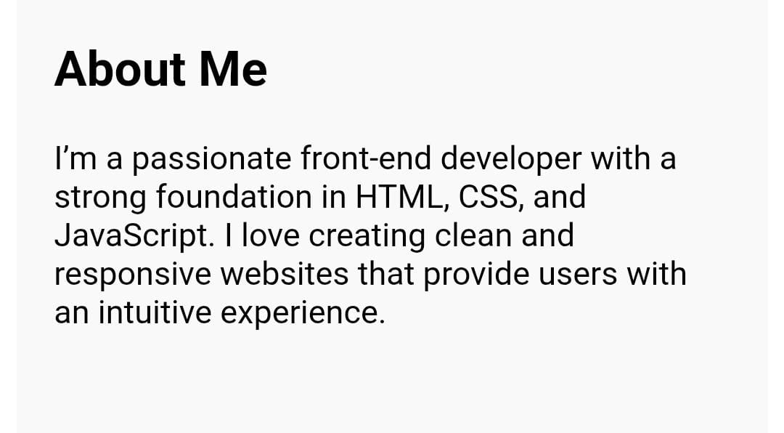
Results and screenshots

Slide 12
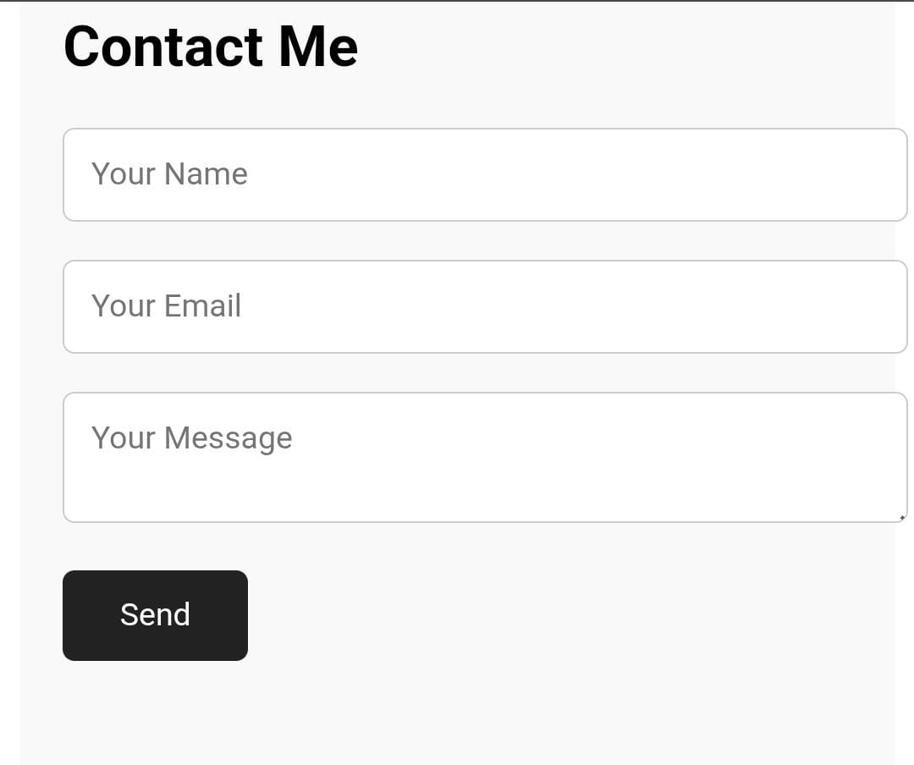
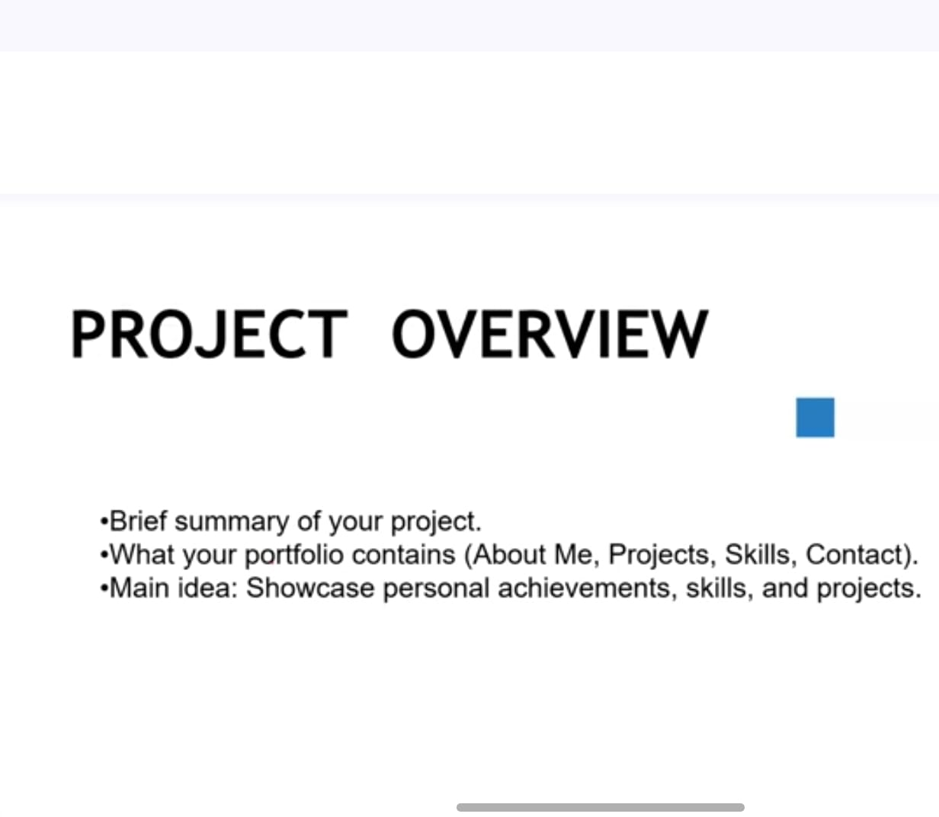
Screenshots

Slide 13
Conclusion
A digital portfolio effectively showcases skills, projects, and experiences, providing a dynamic and accessible platform to demonstrate expertise and attract opportunities.

