Slide 1





NM1051 – SERVICENOW ADMINISTRATOR – SMART INTERNZ
LAPTOP REQUEST CATALOG ITEM
A PROJECT REPORT
Submitted by
SWATHI B (815422243026)
RAJASHREE D (815422243017)
SANGAMITHRA S (815422243020)
SHEELA G (815422243023)
BACHELOR OF TECHNOLOGY
IN
SEVENTH SEMESTER
ARTIFICIAL INTELLIGENCE AND DATA SCIENCE
SRI RAMAKRISHNA COLLEGE OF ENGINEERING
ANNA UNIVERSITY : CHENNAI 600 025
NOV/DEC 2025
ANNA UNIVERSITY : CHENNAI 600 025

Slide 2
BONAFIDE CERTIFICATE
Certified that this project report “LAPTOP REQUEST CATALOG ITEM” is the bonafide work of “SWATHI B, RAJASHREE D, SANGAMITHRA S, SHEELA G” who carried out the project work under my supervision. No part of the dissertation has been submitted for any degree or any other academic award anywhere before.
SIGNATURE
Mrs. A.REETA JOLDRINE M.E.,
ASSISTANT PROFESSOR
Department of AI&DS
Sri Ramakrishna College of Engineering
Perambalur
SIGNATURE
Mr. S.SIVABALAN M.E.,
HEAD OF THE DEPARTMENT
Department of AI&DS
Sri Ramakrishna College of Engineering
Perambalur
Submitted for the University Practical Examination held on……………….
INTERNAL EXAMINER EXTERNAL EXAMINER

Slide 3
TABLE OF CONTENTS
S.NO | CONTENT | PAGE NO
1 | IDEATION PHASE Problem Statement Empathy Map Canvas | 3 4 5
2 | PERFORMANCE & TESTING Procedure/ Implementation Steps Testing Screenshots | 9 10 14
3 | PROJECT DESGIN PHASE Problem Solution fit Proposed Solution Conclusion Solution Architecture | 19 20 20 21 22
4 | PROJECT PLANNING PHASE Product Backlog Sprint Planning User Stories Story Points | 24 25 25 26 26
5 | REQUIREMENT ANALYSIS Solution Requirement Dataflow Diagram Technology Stack | 27 28 29 30

Slide 4
IDEATION PHASE

Slide 5
Problem Statement
Employees in the organization need a quick and efficient way to request laptops for work. The current process is manual and prone to delays, with no dynamic form behavior to guide users or ensure accurate data collection. To address this, a Service Catalog item needs to be created, allowing users to easily request a laptop, with dynamic fields, clear instructions, and additional functionality like resetting the form if needed. The solution should also ensure all changes are tracked for governance and deployment.
Problem Definition
The current laptop request process within the organization is manual and inefficient, resulting in frequent delays, incomplete submissions, and miscommunication between employees and the IT department. Employees typically rely on static forms or email-based communication to request laptops, which often lack dynamic behavior to guide the user in providing accurate and complete information. This leads to repetitive clarifications, approval delays, and inconsistencies in data collection.
Additionally, the absence of form automation and governance controls poses challenges in tracking request history, managing configuration changes, and maintaining compliance during deployment. The IT department struggles to ensure that every modification to the process is properly documented and approved. Furthermore, users do not have the option to easily reset or modify their request forms without restarting the entire process, which adds to frustration and inefficiency.
In essence, the existing process fails to meet the growing demand for speed, transparency, and accuracy in IT service requests. There is a clear need for an automated, dynamic, and user-friendly Service Catalog item that addresses these challenges and enhances the overall employee experience.
Abstract
In many organizations, employees require laptops to perform their daily tasks effectively. However, traditional manual processes for requesting such assets often lead to inefficiencies, errors, and delays in fulfillment. This project aims to design and implement a dynamic Service Catalog item within the organization’s IT Service Management (ITSM) platform to streamline laptop requests. The solution will replace the manual process with an

Slide 6
automated, user-friendly interface that dynamically adjusts form fields based on user inputs, provides clear instructions, and enables users to reset or modify their requests with ease.
Additionally, all form changes, submissions, and deployments will be tracked to ensure transparency, compliance, and effective governance. By implementing this solution, the organization can enhance employee experience, improve request accuracy, and reduce turnaround time in laptop provisioning.
Empathy Map canvas
Says
  “I need a laptop quickly to start my project.”
  “The current request process takes too long.”
  “I’m not sure what details I need to fill in.”
  “It would be easier if the form guided me automatically.”
Thinks
  “Why can’t this process be automated?”
  “I hope my request doesn’t get delayed again.”
  “There should be a simpler way to track my request.”
  “It would be nice if I could reset the form and start fresh.”
Does
  Fills out manual or static forms to request laptops.
  Contacts the IT or HR department for updates.
  Submits repeated requests due to missing or incorrect data.
  Waits for approvals without knowing the request status.
Feels
  Frustrated with delays and repetitive manual steps.
  Confused about what information to provide.
  Anxious about approval timelines.
  Relieved when the process is automated and transparent.

Slide 7
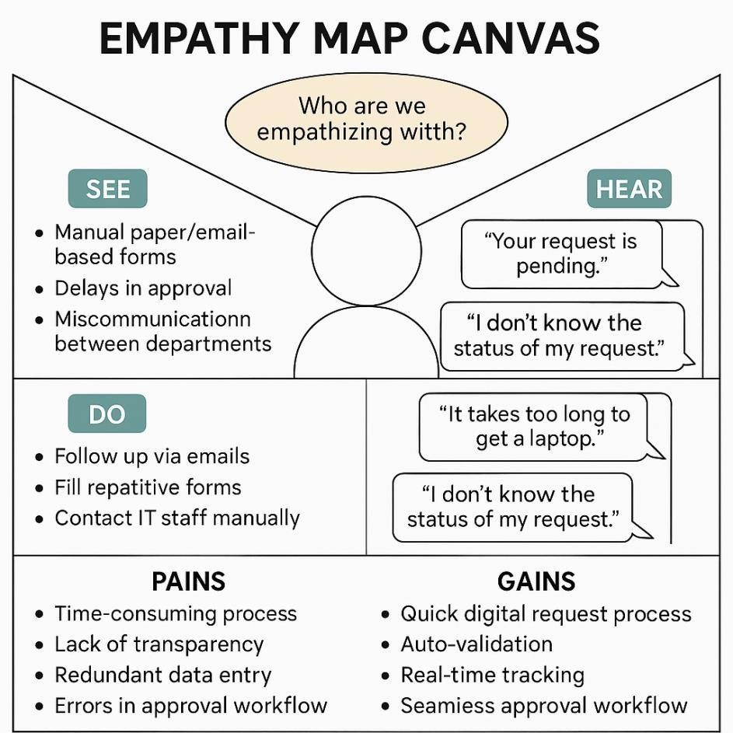

Slide 8
Introduction
In the modern digital workplace, efficient IT asset management is crucial to maintaining productivity and operational continuity. One of the most common IT service requests is the provisioning of laptops for employees. Despite its frequency, many organizations still rely on manual, paper-based, or email-driven processes for managing laptop requests. These outdated methods are not only time-consuming but also prone to errors, miscommunication, and inconsistent data collection.
The proposed solution seeks to automate and optimize this process through the development of a Service Catalog item within the ITSM platform. This catalog item will allow employees to request laptops through an intuitive web-based interface. The form will feature dynamic behavior, adapting visible fields and instructions based on user roles, departments, or selected options (e.g., laptop type, usage requirements). This ensures that users provide all necessary and relevant information before submission, minimizing back-and-forth communication with the IT team.
To further enhance usability, the catalog item will include functionalities such as form reset, allowing users to clear inputs and restart the process if needed. Moreover, to maintain governance and compliance, every configuration change and form update will be tracked and logged, ensuring full visibility for administrators and simplifying deployment management.
The implementation of this dynamic Service Catalog item will significantly improve the efficiency, accuracy, and user experience of the laptop request process. It will also align with organizational goals of digital transformation, automation, and IT service excellence, ultimately leading to faster service delivery and better resource utilization.
Objectives
The primary goal of this project is to design, develop, and implement a dynamic Service Catalog item that streamlines the laptop request process for employees while ensuring data accuracy, governance, and efficient deployment. The specific objectives are as follows:
Automation of Laptop Request Process
Replace the existing manual and email-driven process with an automated Service Catalog item that allows employees to easily request laptops online.
Dynamic Form Behavior
Implement intelligent form functionality where fields dynamically appear, hide, or change based on user selections (e.g., laptop type, job role, department, or location).
Enhanced User Experience

Slide 9
Provide clear field-level instructions, validation messages, and tooltips to guide users through the form, reducing confusion and submission errors.
Form Reset and Modification Functionality
Enable users to reset or modify form entries before submission, ensuring flexibility and minimizing data entry mistakes.
Governance and Change Tracking
Establish a mechanism to log and track all changes made to the catalog item, workflows, and configurations for compliance and auditing purposes.
Seamless Integration and Deployment
Ensure that the catalog item integrates smoothly with existing ITSM workflows (e.g., approval, fulfillment, and asset management) and that changes are easily deployable across environments (development, testing, production).
Improved Efficiency and Transparency
Reduce request turnaround time, eliminate manual intervention, and provide visibility into the request lifecycle for both employees and administrators.
Scope
The scope of this project encompasses the design, development, implementation, testing, and deployment of a dynamic Service Catalog item for laptop requests within the organization’s IT Service Management (ITSM) system (e.g., ServiceNow or an equivalent platform).
The solution will focus on automating the end-to-end laptop request process — from submission to approval and fulfillment — ensuring improved accuracy, efficiency, and governance. The project will also include the creation of form logic, dynamic field behavior, and tracking mechanisms for change management.
In-Scope Activities
  Design and development of a dynamic catalog item for laptop requests.
  Implementation of client-side and server-side scripting for dynamic behavior.
  Integration with existing workflows (e.g., approvals, fulfillment tasks, notifications).
  Implementation of data validation, tooltips, and instructional text.
  Development of form reset and modification features.
  Configuration of audit trails and change tracking mechanisms.
  Deployment management through proper governance and version control.
  User training and documentation preparation.
Out of Scope
  Physical laptop procurement or inventory management processes beyond catalog integration.
  Development of unrelated IT assets or service catalog items.
  Integration with third-party procurement systems (unless specified in later phases).

Slide 10
PERFORMANCE & TESTING

Slide 11
Procedure / Implementation Steps:
Phase 1 : Create Local Update set
Open service now.
Click on All >> search for update sets
Select local update sets under system update sets
Click on new
Fill the following details to create a update set as: “Laptop Request”
Click on submit and make current
By clicking on the button it activates the update set.
Phase 2 : Create Service Catalog Item
1.
2.
3.
4.
5.
Open service now.
Click on All >> service catalog
Select maintain items under catalog definitions Click on New.
Fill the following details to create a new catalog item Name: Laptop Request
Catalog: service Catalog Category: Hardware
Short Description: Use this item to request a new laptop
Click on ‘SAVE’ Phase 3 : Add variables
6.
Step1:
After saving the catalog item form scroll down and click on variable(related list)
Click on new and enter the details as below
  Variable 1:Laptop Model Type: Single line text
10

Slide 12
Name: Order:100
laptop_model
Click on submit
Again click on new and add Remaining variables in the above process
Variable 2:Justification
Type: Multi line text Name: justification
Order:200
Variable 3:Additional Accessories Type: Checkbox
Name: additional_accessories Order:300
Variable 4: Accessories Details
Type: Multi line text Name:accessories_details
Order:400 Step2:
  After adding above variable which are added to newly created catalog item
  Then save the catalog item form
Phase 4 : Create Catalog Ui policies
Click on all>> search for service catalog
Select maintain item under catalog definition
Search for ‘laptop request’ which is created before
Select ‘laptop request’ and scroll down click on “Catalog Ui policies”
In the catalog ui policies related list tab click on new
Give short description as: show accessories details
Set the Catalog Condition in the related list tab ‘when to apply’
[field: additional_ accessories, operator: is, value: true]
Click on save.(do not click on submit)
Scroll down and select ‘catalog ui action’
Then click on new button
Select variable name as: accessories_details
Order:100 Mandatory:
Visible : True
True

Slide 13
12. Click on save and again click save button of the catalog ui policy form
Phase 5 : Create ui action
Open service now.
Click on All >> search for ui action
Select ui actions under system definition
Click on new
Fill the following details to create ui action
Table: shopping cart(sc_cart) Order:100
Action name: Reset form Client : checked Script:
function resetForm() {
Clears all fields in the form reset.");
}
g_form.clearForm(); //
alert("The form has been
6. Click on save
Phase 6 : Exporting changes to another instances
Click on All >> search for update sets
Select local update set
Select created update set i.e. ‘Laptop Request Project’
Set the state to ‘Complete’
In the related list Update tab, updates are visible which we perform under this update set.
Click on export to XML ,it download one file
Phase 7 : Retrieving the update set
Open another instance in incognito window
Login with credentials
Click on all>> search for update sets

Slide 14
Select “Retrieved update set” under system update set
It open retrieved update set list and scroll down
Click on Import update set from XML
Upload the downloaded file in XML file
Click on Upload and it gets uploaded.
Open retrieved update set ‘laptop request project’
Click on preview update set
And click on commit update set
And also see the related tab updates
After commiting update set in this instance we get all updates which are done in the previous instance
Phase 8 : Test Catalog Item
Search for service catalog in application navigator in target instance
Select catalog under service catalog
Select hardware category and search for ‘laptop request’ item
Select laptop request item and open it
It shows three variables only
As per our scenario, when we click on additional accessories checkbox then accessories details fields is visible and that should be mandatory
Now see the results,it fulfills our requirements.

Slide 15
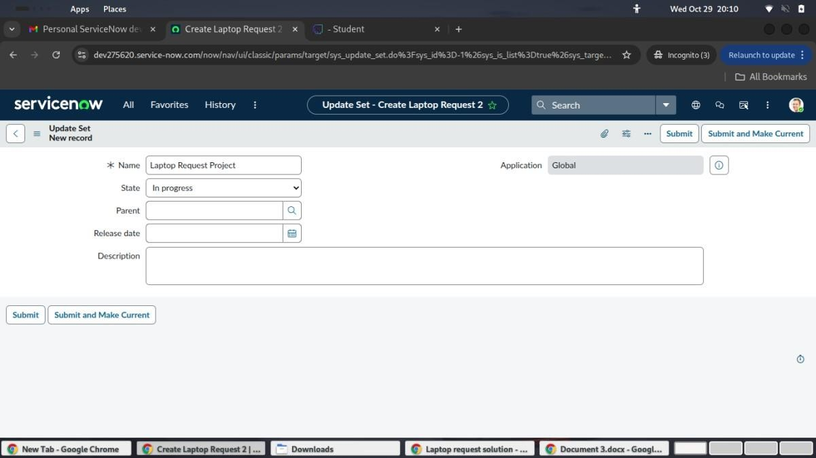
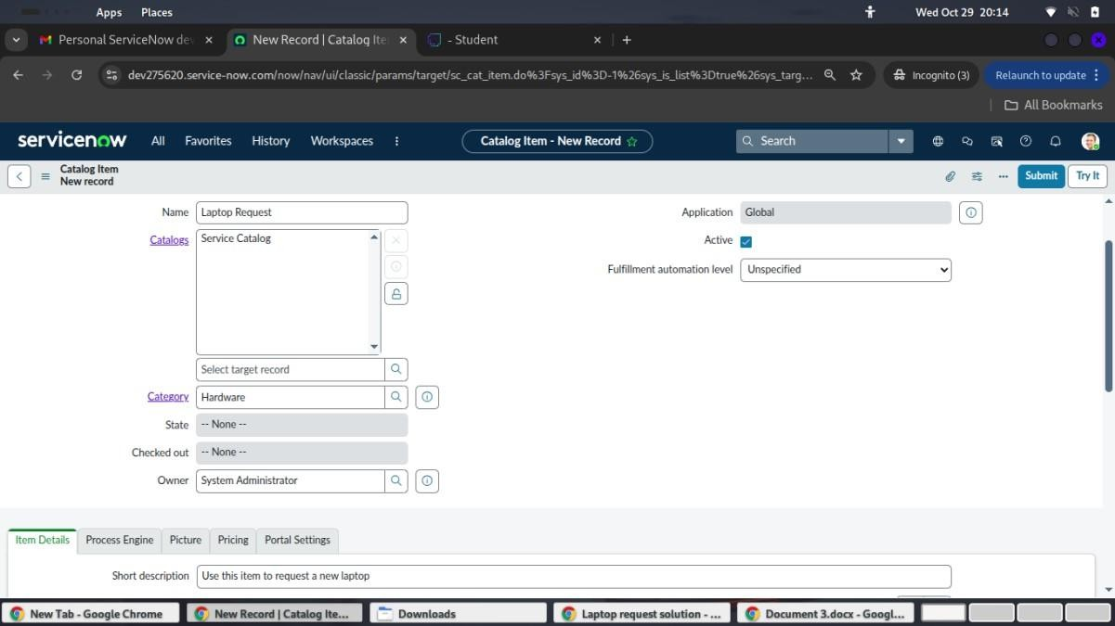
Screenshots:
Phase 1 : Create Local Update set
Phase 2 : Create Service Catalog Item
Phase 3 : Add variables

Slide 16
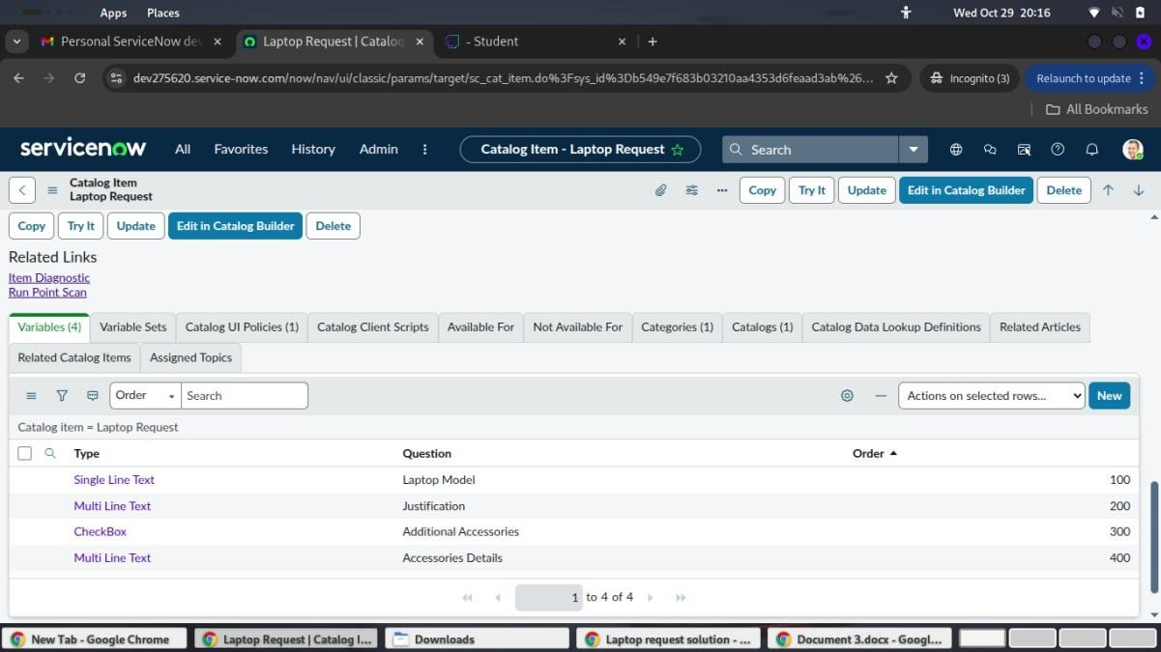
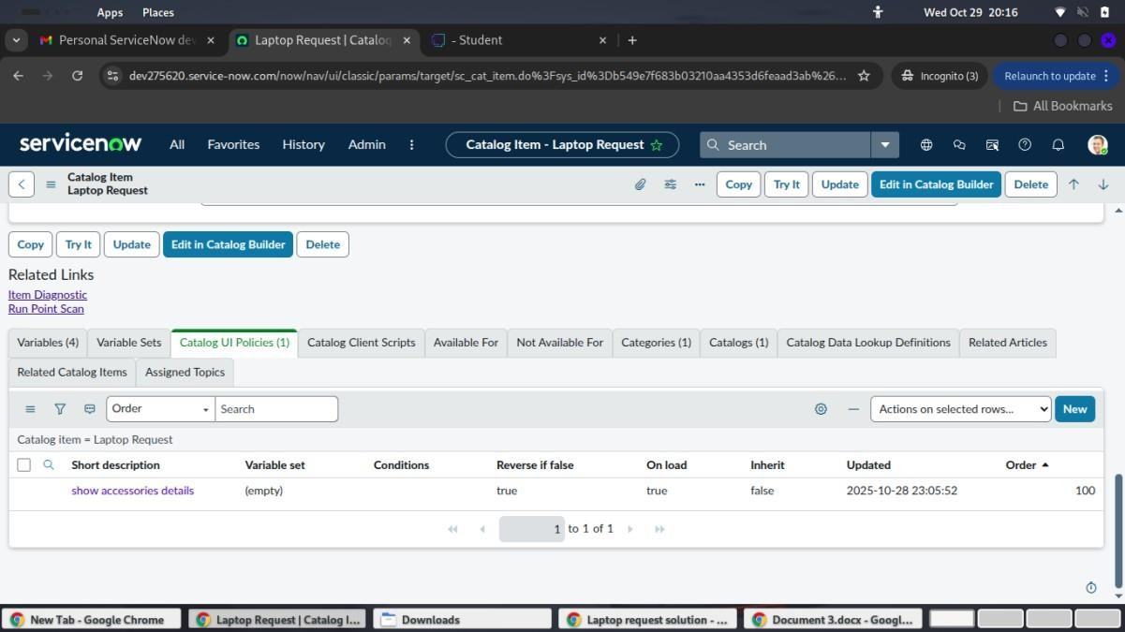
Phase 4 : Create Catalog Ui policies
Phase 5 : Create ui action

Slide 17
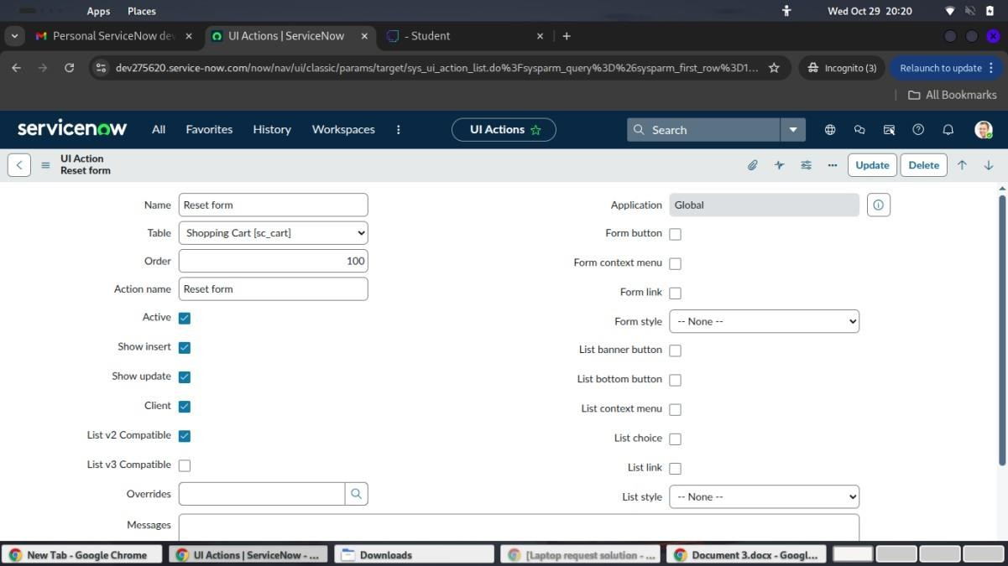
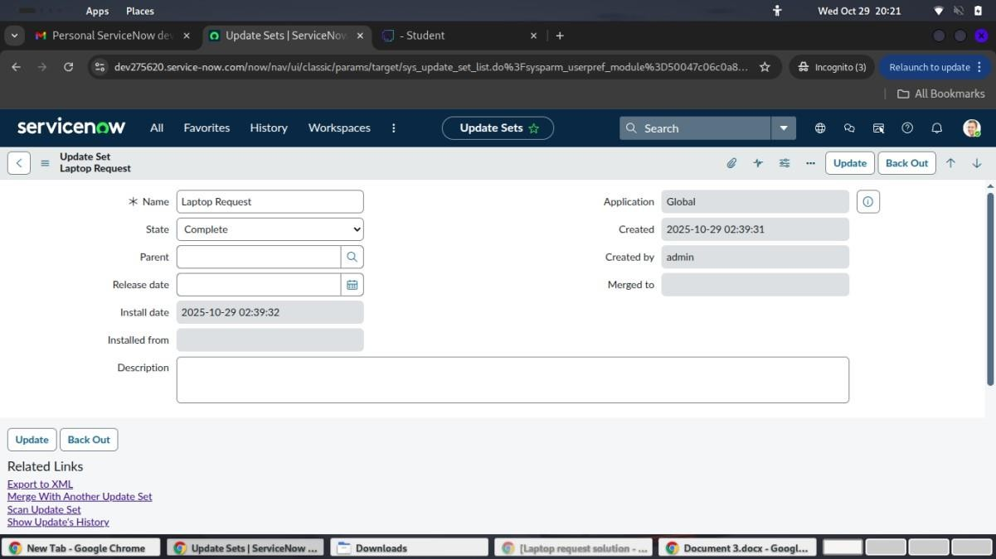
Phase 6 : Exporting changes to another instances

Slide 18
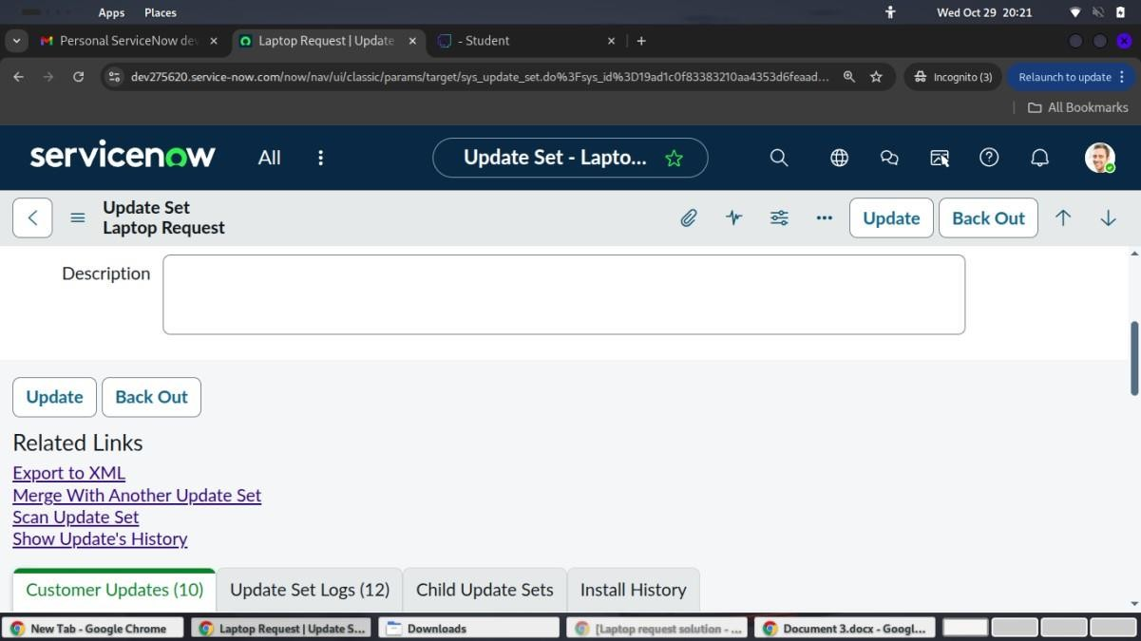
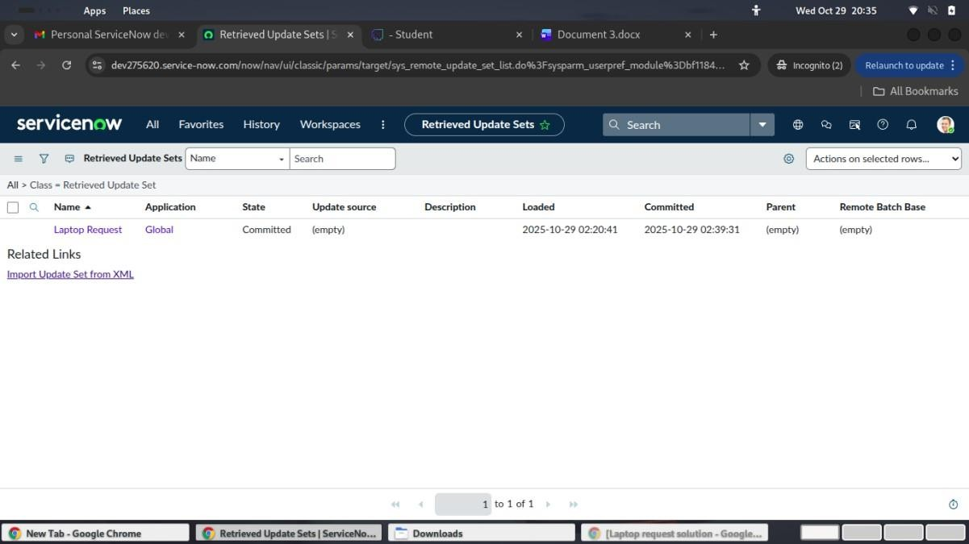
Phase 7 : Retrieving the update set

Slide 19
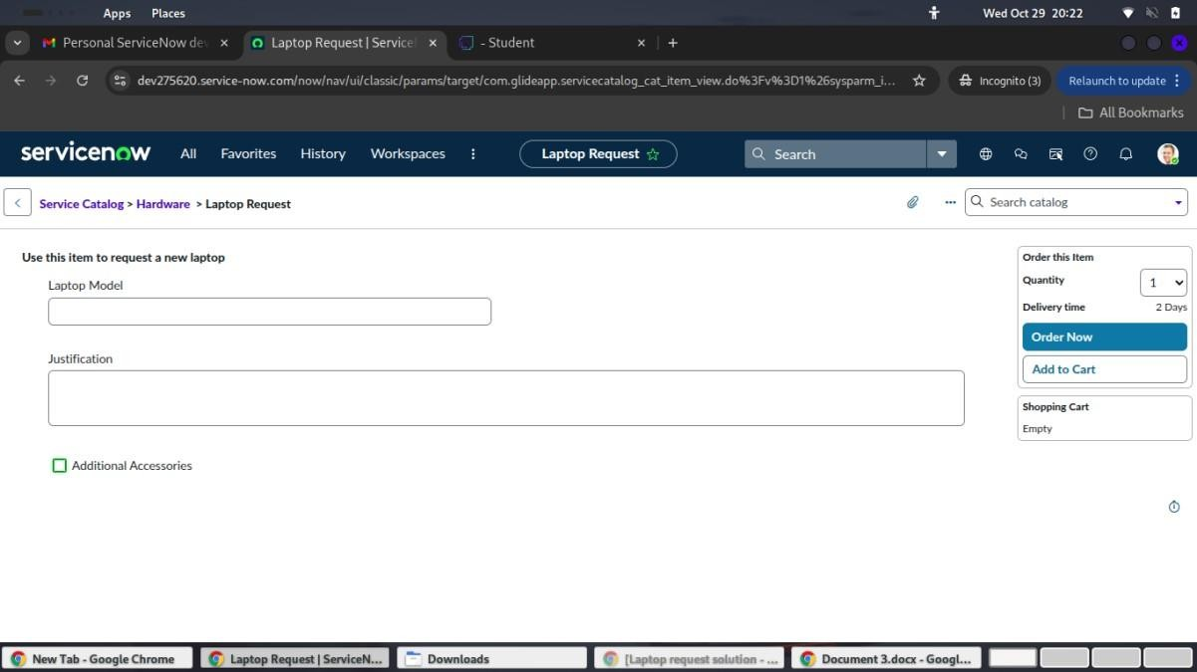
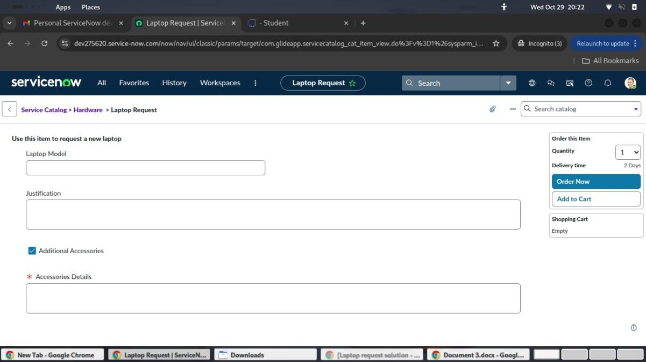
Phase 8 : Test Catalog Item

Slide 20
PROJECT DESIGN PHASE

Slide 21
Problem – Solution fit
Problem
The organization’s current laptop request process is manual, time-consuming, and lacks transparency. Employees must rely on emails or paper forms, causing:
Delays in approvals and provisioning.
Missing or incorrect data due to unstructured forms.
Repeated communication with IT staff.
No clear visibility into request status or history.
This inefficiency reduces productivity and increases workload for both employees and IT teams.
Proposed Solution
To address these challenges, the project introduces an automated Service Catalog Item in the ServiceNow platform that:
Allows employees to submit laptop requests digitally through a self-service portal.
Includes dynamic form fields that adapt based on the employee’s department, role, or laptop type.
Offers a reset button to clear the form and start over easily.
Integrates a workflow-driven approval process, automatically routing requests to managers and IT admins.
Ensures real-time tracking and email notifications at each stage.
Maintains audit logs to track all changes for compliance and governance.
20

Slide 22
Parameter | Description
Service Catalog Item Creation | Develop a dedicated catalog item in ServiceNow that allows employees to request laptops through a structured, user-friendly interface.
Dynamic Form Fields | Configure form fields that change dynamically based on user input, such as department, role, or device preference, ensuring accurate and relevant data collection.
UI Policy and Client Scripts | Implement UI Policies and scripts to guide users, enforce mandatory fields, and display context-specific instructions for better usability.
Reset Form Functionality | Add a reset button to allow users to clear all fields and restart the request process easily.
Approval Workflow | Design an automated approval workflow that routes requests to the appropriate manager or IT admin for quick action.
Notification System | Enable automated email notifications to update users about request submission, approval, and provisioning status.
Update Set and Migration | Use Update Sets to capture configuration changes, enabling easy deployment to other ServiceNow instances.
Audit and Tracking | Maintain complete visibility of all changes and requests for governance, compliance, and accountability.
Performance Optimization | Ensure the catalog item loads quickly, uses minimal resources, and delivers a seamless experience for users across devices.

Slide 23
Conclusion
The Laptop Request Catalog Item project successfully streamlines the process of requesting laptops within the organization by leveraging ServiceNow's Service Catalog capabilities. Through the implementation of a dynamic catalog item, the project ensures that users have an intuitive and user-friendly interface, reducing errors and improving efficiency.This project demonstrates how ServiceNow can be used to replace manual, errorprone processes with automated, efficient, and user-centric solutions. It not only improves service delivery but also enhances employee satisfaction by providing a modern and streamlined request experience.
Solution Architecture
Goals of the Architecture
The main goal of the solution architecture is to design a scalable, automated, and user-friendly system for employees to request laptops efficiently while ensuring accuracy, governance, and ease of maintenance.
Key Goals:
  To automate the laptop request process through a self-service catalog.
  To provide a dynamic and guided form that adapts based on user input.
  To enable workflow-driven approvals for faster and more transparent processing.
  To ensure data accuracy, auditability, and governance through controlled changes.
  To deliver a seamless user experience with optimized performance and security.
Key Components
  Service Portal Interface: User-friendly portal for submitting laptop requests.
  Catalog Item & Form Fields: Dynamic fields for accurate data input.
  Client Scripts & UI Policies: Manage field visibility, validations, and reset actions.
  Workflow / Flow Designer: Automates approval and fulfillment processes.
  Notification System: Sends status updates and alerts to users.
  Integration Layer: Connects with HR, CMDB, and Asset systems.
  Audit & Tracking Module: Logs all activities for governance and compliance.
  Update Set / Deployment Manager: Manages configuration migration across environments.
Development Phase
  Requirement Analysis: Gather user needs, identify process gaps, and define functional goals.
  Design & Architecture: Plan system flow, UI structure, and integration points.

Slide 24
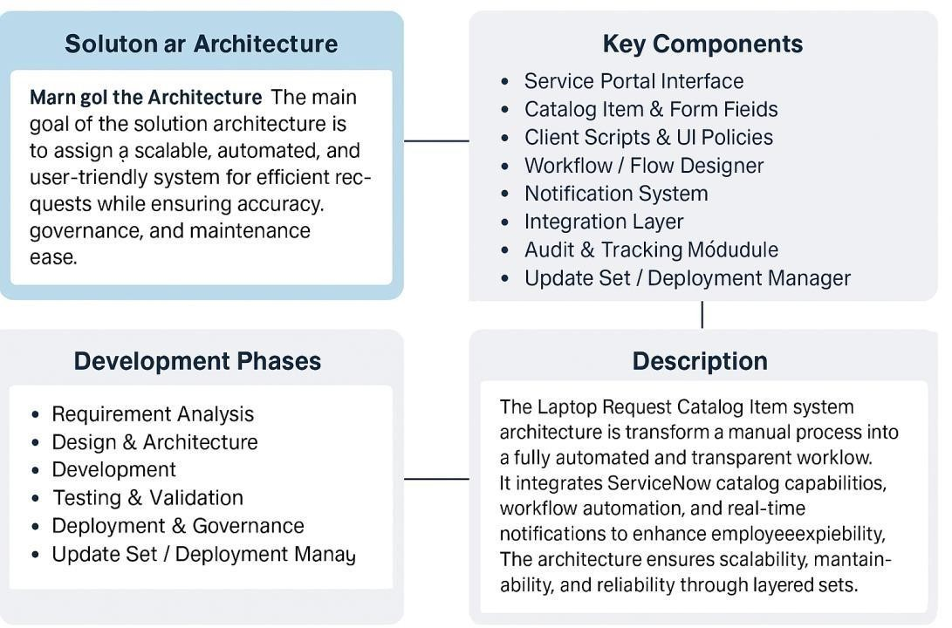
Development: Configure catalog item, client scripts, workflows, and dynamic behaviors.
Testing & Validation: Conduct functional, performance, and user acceptance testing.
Deployment & Governance: Deploy solution, enable audit tracking, and ensure compliance.
Solution Architecture Description
The Laptop Request Catalog Item system architecture is built to transform a manual, error-prone laptop request process into a fully automated and transparent workflow. The architecture integrates ServiceNow catalog capabilities, workflow automation, and real- time notifications to enhance the employee experience. Dynamic form fields simplify data entry, while automated approvals and tracking ensure efficiency and compliance. The layered structure — consisting of User Interface, Workflow Logic, Integration Services, and Governance Modules — ensures scalability, maintainability, and reliability. The system supports continuous improvement through monitored metrics, audit logs, and update sets for version control.
Solution Architecture Diagram

Slide 25
Project Planning Phase
1. Product Backlog

Slide 26
ID Feature / Task
PB1 Laptop Request Form
Description Priority
Create a dynamic form to capture laptop request High
details
PB2 Form Reset Option
Implement reset functionality for user convenience
Medium
PB3 UI Policy C Validation
Ensure correct field visibility and data validation High
Design automated approval routing High
PB4 Approval Workflow
PB5 Notification System Send confirmation and approval emails Medium
PB6 Audit C Tracking Module Track and log user actions for governance High
PB7 Deployment
Export update sets and migrate configuration
Medium
Management
2. Sprint Planning
Sprint Duration Major Goals
Sprint 1 Week 1–2 Requirement gathering and catalog form design Sprint 2 Week 3–4 Add UI policies, validations, and client scripts

Slide 27
Sprint 3 | Week 5–6 | Implement workflows and notifications
Sprint | Duration | Major Goals
Sprint 4 | Week 7–8 | Conduct testing, fix bugs, and prepare deployment
3. User Stories
Story ID | As a... | I want to... | So that I can...
US1 | Employee | Request a laptop easily | Get the device without delays
US2 | Manager | Approve or reject requests quickly | Maintain workflow efficiency
US3 | Admin | Track and audit form usage | Ensure compliance and accuracy
US4 | Developer | Reset form and manage validations | Improve usability and data quality
4. Story Points
Story ID | Complexity | Story Points
US1 | Medium | 5
US2 | Medium | 4
US3 | High | 6
US4 | Low | 3

Slide 28
REQUIREMENT ANALYSIS

Slide 29
1. Solution Requirements
Type | Requirement | Description
Functional | Dynamic Laptop Request Form | Enable users to submit laptop requests with dependent fields (e.g., department → model type).
Functional | Form Reset Function | Allow users to reset all form fields easily.
Functional | Approval Workflow | Route requests automatically to the appropriate approver.
Functional | Notification Alerts | Send automated emails for submission, approval, and rejection.
Functional | Audit Logging | Record all activities for governance and transparency.
Non- Functional | Performance Efficiency | Ensure form submission happens under 2 seconds.
Non- Functional | Data Security | Protect employee and asset data with access control.
Non- Functional | Scalability | Support increasing number of users without performance drop.
Non- Functional | Maintainability | Allow easy configuration updates through update sets.

Slide 30
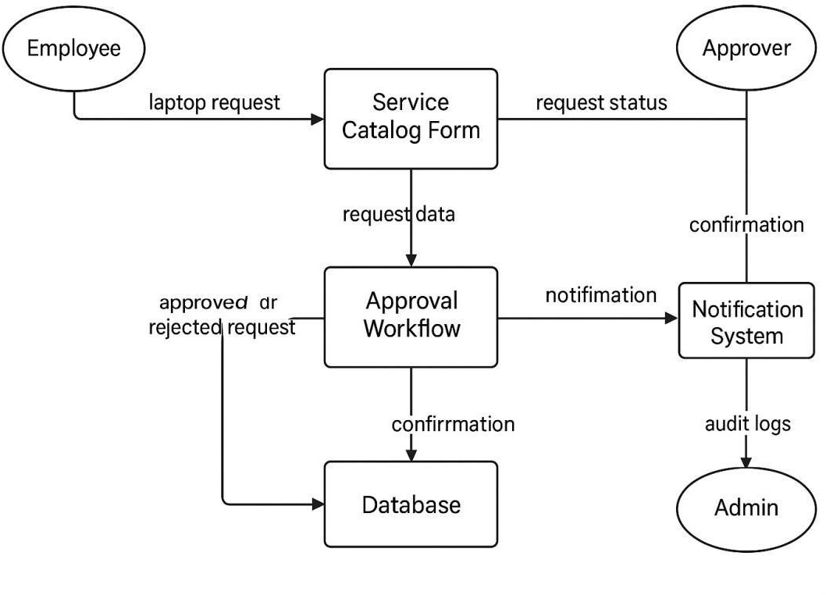
2. Data Flow Diagram (DFD – Level 1)
Description:
The DFD represents the data movement between the User, System Catalog Module, Approval Workffow, Database, and Notification System.
Flow Steps:
Employee submits laptop request via the Service Catalog Form.
Request data is validated and sent to the Workflow Engine.
The Approver reviews and updates the request status.
Approved or rejected data is stored in the Database.
The Notification System sends confirmation emails to the employee.
Admin monitors through the audit and tracking module.
30

Slide 31
3. Technology Stack
Layer | Technology / Tool | Purpose
Frontend | ServiceNow Service Portal | Interface for users to submit laptop requests
Backend | ServiceNow Platform (Glide System) | Handles business logic, workflows, and automation
Database | ServiceNow Data Tables | Store request, user, and approval records
Automation Tools | Flow Designer / Workflow Editor | Automates approval and fulfillment
Scripting | JavaScript (Client Scripts, UI Policies) | Controls form behavior and validation
Layer | Technology / Tool | Purpose
Notifications | ServiceNow Email Notification Engine | Sends automated messages to stakeholders
Deployment | Update Sets | Package and migrate configurations
Tracking | Audit Logs C Change History | Ensures transparency and compliance
31

Slide 32
GENERATIVE AI IN ACTION
Artificial intelligence has evolved through numerous phases, yet it remains both intriguing and inspiring to witness machines become increasingly capable of crafting poetry, humor, and responses that uncannily mimic human creativity. You’ll learn about the history of AI, how deep learning plays a pivotal role in generative AI (“gen AI”), and how gen-AI works and is applied to various industries. Throughout this course, you will also learn how to create algorithms, and gain hands-on experience writing code using popular programming languages.
Completed the following required modules to earn an industry-recognized IBM SkillsBuild digital credential called Generative AI in Action:
Introduction to Generative AI
Crafting Precision Prompts with Generative AI
Coding Simplified with Generative AI
After completing Generative AI in Action, I was able to:
  Explain how generative artificial intelligence works
  Define what foundation models are and their role in machine learning
  Understand how transformers models are used to solve various language-related tasks
  Describe how prompt engineering improves generative AI models
  Identify common prompt elements
  Explore code generation using a natural language prompt
  Describe prompt engineering techniques
  Perform common programming tasks using Python’s built-in functions and libraries
  Create scripts and code for solving real-world problems and automating routine tasks
MODULE 1 - Introduction to Generative AI
In this course, I have learned about the history of AI, how deep learning plays a pivotal role in generative AI (gen-AI), and how gen-AI works and is applied to various industries. I also learned how to create algorithms, and gain hands-on experience writing code using popular programming languages.
After completing this module, I was able to:
  Explain how generative artificial intelligence (gen-AI) works
  Define what foundation models are and their role in machine learning
  Understand how transformers models are used to solve various language-related tasks

Slide 33
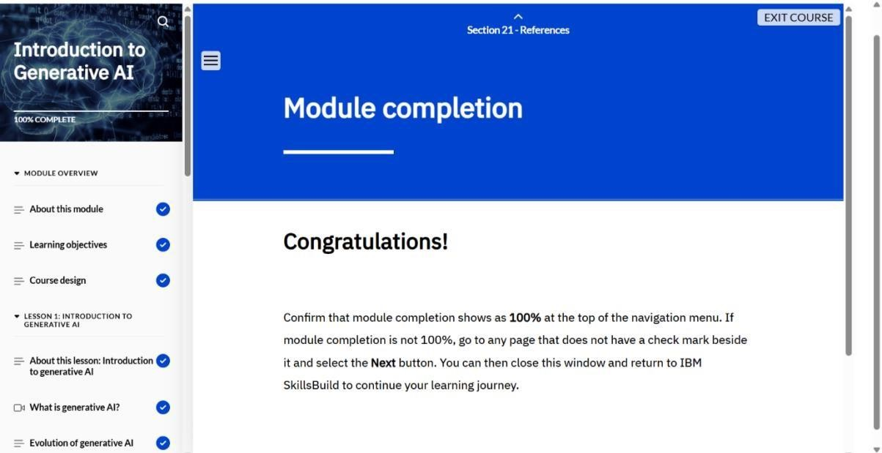
Describe how prompt engineering improve generative AI models
Perform common programming tasks using Python's built-in functions and libraries
Create scripts and code for solving real-world problems and automating routine tasks
MODULE 2- Crafting Precision Prompts with Generative AI
This was an activity-based course. I learned about AI language models and the rules to follow when giving instructions, or prompting, an AI language model. I walked-through a guided activity that demonstrates how to write effective prompts for an AI language model to help plan a travel itinerary. Finally, I participated in an activity to apply what I learned to effectively write prompts for an AI language model to create my own custom music playlist.
After completing this course, I was able to:
Describe an AI language model
Explain how an AI language model understands and responds to humans
Identify the rules to follow to write effective prompts to generate focused and accurate results from an AI language model
List the steps to sign up for a ChatGPT account
Follow the steps to effectively write and refine a series of prompts for ChatGPT for a travel itinerary scenario
Demonstrate the steps to effectively write and refine a series of prompts for ChatGPT to create a custom music playlist

Slide 34
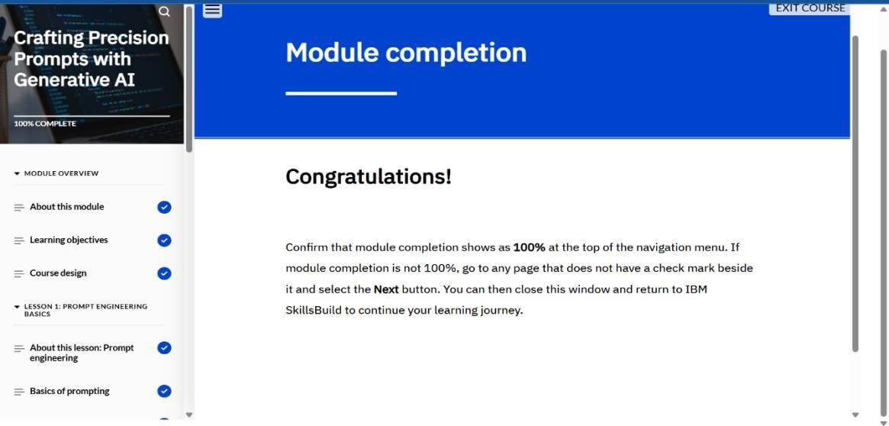
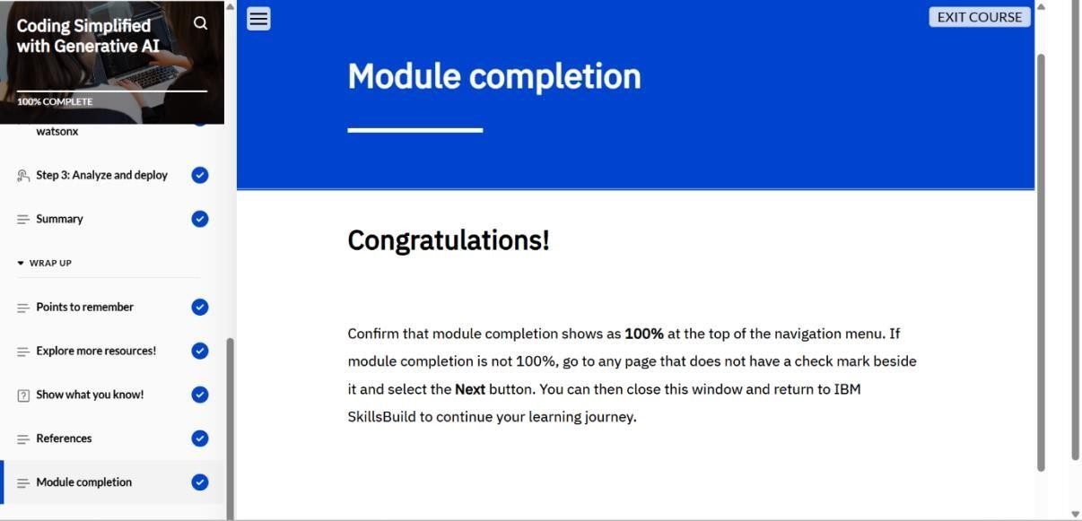
MODULE 3- Coding Simplified with Generative AI
In this course, I had learned the basics of scripting, understand its distinctions from traditional programming, and explore how generative AI models are used to simplify and streamline code generation. Through hands-on labs, I also learned how to create algorithms and apply my skills using widely used programming languages.
After completing this module, I was able to:
Define scripting and how it is works
Explain the differences between scripting and traditional programming and when each approach is used
Describe how Python is used to perform various tasks
Create a working Python application using IBM watsonx Code Generation

Slide 35
CONCLUSION
The Generative AI in Action program provided a solid foundation in understanding the core principles and practical applications of generative artificial intelligence. Through the three modules—Introduction to Generative AI, Crafting Precision Prompts with Generative AI, and Coding Simplified with Generative AI—I developed a deep understanding of how AI models such as foundation and transformer models function, and how prompt engineering enhances their effectiveness. The hands-on activities improved my ability to craft accurate prompts, automate coding tasks, and generate creative as well as technical outputs using Python and AIassisted tools. Overall, this program strengthened my knowledge of AI-driven innovation, improved my coding proficiency, and equipped me with essential skills to apply generative AI techniques in real-world scenarios across multiple industries.
GITHUB LINK:
https://github.com/swathisusila

