Slide 1
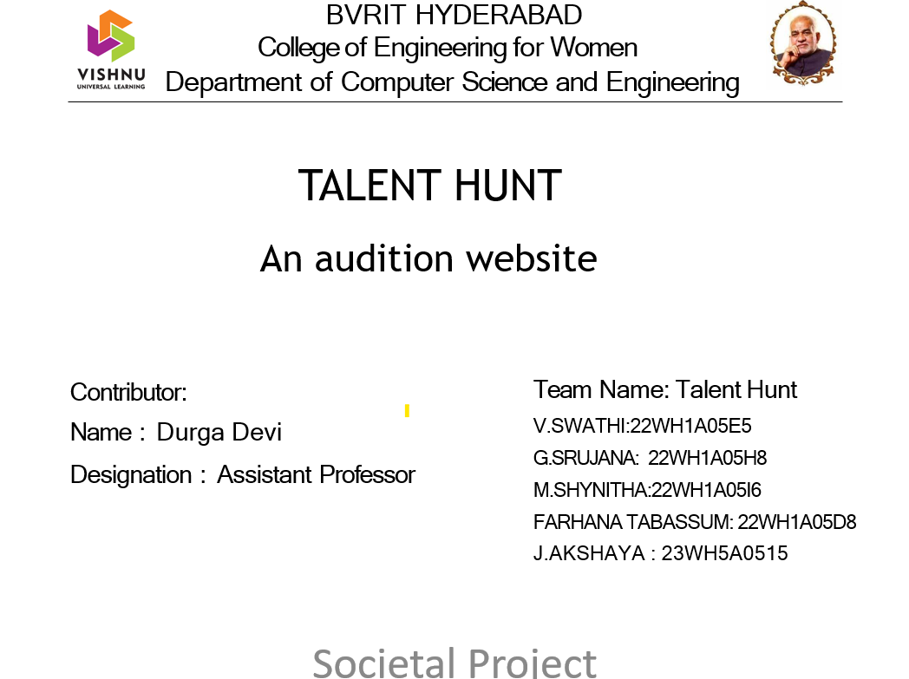

Slide 2
AGENDA
Introduction
Problem Statement
Existing System
Tools and Technology
Societal Impact
Results
References

Slide 3
INTRODUCTION
Talent Hunt is a platform for aspiring performers to showcase their skills and get discovered. Whether one is a singer, dancer, actor, comedian, or any kind of performer, Talent Hunt offers a stage for every talent to shine.
Designed with ease of use in mind, Talent Hunt allows users to effortlessly connect with industry professionals, and catch the eye of top talent scouts and agents. More than just an auditioning website, Talent Hunt is a vibrant community where dreams take flight and careers are launched.

Slide 4
PROBLEM STATEMENT
The traditional auditioning process in the entertainment industry is inefficient and restrictive, often requiring in-person tryouts and manual submissions. This creates barriers for aspiring performers, such as high travel costs and limited access to industry connections, hindering their opportunities to be discovered.
OBJECTIVE: To overcome these challenges, there is a need for a streamlined, user-friendly online platform. This website will allow performers to submit their audition forms easily and enable industry professionals to review submissions efficiently.

Slide 5
EXISTING SYSTEM
Homepage: This is the first impression for visitors. It should be engaging, providing an overview of what the talent hunt is about, how it works, and why people should participate.
Registration/Login: Users should be able to create accounts or log in with existing ones. Collect necessary information like name, email, and possibly a brief bio.
Audition Categories: Define different talent categories (e.g., singing, dancing, acting, comedy, etc.). Each category should have its own page with details on how to audition and any specific requirements.
Audition Submission: Users should be able to submit their audition materials directly through the website. This could include uploading videos, audio files, or written samples, depending on the talent category.

Slide 6
TOOLS AND TECHNOLOGIES
Front-End Development :HTML/CSS: For structuring and styling the web pages. The box model and responsive design are crucial concepts in web developments, especially when creating user-friendly and visually appealing websites.
Additional Tools:
VS Code: A source-code editor made by Microsoft.
Design:
Canva: A versatile graphic design platform that makes it easy to create a variety of visual content, including logos and edited pictures.

Slide 7
SOCIETAL IMPACT
Accesibility: Online auditioning platforms can make the audition process more accessible to people from diverse backgrounds who may not have had access to traditional audition opportunities due to geographical constraints, financial limitations, or other barriers.
Democratization of Talent: By providing a platform for anyone to showcase their talent online, regardless of their connections or location, these websites can democratize the talent discovery process.
Global Reach: Online auditioning websites can connect talent with opportunities on a global scale, breaking down geographical barriers and allowing performers to reach audiences and opportunities they might not have access to otherwise.

Slide 8
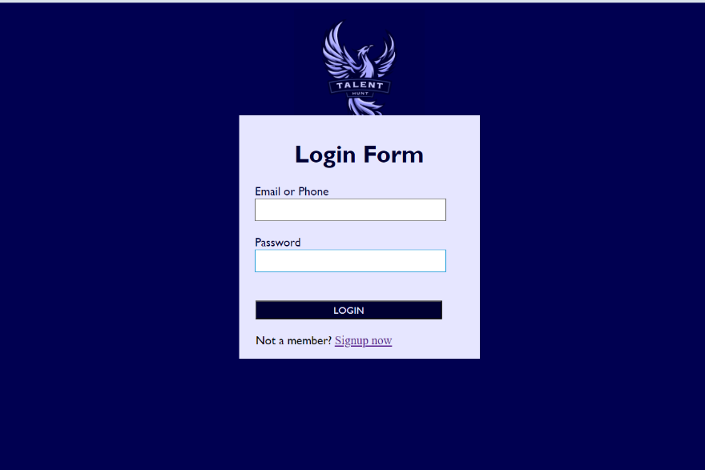

Slide 9
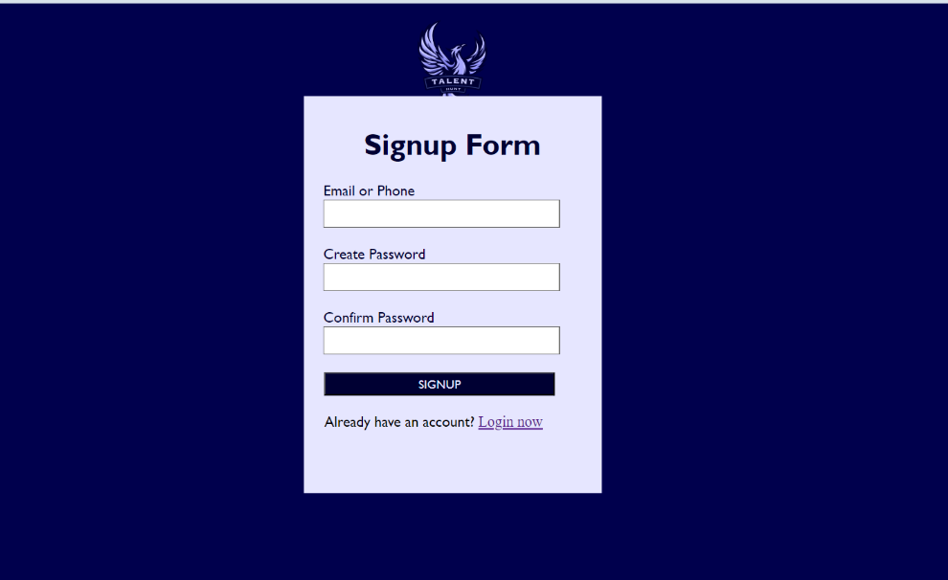

Slide 10
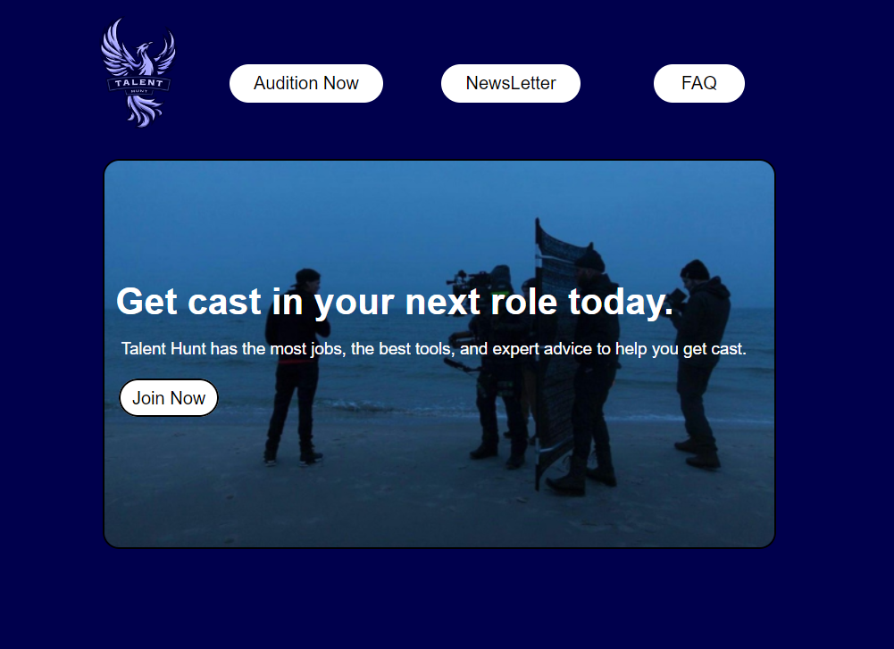

Slide 11
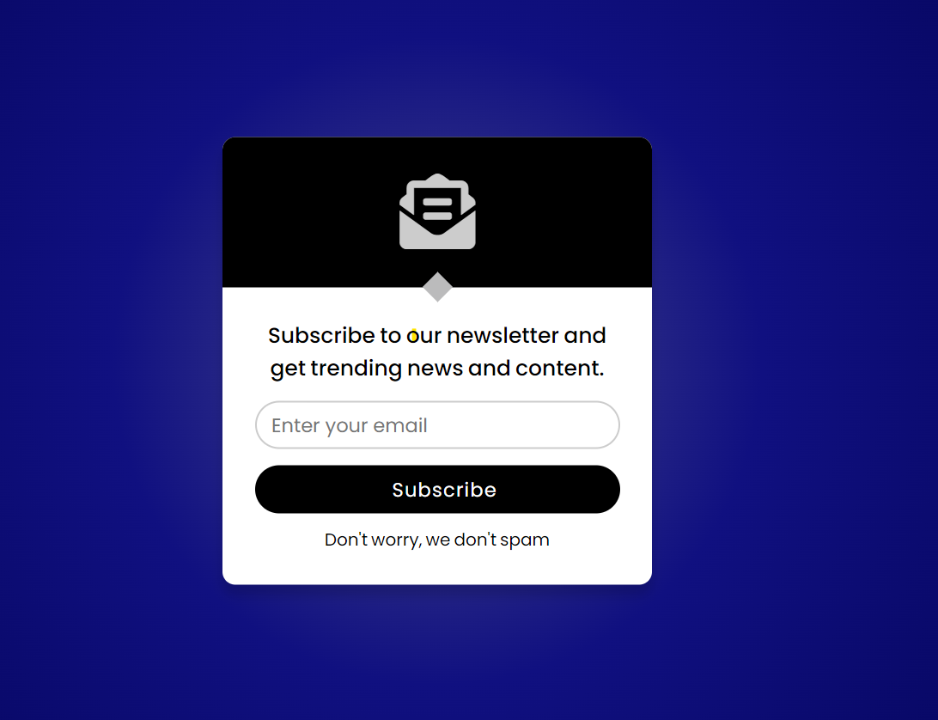

Slide 12
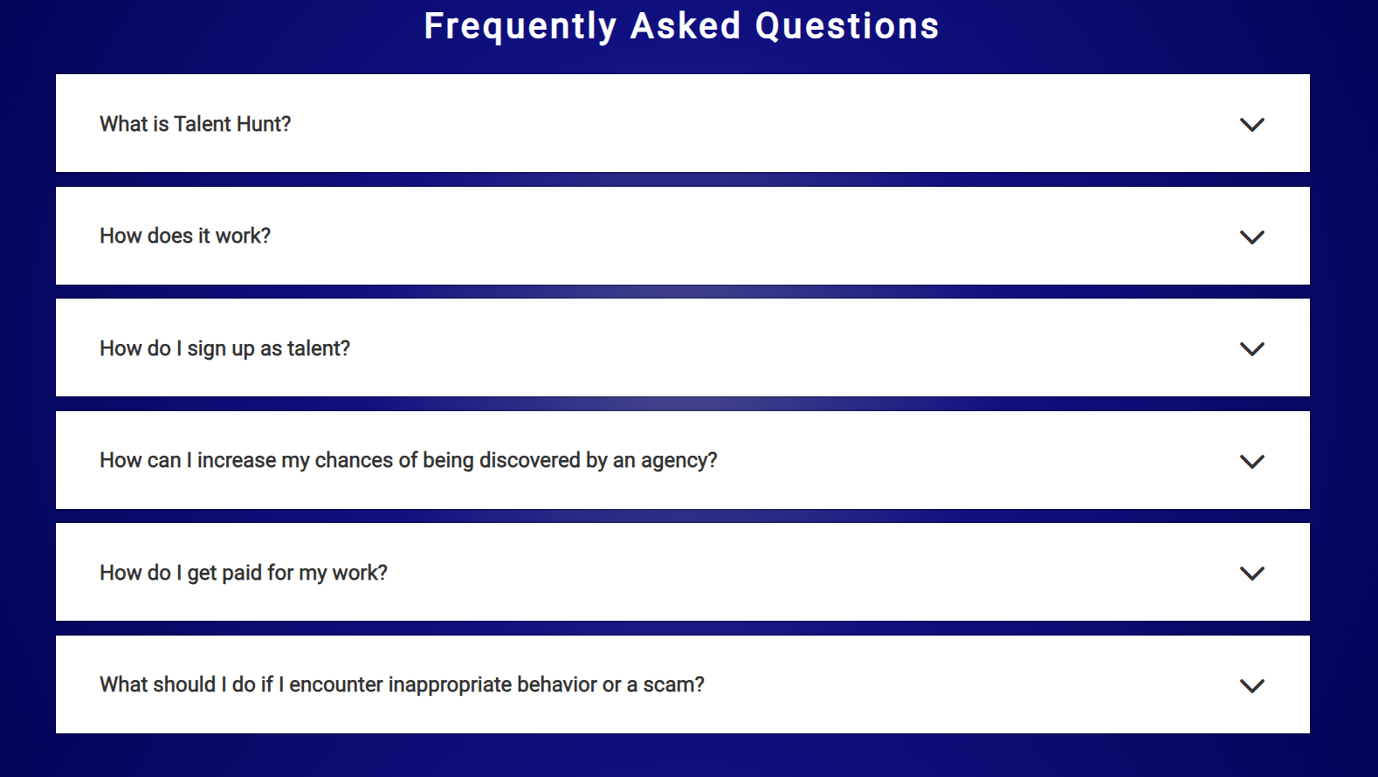

Slide 13
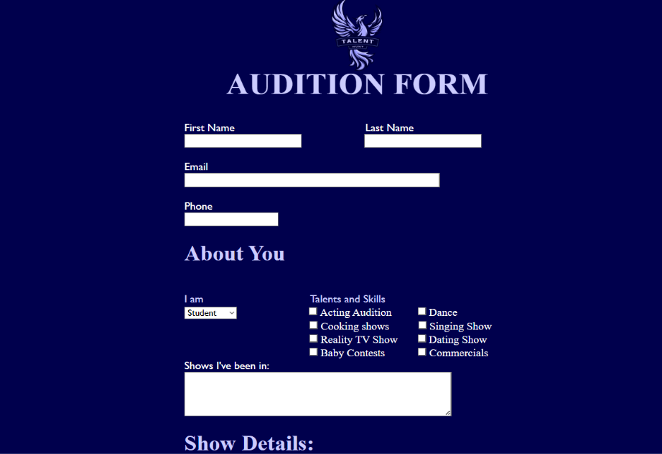

Slide 14
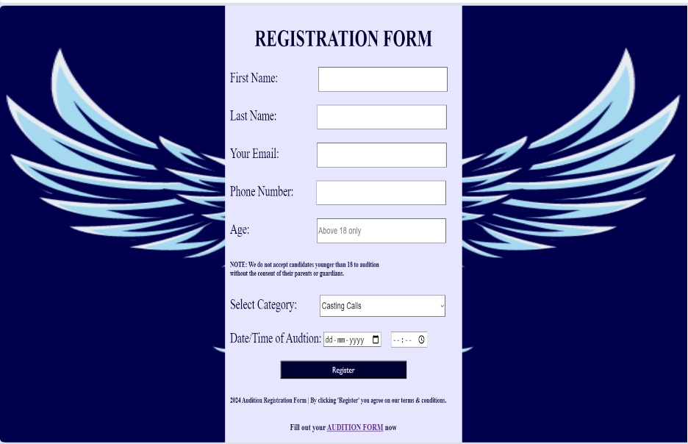

Slide 15


Slide 16
REFERENCES
Reference : www.backstage.com
When developing Talent Hunt, we drew inspiration from industry-leading platforms such as Backstage, renowned for their comprehensive approach to talent discovery and audition management. By studying Backstage's user experience, functionality, and best practices, we gained valuable insights that informed the design and development of our own audition website. Leveraging Backstage's success as a reference point, we aimed to create a user-friendly and inclusive platform that empowers aspiring talents to showcase their skills and pursue their dreams with confidence.

Slide 17
THANK YOU

