Slide 1


PHARMACY MANAGEMENT SYSTEM
SUPERVISOR Mr.A.Malarmannan,M.E., AP/CSE.
PRESENTED BY
2303811710422165 – SWATHI V

Slide 2

PRESENTATION OVERVIEW
Objective
Project Introduction
Problem Statement
Methodologies (Programming concepts relevant to problem statement)
Architecture of the proposed system
List of Modules
7. Merits
8. Results and Discussion
9. Queries

Slide 3
OBJECTIVE
The objective of a Pharmacy Management System is to streamline and automate the operations of a pharmacy, ensuring efficient management of inventory, prescriptions, and sales. It aims to improve the accuracy of medication dispensing, track stock levels in real-time, and ensure compliance with regulatory requirements. Additionally, it enhances customer service by managing patient records, processing prescriptions, and providing detailed reports.

Slide 4
PROJECT INTRODUCTION
A Pharmacy Management System (PMS) is a software solution designed to manage the day-to-day operations of a pharmacy. It helps in automating key tasks such as inventory control, prescription management, billing, and customer data handling. By integrating various processes, the system ensures accurate medication dispensing, reduces human errors, and improves the efficiency of pharmacy staff. The system enhances operational efficiency, improves customer service, and supports the growth of the pharmacy business.

Slide 5
PROBLEM STATEMENT
The problem with traditional pharmacy management lies in the reliance on manual processes, which are prone to errors, inefficiencies, and delays. Challenges such as inaccurate inventory tracking, mismanagement of prescriptions, and slow billing systems often lead to stock discrepancies, medication errors, and poor customer service. These issues result in increased operational costs, wasted time, and a higher risk of mistakes, highlighting the need for an automated Pharmacy Management System to improve accuracy, efficiency, and overall pharmacy performance.

Slide 6
Methodologies (Programming concepts relevant to problem statement)
→Object-Oriented Programming (OOP):Classes and Objects, Encapsulation, Inheritance, Polymorphism are to represent real-world entities and their interactions. (eg : Medicine, Prescription, Customer, Pharmacy).
→GUI (Graphical User Interface):For user interaction, Java’s Swing or JavaFX libraries are used to create a graphical user interface (GUI) for pharmacy staff to easily manage inventory, prescriptions, and billing.
→Multithreading: It can be used to handle multiple operations concurrently, such as processing customer orders, updating inventory, and generating reports.

Slide 7
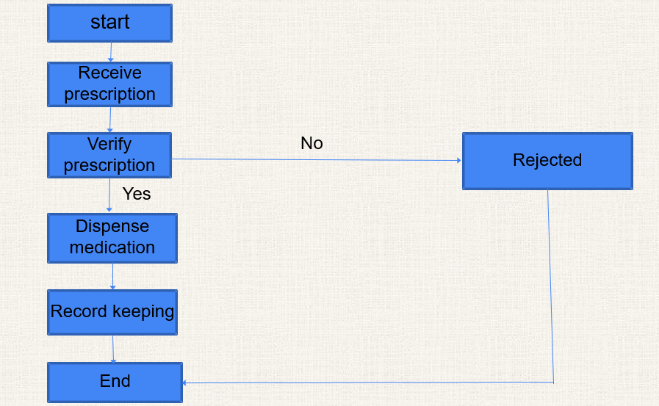
FLOW DIAGRAM

Slide 8
MODULE DESCRIPTION
1.Prescription Management Module:
→This module is responsible for handling the entire lifecycle of prescriptions, from creation and verification to dispensing.
2. Patient Management Module:
→This module manages patient-related information, including personal details, medical history, medication records, and prescriptions.
3.Billing and Payment Module:
→This module handles all aspects of billing and payment processing, from calculating medication costs to generating invoices and processing payments.
4.Reporting Module:
→This module generates reports that help pharmacy managers make data-driven decisions, manage profitability, and plan future stock needs.

Slide 9
MERITS
Improved Accuracy: Reduces human errors in prescriptions, inventory, and billing.
Real-time Inventory Tracking: Monitors stock levels to prevent shortages or overstocking.
Time Savings: Automates tasks like billing and inventory management, speeding up processes.
Regulatory Compliance: Helps meet legal and regulatory requirements easily.
Scalability: Can grow with the pharmacy as it expands.

Slide 10
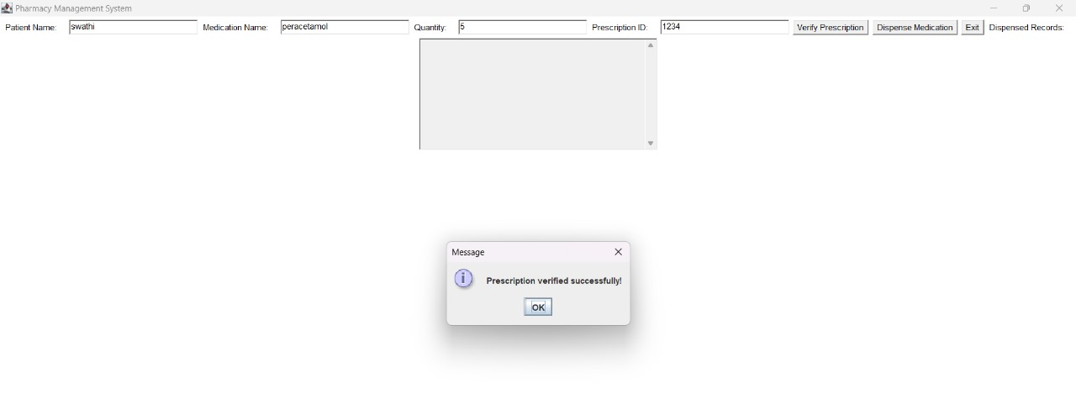
RESULT AND DISCUSSION

Slide 11
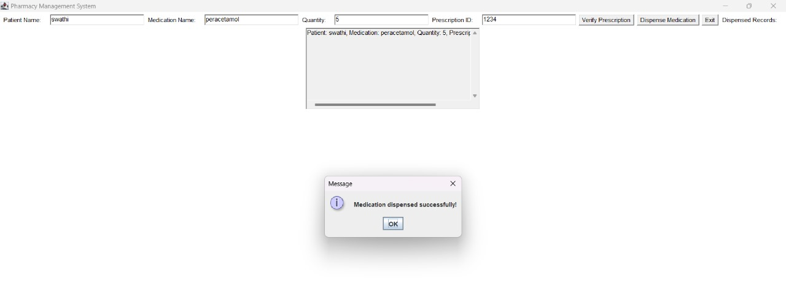

Slide 12
ANY QUERIES ?

Slide 13
THANK YOU

