Slide 1

WELCOME
AI for prediction of extreme weather events

Slide 2
ADITYA DEGREE COLLEGE FOR WOMEN’S,KAKINADA
3RD BSC CS-2
1.Y.V.SWATHI 2. M.DEEPIKA 3. D.LAVANYA 4. V.SUPRIYA
5.D.LALITHA 6.S.MOUNIKA REDDY

Slide 3
AI in Climate Applications
An Overview of How Artificial Intelligence Helps Fight Climate Change

Slide 4
Introduction
Climate change is one of the biggest global challenges, causing rising temperatures and extreme weather.
Traditional methods are not enough to handle the scale and complexity of climate issues.
Artificial Intelligence (AI) helps by analyzing large amounts of climate and environmental data.
AI improves climate forecasting, disaster prediction, and sustainable resource management.

Slide 5
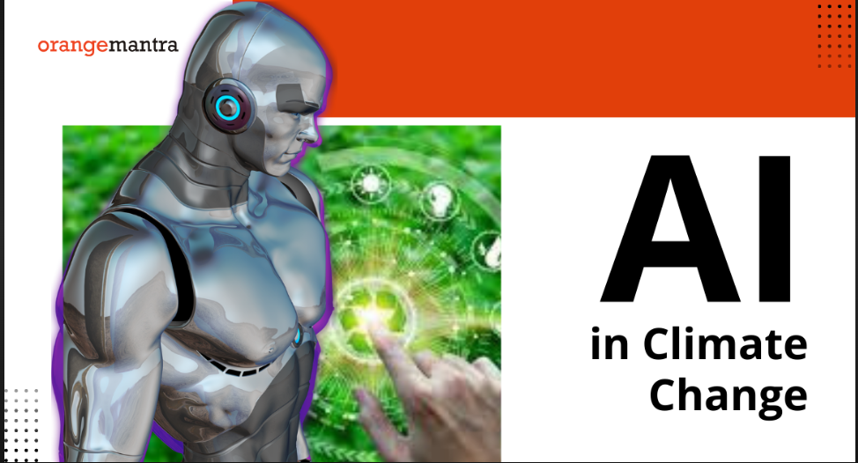
AI in Climate Modelling
AI reduces computational cost and time compared to traditional climate simulation.
Neural networks can detect hidden patterns in temperature, rainfall, and CO₂ levels.
AI models help in predicting long-term climate trends and extreme events.
It supports regional climate analysis, useful for local adaptation strategies..

Slide 6

AI for Renewable Energy
AI improves the efficiency and reliability of renewable energy systems like solar, wind, and hydro.
Machine Learning predicts energy demand and supply fluctuations for better grid management.
AI helps in forecasting solar radiation and wind speeds to optimize power generation.
Smart algorithms reduce energy storage costs by managing batteries effectively

Slide 7

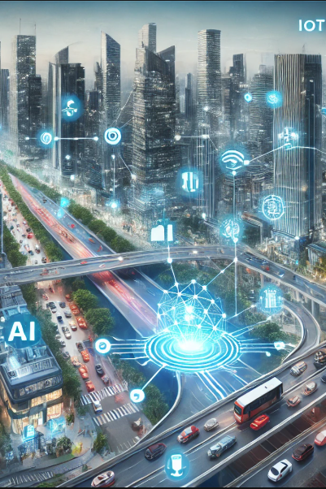
AI in Smart Cities
AI manages traffic flow and reduces congestion through smart traffic signals.
Machine Learning improves energy efficiency in buildings and street lighting.
AI supports waste management by optimizing collection routes and recycling.
Smart surveillance with AI enhances public safety and crime detection.

Slide 8
AI for Disaster Management
AI analyzes satellite images and sensor data to detect early warning signs of disasters.
Machine Learning models predict floods, earthquakes, storms, and wildfires with higher accuracy.
AI supports real-time monitoring and quick response during disasters.
Chatbots and AI systems assist in emergency communication and rescue operations.
AI helps in damage assessment by analyzing post-disaster images and reports.

Slide 9

Challenges
Data limitations: Lack of high-quality, long-term climate data for accurate modeling.
High computational cost: AI models require significant computing power and energy.
Complexity of climate systems: Difficult to capture all variables and interactions
Interpretability issues: AI predictions can be hard to understand and trust.

Slide 10
Conclusion
AI is a powerful tool to understand, predict, and mitigate climate change
impacts.
It enhances climate modeling, renewable energy, agriculture, disaster
management, and smart cities.
AI enables efficient resource management and supports sustainable
development goals.

Slide 11

Thank you
.

