Slide 1
Product Backlog
# | User Story | Story points | priority
1 | As a user I want create a file and write data to that | 4 | 1
2 | As a user I want delete a file | 2 | 1
3 | As a user I want to view the files in ascending order | 2 | 1
4 | As a user I want to search a file | 2 | 1
5 | As a user I want to view a file specified | 1 | 2

Slide 2
Product Backlog item | Task to do | Started task | Done
As a user I want create a file and write data to that | Complete testing | Created a solution
As a user I want delete a file | Testing whether a file exist | Created a working function | code
As a user I want to view the files in ascending order |  | Creates function and tested
As a user I want to search a file | Testing whether the file exist | Created function with working codes
As a user I want to view a file specified | Complete testing | Created a solution

Slide 3
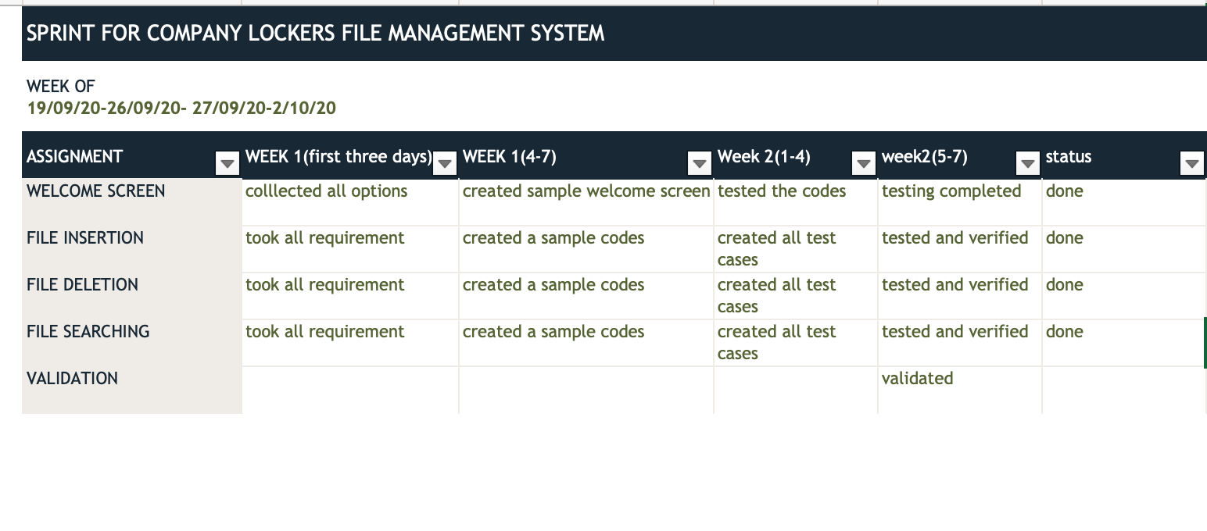

Slide 4
start
Read the name of file for searching
Display the file
Display the files
Read the name of file to be viewed
Read the input option
Read the name of file to be delete the file ,delete it, go back to menu
Display the contents of the file
If option 1,read the input file name
Read the input
Check the input ,if continue go back to main menu
stop
If file exist change the name else create the file , go back to menu

