Slide 1
Product Backlog
# | User Story | Story points | priority
1 | As an user I want to search for flights with inputs source and destination | 4 | 1
2 | As an user I want book the tickets | 3 | 1
3 | As an user I want to view the detailed view | 2 | 1
4 | As an admin I want to login to web page | 3 | 1
5 | As an admin I want to view a the user feedbacks | 1 | 2
6 | As an admin I want to change username and password | 2 | 2

Slide 2
Product Backlog item | Task to do | Started task | Done
As a user I want create a file and write data to that | Complete testing | Created a solution
As a user I want delete a file | Testing whether a file exist | Created a working function | code
As a user I want to view the files in ascending order |  | Creates function and tested
As a user I want to search a file | Testing whether the file exist | Created function with working codes
As a user I want to view a file specified | Complete testing | Created a solution

Slide 3
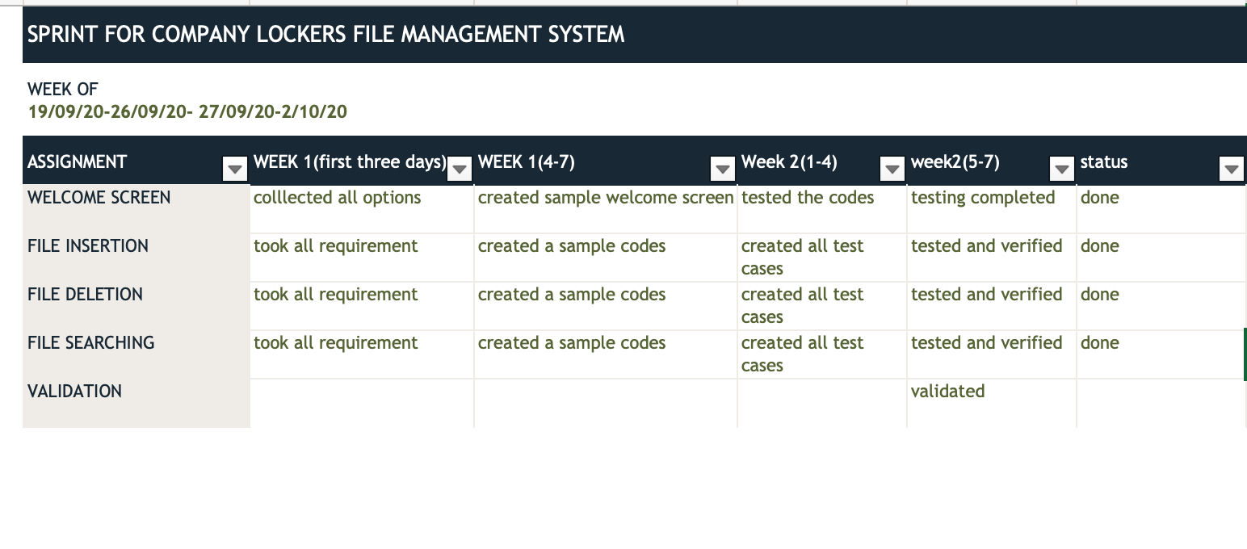

Slide 4
If 3 read the details of flight like source destination
start
If 2 display the flight details
Add the details to database
Check username and password
Update the database
If logout close the session
If true, forward to welcome page
If one read the new user name and password
Go to home page
stop
Display the links for change password, view flights add flights
Flow Chart for admin

Slide 5
Read the payment details
start
Display the details of the flights
Display the details of user including personal and flight details
Read the source destination for searching
Read the user details
Go to home page
Check the database if the correct source and destination exist
Read the selection from user
stop
If yes display the full details with ticket fare and flights
Flow Chart for user

