Slide 1
CHICAGO Crimes
Does Weather Affect Crimes?

Slide 2


Executive summary
Crime rates and avenues of committing crime have been on the rise and it is unsettling to know how much we need to be on our toes to stay abreast of vulnerable situations. How can we predict crime? Can we understand the underlying patterns?
What?
All crimes leave a trail. In our case we are looking at the trail left by nature – Weather. This analysis aims to unveil any trends in crime that are influenced by weather and find actionable insights from Chicago crime data.
Why?
Further expansion of the analysis and its implementation to real-time crime analysis can prove beneficial to the government, police departments and the citizens, in the form of cognitive ability to sidestep crime or to provide assistance to citizens through alerts.
How?

Slide 3
DATA Architecture

Slide 4
SERVER details
Server | Function
Extractor server | Parses CSV data file to extract raw data into Pandas Dataframe Directly connects to the RAW database server and inserts the dataframe Sends an AMQP message to the Broker under the topic update
Database server (RAW) | MySQL Database running on a GCP server Updated by the extractor server as and when raw data becomes available
Broker server | RabbitMQ server used to route AMQP messages through a topic-based Exchange Each data point published in the exchange must be received by a queue tied to a subscriber Published datapoints are not persisted in memory
Wrangling Server | Subscribes to the Exchange for AMQP messages from the Broker server under topic update Cleans and transforms the data (retrieved from RAW database) into a star schema Sends AMQP message to Broker under topic star_update
Database server (Analysis) | MySQL Database running on a GCP server Updated by the Wrangling server as and when data becomes available
Client Device | Subscribes to the broker for AMQP messages under topic star_update Connect with the Analysis database server to pull data for visualisation

Slide 5




Architecture and Data flow
Broker server
Data flow stages
Data is Extracted from a CSV file dumped from a website into a Dataframe
The dataframe is saved into the RAW database
A Signal is sent to the broker indicating the update
Wrangling server receives this signal
Wrangling server pulls RAW data, transforms and updates the Analysis Database
Wrangling server sends signal to broker indicating update
Client device receives update from broker
Client device pulls data from Analysis Database server for visualization and analysis
RabbitMQ
Exchange
Q
Q
Q
Extractor server
Wrangling server
2a
2b
3a
3b
.py
Cleaning + Transformation
1
.py
Data Extractor
Client device
3
2
Database server (Analysis)
Database server (RAW)
MySQL
MySQL
4
Legend
Communication Protocol
AMQP
Topic + message
Persistent connection
Temporary connection

Slide 6
DATA INGESTION

Slide 7





DATA
Data extracted from multiple sources to provide a comprehensive overview of the weather, geographical information and crimes related attributes.
Weather data of Chicago
Source: (Type : CSV)
https://www.ncdc.noaa.gov/cdo-web/datasets/GHCND/stations/GHCND:USW00094846/detail
Crime Data of Chicago
Source: (Type : CSV)
https://data.cityofchicago.org/Public-Safety/
Crime Data
Weather Data
Data Preparation:
Employed basic data cleaning/wrangling techniques on extracted data such as missing value treatment, filtering empty rows, reducing dimensions specific to use case, formatting etc.

Slide 8
DATA MODELLING

Slide 9

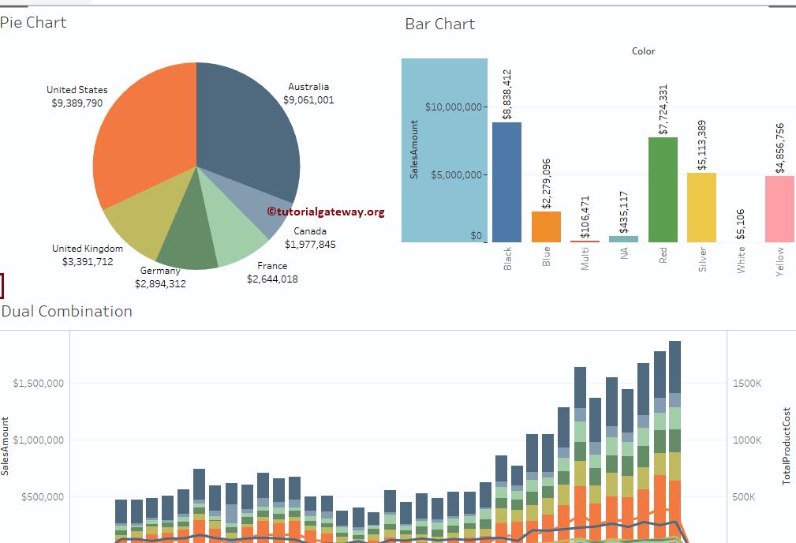

Database DESIGN
Analytical (OLAP) :
Purpose – Retrieval of analytical information
Subject Oriented - Tailored specific to analysis
Dimensional Model :
Using MySQL for the analysis
Intuitive framework
Stability and ease of use
Focuses on reliability over availability(NoSQL)
Schema : Star
Less complex queries
Maximum number of joins is number of dimensions
Hence, faster execution of queries
Cloud Platform:
Not infrastructure dependent
Save on upfront costs, Low cost entry
Fast setup and implementation
Dim1
Dim2
Fact
Dim3
Dim4

Slide 10

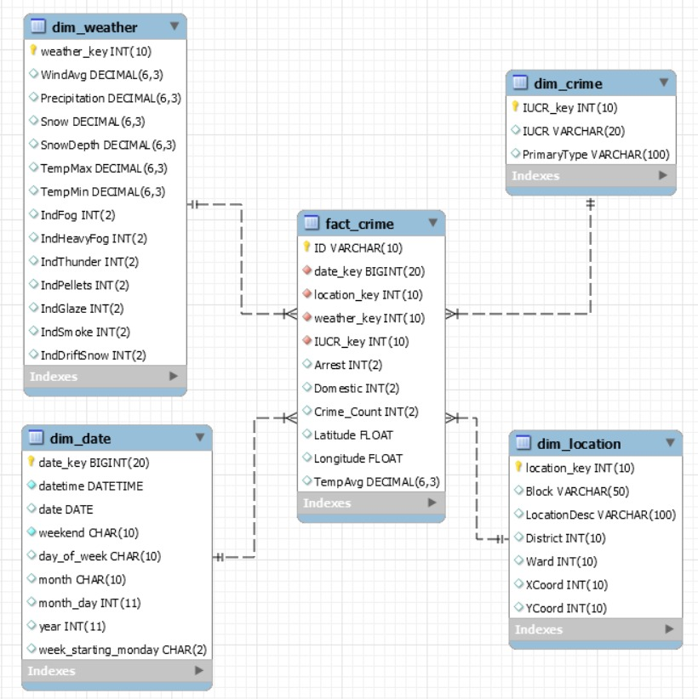

CRIME DATA : STAR SCHEMA
FACT TABLE
Fact Crime is the central table with all facts and measures like arrest/domestic flag, count of crimes etc.
DIMENSION TABLES
Each Dimension table holds other attributes of that dimension/additional information like address of crime location, day/month of crime, type of crime etc.
DIMENSIONS
LOCATION
Weather
CRIME
DATE

Slide 11
DATA analysis

Slide 12
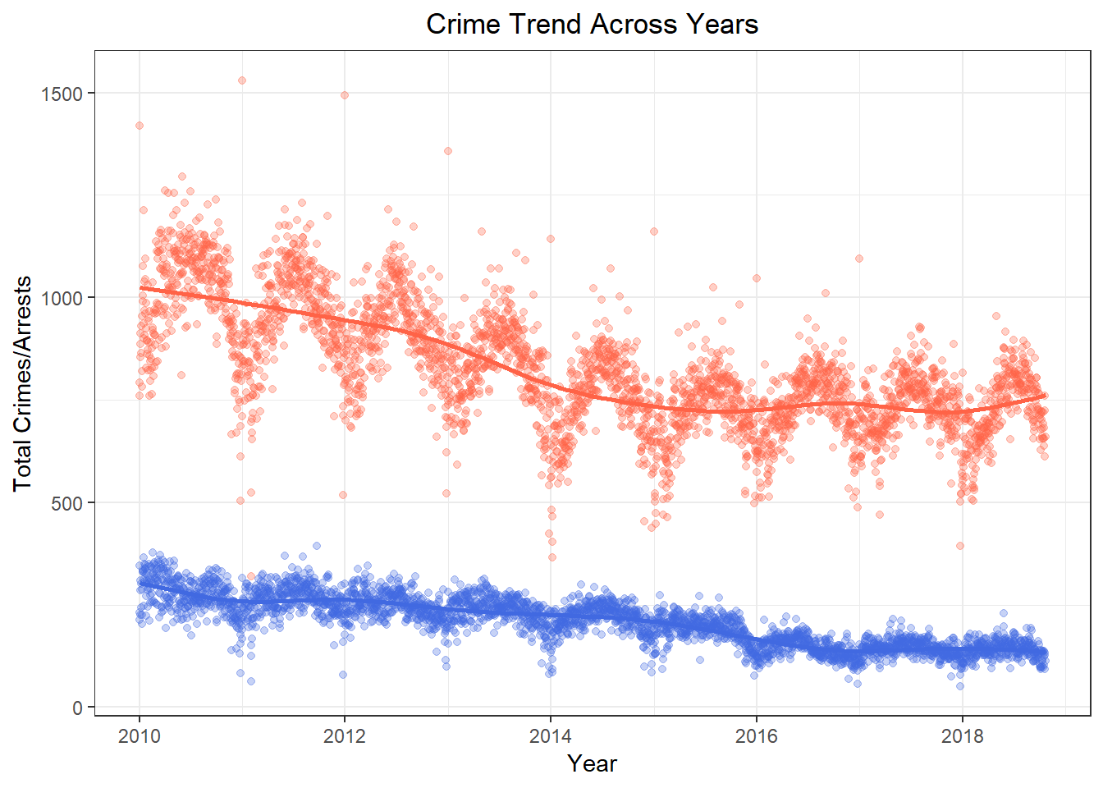
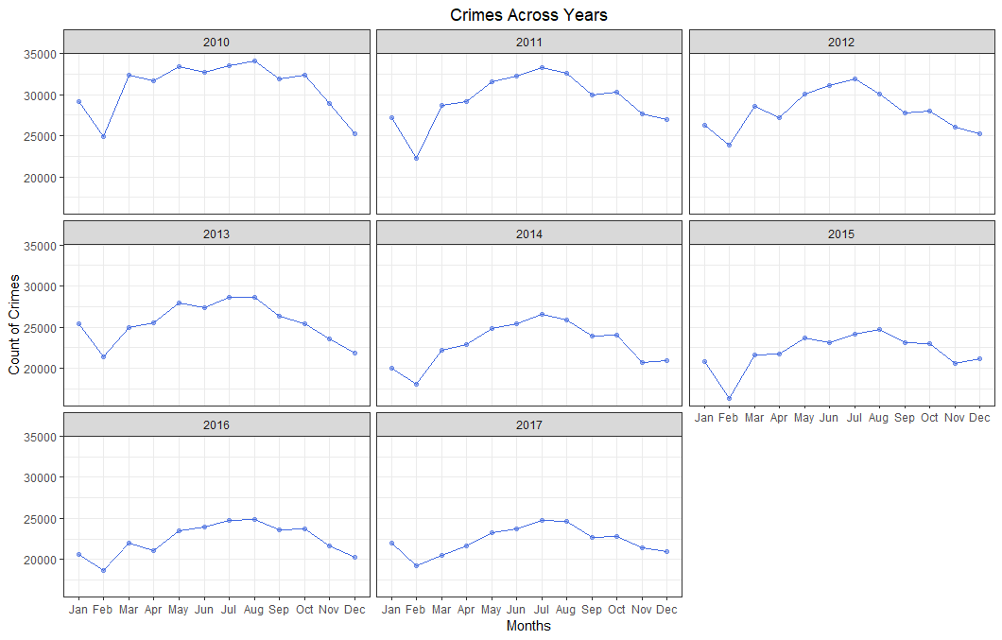
How HAS RATE OF crimes changed over the years?
Crime has declined over the years which is a good sign. The Arrests and Crimes have closed their gap as measures to catch criminals are improving.
Crimes to Arrests ratio sees a decline over years with a significant dip in the year 2014, and a relatively constant downward trend there after.
Also, we see that Crimes exhibit similar trends across all months over the years, showing a rise and fall during relatively same months of the year

Slide 13
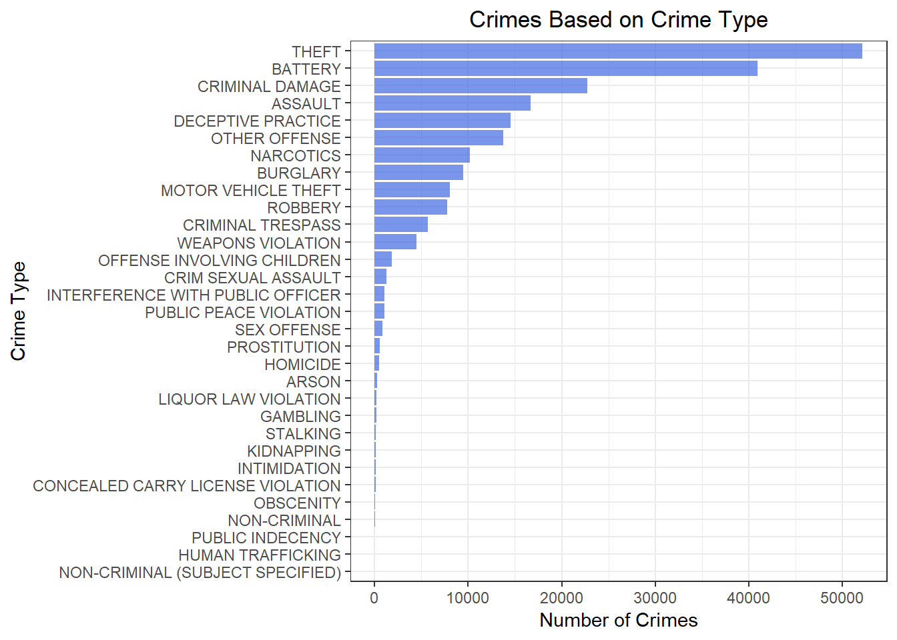
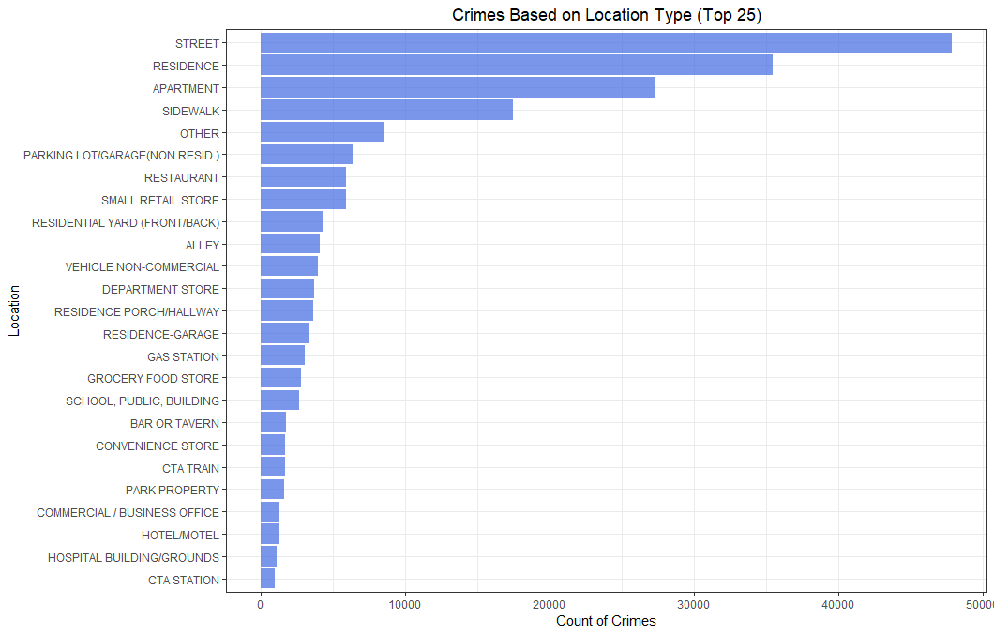
WHAT ARE THE COMMON TYPES OF CRIMES AND WHERE DO THEY TAKE PLACE?
Theft, Battery, Criminal Damage and Assault constitute the most to crimes in Chicago
Theft, Battery, Criminal Damage and Assault amounts to ~61% of the total crimes that happen in Chicago.
Street, Residence, Apartment and Sidewalk contribute to ~60% of the total crimes that happen in Chicago

Slide 14
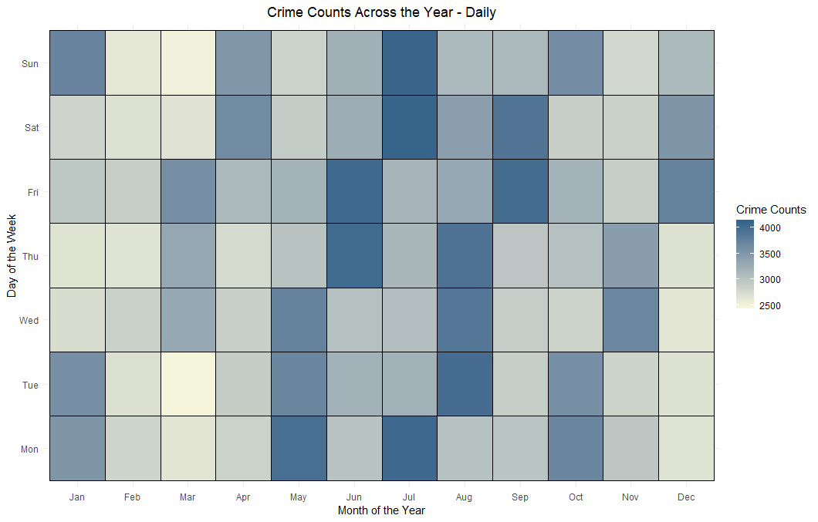
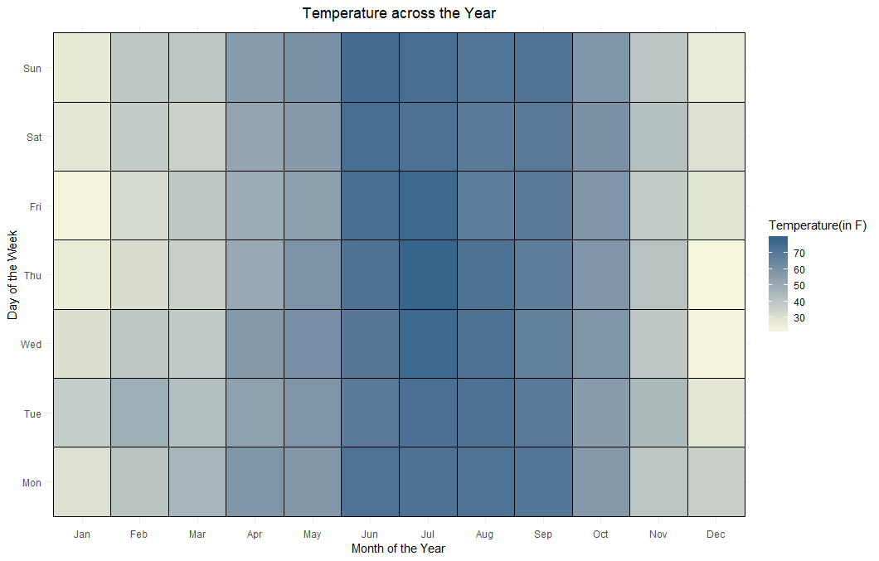
CONTRASTING CRIME RATE AND AVERAGE TEMPERATURE ACROSS MONTHS
Crime count tends to increase around the months of June, July and August. This is correlated with higher temperatures during the same months as shown by the darker regions in the two graphs
Crimes increase during the hotter months of June, July and August. This may be due to the fact that more people tend to go out during summers causing increase in crimes.
Months of June, July and August which see high crimes also see high temperatures being the summer period showing the correlation between them

Slide 15
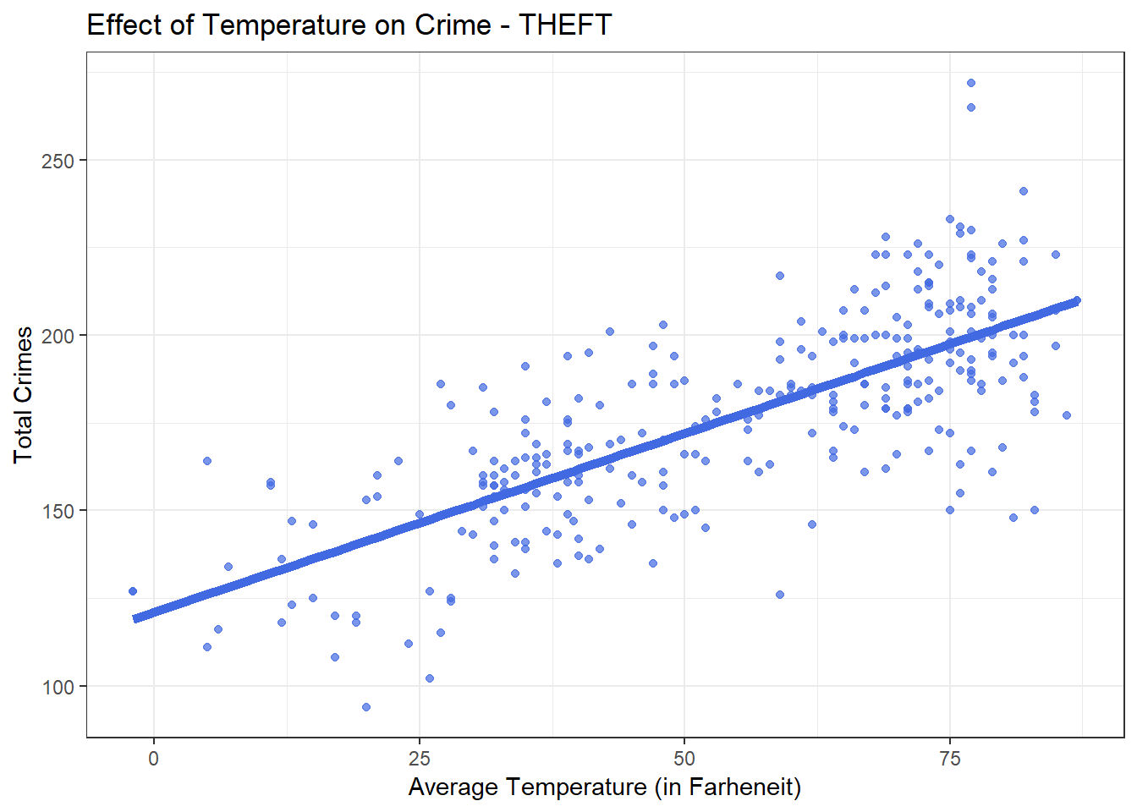
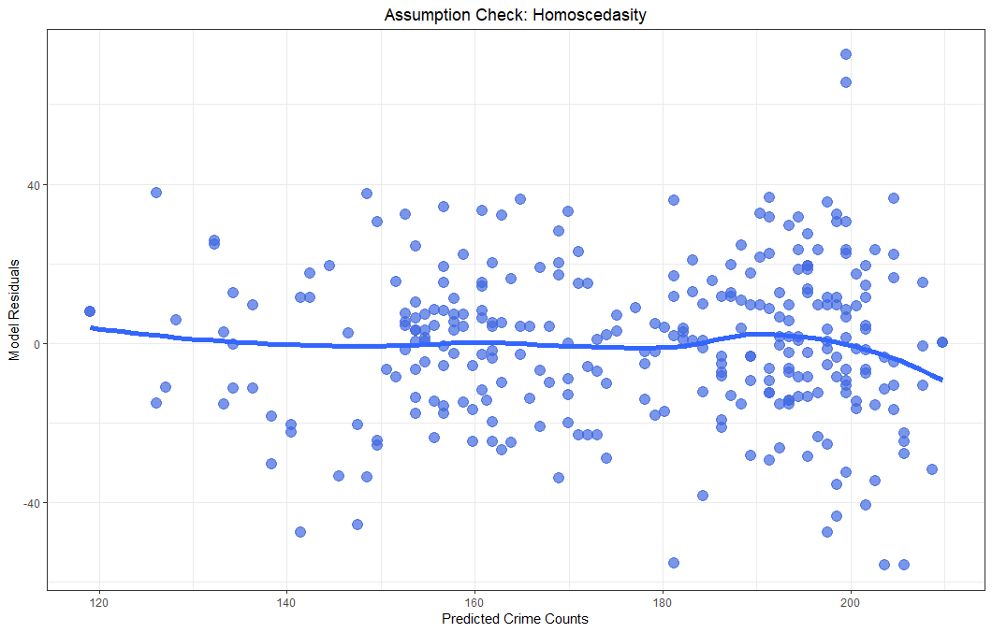
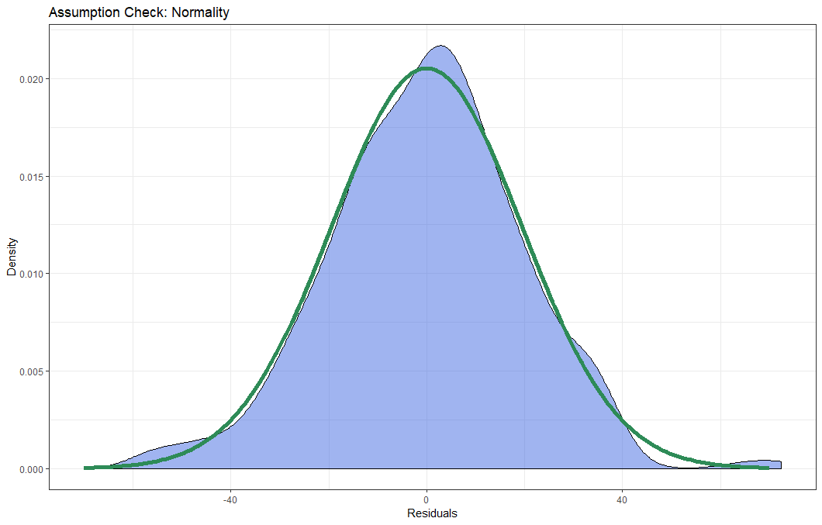
BUILDING a Linear REGRESSION MODEL TO ANALYZE Crimes vs Temperature
From the model results we observe that Thefts increases linearly with increase in Average Temperature.
The linearity, homoscedasticity and normality assumptions holds sufficiently good, hence aiding this conclusion.

Slide 16
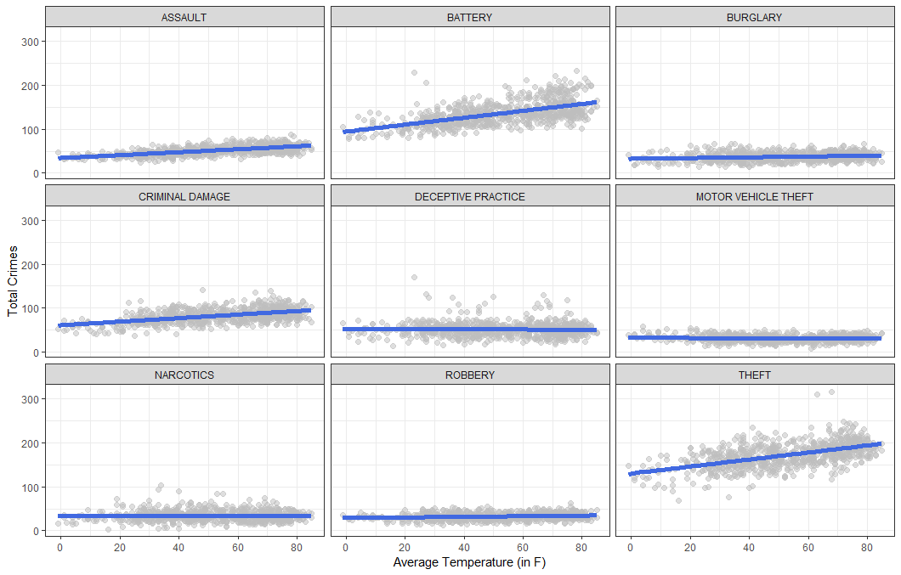
EVALUATING Linear MODEL FOR ALL CRIME TYPES
All major crime types (Theft, Battery, Assault and Criminal Damage) are linearly dependent on temperature. This information can be used to deploy police resources optimally based on temperature of the day, as one application
A positive linear relationship with average temperature can be observed most strongly among Thefts and Battery
The strong correlation of Thefts and Battery crimes with average temperature is indicative of the affect of weather on crimes
Other crime types show little or no correlation to average temperature

Slide 17
DATA VISUALIZATION

Slide 18

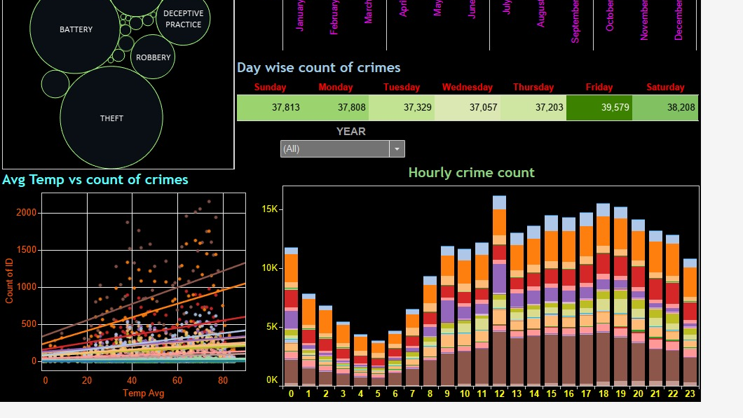
Tableau Dashboard

Slide 19
WAY FORWARD
The analysis of linear relationship can be further extended to find correlation with other significant metrics such as location, police stations in the region, economic and other geographic factors to build a more comprehensive framework to predict crime rates accurately
A real-time dynamic dashboard can be set in place with live weather updates and crime rate prediction location to location for efficient deployment of security
The analysis can be extended to not only predict crime rates and assist in allocation of security personnel, but also in alerting citizens through apps and provide real time update post development of a highly accurate model

Slide 20

thank you
Created by:
Srihari Seshadri
Santosh Selvaraj
Giridhar Ravindran
Swathy Sujit

