Slide 1
Earthquake Activity Along the Pacific Coast
Mayuresh, Alex, Rucha, and Swati
(M.A.R.S)

Slide 2
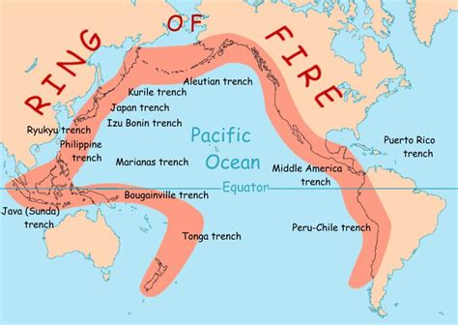
High Seismicity along Pacific Coast

Slide 3
Unstructured Data in MongoDB
Data Exploration
Date dimension
Region Dimension
Magnitude of Seismic Activity
Tsunami Warning
Data from USGS
Earthquake data for the 30 days

Slide 4
Visualizing Earthquake Data with User Inputs
User Inputs:
Date
Region/Trenches
Seismic Magnitude
Tsunami Warning flag
Visualizations:
Map with earthquake indicators by magnitude (MapTalks)
Earthquake instances by Time Scatterplot (Plotly)
Number of Earthquakes by Significance (Plotly)

Slide 5
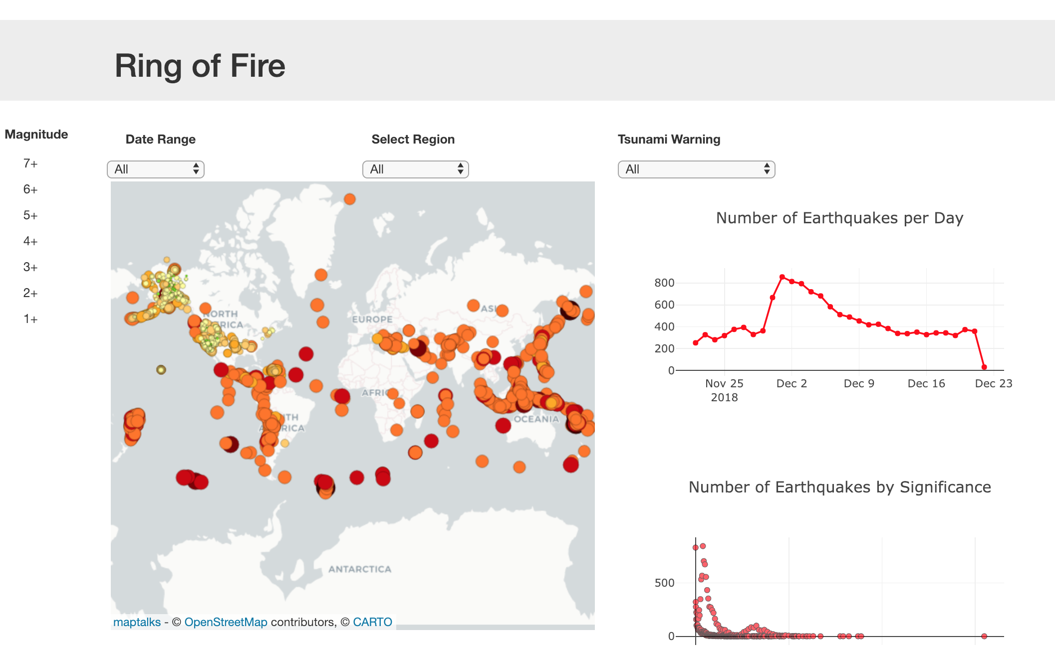
Conclusion
Visualizations demonstrate concentration of Earthquake activity along the Pacific Cost
Let’s go to the Dashboard!

