Slide 1

BAN 602 Team Project Quantitative Fundamentals
By Group 1:
Swati Sharma, xn2486 Mihir Mane, du3425 Deepansh Malviya, ts1799

Slide 2
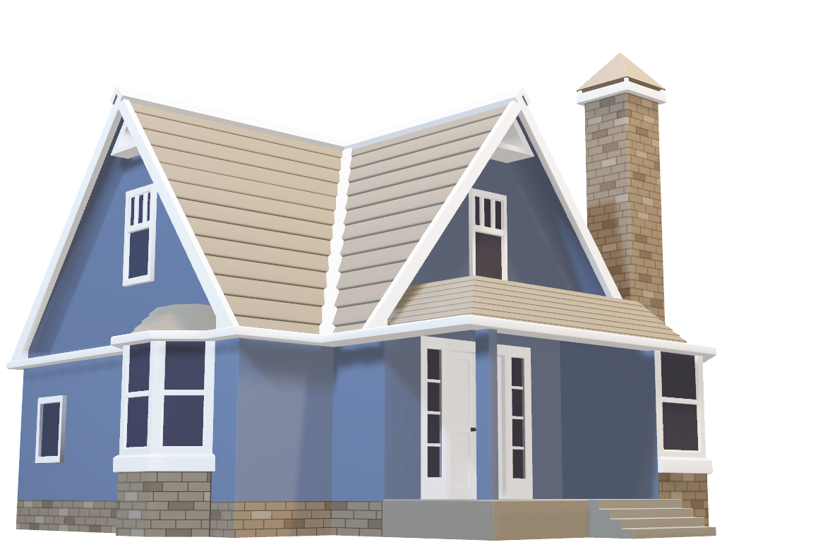
This presentation is about analysis of San Francisco house pricing data having different attributes like
Price
Sqft
Beds
Baths
Laundry
Pets
Housing type
Parking
Hood District.

Slide 3
Insights
The maximum number of houses belong to 1-Bed category
Most houses include a 1-Bath unit
Most of the houses have In-Unit laundry system
Majority of the houses don’t allow pets
Districts 8 and 9 have maximum number of houses.
439 houses have Parking Permits

Slide 4
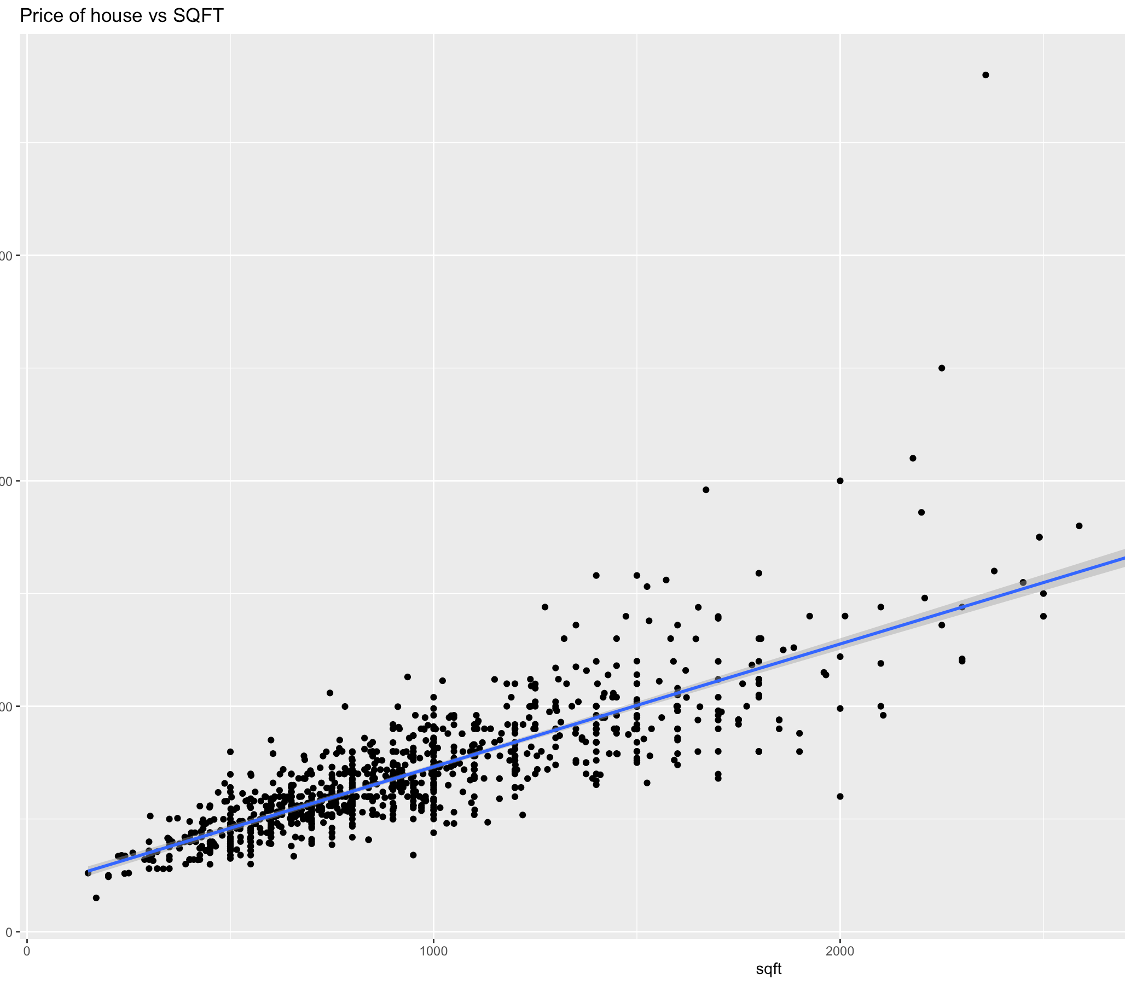
Summary
Price vs Sqft
Insights
The minimum and the maximum price of the house is $750 and $19000 respectively
There is a decline in price value of per square foot between the second and third quartile
There is a linear progression between price and square foot area, meaning that a house's price rises as its square foot area increases.

Slide 5
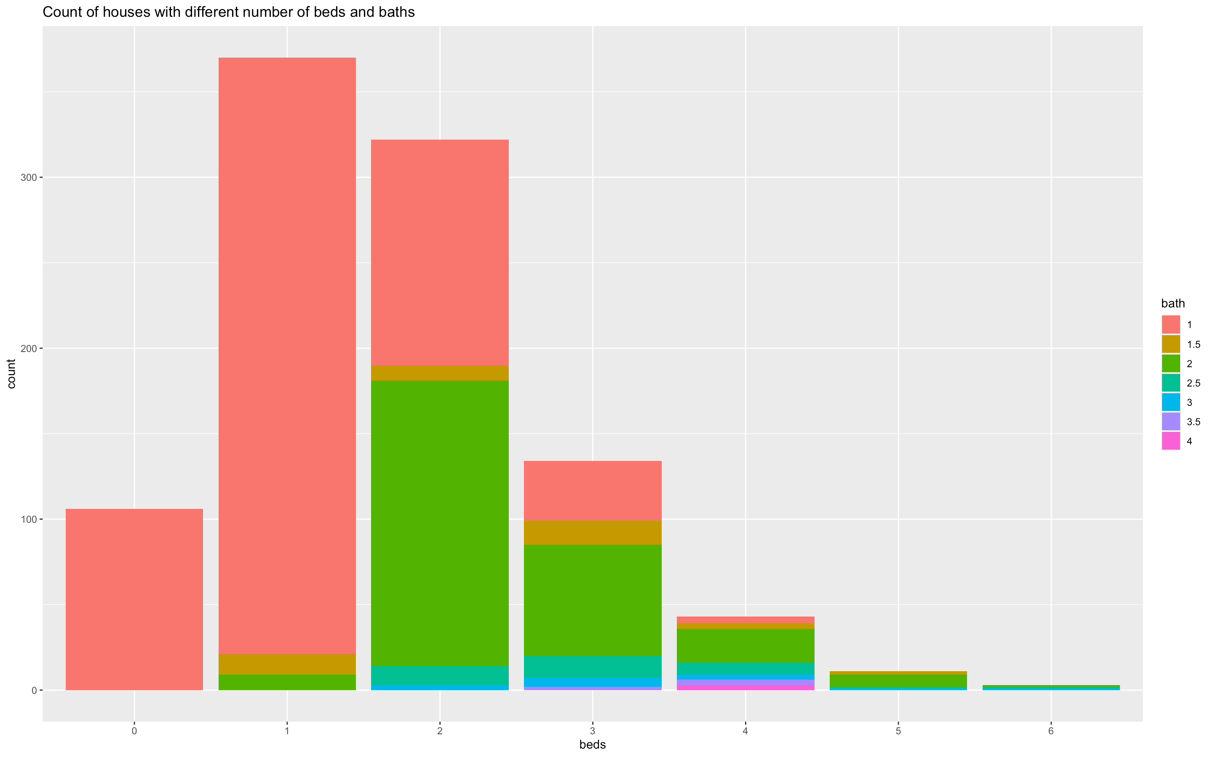
Summary
2) Bed vs Bath types
Insights
The maximum number of house units have 1 bed and 1 bathroom.
There are 106 housing units in total with 0 beds and 1 bathroom.
Only houses with 4 bedrooms, which are relatively fewer in number, can accommodate more than 3.5 baths.

Slide 6
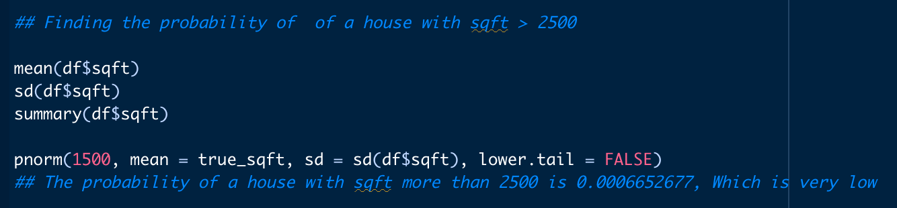
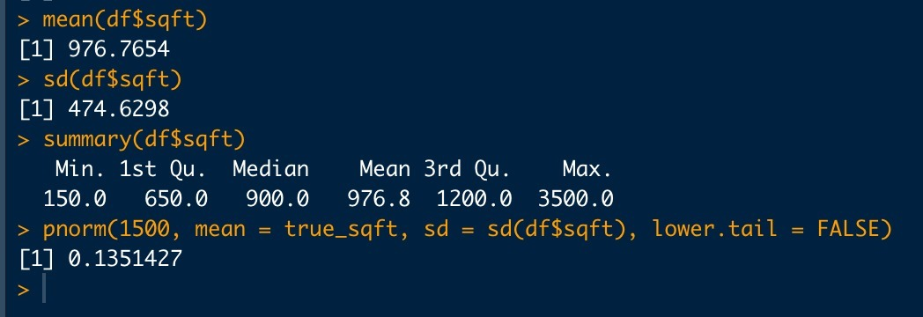
Probability Distribution
Input
As can be seen from the results, the probability of a house having area more than 1500 sqft is 13.51%.
Output

Slide 7
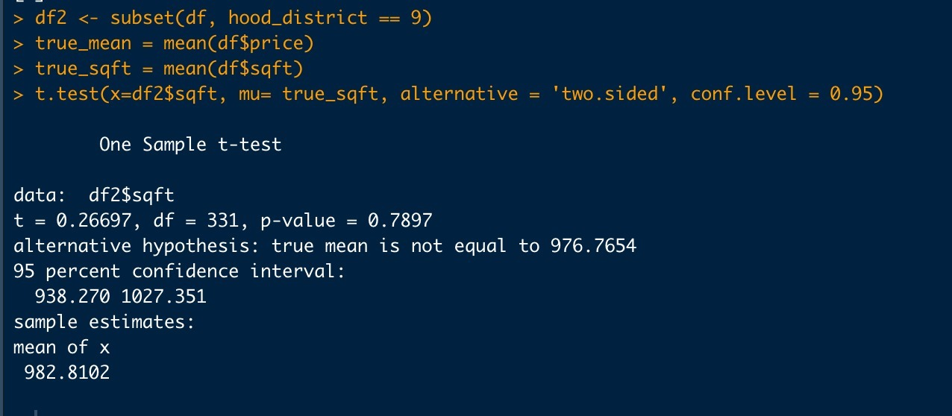
Hypothesis Testing
Output
Ho : µ = 976.7654.
Ha : µ ≠ 976.7654.
α = 0.05.
t = 0.26697.
P-value = 0.7897.
Since p-value > 0.05, we cannot reject the null hypothesis. In conclusion, we are 95% confident that the mean value of houses in district 9 is equal to the mean value of houses in all the districts.

