Slide 1
RabbitMQ
--Swati Ojha

Slide 2
What is RabbitMQ
RabbitMQ is an open-source messaging system that allows you to integrate applications together by using exchanges and queues.
RabbitMQ implements the AMQP protocol.
The underlying RabbitMQ server is written in the Erlang programming language
The RabbitMQ server is a message broker that acts as a message coordinator for the applications that you want to integrate.

Slide 3
MSMQ
MSMQ is essentially a messaging protocol that allows applications running on separate servers and processes to communicate in a fail-safe manner.
The queue is a temporary storage location which messages can be sent and received reliably, as and when conditions permit.
MSMQ is responsible for reliably delivering messages between applications inside and outside of the enterprise.
MSMQ ensures reliable delivery by placing messages that fail to reach their intended destination in a queue, and then resending them once their destination is reachable.
It also supports security and priority-based messaging.

Slide 4
RabbitMQ vs. MSMQ
RabbitMQ is a centralized message broker where the messages are stored on a central server, and a client sends messages to that server, and then a subscriber can then retrieve that message. MSMQ, on the other hand, is decentralized, where each machine has its own queues. A client will send a message to an incoming message queue on another server. Each machine will have its own sets of queues that services can access.
RabbitMQ is a multi-platform messaging broker. MSMQ is a Windows only messaging system.
RabbitMQ and many other message brokers implement different messaging standards. The main standard adopted by RabbitMQ is the AMQ. MSMQ uses its own proprietary messaging format.

Slide 5
What is AMQ
RabbitMQ is built on top of the AMQP protocol, which stands for the Advanced Message Queuing Protocol. This is a network protocol that enables client's applications to communicate with the compatible messaging system.
Like any messaging system, AMQP is a message protocol that deals with publishers and consumers. The publishers produce the messages, the consumers pick them up and process them. It's the job of the message broker (such as RabbitMQ) to ensure that the messages from a publisher go to the right consumers.

Slide 6

    The basic architecture of a message queue is simple - there are client applications called producers that create messages and deliver them to the broker (the message queue). Other applications, called consumers, connect to the queue and subscribe to the messages to be processed.

Slide 7
Exchanges
Exchanges are AMQP entities where messages are sent to the message broker. Exchanges take a message and then route it to one or more queues.
The type of routing depends on the exchange type used in different exchange rules called bindings.

Slide 8
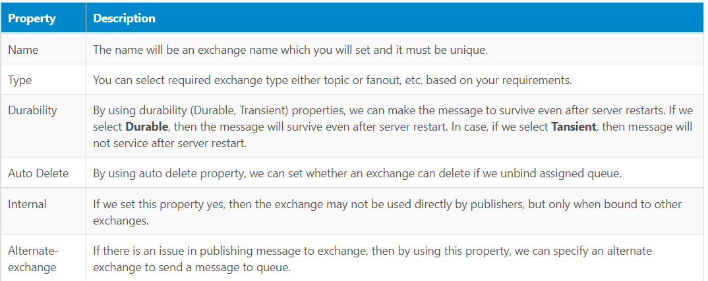
RabbitMQ Exchange Properties

Slide 9
Queues
Queues in RabbitMQ are ordered collections of messages. Messages are enqueued and dequeued (delivered to consumers) in the FIFO manner.
Properties
Name
Durable (the queue will survive a broker restart)
Exclusive (used by only one connection and the queue will be deleted when that connection closes)
Auto-delete (queue that has had at least one consumer is deleted when last consumer unsubscribes)
Arguments (optional; used by plugins and broker-specific features such as message TTL, queue length limit, etc)

Slide 10
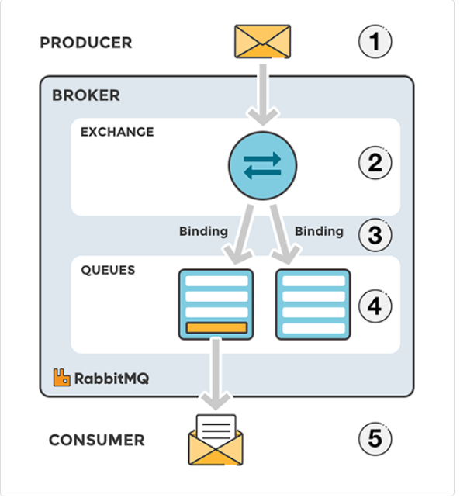
Message flow in RabbitMQ
The producer publishes a message to an exchange. When creating an exchange, the type must be specified.
The exchange receives the message and is now responsible for routing the message. The exchange takes different message attributes into account, such as the routing key, depending on the exchange type.
Bindings must be created from the exchange to queues. In this case, there are two bindings to two different queues from the exchange. The exchange routes the message into the queues depending on message attributes.
The messages stay in the queue until they are handled by a consumer
The consumer handles the message.

Slide 11
TYPES OF EXCHANGES
Direct: The message is routed to the queues whose binding key exactly matches the routing key of the message.
Fanout: A fanout exchange routes messages to all the queues bound to it.
Topic: The topic exchange does a wildcard match between the routing key and the routing pattern specified in the binding.
Headers: Headers exchanges use the message header attributes for routing.

Slide 12
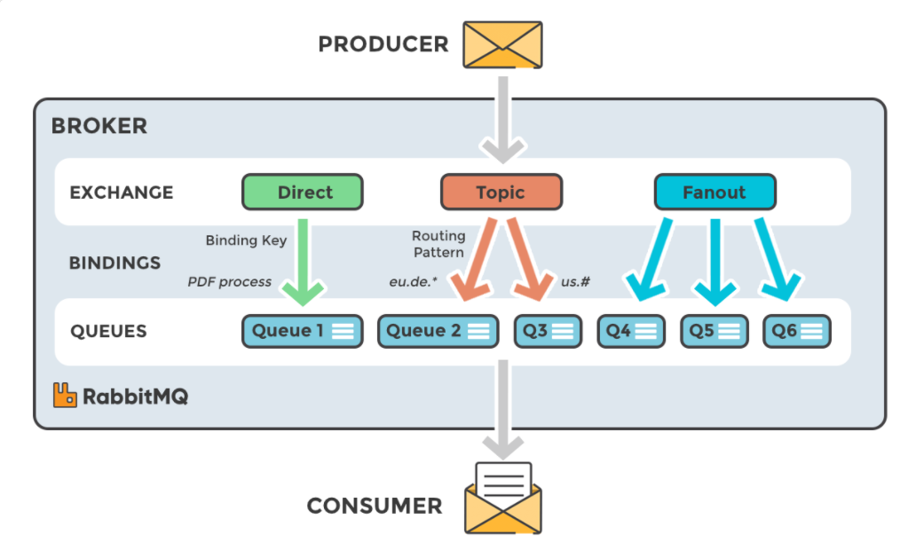

Slide 13
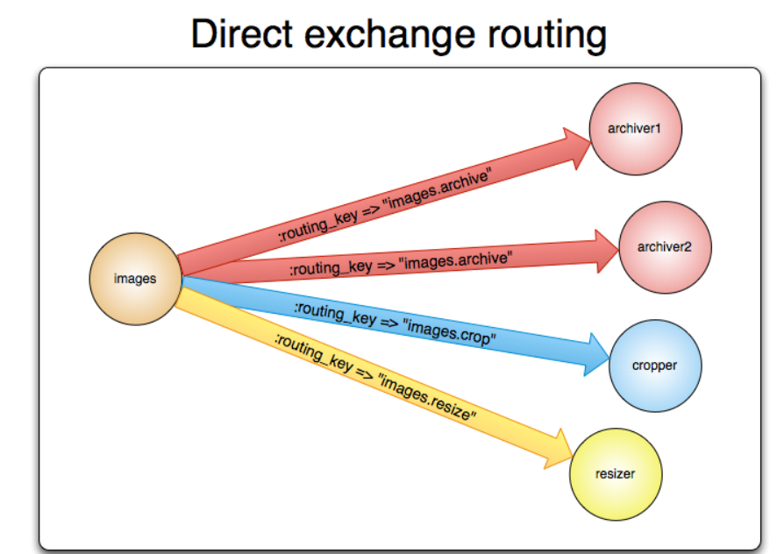
Direct Exchange
A direct exchange delivers messages to queues based on the message routing key. A direct exchange is ideal for the unicast routing of messages.
A queue binds to the exchange with a routing key K
When a new message with routing key R arrives at the direct exchange, the exchange routes it to the queue if K = R

Slide 14
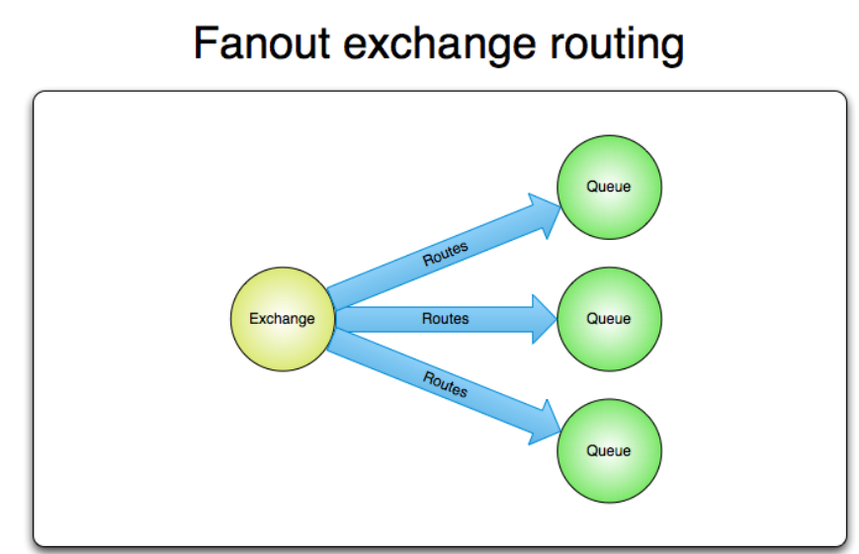
Fanout Exchange
A fanout exchange routes messages to all the queues that are bound to it and the routing key is ignored.
If N queues are bound to a fanout exchange, when a new message is published to that exchange a copy of the message is delivered to all N queues.
Fanout exchanges are ideal for the broadcast routing of messages.

Slide 15
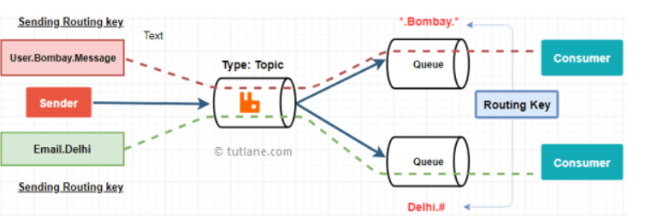
Topic Exchange
Topic exchange will perform a wildcard match between the routing key and the routing pattern specified in the binding to publish a messages to queue.
The routing patterns may also contain an asterisk (“*”) to match a word in a specific position of the routing key.
The routing pattern may also contain a pound symbol (“#”) which means a match of zero or more words.
The topic exchange type is often used to implement various publish/subscribe pattern variations.
Topic exchanges are commonly used for the multicast routing of messages.

Slide 16
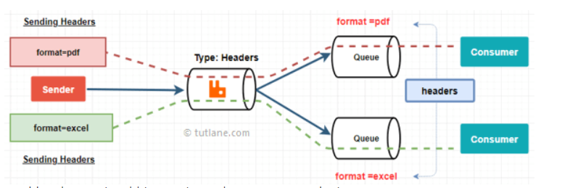
Header Exchange
A headers exchange is designed for routing on multiple attributes that are more easily expressed as message headers than a routing key.
Headers exchanges ignore the routing key attribute. Instead, the attributes used for routing are taken from the headers attribute.
A message is considered matching if the value of the header equals the value specified upon binding.

Slide 17
Install and Configure RabittMQ
The easiest way to get RabbitMQ running is to install Docker Desktop.
Then issue the following command (in one line in a console window) to start a RabbitMQ container with admin UI : C:\dev>docker run -d -p 15672:15672 -p 5672:5672 --hostname my-rabbit --name some-rabbit rabbitmq:3-management
Open your browser on port 15672 and log in with the username “guest” and the password “guest”.

Slide 18
DEMO

Slide 19
Uses of Messaging Queues
Better Performance
Message queues enable asynchronous communication, which means that the endpoints that are producing and consuming messages interact with the queue, not each other.
Increased Reliability
Queues make your data persistent and reduce the errors that happen when different parts of your system go offline.
Granular Scalability
Message queues make it possible to scale precisely where you need to.
Simplified Decoupling
  Break Up Apps
  Migrate to Microservices
  Shift to Serverless

Slide 20
Q/A

Slide 21
Thank You

