Slide 1
Dashboard
Module 3

Slide 2
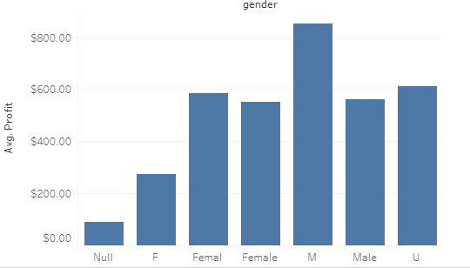
Gender Vs Profit
Male is buying more bicycle than Female.

Slide 3
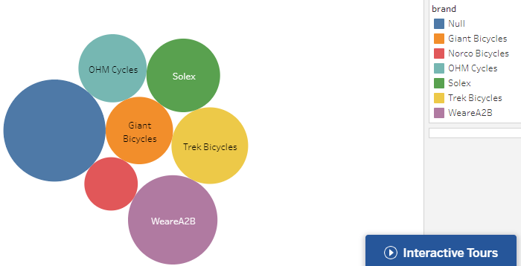
Brand Vs Profit
If area of size more Profit is more.

Slide 4
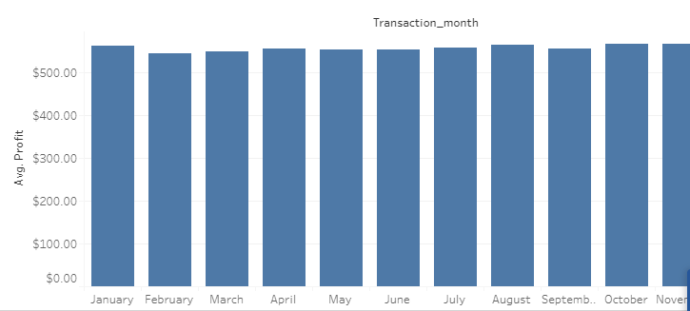
Transaction_month Vs Profit
In January month there is more profit.
Due to new year Purchase is more then Profit is more.

Slide 5

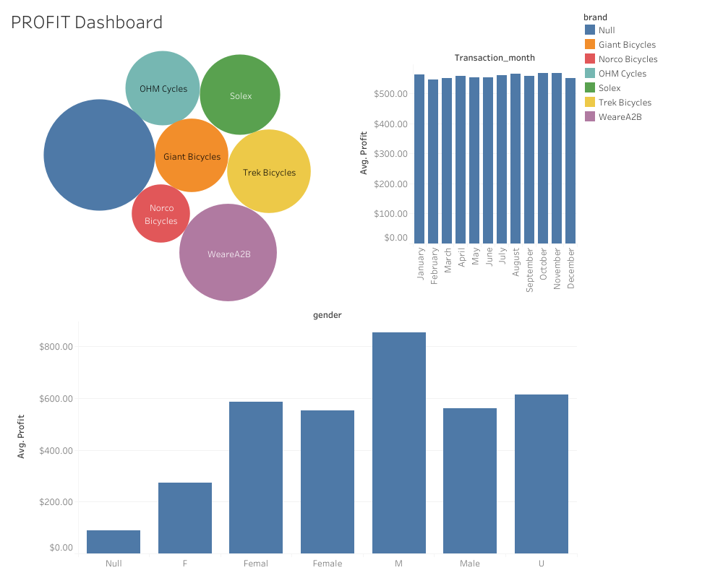
PROFIT Dashboard

