Slide 1
AMAZON WEB SERVICES

Slide 2
AWS is a collection of remote computing services that together make up a cloud computing platform offered over the internet.
EC2 provides web services API for provisioning, managing, and deprovioning virtual servers inside amazon cloud.
Applications anywhere on the Internet can launch a virtual server in the amazon cloud with a single web services call (either REST or SOAP WS call).
Notes:
Four main reasons why Amazon EMR

Slide 3




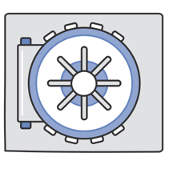
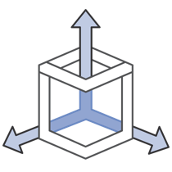
Why Do Researchers Love AWS?
Time to Science
Access research
infrastructure in minutes
Low Cost
Pay-as-you-go pricing
Elastic
Easily add or remove capacity
Globally Accessible
Easily Collaborate with
researchers around the world
Secure
A collection of tools to
protect data and privacy
Scalable
Access to effectively
limitless capacity
Notes:
Four main reasons why Amazon EMR

Slide 4
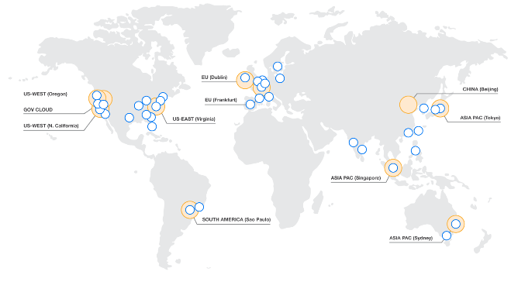
Region
AZ
Transit
Geographic area where AWS services are available
Customers choose region(s) for their AWS resources
Eleven regions worldwide
AZ
AZ
AZ
AZ
Transit
Notes:
[After first bullet point]: Each region designed to be completely isolated from other regions – this achieves the greatest possible fault tolerance and stability
[After second bullet point]: So when you launch an EC2 instance, you select the region it should be in. Customers can select a region based on, e.g., latency requirements or legal requirements

Slide 5
Availability Zone (AZ)
Each region has multiple, isolated locations known as Availability Zones
Low-latency links between AZs in a region <2ms, usually <1ms
When launching an EC2 instance, a customer chooses an AZ
Private AWS fiber links interconnect all major regions
REGION
EC2
AVAILABILITY ZONE 1
EC2
EC2
EC2
AVAILABILITY ZONE 2
AVAILABILITY ZONE 3
Notes:
[After first bullet point]: Really a logical group of data centers
[After third bullet point]:
Note that some customers distribute their instances across multiple AZs to have extremely high fault tolerance.
We have 28 availability zones worldwide

Slide 6

Virtual Private Cloud (VPC)
VPC
REGION
Logically isolated section of the AWS cloud, virtual network defined by the customer
When launching instances and other resources, customers place them in a VPC
All new customers have a default VPC
EC2
AVAILABILITY ZONE 1
AVAILABILITY ZONE 2
EC2
EC2
EC2
AVAILABILITY ZONE 3
Notes:
[At end]: Can launch resources in default VPC or another one that you’ve created

Slide 7
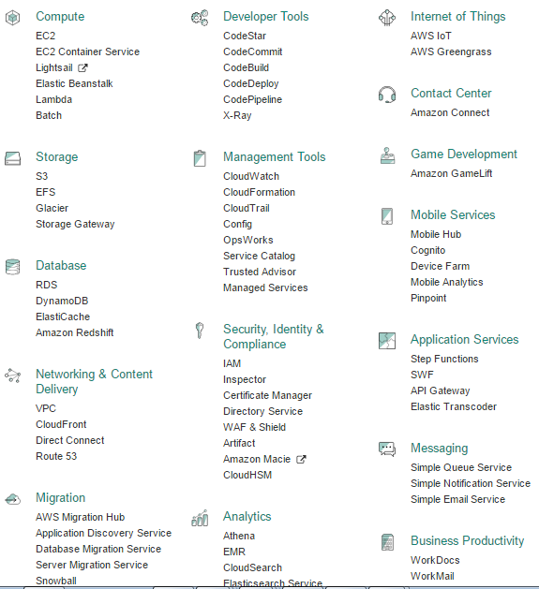
Notes:
[At end]: Can launch resources in default VPC or another one that you’ve created

Slide 8

A web service that provides resizable compute capacity in the cloud.
EC2 allows creating Virtual Machines (VM) on-demand. Pre-configured templated Amazon Machine Image (AMI) can be used get running immediately. Creating and sharing your own AMI is also possible via the AWS Marketplace.
Auto Scaling allows automatically scale of the capacity up seamlessly during demand spikes to maintain performance, and scales down during demand lulls to minimize costs.
Elastic Load Balancing automatically distributes incoming application traffic across multiple Amazon EC2 instances.
Provide tools to build failure resilient applications by launching application instances in separate Availability Zones.
Pay only for resources actually consume, instance-hours.
VM Import/Export enables you to easily import virtual machine images from your existing environment to Amazon EC2 instances and export them back at any time.

Slide 9





EC2
http://aws.amazon.com/ec2/
Infrastructure
Services
VPC
http://aws.amazon.com/vpc/
S3
http://aws.amazon.com/s3/
EBS
http://aws.amazon.com/ebs/
9

Slide 10
Thank you!

