Slide 1
Docker Features
GTO SeaLab

Slide 2
Agenda
Docker 1.12 Features
Docker on Windows
Docker Commercial Features
Docker Use Case

Slide 3
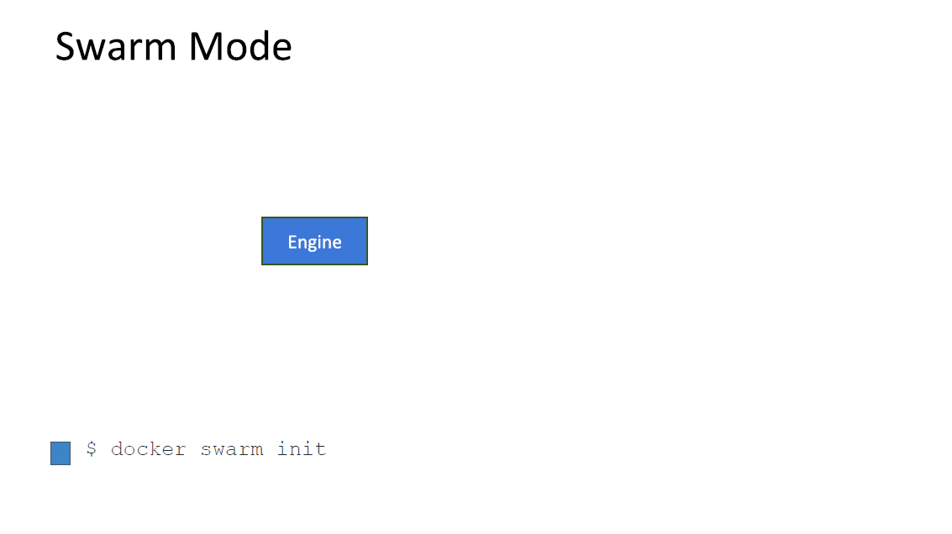

Slide 4
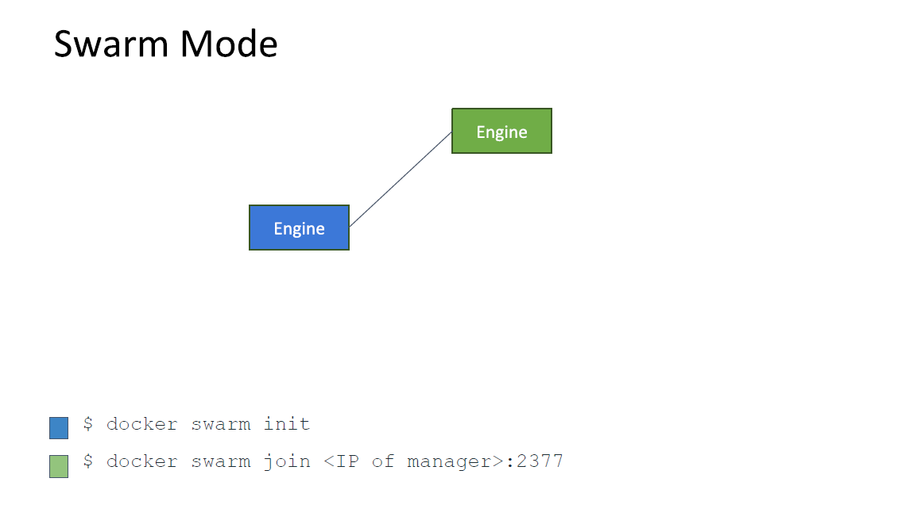

Slide 5
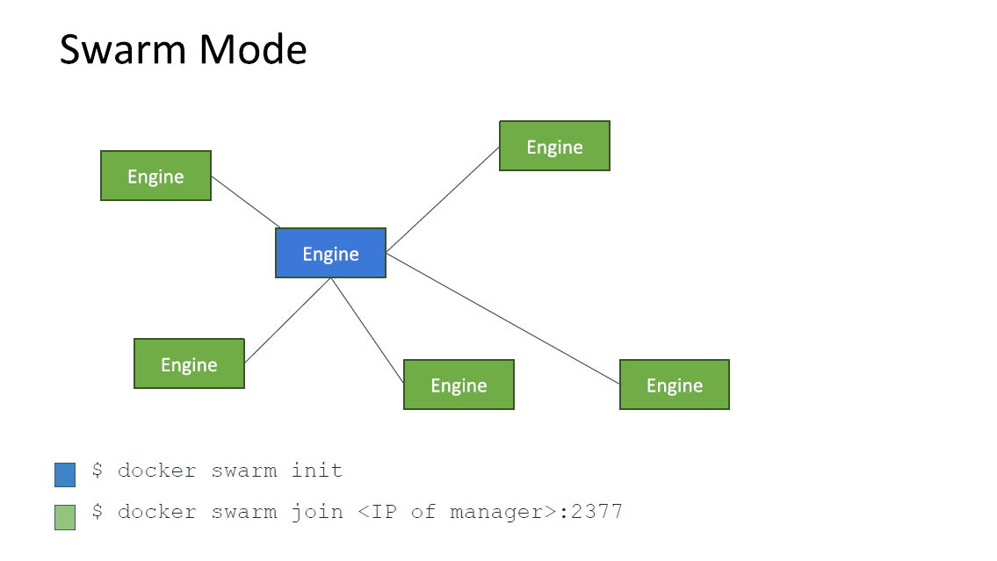

Slide 6
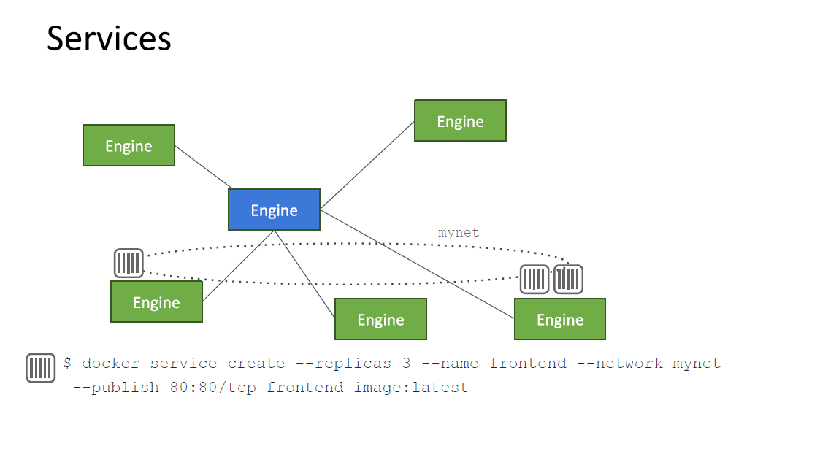

Slide 7
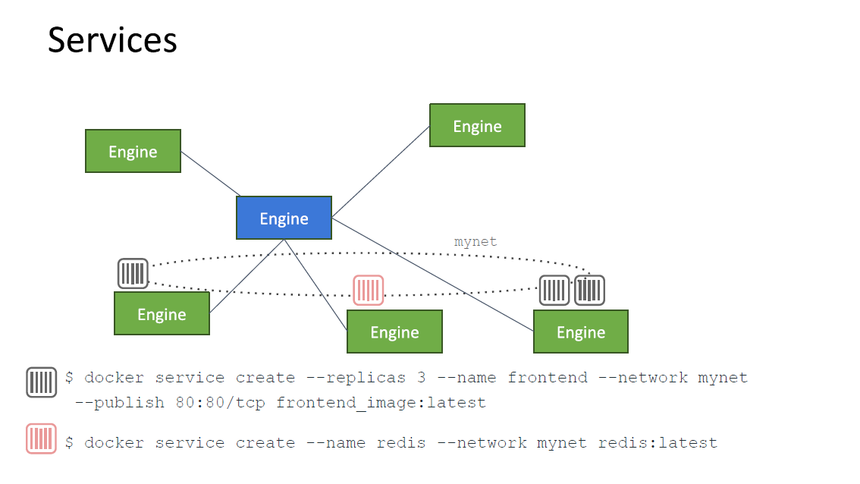

Slide 8


Slide 9
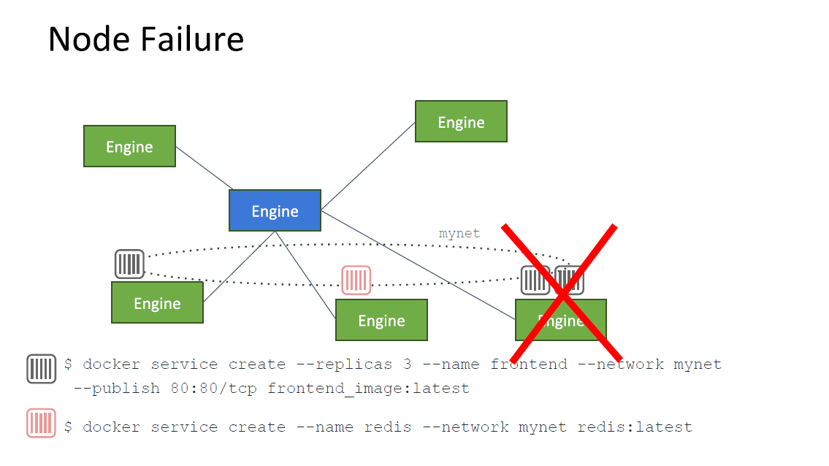

Slide 10
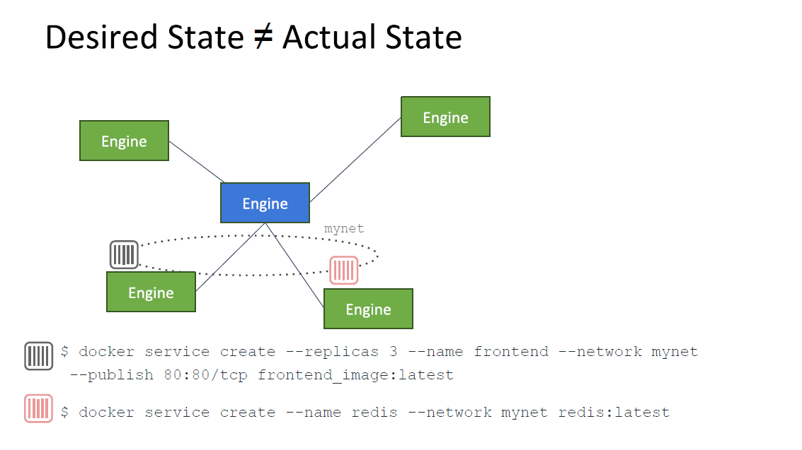

Slide 11
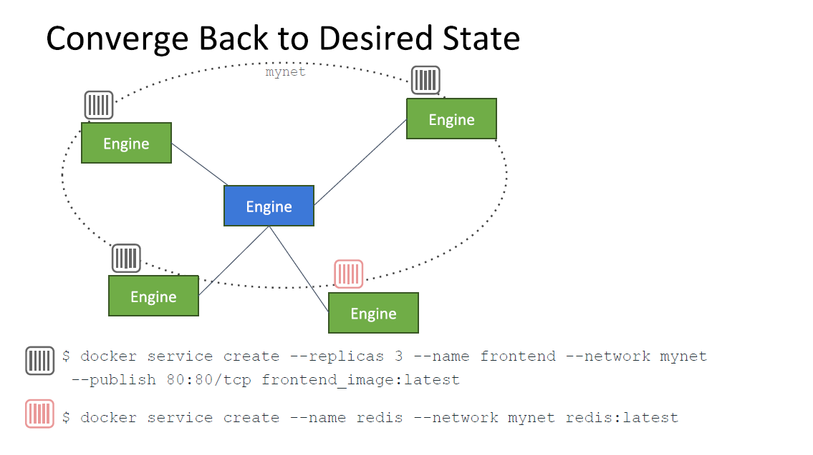

Slide 12
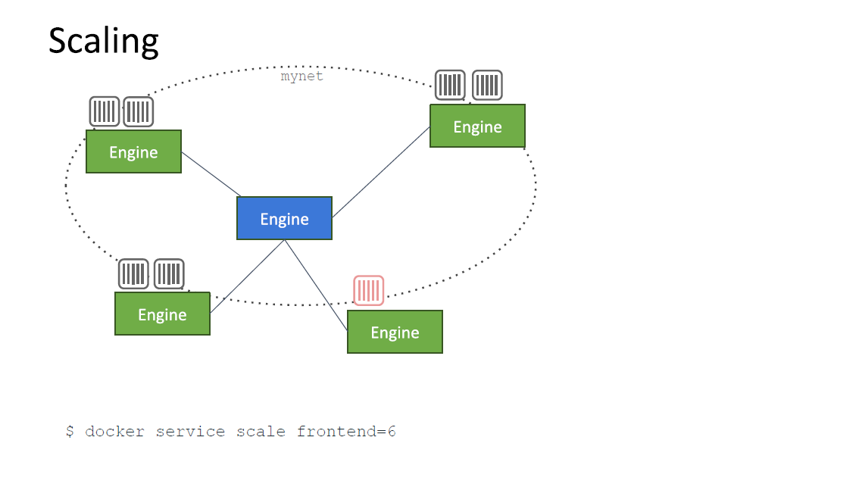

Slide 13
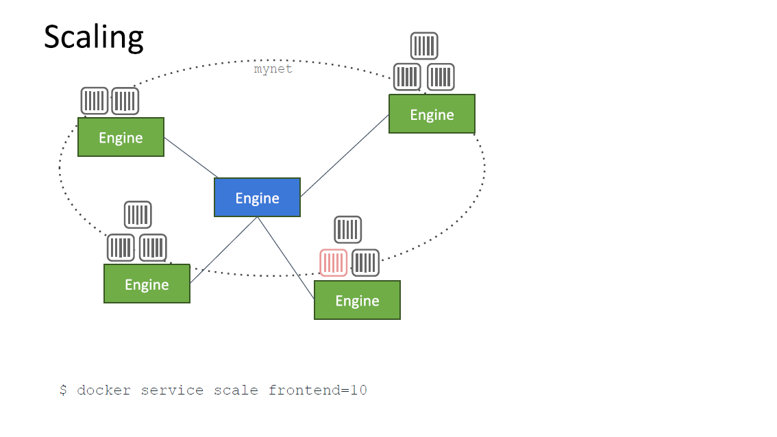

Slide 14
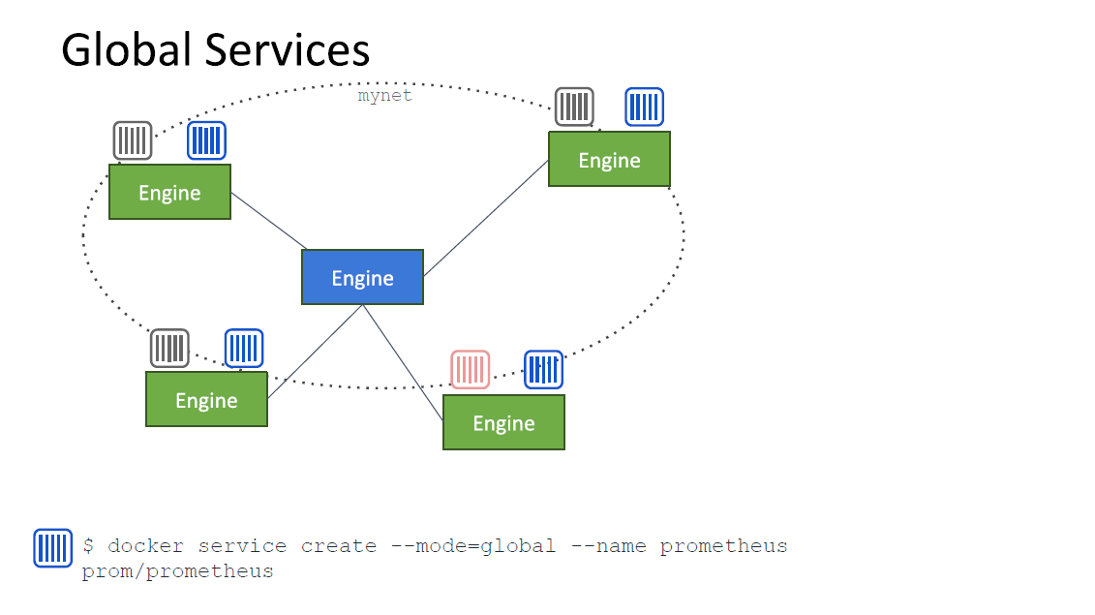

Slide 15
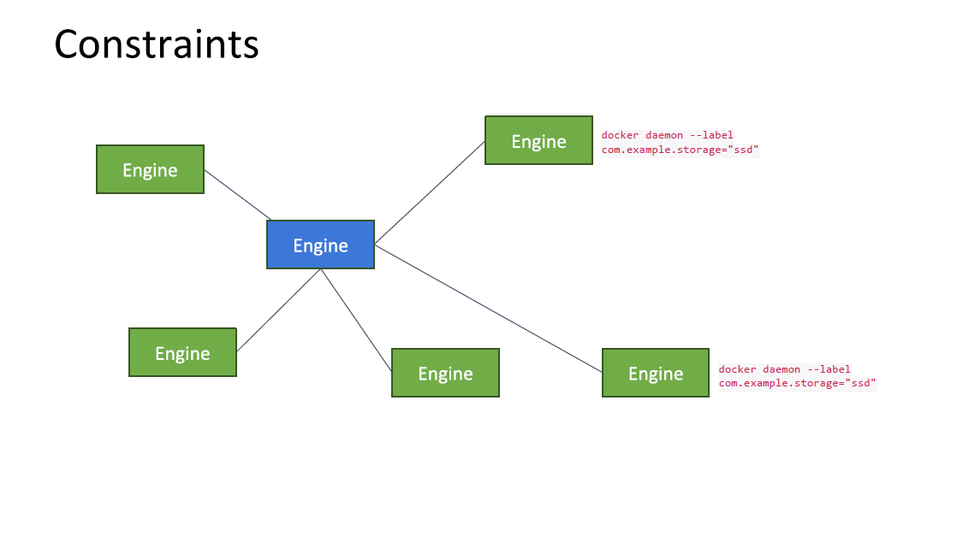

Slide 16
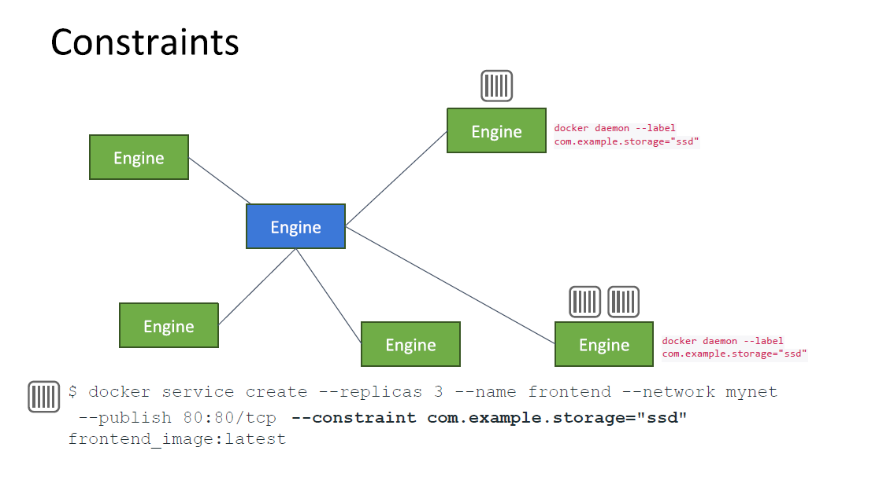

Slide 17
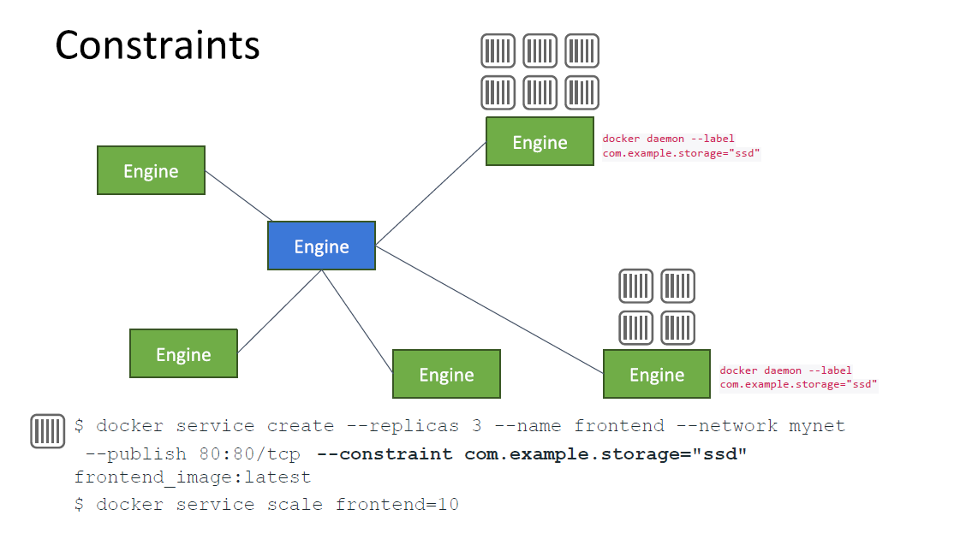

Slide 18
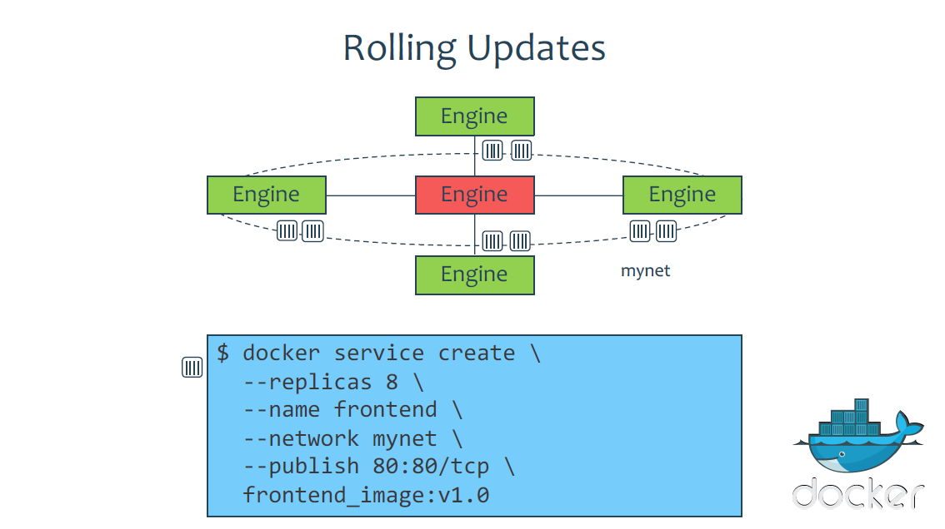

Slide 19
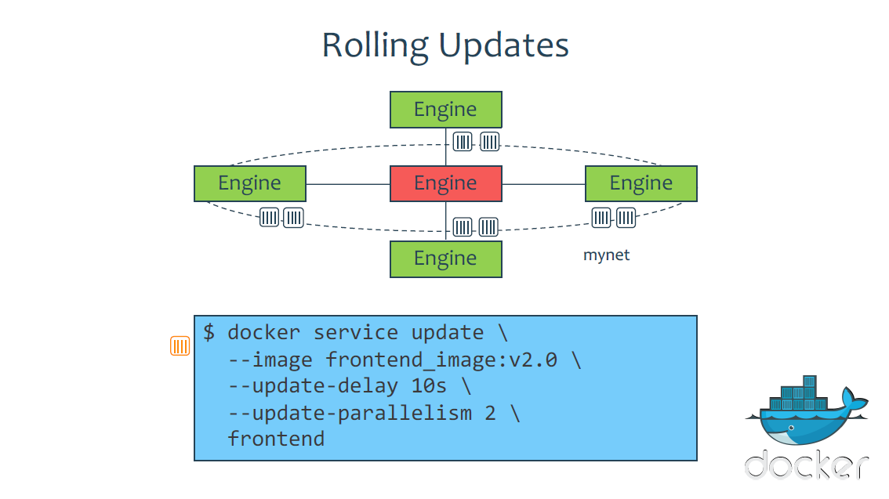

Slide 20
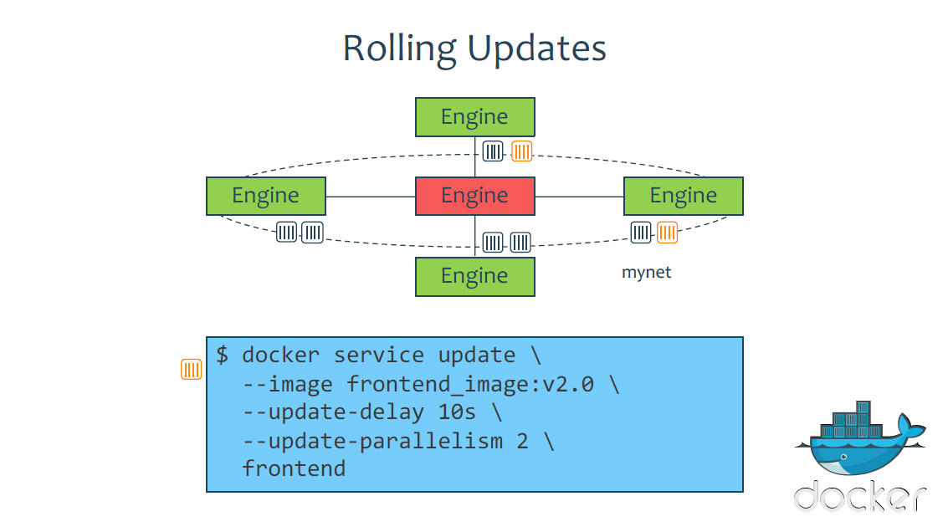

Slide 21
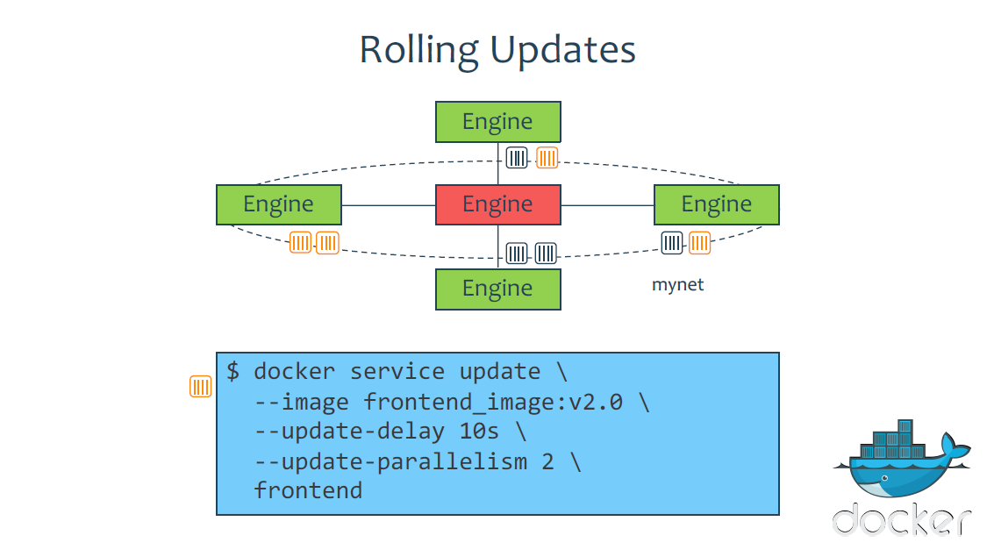

Slide 22
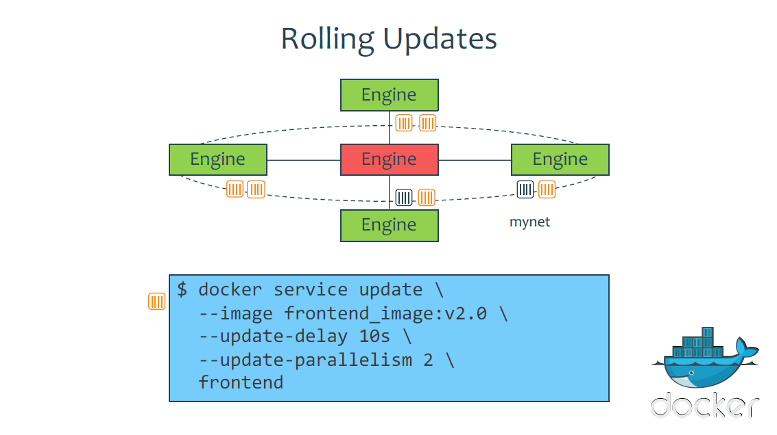

Slide 23


Slide 24
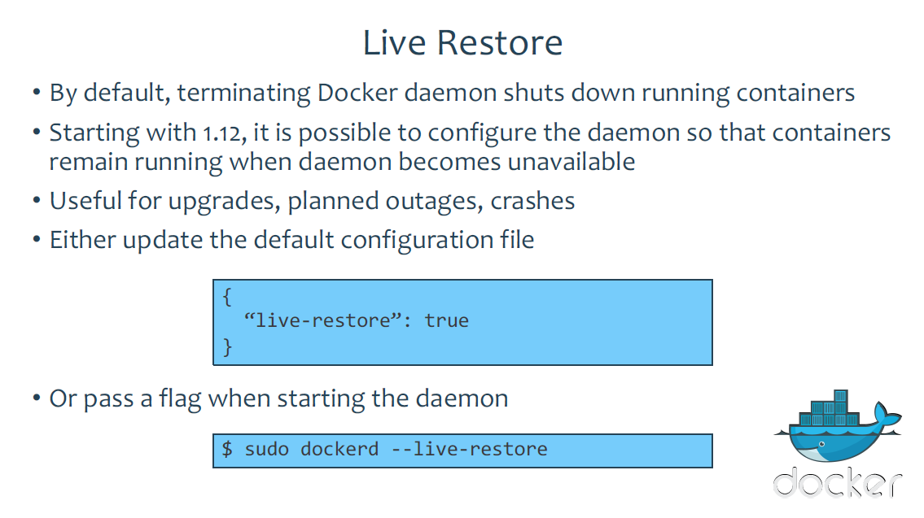

Slide 25
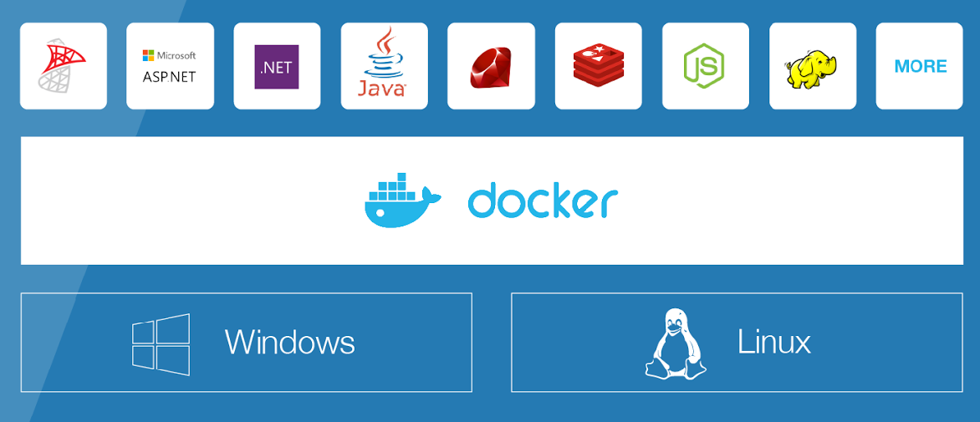
Docker on Windows Server 2016
Now 98% of enterprise workloads supported by Docker
Proven benefits of Docker on Linux available to Windows Server developers and IT Pros
One Docker platform and one adoption journey for all enterprise applications and infrastructure
Docker CS Engine with Windows Server 2016 at no additional cost

Slide 26
Docker on Windows Server 2016
Microsoft and Docker formed partnership in 2014
Windows kernel (both 2016 and Windows 10) now has containerization primitives
Microsoft and Docker worked to port Docker Engine to Windows, all in the open on https://github.com/docker/docker
Ancillary services like registry, Hub, etc. have multi-arch support, maintain Linux and Windows Docker images side by side

Slide 27
Windows Server 2016 technical details
Choice of base image
windowsservercore: Runs most Windows Server apps, eg. IIS, SQL Server, full .NET Framework
nanoserver: New minimal Windows version, runs IIS and .NET Core
Choice of isolation
Windows Server Containers
Hyper-V Containers
App
App
App
Bins/Libs
Bins/Libs
Bins/Libs
Windows Kernel
CS Docker Engine
Windows Server 2016
Infrastructure

Slide 28
Comparing OS Architectures
Platform
Independent
Docker
Docker Client
Docker Compose
Docker Swarm
Docker Registry
Docker Engine
REST Interface
Platform
Specific
libcontainerd
libnetwork
graph
plugins
Containerd + runC
Windows
Compute Services
Other OS Functionality
Control Groups
Job objects
Namespaces
Object Namespace, Process Table, Networking
Layer Capabilities
Registry, Union like filesystem extensions
Linux
Control Groups
cgroups
Namespaces
Pid, net, ipc, mnt, uts
Layer Capabilities
Union Filesystems: AUFS, btrfs, vfs, zfs*,DeviceMapper
Other OS Functionality

Slide 29
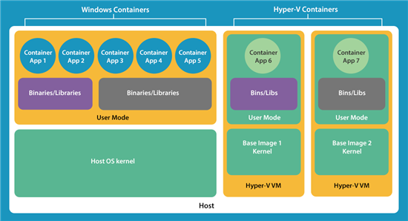
Windows Vs Hyper-V Containers

Slide 30

Docker Commercial
Operating Systems
CI/CD
Images
Networking
Volumes
Config Mgt
Monitoring
Logging
..more..
Docker Universal Control Plane
Integrated Security
Docker Trusted Registry
Docker Engine
Container runtime, orchestration, networking, volumes, plugins
Public Cloud
Virtualization
Physical

Slide 31


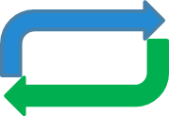






CI/CD Solution with Docker Ecosystem
CloudSet
Create Story
Pass Story ID and trigger Self service
Creates Feature Branch with Story ID
Feature Branch Job 1
Build & Package
Deploy Application
Code Analysis
Quality gate
Get Latest from FB
Test
Build & Deployment in Container
Feature Branch Job 2
Feature Branch Job 3
Merge Approved
Get Latest from Dev
Build & Publish Image
Creates Merge request
Feature Branch Job 4
Deploy Application
Test
Quality gate
Publish Image
* minor changes may be possible post due diligence
CONFIDENTIAL AND PROPRIETARY COGNIZANT © 2016
Notes:
The above information portrays the current usage of the pre-production environments across different types of testing performed on them. It also highlights the current issues prevalent due to non alignment of between the types of testing and the environments.

Slide 32
THANK YOU

