Slide 1
DOCKER

Slide 2
Agenda
Introduction
Docker Vs Virtualization
Docker Architecture
Docker Installation
Docker File
Docker Images
Docker Containers
Docker Commands
Docker Hub
Docker Volume
Docker Compose
Docker Swarm

Slide 3
Introduction to Docker
Docker is a tool designed to make it easier to create deploy and run applications using containers.
Containers package the application with all the parts it needed such as libraries etc.
Containers are lite weight, easy to Use and portable.
Docker provide environment for developers.
For operational staff docker give flexibilities and reduces number of systems needed.

Slide 4
Goals
Utility computing
Elasticity of the infrastructure
On-demand
Pay as you go
Multi-tenant
Programmable access

Slide 5
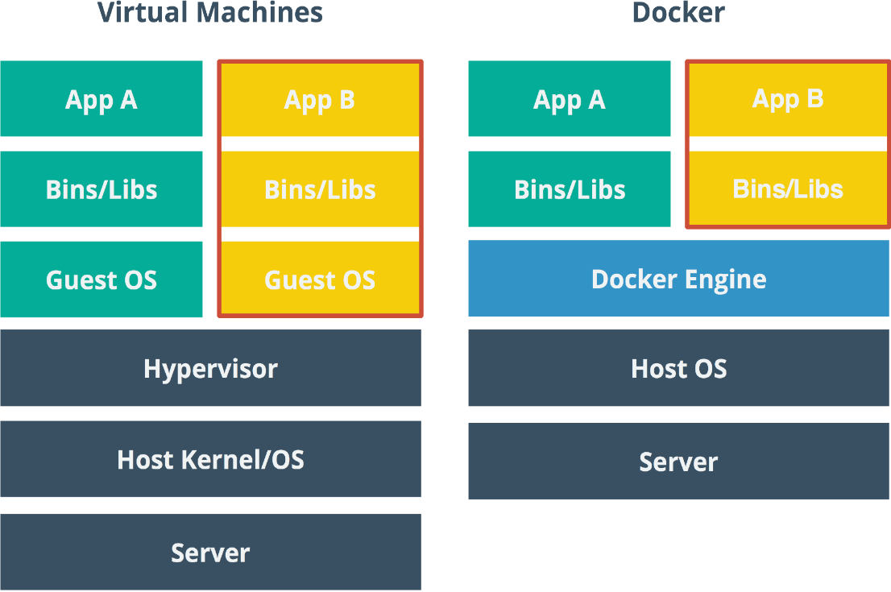

Docker Vs Virtualization
Docker vs Virtualization:
Container’s provide OS level process isolation where as virtual machines offer isolation at the hardware abstraction layer.
Virtual machines could take several minutes to create and launch where as containers can be created and launched in few seconds.
Applications in containers offer better performance compared to VM’s.
Containers are more resource
efficient than VM’s because
additional resources for OS is
eliminated
Containers are portable where
as VM’s are dependent on Hyper-
visor’s.

Slide 6
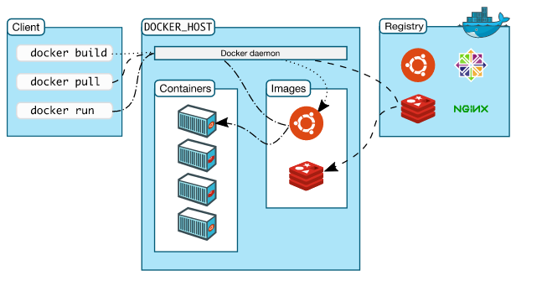
Docker Architecture

Slide 7
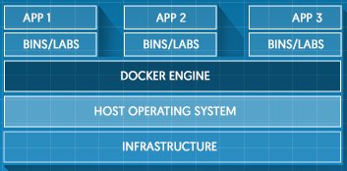
Docker Engine
Docker engine is a core of a docker platform which acts as lightweight runtime that runs Docker containers.
Docker Engine runs on Linux to create the operating environment for distributed applications.
It uses Linux namespace and control groups.

Slide 8
Docker Installation
Installing docker on Ubuntu
Login to your Ubuntu installation as a user with sudo privileges.
Update APT package index
$ sudo apt-get update
Install Docker
$ sudo apt-get install docker-engine
Start the docker daemon
$ sudo service docker start
Verify docker installed correctly
$ sudo docker run hello-world
Create docker group
$ sudo groupadd docker
Add user to the docker group
$ sudo usermod –aG docker $USER

Slide 9
Installing Docker on windows
Download docker for windows installer(InstallDocker.msi) from Stable or Beta channel.
Docker for windows requires Microsoft Hyper-V to run.
Double-Click InstallDocker.msi to run the installer.
Follow the install wizard to accept the license ,authorize the installer , and proceed with install.
Authorize docker-app with system password during install process. Privileged access is needed to install network components ,links to docker-apps and manage the Hyper-V VM’s.
Click finish on the setup complete dialog box to launch Docker.

Slide 10
Docker basics
Docker build
Docker build refers to the process of building an image.
Docker allows to compose our application from micro services without any inconsistencies between development and production environment.
Docker run
Docker offers the ability to deploy the scalable services , securely and reliably on a wide variety of platforms
Docker Ship
Docker lets you design the entire cycle of application development, testing and distribution, and manage it with a consistent user interface

Slide 11
Docker file
Docker file is a configuration file that contains instructions for building a docker image.
Provide more effective way to build images compared to using “Docker commit”.
Easily fits in to your continuous integration and deployment process.
Docker file instructions:
Instructions specify what to do when building the image
FROM instruction specifies what the base image should be
RUN instruction specifies a command to execute
# Example
FROM Ubuntu:14.04
RUN apt-get install vim

Slide 12
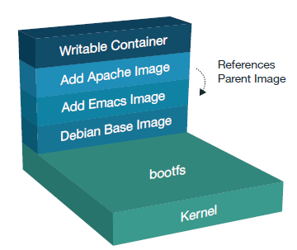
Docker Images
What’s an Image?
Images are immutable, file that’s essentially a snapshot of a container.
Images are created with the build command and produce a container when started with run.
Images are designed to be composed of
layers of other images , allowing a minimal
amount of data to be sent when transferring
images over the network.
Local images can be listed by running docker images
Images are made of layers, conceptually stacked on top of each other.

Slide 13
Terminology - Image
Persisted snapshot that can be run
images: List all local images
run: Create a container from an image and execute a command in it
tag: Tag an image
pull: Download image from repository
rmi: Delete a local image
This will also remove intermediate images if no longer used

Slide 14
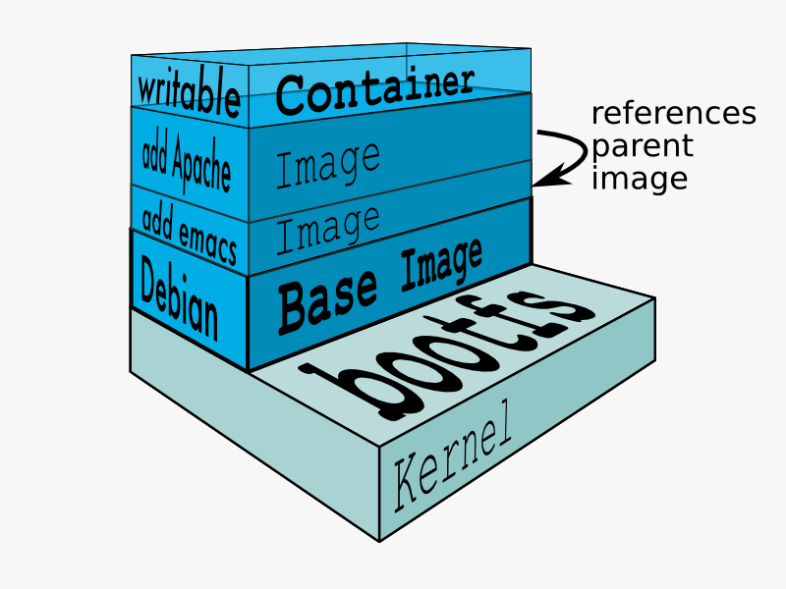
Building Docker images

Slide 15
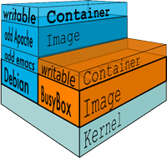
Containers
Container is a runnable instance of an image. Container is read-write layer on top of other read-only layers of an image.
Containers are light weight and easily portable.
Containers are created using run command
$ docker run image_id/name [command ][args].
Containers are used to run the application where as
images stores the application.
When we start a container ,we are referring to an image through its unique ID. Docker pulls the required image and its parent image until reaches base image.
To view docker containers list
$docker ps -a

Slide 16
Terminology - Container
Runnable instance of an image
ps: List all running containers
ps –a: List all containers (incl. stopped)
top: Display processes of a container
start: Start a stopped container
stop: Stop a running container
pause: Pause all processes within a container
rm: Delete a container
commit: Create an image from a container

Slide 17
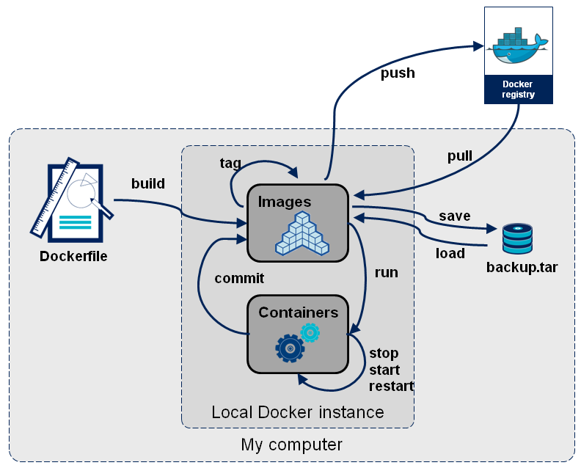
Docker Workflow

Slide 18
Basic docker commands
To view all images
$ docker images
To view all the hidden and intermediate images
$ docker images –a
To view all the active containers
$ docker ps
To view all the containers, both active and exited
$ docker ps –a
To get interactively inside the container which has Ubuntu
$ docker run –I –t Ubuntu /bin/bash
To get interactively inside the container which has Ubuntu v12.10
$ docker run –I –t Ubuntu:12.10 /bin/bash
To push image into docker hub
$ docker push <repository name:tag>
To pull images from docker hub
$ docker pull <image name>

Slide 19
To stop the running container
$ docker stop <Container ID>
To start the running container
$ docker start <Container ID>
To start the container and get inside the container interactively
$ docker start -i <Container ID>
To restart docker engine
$ service docker restart
To start docker engine
$ service docker start
To stop docker engine
$ service docker stop
To build an image using docker file
$ docker build .
To tag an image with repository name and tag
$ docker tag <image ID> <repository name:tag>

Slide 20
Resource Usage
top
ps
free -m
docker ps [containerId]
docker ps –a
docker images

Slide 21
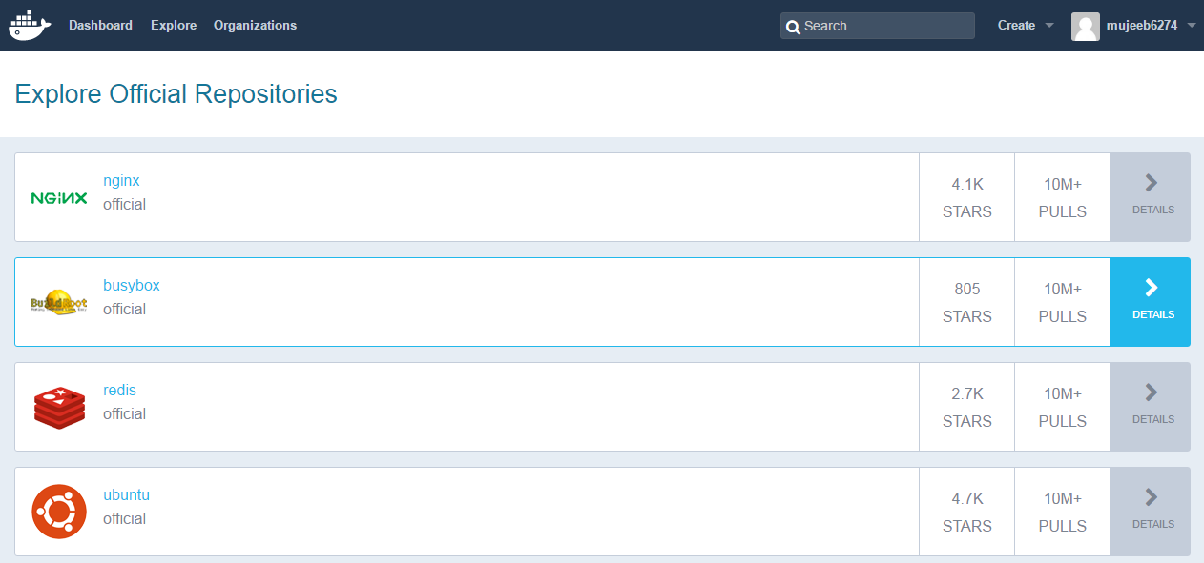
Docker Hub
Docker hub is a cloud-based registry service which allows to link to code repositories, build Images and test them.
It provides a centralized resource for container image discovery, distribution and change management .
Docker hub provides different features.
Image repositories: find, manage, push, pull images from public, private image libraries.
Automated builds: Automatically create new images when you make changes to source code.
Organizations :create work groups to manage access to image repositories .

Slide 22
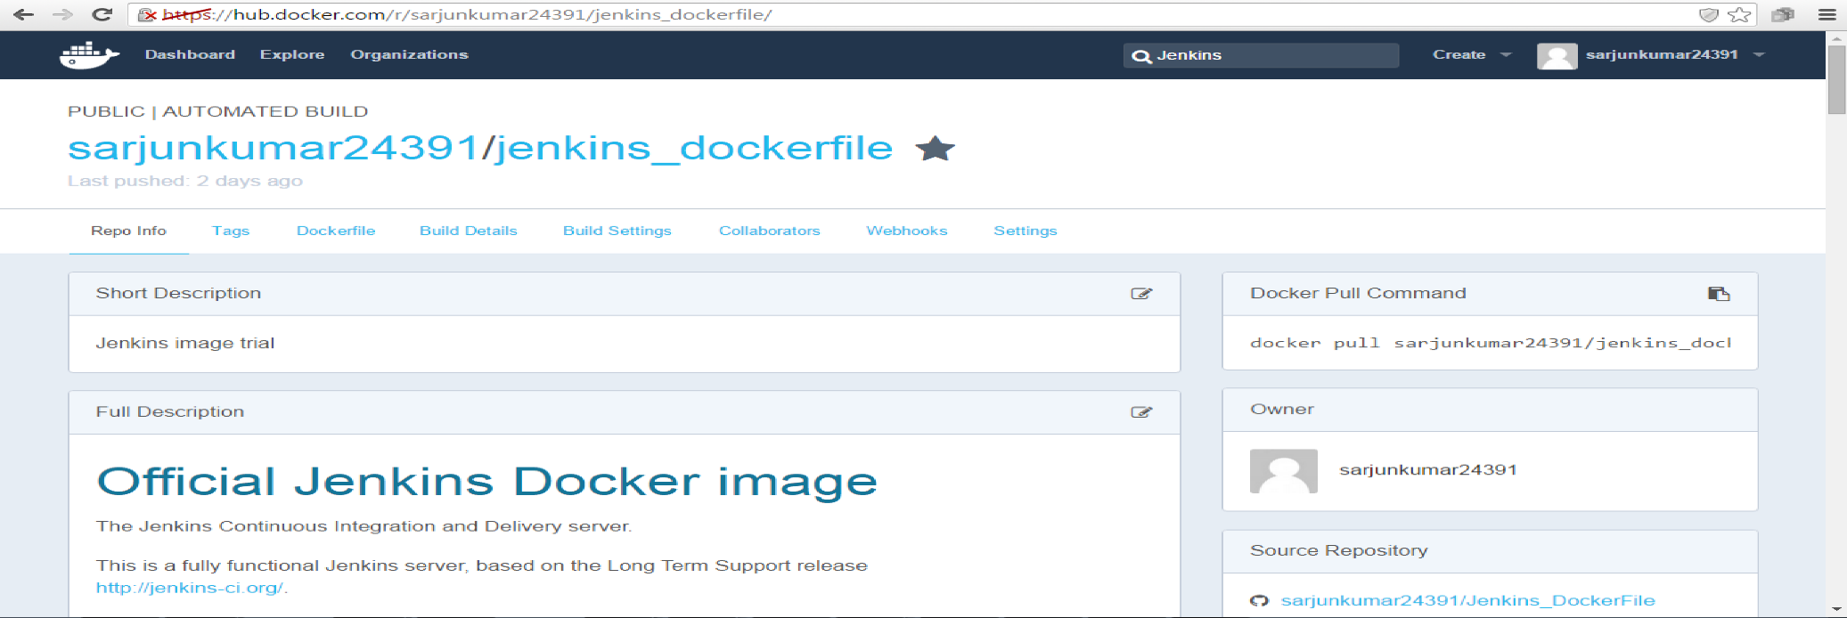
Docker Hub Automated Build
Using Automated Build we can connect to the SCM and trigger a build to create an image. Docker HUB can be integrated with “github”.
From github the source application can be pulled and image will be created in Docker HUB based on the Dockerfile in the github source code. If the code doesn’t have a Dockerfile or the repository is not accessible, then image cannot be built.

Slide 23
Docker Volume
A volume is a designated directory in a container, which is designed to persist data, independent of the container’s life cycle.
Changes to a volume will not be included when you update an image.
Exist even container is deleted and can be mapped to a host folder.
Data volumes can be Shared and used of other containers.
Volumes can be mounted when creating or executing a container.
There are three main use cases for Docker data volumes:
To keep data around, even through container restarts.
To share data between the host file system and the Docker container.
To share data with other Docker containers.

Slide 24
Docker Volume
There are 2 ways in which you can manage data in Docker:
Data volumes
Data volume containers

Slide 25
Data Volumes
A data volume is a specially designed directory in the container.
It is initialized when the container is created. By default, it is not deleted when the container is stopped. It is not even garbage collected when there is no container referencing the volume.
The data volumes are independently updated. Data volumes can be shared across containers too. They could be mounted in read-only mode too.

Slide 26
Mounting a Data volume
Launching a container and mount a volume using the option –v [\VolumeName]
Commands:
# docker run -it -v /data --name container1 busybox
# ls
# cd data
# touch file1.txt
# ls
# exit
# docker ps –a
# docker inspect container1
# sudo ls
# docker restart container1
# docker attach container1
# docker rm container1
# sudo ls

Slide 27
Data volume containers
If data needs to be shared between containers or the data from non-persistent containers to be used .The process contains two steps:
1. Create a Data volume container
2. Create another container and mount the volume from the container created in Step 1
Commands :
# docker run -it -v /data --name container1 busybox
# cd data
# ls
# touch file1.txt
# touch file2.txt
Note : press Ctrl-P-Q to come back to the boot2docker prompt without exiting the container
# docker ps

Slide 28
Data volume containers
# docker exec container1 ls /data
# docker run -it --volumes-from container1 --name container2 busybox
# ls
# cd data
Conclusion : see that the data folder is present and if we do a ls inside of that, we can see our two files: file1.txt and file2.txt

Slide 29
Docker compose
Compose is a tool for defining and running multi-container docker applications.
Compose file is used to configure application’s services. Using single command we can create and start all the services from configuration.
This allows for container redundancy at the host level which is good for production resiliency
Compose is great for development, testing and staging environments as well as CI workflows.
Compose can be used in many different use cases as Development environments, automated testing environments and single host deployments etc.
This tool takes a simple configuration yml file and deploys the containers.

Slide 30
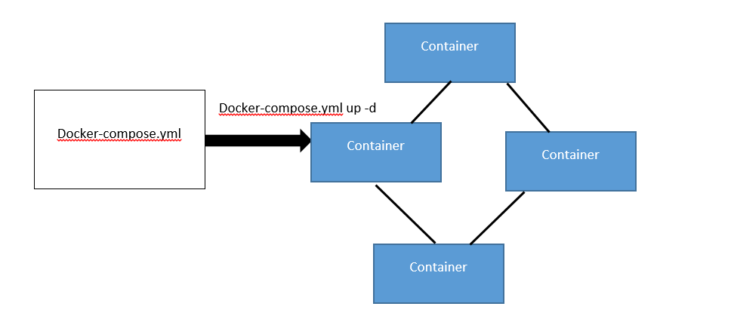
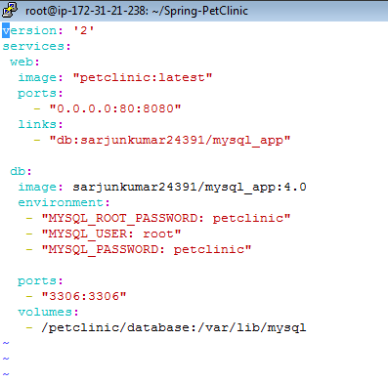
Docker Compose

Slide 31
Install compose - Ubuntu
Installation Commands
curl -L https://github.com/docker/compose/releases/download/1.8.0/docker-compose-`uname -s`-`uname -m` > /usr/local/bin/docker-compose
chmod +x /usr/local/bin/docker-compose
docker-compose version

Slide 32
Compose Command
docker-compose up
Builds images from Dockerfiles
Pulls images from registries
Creates and starts containers
Streams their logs
Benefits
Make your development environments:
Repeatable
Isolated
Fast

Slide 33
Docker Compose Execution
git clone https://github.com/sarjunkumar24391/Spring-PetClinic.git
cd Spring-PetClinic/
docker build .
docker images
docker tag <Image id> petclinic
docker-compose up -d

Slide 34
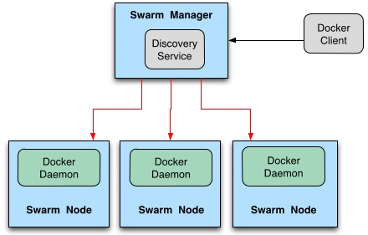
Docker Swarm
Docker Swarm is a tool that clusters Docker hosts and schedule containers.
It turns a pool of docker hosts into a single virtual docker host.
Swarm follows the “swap, plug, and play” principle.
To create swarm cluster on our
network pull docker swarm image.
Configure swarm manager and all
node to run Docker swarm.

Slide 35
Docker Swarm Cluster Setup
To create Token – Swarm Manager
docker -H tcp://172.31.35.4:2375 run --rm swarm create
566464c8da84c163eb0d7e113bdac65c
Node to bradcast to Manager
sudo docker -H tcp://172.31.21.238:2375 run -d swarm join --addr=172.31.21.238:2375 token://566464c8da84c163eb0d7e113bdac65c
To Manage
docker -H tcp://172.31.35.4:2375 run -d -p 5000:5000 swarm manage token://566464c8da84c163eb0d7e113bdac65c

Slide 36
Note : Edit /etc/init/docker.conf and update the DOCKER_OPTS variable to the following
DOCKER_OPTS='-H tcp://0.0.0.0:<port_id> -H unix:///var/run/docker.sock'

Slide 37
Thank you

