Slide 1
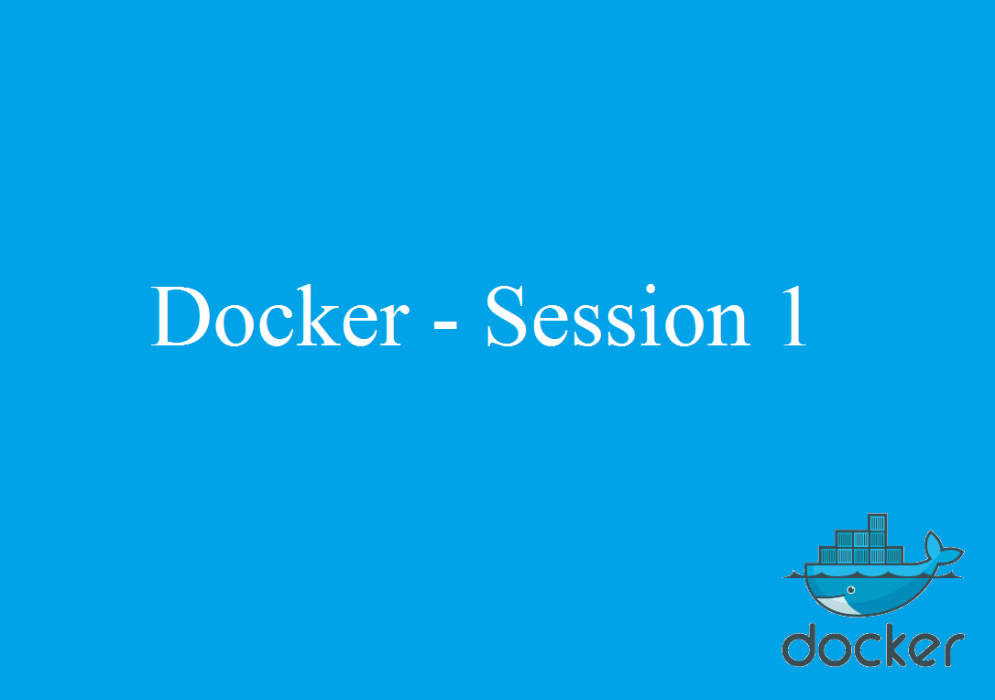

Slide 2
Agenda
Docker Overview
Docker vs Virtualization
Docker Installation
Docker Engine
Docker Base – Build, Ship and Run
Dockerfile
Docker Image
Docker Container
Docker Hub
Automated Build in Hub

Slide 3
Docker overview
Docker is an open source, container based technology.
Containers-packages the application and all of its parts ,the stack that it runs on, the dependencies that are associated with it.
Containers are lite weight, easy to use, portable.
For developers it provides the environment.
For operational staffs it gives flexibility and potentially reduces the number of systems need because of its small foot prints and lower overhead.

Slide 4
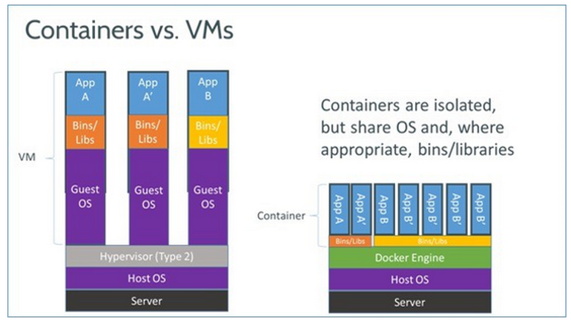
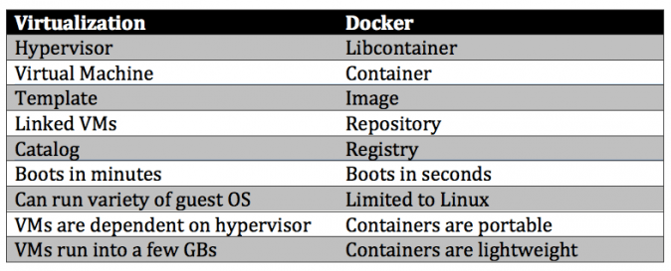
Docker vs Virtualization

Slide 5
Docker vs Virtualization
As compared to virtual machines, containers can be faster and less resource heavy as long as the user is willing to stick to a single platform to provide the shared OS. A virtual machine could take up several minutes to create and launch whereas a container can be created and launched just in a few seconds. Applications contained in containers offer superior performance, compared to running the application within a virtual machine.
With Docker ecosystem you will never need to move around Gigabytes on "small changes" and you don't need to worry about losing performance by packaging applications into a Docker container on runtime. You don't need to worry about versions of that image.

Slide 6
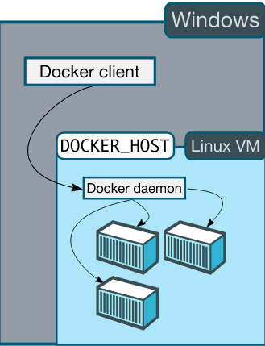
Docker Installation
Toolbox(Windows, Mac OS)
Windows
Docker toolbox consist of
Docker Machine for running the Docker –machine
binary.
Docker Engine for running the docker binary.
Kitematic, the docker GUI.
A shell preconfigured for a docker command-line
environment.
5. Oracle VM virtual box
Requirement
64 bit OS running windows 7 or higher
Note: Docker native support in windows is expedite with Windows Server 2016. And 4 beta version is already released from Microsoft.

Slide 7
Installation-toolbox for windows
If you have VirtualBox running, you must shut it down before running the installer.Install docker toolbox from docker toolbox page.
Either you can use docker quickstart terminal or windows command prompt(create vm and use docker cmd ) .
https://docs.docker.com/engine/installation/windows/

Slide 8
Installation-Linux
curl -fsSL https://get.docker.com/ | sh
The system prompts for your sudo password. Then, it downloads and installs Docker and its dependencies.
Ref:https://docs.docker.com/linux/step_one/

Slide 9
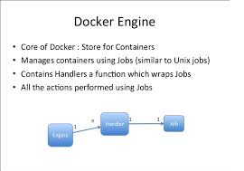
Docker Engine
Docker Engine is a lightweight runtime and robust tooling that builds and runs your Docker containers. Docker Engine runs on Linux to create the operating environment for your distributed applications. The in-host daemon communicates with the Docker client to execute commands to build, ship and run containers.

Slide 10
Docker Base – Build, Ship and Run
Build: Docker allows you to compose your application from micro services, without worrying about inconsistencies between development and production environment and without locking into any platforms or language
Ship: Docker lets you design the entire cycle of application development, testing and distribution, and manage it with a consistent user interface
Run: Docker offers you the ability to deploy scalable services, securely and reliably, on a wide variety of platforms

Slide 11
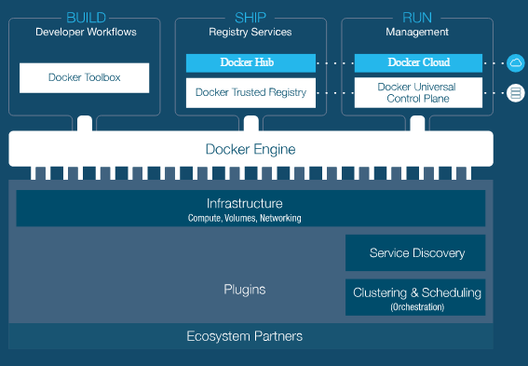
Docker Base – Build, Ship and Run

Slide 12
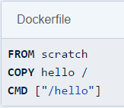
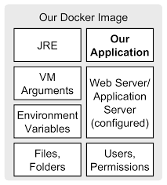
Dockerfile
How to build an image and run as a container can be understood when knowing about Docker file.
How an application is provided as image? How an applications jar file can be pulled as an image? The answers to these questions can be found when understanding the Dockerfile.

Slide 13
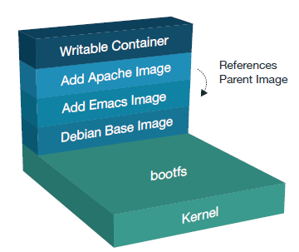
Docker Image
Docker images are the basics of the containers at rest
An image is a collection of files + some metadata. (Technically: those files form the root filesystem of a container.)
Images are made of layers, conceptually stacked on top of each other.
Images are conceptually similar to classes in Object Oriented Programming
Layers are conceptually similar to inheritance in Object Oriented Programming

Slide 14
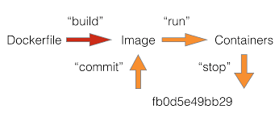
Docker Container
A Docker container wraps up a piece of software in a complete file system that contains everything it needs to run: code, runtime, system tools, system libraries – anything you can install on a server
Docker containers are built from Docker images
Containers are created from an image with the “docker run” command. Once initiated, the Docker Engine spins up that container from the defined image
Docker containers make distributed applications:
Composable: Lightweight containers start instantly and use minimal resources because they share the kernel of the underlying operating system
Dynamic: Quick to spin up and easy to scale and change make containers ideal for agile teams
Portable: Able to run on any physical, virtual or cloud environment running Docker.

Slide 15
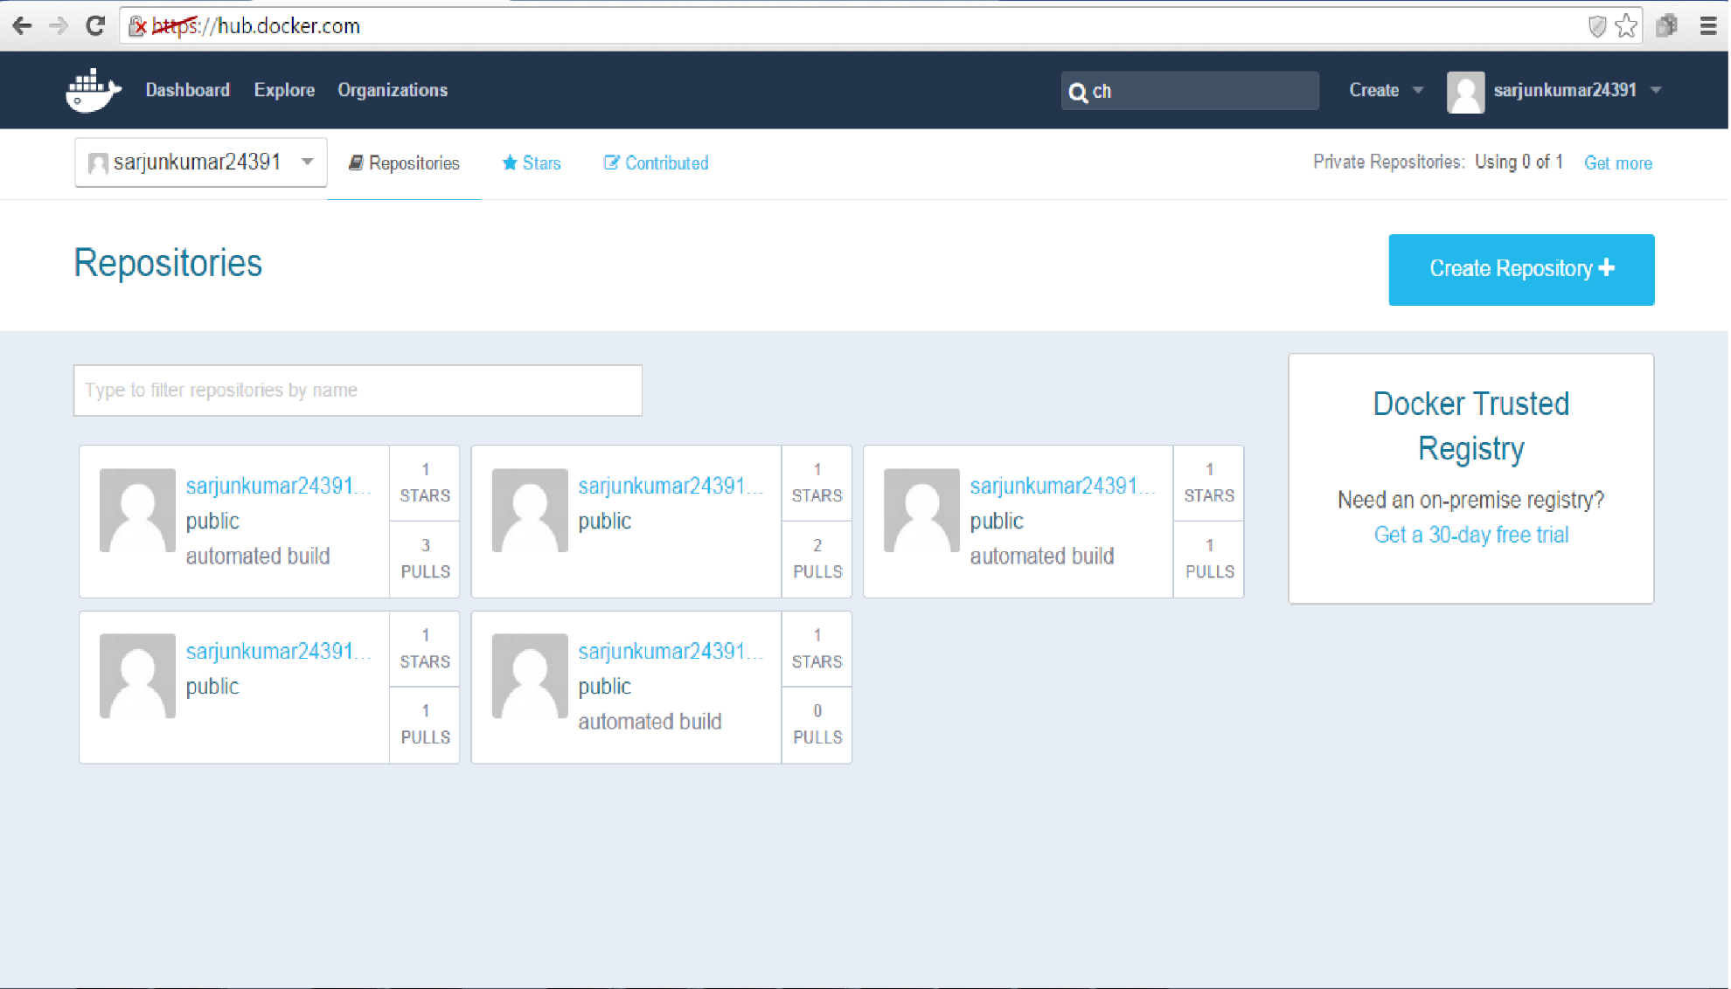
Docker Hub
Docker HUB is a public repository from where we can pull images, push updated images, trigger auto build and to create our own repository.

Slide 16
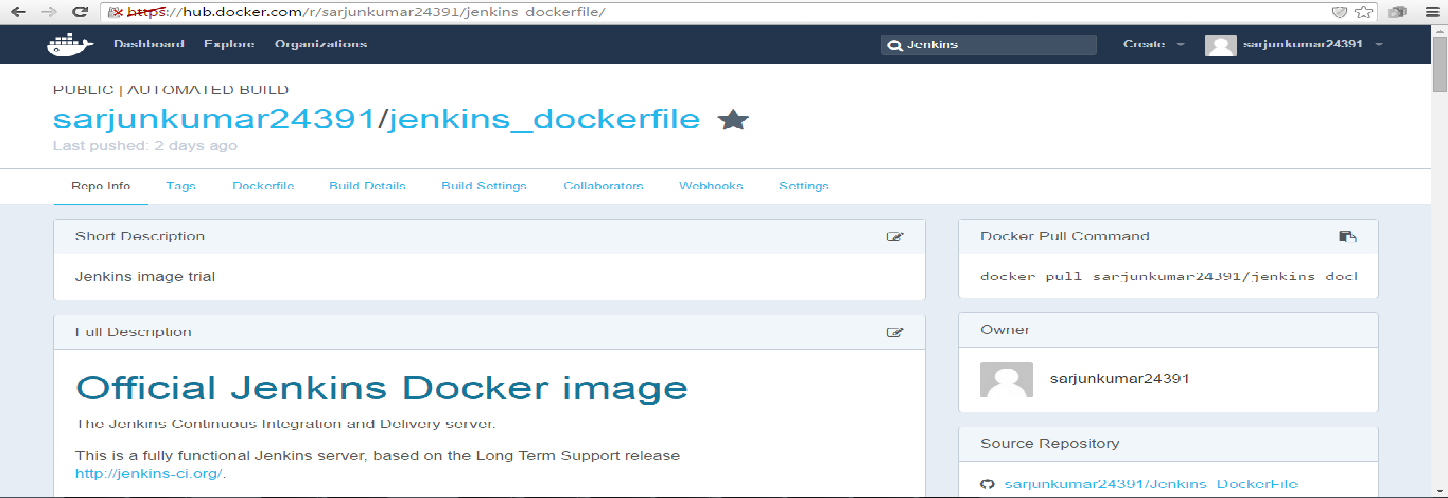
Docker Hub – Automated Build
Using Automated Build we can connect to the SCM and trigger a build to create an image. Docker HUB can be integrated with “github”.
From github the source application can be pulled and image will be created in Docker HUB based on the Dockerfile in the github source code. If the code doesn’t have a Dockerfile or the repository is not accessible, then image cannot be built.

Slide 17
Docker Basic Commands
## To view all images
docker images
## To view all the hidden and intermediate images
docker images –a
## To view all the active containers
docker ps
## To view all the containers, both active and exited
docker ps –a
## To get interactively inside the container which has Ubuntu
docker run –I –t Ubuntu /bin/bash
## To get interactively inside the container which has Ubuntu v12.10
docker run –I –t Ubuntu:12.10 /bin/bash
## To push image into docker hub
docker push <repository name:tag>
## To pull images from docker hub
docker pull <image name>

Slide 18
Docker Basic Commands
## To stop the running container
docker stop <Conatiner ID>
## To start the running container
docker start <Conatiner ID>
## To start the container and get inside the container interactively
docker start -i <Conatiner ID>
## To restart docker engine
service docker restart
## To start docker engine
service docker start
## To stop docker engine
service docker stop
## To build an image using docker file
docker build .
## To tag an image with repository name and tag
docker tag <image ID> <repository name:tag>

Slide 19
Docker Basic Commands
## To remove the images
docker rmi <image id>
## To remove the containers
docker rm <container id>

Slide 20
