Slide 1
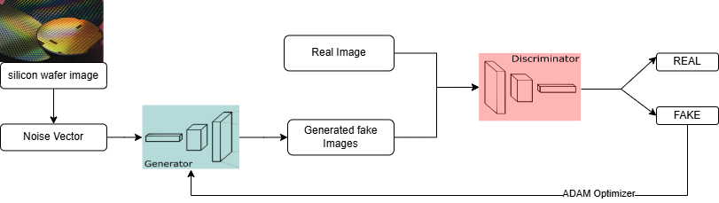
Generation Of Silicon Wafer Images Using Generative Adversarial Networks [GAN's]
Problem statement
Methodology:
We have trained GAN model to generate synthetic silicon wafer defect images. First, we preprocess 1000 grayscale images by resizing and normalizing them. Our GAN consists of a Generator (which creates images from random noise) and a Discriminator (which classifies images as real or fake). Both models are trained using Binary Cross-Entropy loss and optimized with the Adam optimizer. During training, we alternate between training the Discriminator and Generator across multiple epochs. We periodically save and visualize generated images to evaluate the quality and learning progress.
Silicon wafer images requires large, diverse datasets, which are often costly and limited. This project uses Generative Adversarial Networks (GANs) to synthetically generate realistic wafer images, enhancing data availability
Objectives:
Develop a GAN model to generate realistic silicon wafer images, including rare variations.
Use the generated images to enrich wafer image datasets and reduce the need for costly data collection.
Approach and model architecture:
Dataset: Silicon wafer images
Model: GAN’s
Implementation: Generation of silicon wafer Images
Evaluation: Loss function of Discriminator and Generator
Figure 1. Workflow of our model.
Refrence paper : by S.-N. Chen and S.-H. Chen explores using Generative Adversarial Networks (GANs) to generate virtual silicon data for enhancing Wafer Acceptance Test (WAT)

Slide 2
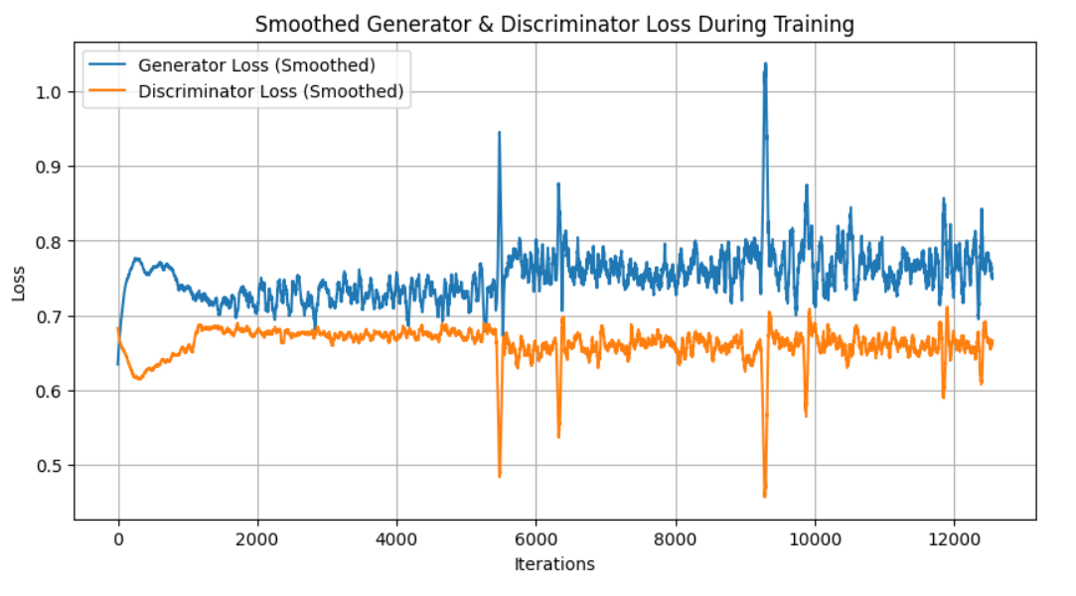
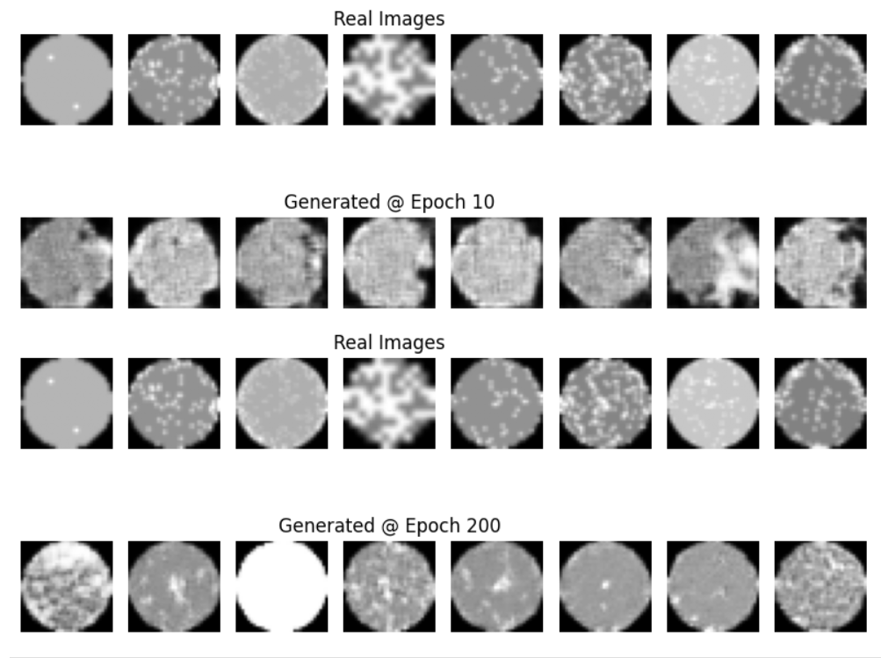
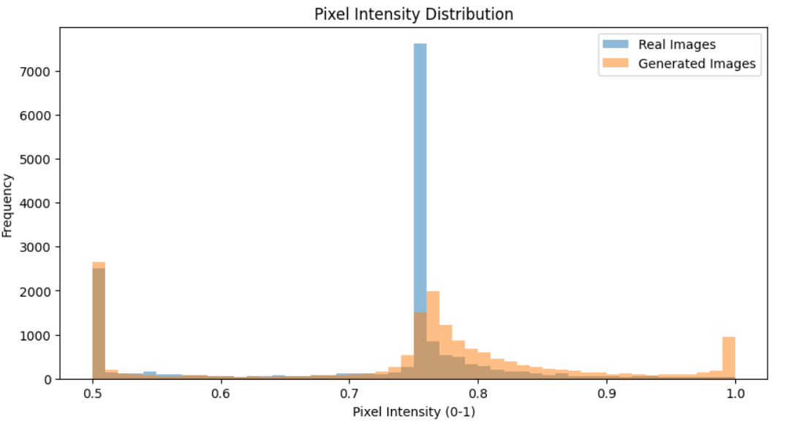
Generation Of Silicon Wafer Images Using Generative Adversarial Networks [GAN's]

