Slide 1

23EECW301
MINOR PROJECT-6th SEM Under the Guidance of Prof . Shivaling Hungund
Health Monitoring System using IoT and Cloud Computing
Department of Electronic and Communication,
KLE Technological University’s Dr. M. S. Sheshgiri College of Engineering and Technology, Belagavi

Slide 2
Details of the Team
Div: |  | B
Sl. No. | Name |  | SRN.
1 | SANSKRUTI MIRAJKAR |  | 02FE22BEC084
2 | SHRAMAN KANTHI |  | 02FE22BEC092
3 | SWATI PATIL |  | 02FE22BEC112
4 | DARSHAN MODEKAR |  | 02FE22BEC119

Slide 3
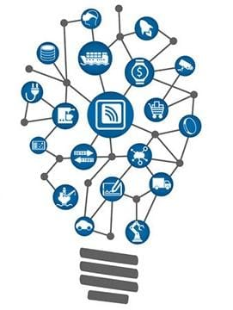
CONTENTS
Gantt Chart
Work Breakdown Structure
Specification and dentification
Functional Block Diagram
Simulation of the Design
Conclusion

Slide 4
PROBLEM STATEMENT
There is a need for an IoT-based health monitoring application that continuously tracks vital signs like heart rate and blood pressure. This system should utilize cloud monitoring for real-time data analysis and alerts enabling timely interventions, personalized health, to improve patient outcomes and engagement.

Slide 5
INTRODUCTION
With the rise of chronic diseases, continuous health monitoring has become crucial for managing conditions like hypertension and heart disease. This project proposes an IoT-based health monitoring system that tracks vital signs, such as heart rate and blood pressure, in real-time. By transmitting data to a cloud-based platform, the system allows for continuous analysis, real-time alerts, and remote access for healthcare providers. This approach enhances patient care by enabling timely interventions and promoting proactive health management, ultimately improving patient outcomes and engagement.

Slide 6
LITERATURE SURVEY
Sl No. | Paper Title | Purpose of the study | Tools/ software used | Limitations /Disadvantages
1 | IoT Based Health Monitoring System Built on ESP32 | To compare the existing technology with the recent one and scope of improvement | Heart Beat Sensor, temperature sensor, ESP32, Buzzer | Only used for data transmission over short distances With increased users and loaded data, no guarantee for users, poor performance over time, and low knowledge usage
3 | IoT based Healthcare Monitoring and Tracking System for Soldiers using ESP32 | To compare the existing technology with the recent one and scope of improvement | MAX30102 ,ESP32, Jumper wires, Server | Data Security Concerns Dependence on Connectivity Sensor Limitations Power Consumption

Slide 7
LITERATURE SURVEY
Sl No. | Paper Title | Purpose of the study | Tools/ software used | Limitations /Disadvantages/Remarks
3 | IoT based Healthcare Monitoring and Tracking System for Soldiers using ESP32 | To compare the existing technology with the recent one and scope of improvement | ESP32, .Heartbeat sensor (LM358), GPS, Panic Button, Think Speak app | Dependency on internet connectivity Power constraint(battery drains) Limited data security, lack of advanced emergency features
4 | Design and Development of a Smart and Multipurpose IoT Embedded System Device Using ESP32 Microcontroller | To compare the existing technology with the recent one and scope of improvement | MAX30102 ,ESP32, Jumper wires, Server, Pulse Sensor | High Power Consumption Limited Sensor Accuracy Dependence on Wi-Fi Connectivity, Lack of Data Security Measures

Slide 8
DETAILED BLOCK DIAGRAM
HEALTH MONITORING
Initiation
Hardware Acquisition
Software
Server and Analytics
Testing and validation
Objectives
Sensors
Arduino IDE
Real-Time Data
Functional Testing
Literature survey
ESP32
ThingSpeak
Alert-System
End-User Testing
Gathering data
Web-Server
Dashboard Monitoring

Slide 9


FUNCTIONAL BLOCK DIAGRAM
ThingSpeak
ESP32
(microcontroller)
Power Supply
Web-Server
Human Body
MAX30102
Heart Pulse and sp02
DS18B20
Body temperature
Stakeholder
(doctor, patient, nurse)
DHT11
Room temp and Humidity temp

Slide 10
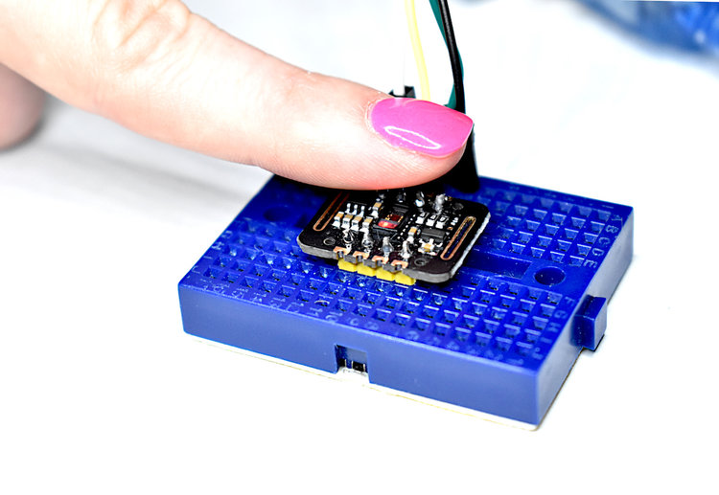
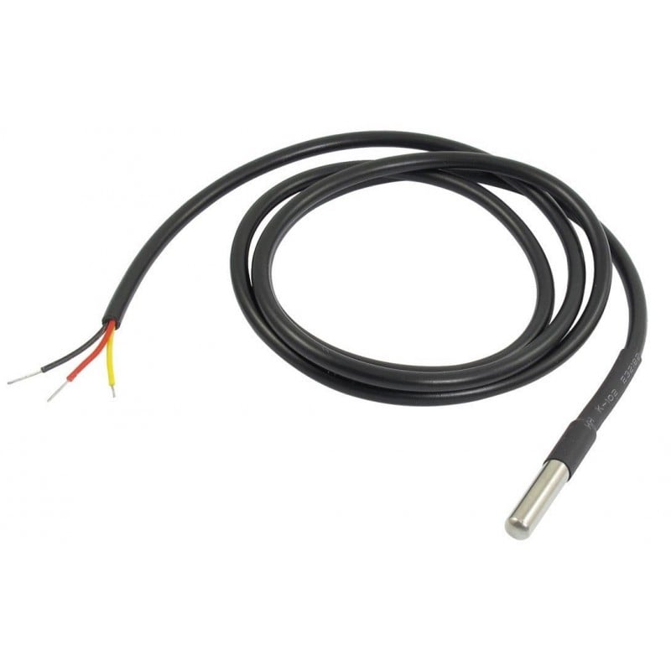
SPECIFICATIONS
Specification of inputs:
1. SENSORS:
MAX30102 (Pulse Oximeter and Heart Rate Sensor)
Role: Measures Pulse rate and blood oxygen levels (spO2)
Specification:
Parameters: SpO2 (oxygen saturation) and pulse rate
Communication: I2C Protocol
Applications: Health monitoring, fitness tracking
DS18B20 (Digital Temperature Sensor)
Role: Measures temperature
Specifications: Range: -55°C to +125°C.
Accuracy: ±0.5°C (in the -10°C to +85°C range)
Communication: 1-Wire Protocol
Input: Temperature data

Slide 11
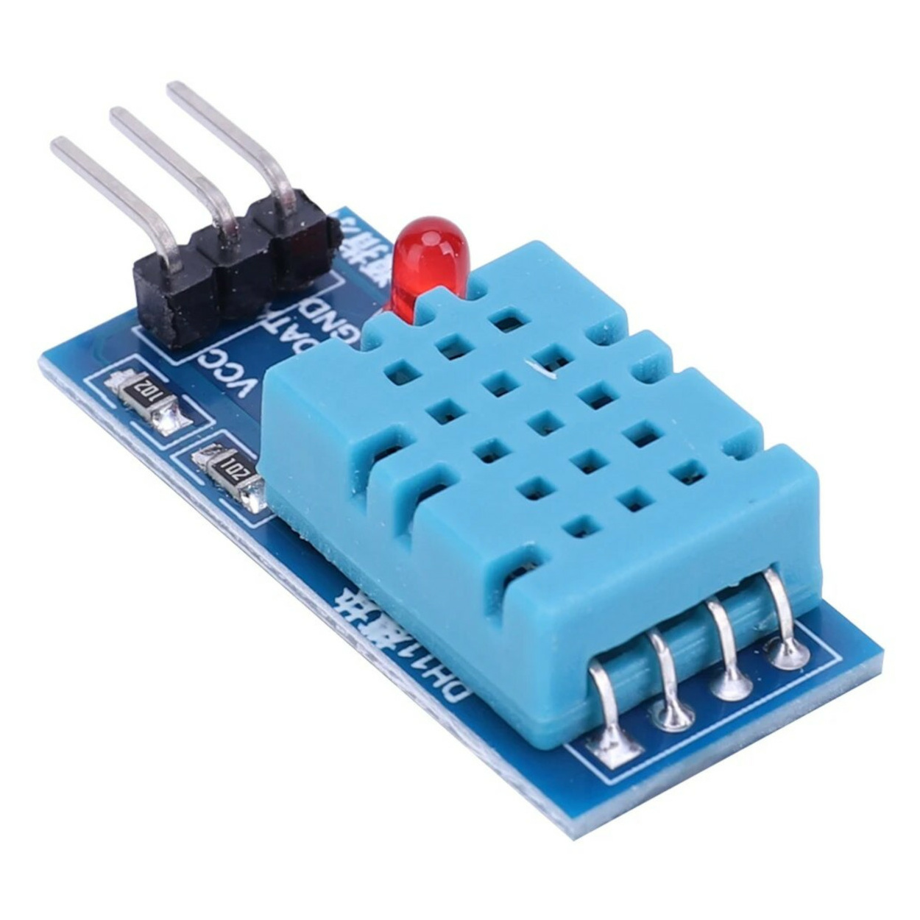
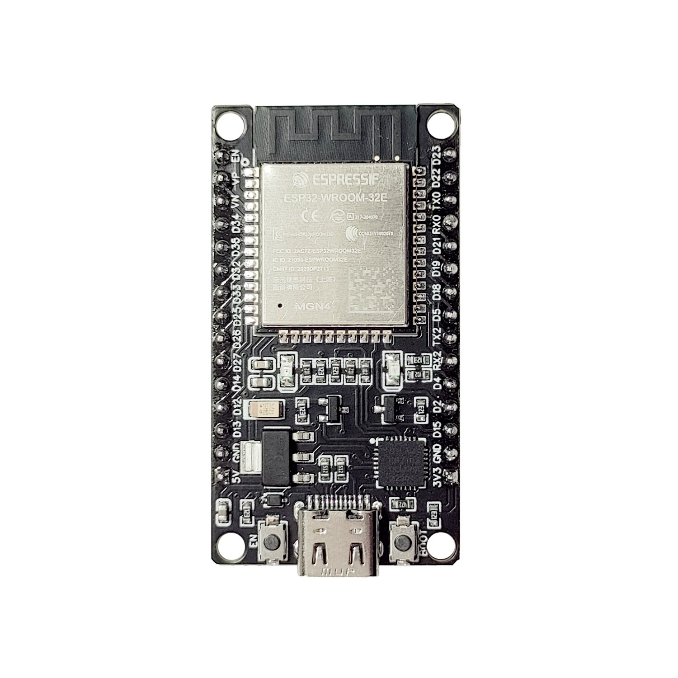
SPECIFICATIONS
DHT11 (Temperature and Humidity Sensor)
Role: Measures ambient temperature and humidity.
Specifications:
Temperature Range: 0°C to 50°C (±2°C accuracy).
Humidity Range: 20% to 90% RH (±5% accuracy).
Communication: Digital single-wire protocol.
Input: Ambient temperature and humidity levels.
2. User Input
Patient information (e.g. name, age, medical history)
Emergency contact
Threshold values for alert (e.g. maximum heart rate);

Slide 12
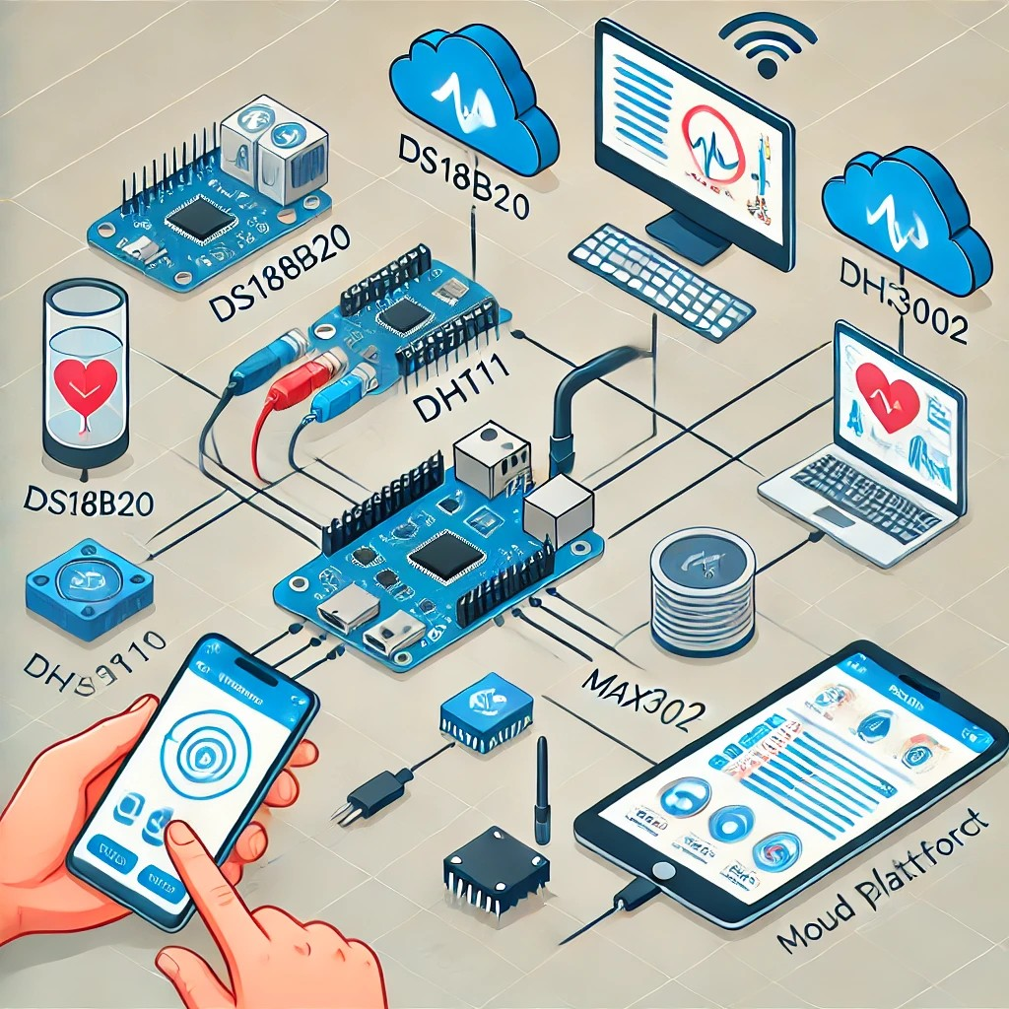
SPECIFICATIONS
Specification of outputs:
Real-Time Feedback: Visualization of health data on dashboards (e.g., graphs, charts).
Continuous Monitoring: Monitoring parameters like Pulse rate, blood oxygen levels (spO2), body temperature, ambient temperature and humidity.
Alert System: Send Alerts to the stakeholders when the parameters reaches the threshold.

Slide 13
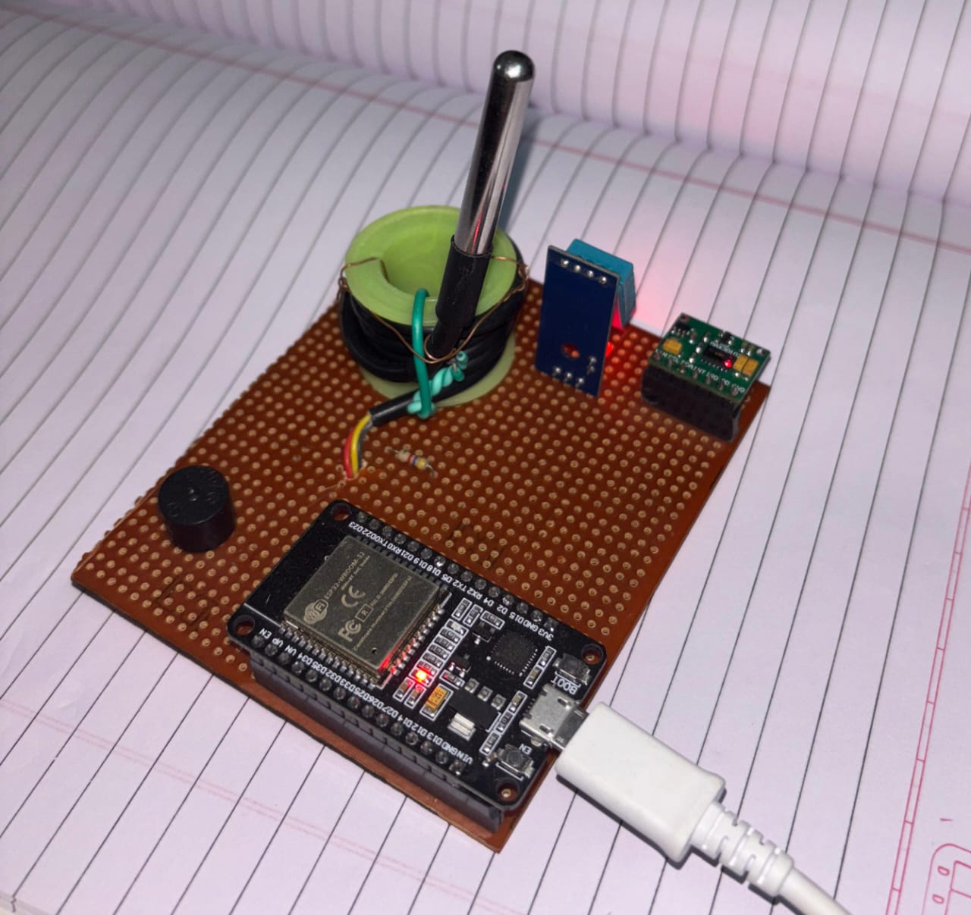
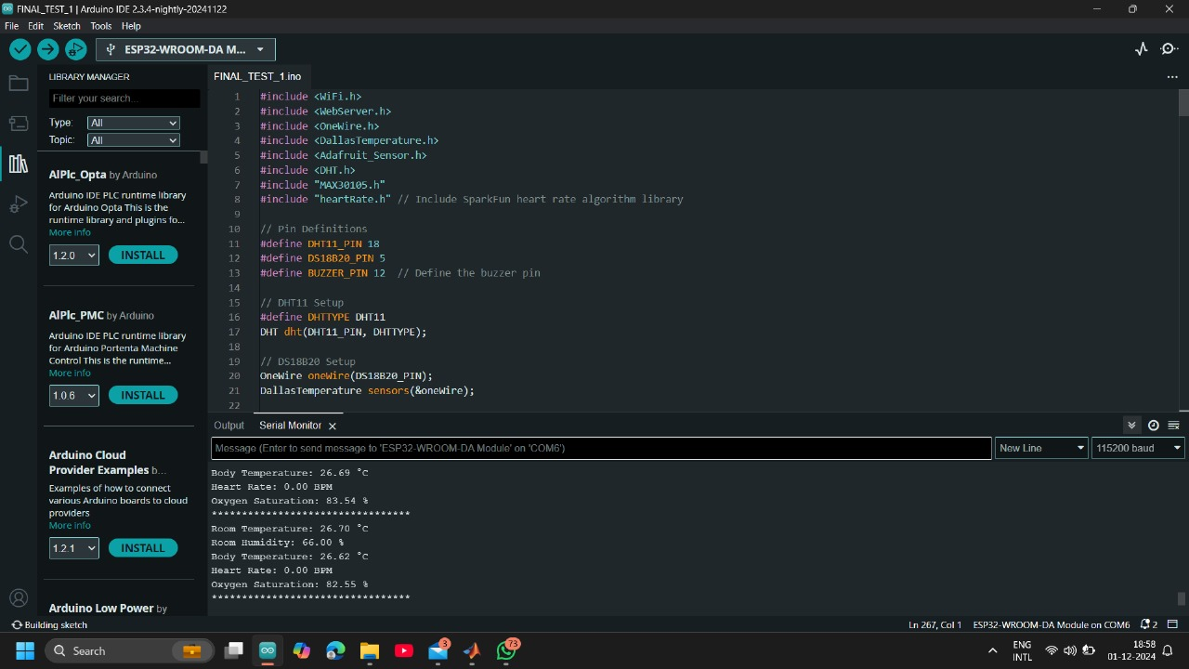
INTEGRATING THE FUNCTIONAL BLOCK DIAGRAM
Hardware Implementation
Code Implementation in Arduino IDE

Slide 14
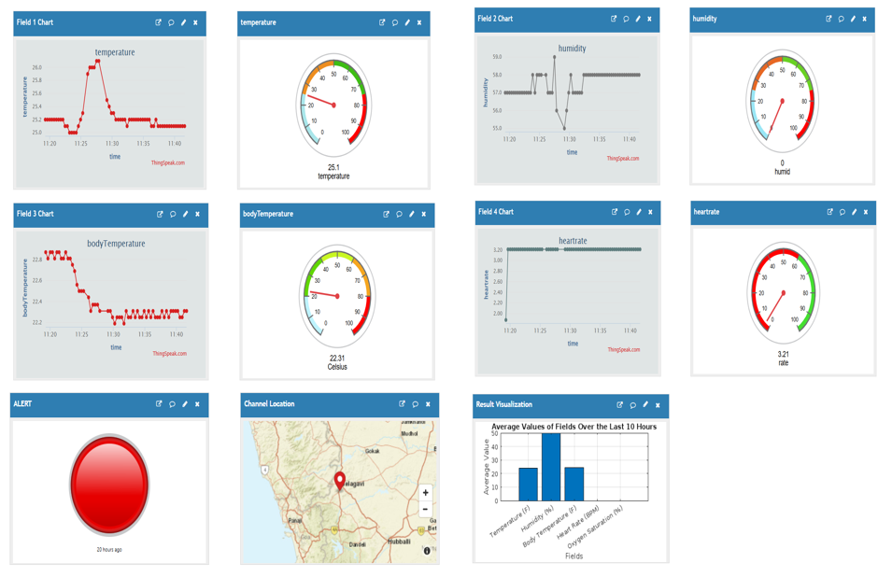
RESULTS

Slide 15
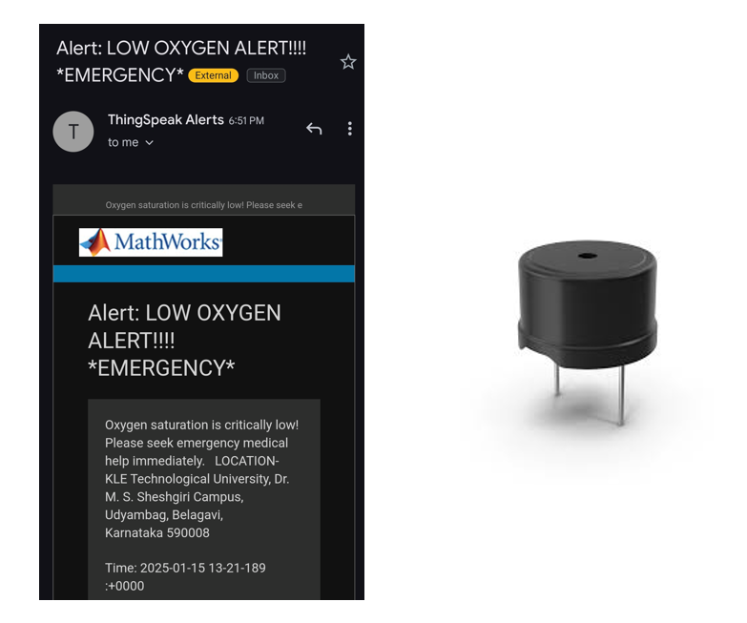

Slide 16
PLAN AND NEED FOR OPTIMIZATION
To enhance the functionality and user experience of the health monitoring system, we will be implementing a dedicated mobile application. This app will integrate with ThingSpeak to provide real-time data visualization and improved accessibility. By using the app:
Users will be able to monitor their health parameters directly on their smartphones.
Notifications and alerts will be delivered instantly.
The app will reduce dependency on the ThingSpeak web interface, offering a more optimized and user-friendly solution for managing health data.
This implementation will ensure seamless connectivity and better optimization for end-users.

Slide 17
THANK-YOU

