Slide 1

Case Study on Paytm E-commerce Payment System
Team: SHASHI
Aiswarya Sasikumar
Akshara T
Swati Mahapatra

Slide 2
What is Paytm?
Paytm is an Indian e-commerce payment system and financial technology company, based out of Noida, India.
Founded in August 2010 by Vijay Shekhar Sharma in Noida, India.

Slide 3
Paytm Services
Available in 11 Indian languages
Offers online use-cases like mobile recharges, utility bill payments, travel, movies, and events bookings
Also offers in-store payments at grocery stores, fruits and vegetable shops, restaurants, parking, tolls, pharmacies and educational institutions with the Paytm QR code.

Slide 4
Accessing Paytm
To start using Paytm, go to URL:
paytm.com

Slide 5
ONLINE BOOKING

Slide 6
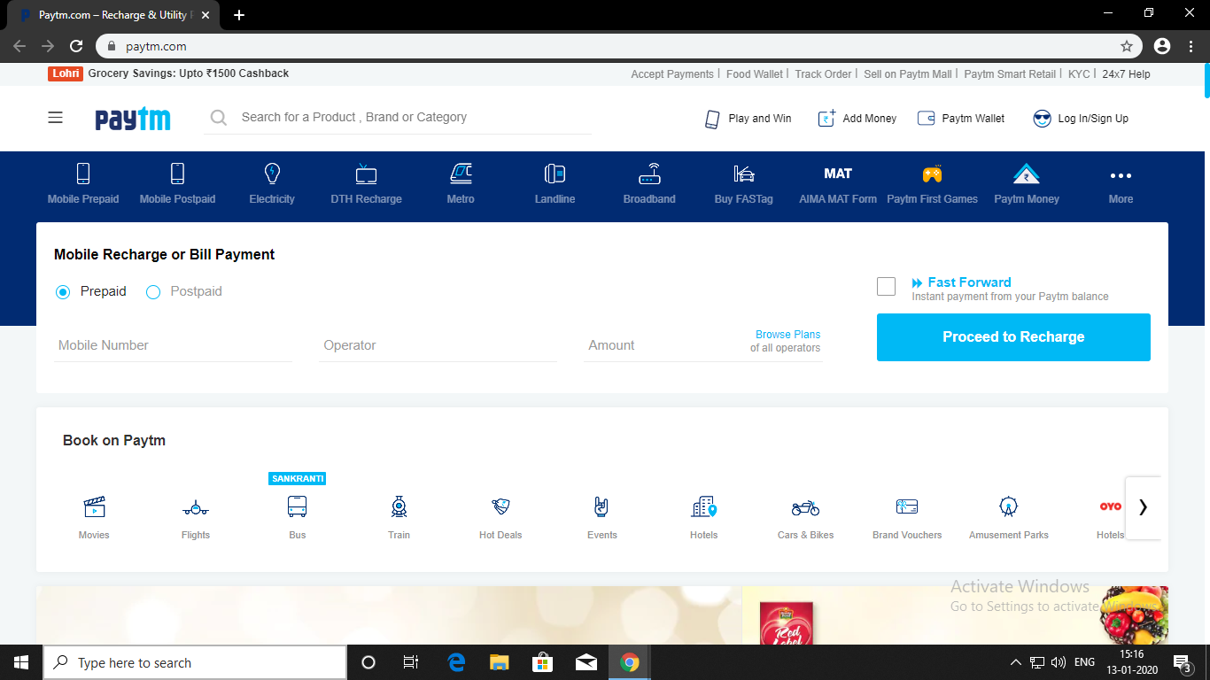
SELECT CATEGORY
Select category from ‘Book on Paytm’ section.

Slide 7
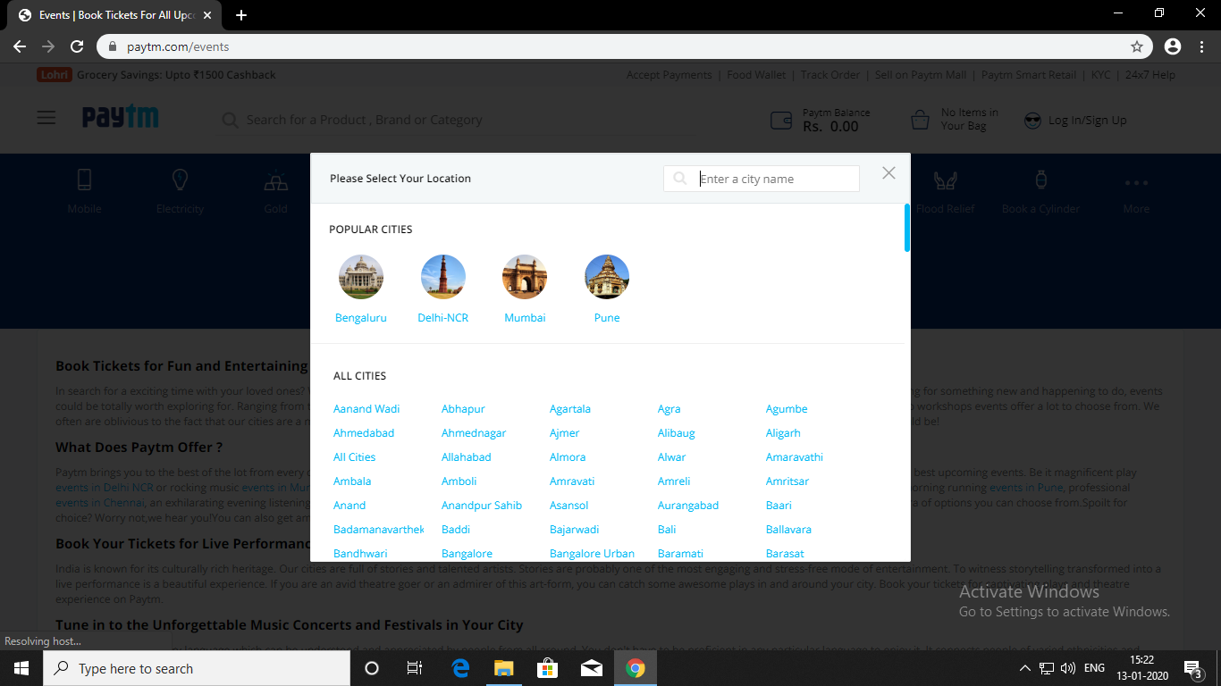
SELECT LOCATION
Select a city from the list of ‘All Cities’.

Slide 8
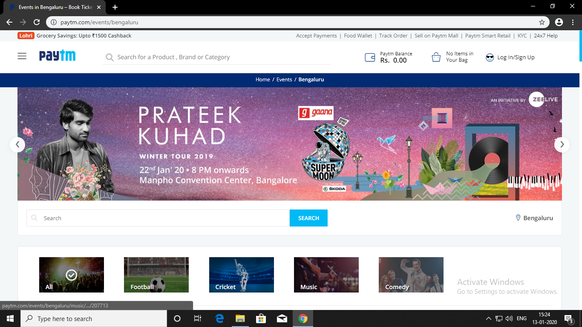
SELECT GENRE
Select a genre from the event list available for the current city.

Slide 9
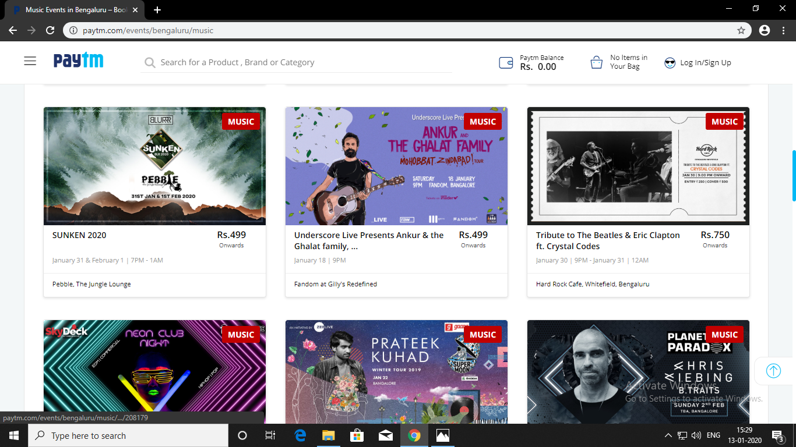
SELECT EVENT
Select an event from the list available for the genre chosen.

Slide 10
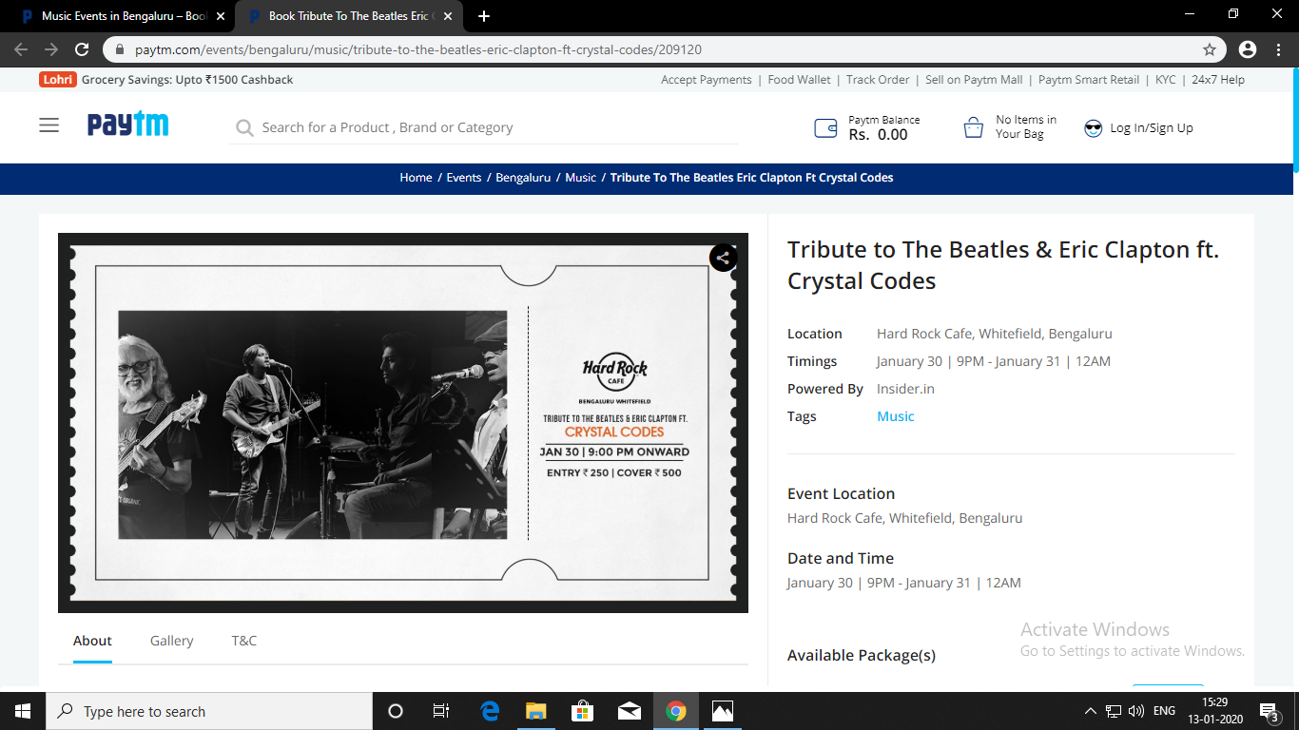
VIEW EVENT DETAILS

Slide 11
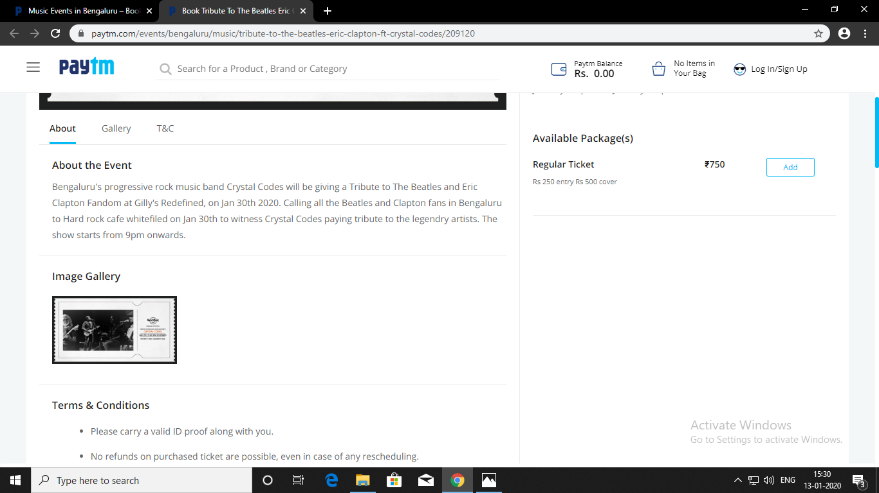
SELECT TICKET TYPE
Select the required event package.

Slide 12
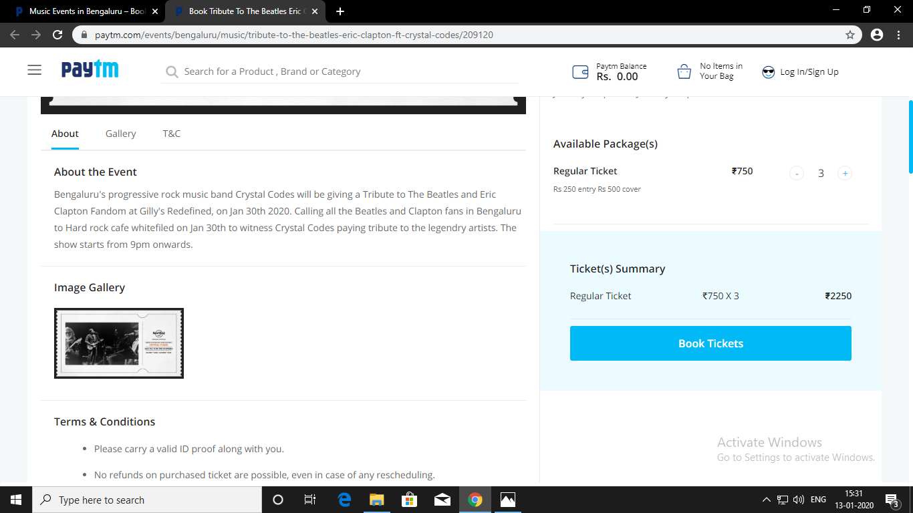
SELECT NUMBER OF TICKETS

Slide 13
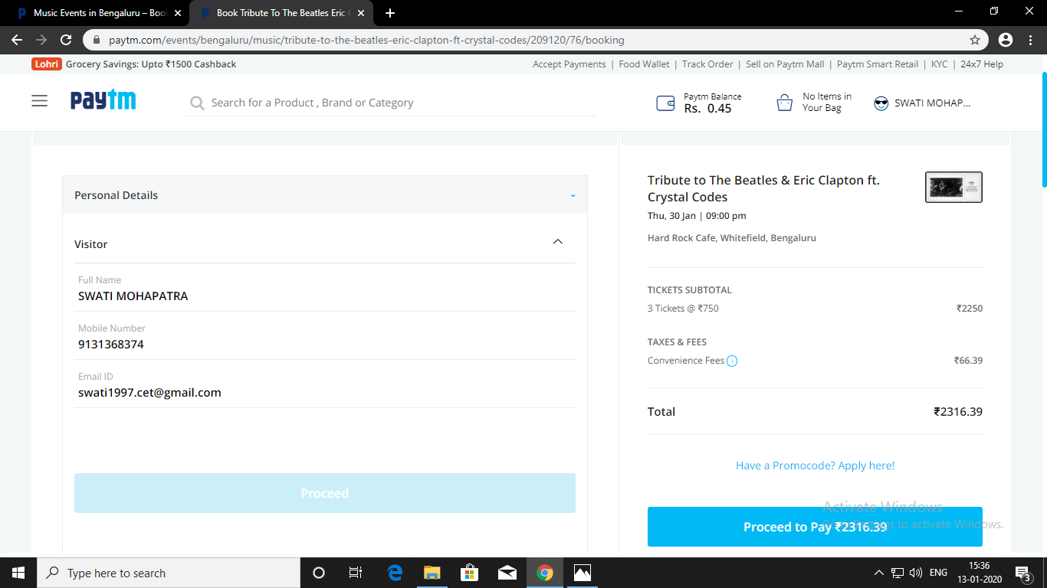

ENTER USER DETAILS

Slide 14
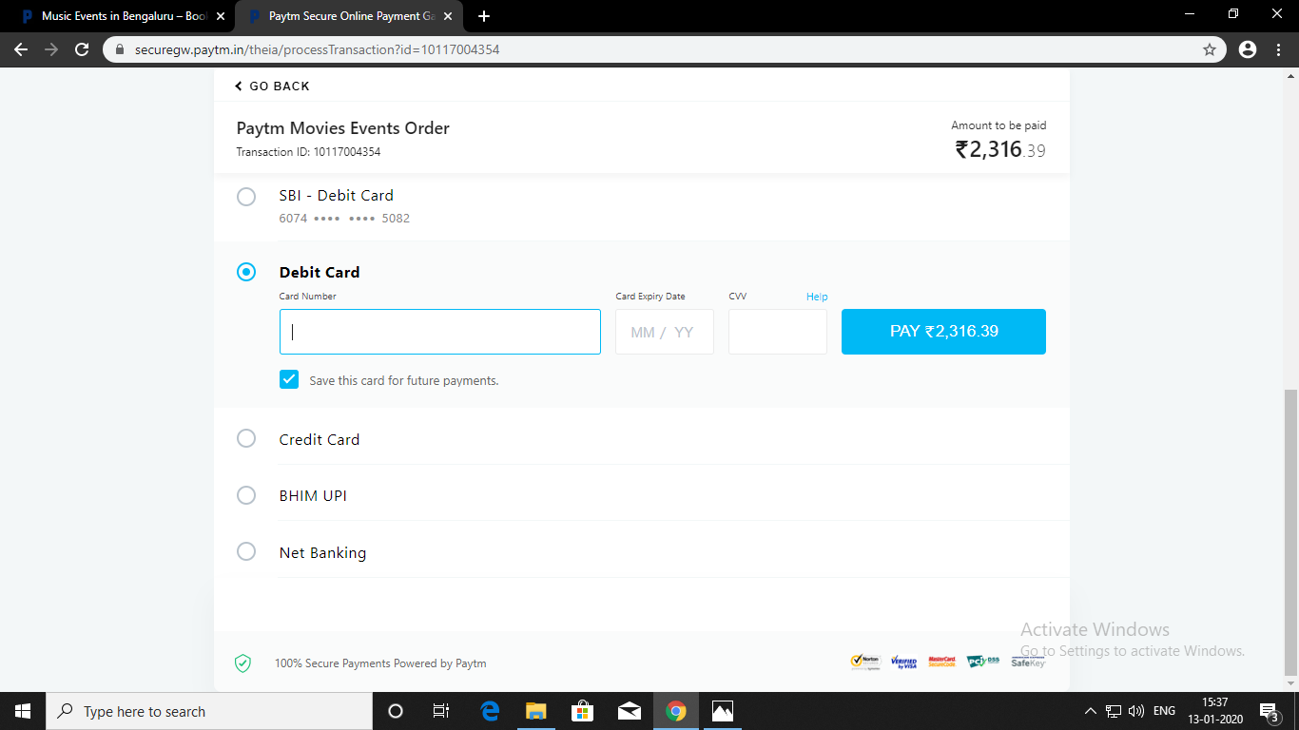
PAYMENT

Slide 15
