Slide 1
Project Title-
Real Estate Listing Intelligence Agent
Agentic AI System for Automated Property Opportunity Discovery & Investment Intelligence
Presented by- Swati Arya
Date-15-06-2026

Slide 2
Problem Statement
Property investors and brokers monitor multiple listing platforms daily to identify undervalued opportunities.
New listings appear frequently and are often missed due to manual monitoring.
Evaluating investment potential requires continuous tracking and comparison.
Existing tools provide listings but do not automatically identify high-potential opportunities.
An intelligent system is needed to monitor listings, analyze potential, and notify users automatically.

Slide 3
Existing System vs Proposed System
Comparison Area
Existing System
Proposed System
PD
Property Discovery
Manual portal browsing
Automated listing monitoring
OD
Opportunity Detection
Manual comparison
AI-powered scoring
IA
Investment Analysis
Subjective evaluation
Structured intelligence scoring
AL
Alerting
No proactive alerts
Automated notifications
RG
Report Generation
Manual review
Groq AI-generated summaries
EF
Efficiency
Time-consuming
Continuous monitoring
DB
Opportunity Tracking
Unstructured notes
Google Sheets storage

Slide 4
Objectives
Functional Objectives
A I
BI
Project Objectives
Monitor property listings from dashboard searches
Retrieve property listings from Realtor API
Analyze listing details with Groq AI
Score investment attractiveness
Send alerts for high-potential listings
Reduce manual listing checks
Improve opportunity discovery speed
Support investors and brokers
Create structured Google Sheets records
Demonstrate n8n-based automation

Slide 5
System Architecture
User / Investor
Streamlit Dashboard
n8n Workflow Engine
Realtor API
Property Data Cleaning
Property Mapping
Investment Scoring Engine
Groq AI Analysis
Telegram Notification
Google Sheets Storage

Slide 6
Agentic AI Workflow
1
2
3
4
5
Listing Collection Agent
Investment Scoring Agent
AI Analysis Agent
Alert Agent
Storage Agent
Agents collect new listings, analyze price and location signals, and assign an opportunity score.
Only high-potential listings pass the alert threshold.
High-potential properties are routed to Telegram alerts and Google Sheets logging.

Slide 7
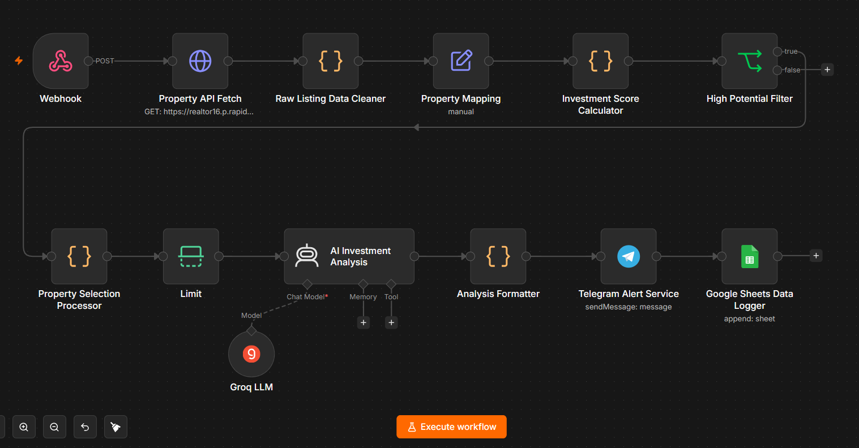
n8n Workflow
The implemented workflow orchestrates data retrieval, scoring, AI analysis, notifications, and storage.

Slide 8
Property Analysis Module
Property Type Identification
Price Evaluation
Beds & Baths Assessment
Lot Size Analysis
Property Summary Generation

Slide 9
Investment Scoring Engine
Actual scoring implementation
Price
3
Example Final Score
Bedrooms
2
Bathrooms
2
8
Lot Size
2
/10
Property Type
1
Decision Rule
Recommendation: High Potential Opportunity
Investment Score >= 7 = High Potential Properties.
Investment Score < 7 = Standard Properties.
Maximum Investment Score = 10.
Listing qualifies for alert and opportunity tracking

Slide 10
Demo Example
Property: 18010 Bambriar Dr
Price
Beds / Baths
Property Type
$327,000
4 / 3
Single Family
Competitive asking price
Good family-home configuration
Residential property fit
AI Analysis Summary
Strengths: Competitive pricing; good bedroom-to-bathroom ratio; suitable family property
Risks: Limited listing details available
Actions Taken: Passed High Potential Filter; AI Analysis Generated; Telegram Alert Sent; Stored in Google Sheets
8
Investment
Score
/10

Slide 11
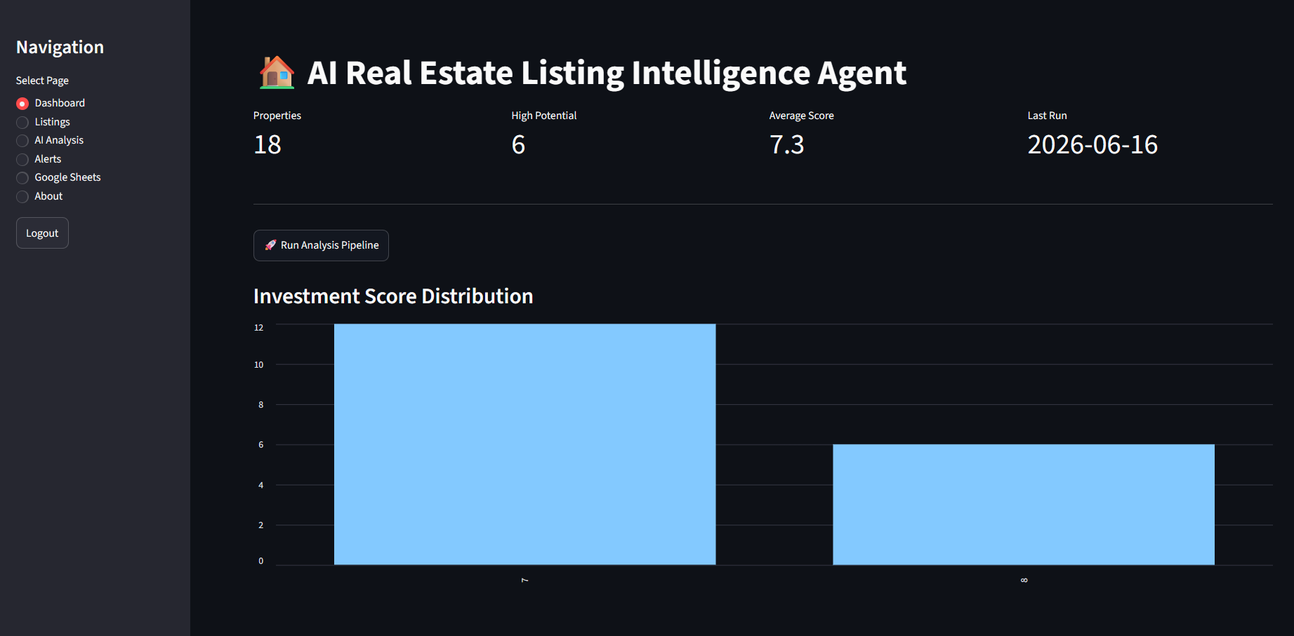
Streamlit Dashboard
Dashboard Features
Property Search
Workflow Execution
KPI Monitoring
Opportunity Tracking

Slide 12
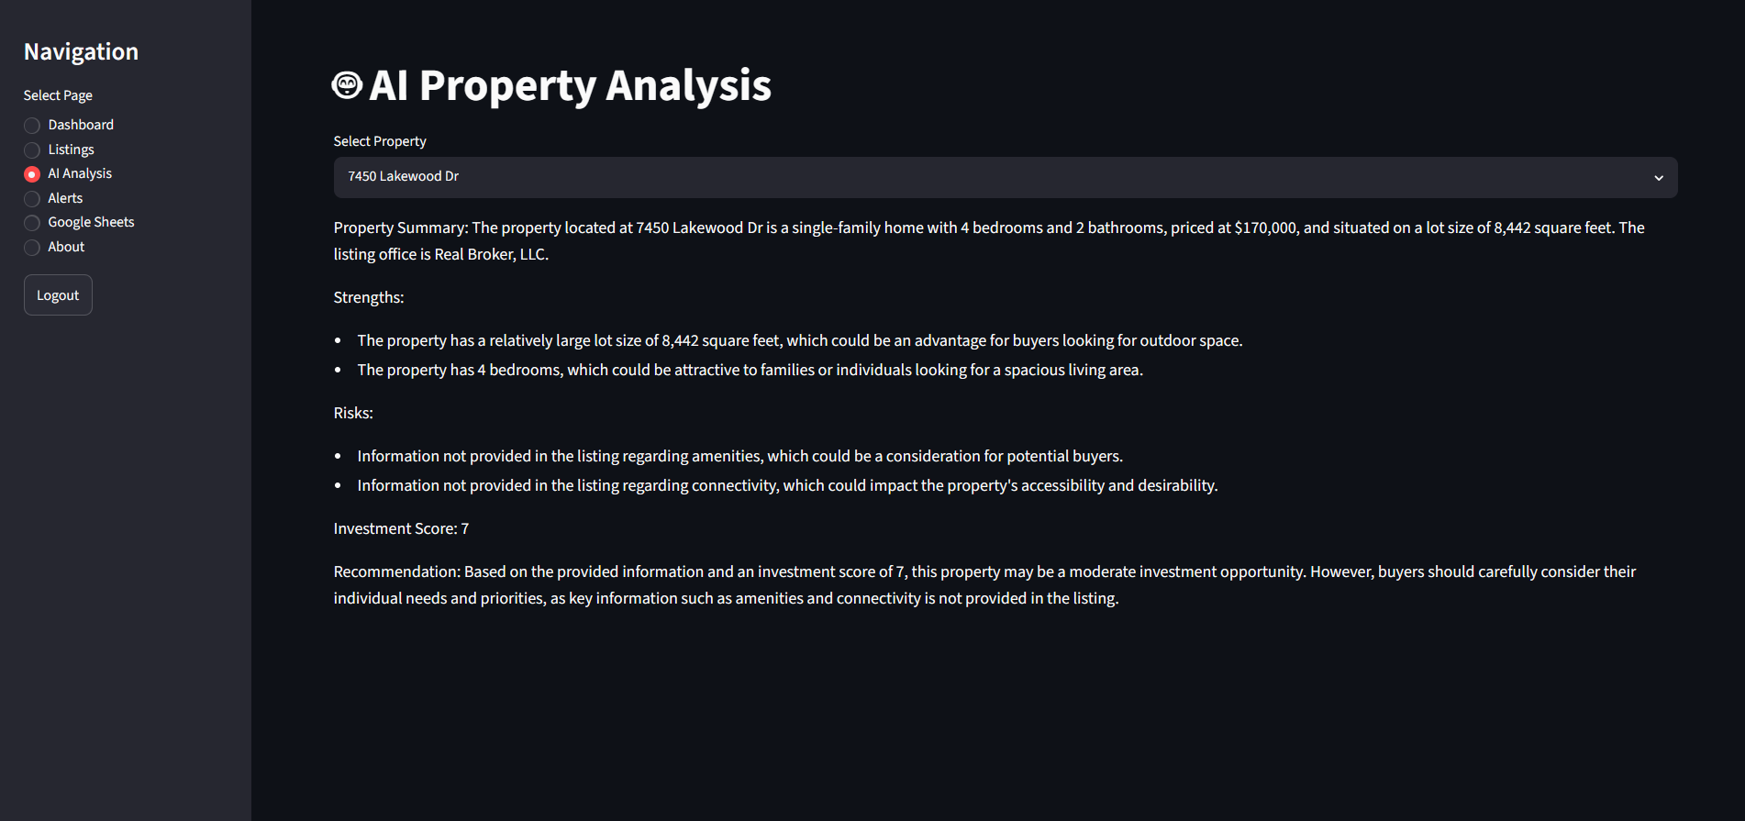
AI Property Analysis
Key Features
AI Generated Summary
Strengths Identification
Risk Identification
Investment Score
Recommendation Generation

Slide 13
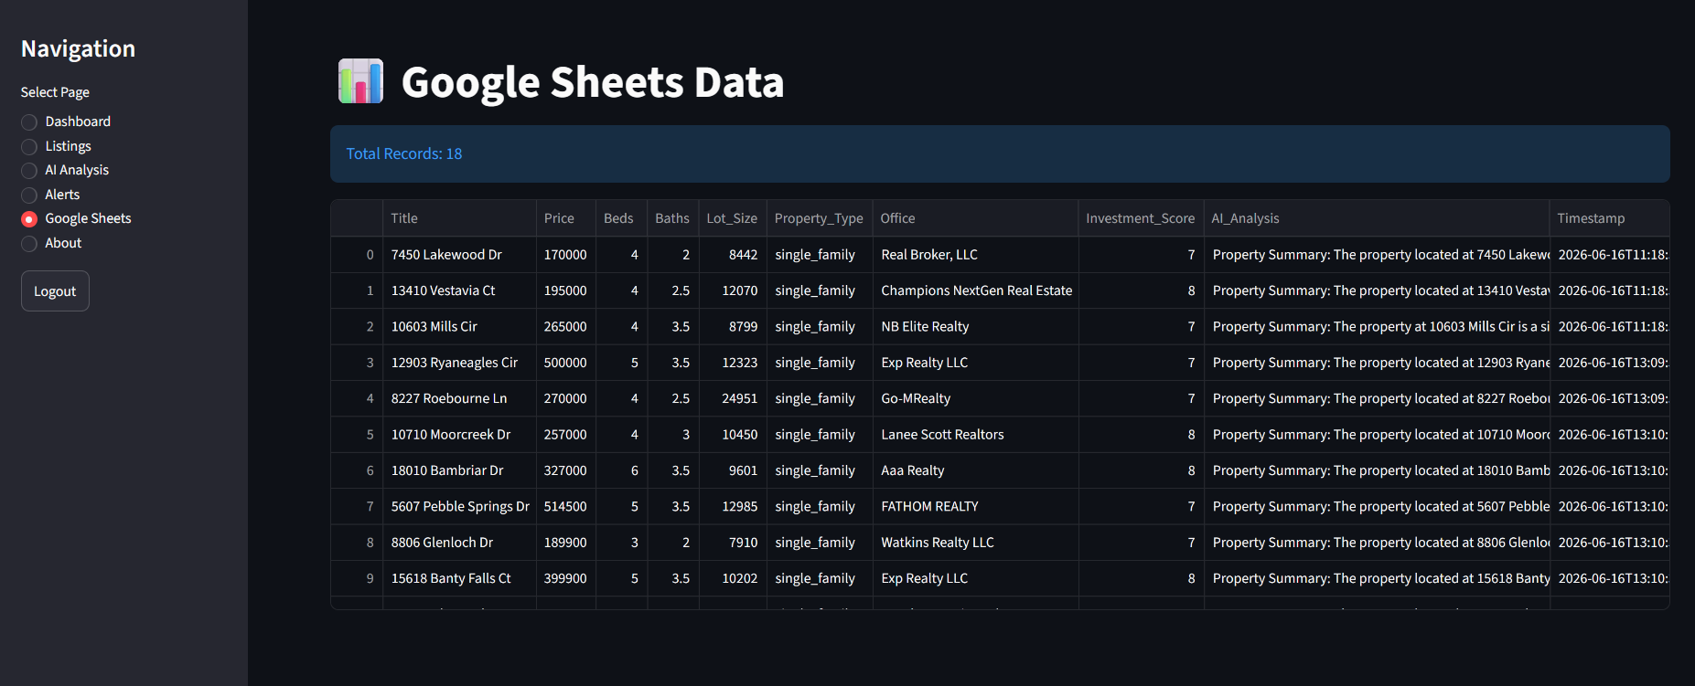
Google Sheets Integration
Key Features
Centralized Storage
Historical Tracking
Structured Property Records
Reporting Dataset

Slide 14
Technology Stack
1
Streamlit
2
Python
3
n8n
User dashboard Property search
Data logic Scoring support
Workflow automation Webhook execution
4
Groq LLM
5
Realtor API
6
Telegram Bot
AI property analysis Narrative summaries
Property listings Market data source
Real-time alerts Opportunity notification
7
Google Sheets
Centralized storage Historical records

Slide 15
Business Impact & KPIs
AD
Automated Discovery
FI
Identification
AI
Analysis
Automated Property Discovery
Faster Opportunity Identification
AI-Powered Analysis
RN
Notifications
CT
Tracking
RM
Efficiency
Real-Time Notifications
Centralized Opportunity Tracking
Reduced Manual Effort

Slide 16
Future Scope
Property price prediction.
Location intelligence integration.
Property comparison engine.
Rental yield estimation.
CRM and broker follow-up integration.
Expanded reporting from Google Sheets history.

Slide 17
Conclusion
The AI Real Estate Listing Intelligence Agent automates property opportunity discovery using n8n and AI.
The implemented workflow connects Streamlit, Realtor API, scoring logic, Groq AI analysis, Telegram alerts, and Google Sheets storage.
It improves screening speed, standardizes investment evaluation, and centralizes opportunity tracking.
The solution provides a practical foundation for scalable real estate intelligence automation.

Slide 18
Thank You
Questions and discussion
Real Estate Listing Intelligence Agent
Agentic AI System for Automated Property Opportunity Discovery & Investment Intelligence

