Slide 1



SUMMARY EXTRACTION AND SENTIMENT ANALYSIS
P-101 TEAM 4
MENTORS- KARTHIK & PALLAVI
TEAM MEMBERS:
DHANALAKSHMI S
GARIMA SONI
SWATI VASAWADE

Slide 2
PROJECT INFORMATION
Data Cleaning
Data Visualization & Plots
Extracted the Summary
Data Modeling
Sentiment Analysis
Deployment in Streamlit
Project Challenges
Business Problem
Sentiment analysis Research
  Summary Extraction
  NLP
Project Architecture / Project Flow
Dataset & EDA

Slide 3
BUSINESS UNDERSTANDING & RESEARCH
Business Problem: To extract E-books of your choice and extract summary ,categorize summary as positive, negative or neutral. Build a NLP model to achieve the said objective with accepted accuracy of 75% and above.
What is Text Summarization?
Text summarization is the process of creating a short, accurate, and fluent summary of a longer text document, It is the process of distilling the most important information from a source text. Automatic text summarization is a common problem in machine learning and natural language processing (NLP).
Automatic text summarization methods are greatly needed to address the ever-growing amount of text data available online to both better help discover relevant information and to consume relevant information faster.
What is Sentiment Analysis?
Sentiment analysis, also referred to as opinion mining, is an approach to natural language processing (NLP) that identifies the emotional tone behind a body of text. This is a popular way for organizations to determine and categorize opinions about a product, service, or idea.

Slide 4
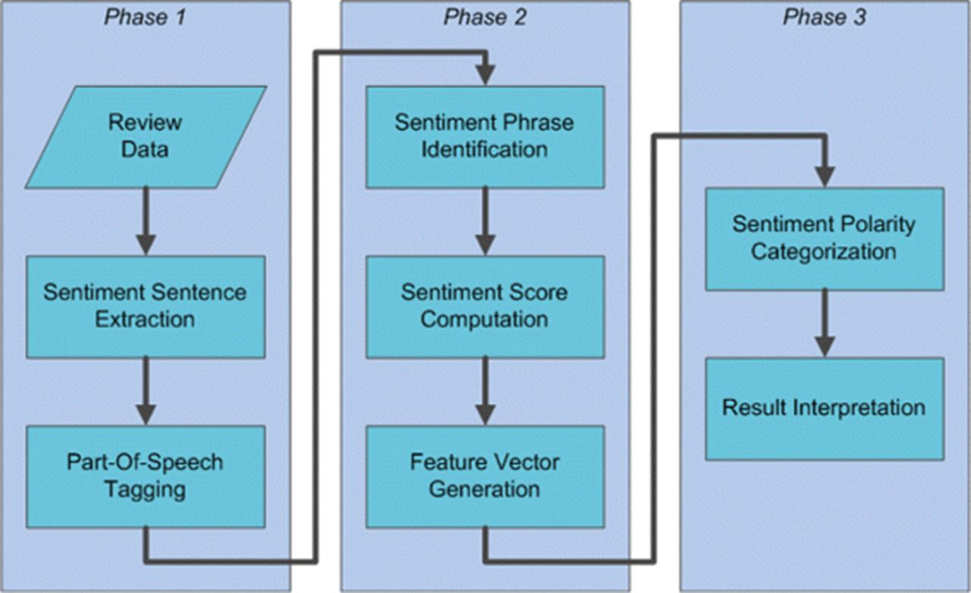
PROJECT ARCHITECTURE / PROJECT FLOW

Slide 5

DATASET USED FOR SUMMARY EXTRACTION.
E-Book Data :- Resisting Happiness.
Author :- Matthew Kelly.
A true story about why we sabotage ourselves, feel overwhelmed, set aside our dreams, and lack the courage to simply be ourselves. . . and how to start choosing happiness again!

Slide 6
STEPS TO DO THE TEXT SUMMARIZATION
1. RESISTING HAPPINESS– scrapping t the text using PyPDF2 library
Data preprocessing
Data cleaning: removing the stop words , punctuations, tags, special characters and digits, converting list to string,.
4. Stemming and Lemmatization
5. Understanding the data (EDA)
6. Generating the word cloud
Finding a Most frequently occurring words ,Bi-grams and Tri-grams.
generate tf-idf for the given document.
Sentence tokenize
Frequency table
summarization

Slide 7
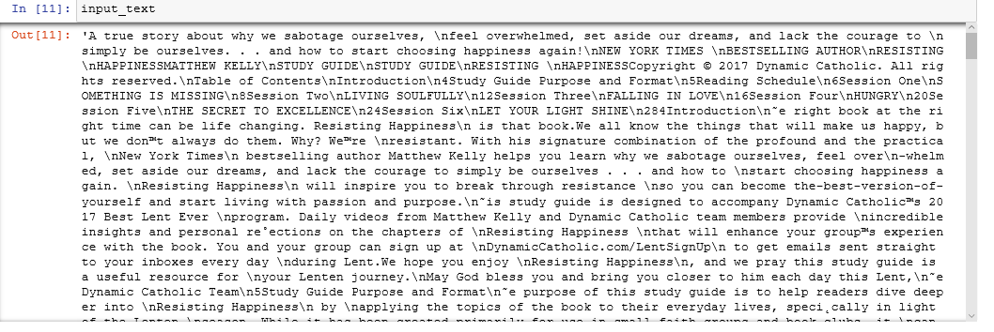
EXTRACTED TEXT-DATA

Slide 8
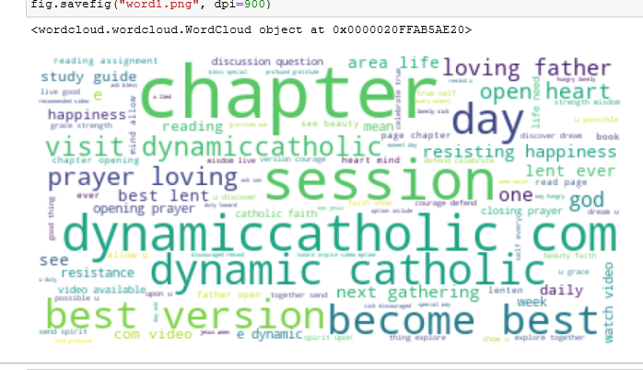
WORD CLOUD

Slide 9
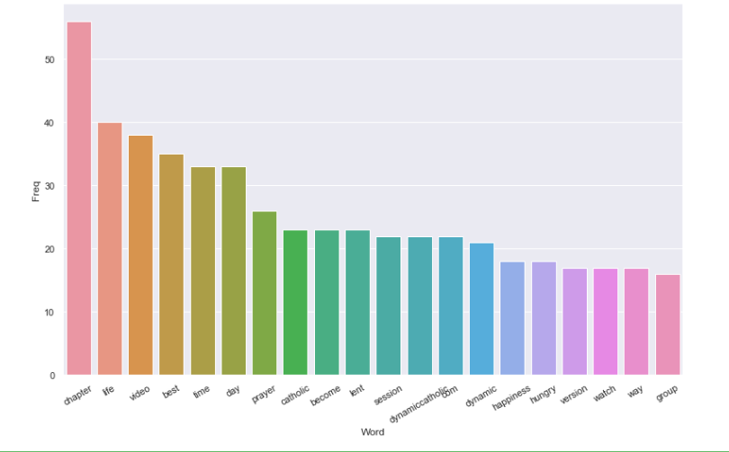
MOST FREQUENTLY OCCURRING WORDS

Slide 10
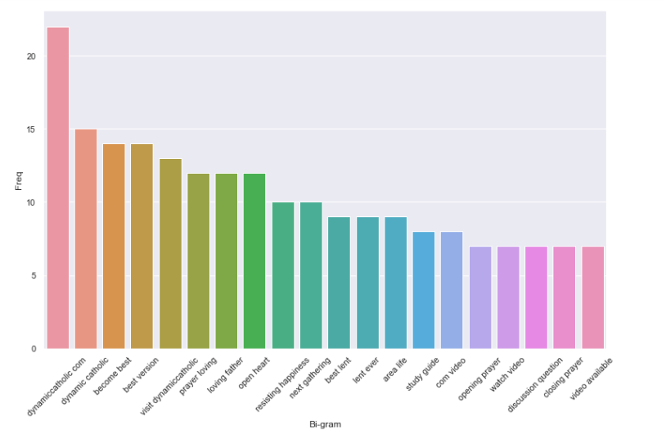
BAR PLOT OF MOST FREQUENTLY OCCURRING BI-GRAMS

Slide 11
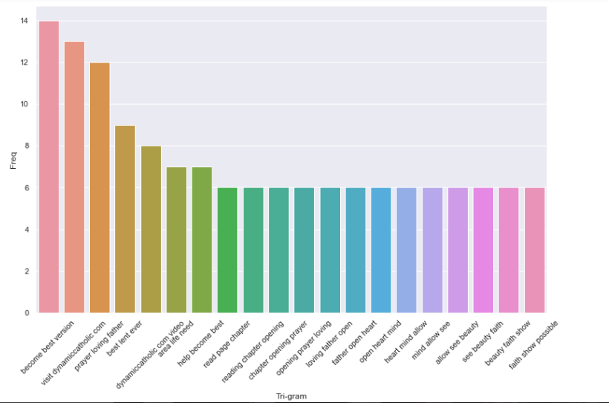
BAR PLOT OF MOST FREQUENTLY OCCURRING TRI-GRAMS

Slide 12
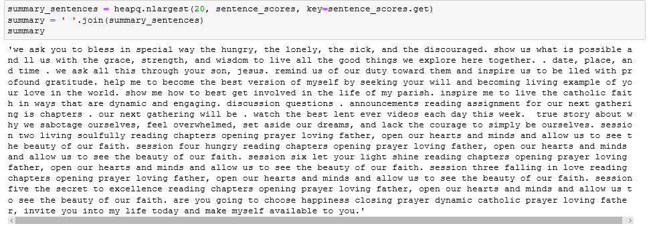
SUMMARY

Slide 13
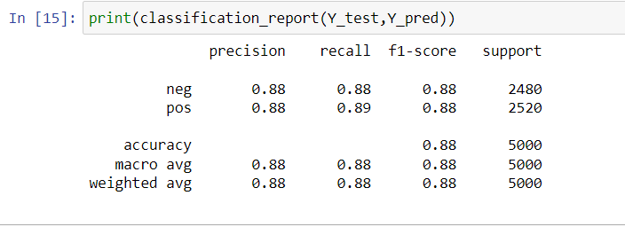
SENTIMENT ANALYSIS AND ACCURACY CHECK
1. We use the 2 data set here Train data and text data
2. Done the necessary cleaning process for the data
3. Used LinearSVC model to work on train data set.
4. Did the prediction on text dataset

Slide 14
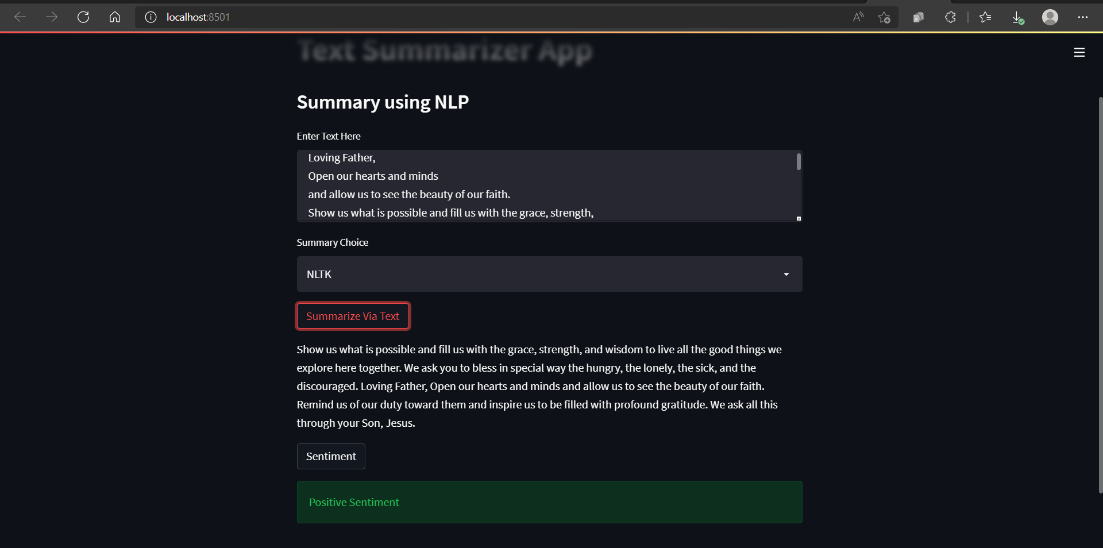
MODEL DEPLOYMENT – PLATFORM STREAMLIT

Slide 15
PROJECT - CHALLENGES
Inadequate accuracy and performance in sentiment analysis based on insufficient labeled data, incapability to deal with complex sentences that require more than sentiment words and simple analyzing.
Web scrapping from websites that do not give scrapping permission. Thus to find alternatives for the same was A difficult task.
But we would like to thank our mentors karthik and Pallavi for the continuous support and help which made us overcome these challenges!

Slide 16
THANK YOU

