Slide 1
Springboard Foundations of Data Science
Capstone Project
Diabetes

Slide 2
Table of Contents
Problem Statement
Significance
Diabetes Overview
Data
Data Wrangling
Data Correlation
Analysis of Data
Logistic Regression Model
References

Slide 3
Problem Statement
Predict Diabetes in people based on different biological diagnostic attributes

Slide 4
Significance
This will be of great significance to doctors.
Help doctors to identify people pre disposed to diabetes
Helpful to doctors to advise the general public on the dangers of high glucose and BMI
Diabetes care costs upwards of $250 billion
Predicting the onset of Diabetes will help in delaying Diabetes which will help reduce the costs
Once people are made aware of their predisposition to diabetes, with proper preemptive measures being taken, their quality of life will improve greatly
Predicting the onset of diabetes can also prevent deaths by regular monitoring

Slide 5
Diabetes Overview
Today Diabetes is seventh leading causes of health complications and death in the country
On an average men with diabetes live 7.5 years less than men without diabetes
On an average women with diabetes live 8.2 years less than women without diabetes
Diabetes increases the risk of heart disease 6 times more in women and 3 times more in men

Slide 6
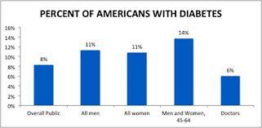
Diabetes

Slide 7
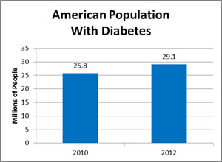
Diabetes

Slide 8
Data
There are nine different attributes in the dataset.
They are Number of Pregnancies, Glucose reading, Blood Pressure Reading, Skin Thickness, Insulin, BMI, Diabetes Pedigree Function, Age and Outcome of whether or not the person developed Diabetes.
The data set contains data for women only.

Slide 9
Data Wrangling
There were many observations where the Blood Pressure, Skin Thickness and Insulin were recorded as 0.
Since it is medically not possible to have 0 values for those attributes, those records were deleted.
The data set was randomly split into training (70%) and testing (30%) sets.

Slide 10
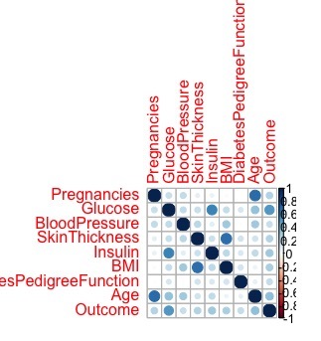
Data Correlation
A Corrplot was created to better visualize the correlations between the different variables

Slide 11
Observations
Some interesting observations can be made from the Corrplot
Age, Glucose, BMI and Insulin have significant impact on Outcome
Age had a significant impact on pregnancies which is puzzling as generally with older women, number of pregnancies should decrease.

Slide 12
Logistic Regression Model
One key assumption made: The independent variables are independent of each other
For model fitting initially started off with using all the features
Settled on using Glucose, BMI and Diabetes Pedigree Function
Model has accuracy of ~82%

Slide 13
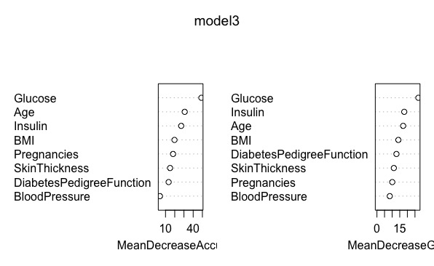
Random Forest
For model fitting, all the features were used
Model has an accuracy of ~80%
A Variable Importance Plot was plotted

Slide 14
Comparison of Models
The Random Forest Model performed better than the Logistic Regression Model
The Root Mean Square Error of the Random Forest Model is 0.376
The Root Mean Square Error of the Logistic Regression Model is 0.948

Slide 15
References
This dataset is originally from the National Institute of Diabetes and Digestive and Kidney Diseases
http://www.diabetes.org/diabetes-basics/statistics/

