Slide 1
IDENTIFYING_AREAS_ACCORDING_TO_THEIR_NATURE

Slide 2
Introduction/Business Problem
The main aim of this project is to find the perfect area for all types of users in the city of Toronto.
The users find difficulty in finding the areas for residential and business purposes. This project guide them in providing solutions for the users.

Slide 3
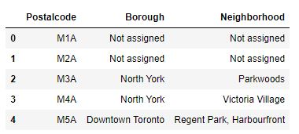
Data and Methodology
1.Where data of postal codes of Canada will be taken from Wikipedia.

Slide 4
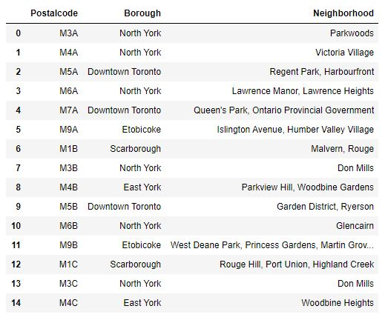
Data and Methodology
2. After cleaning of data

Slide 5
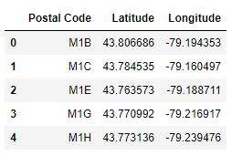
Data and Methodology
3. Geo spatial will be taken from ‘http://cocl.us/Geospatial_data’

Slide 6
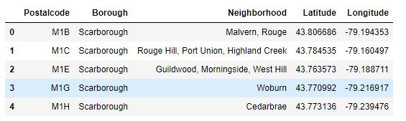
Data and Methodology
4. After merging of both the data

Slide 7
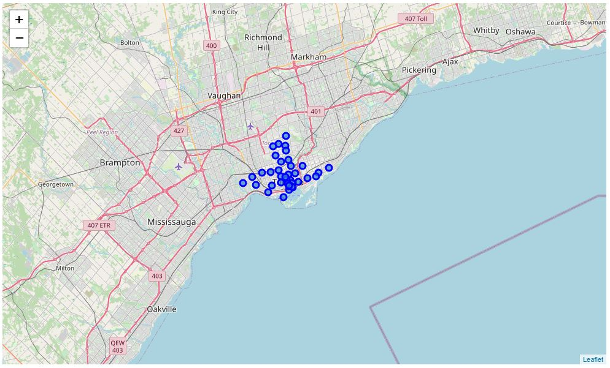
Data and Methodology
5. Plotting of the base data’s

Slide 8
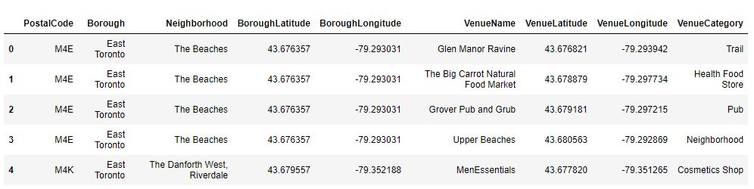
Data and Methodology
6. Venue data of the same has been obtain from foursquare ID

Slide 9
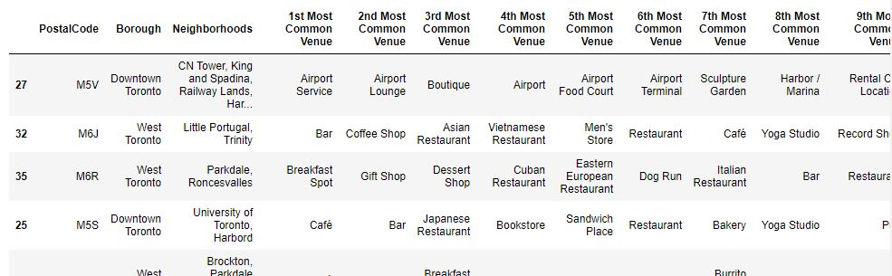
Data and Methodology
7. After cleaning the data

Slide 10
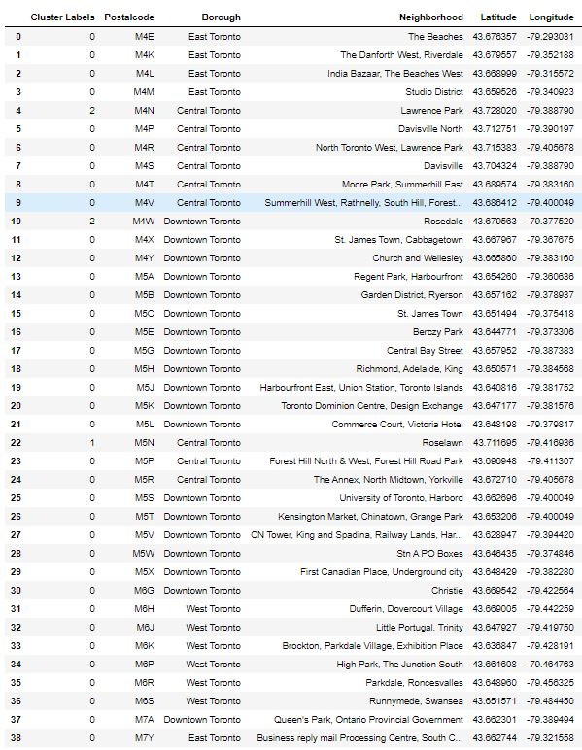
Data and Methodology
8. After K-means clustering

Slide 11
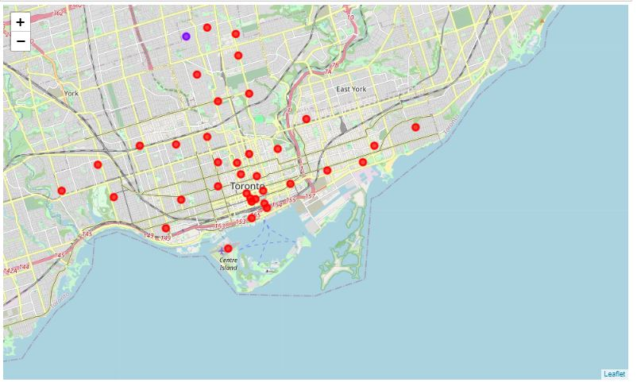
RESULT

Slide 12
RESULT / DISCUSSION / CONCLUSION
Results
From the above analysis, residential area will be 0 cluster and business area will be 2 cluster
Discussion
Availability of data can be more sufficient and reliable. Even the modelling can be done more efficiently
Conclusion
The above project will be the basic prototype for the identification of areas.

