Slide 1




Exploratory and Prescriptive Analytics
on Airbnb Listings in the US region
Group 6: Deshmukh, Akshay/ Gautam, Sankarsan/ Ghosh, Swatik/ Gulati, Tavish/ Lu, Nai Wei

Slide 2

Introduction
​
​
AirBnB wants to evaluate how its business has been performing, and at the same time use that information to fuel growth. The 2 problem statements to address these goals are:
1) We plan to analyze the offerings and performance of hosts across different locations to determine best practices that can be shared with new and existing hosts
2) Using QoQ data we intend to determine the growth in different markets
Link to Dataset:
http://insideairbnb.com/get-the-data
https://www.unitedstateszipcodes.org/zip-code-database/

Slide 3
Contents
​
Process of data management
Analytics on Airbnb in three US locations
Conclusion
Austin​, Texas
New York City​, New York
Hawaii

Slide 4
Data Processing & Transformation
Previous Quarter Listings
Verifications
Count
Room Type
Data Read
​
QoQ Variations
Amenities Count
Location
Latest Quarter
Listings
Price
QoQ Listing Variations
Average Review Ratings
Superhost Status
Zip Code-County Mapping
QoQ Superhost Variations
USE ANALYTICS TO EXPLORE EFFECT OF RELEVANT PARAMETERS
Amenities Provided
Only for Austin
Host Verification
Listing Age
DROP COLUMNS
+
MERGE DATASETS
Volume of Listings
Host Response Time
ENGINEER INTUITIVE FEATURES
Age of LIsting
Host Validation Criteria

Slide 5
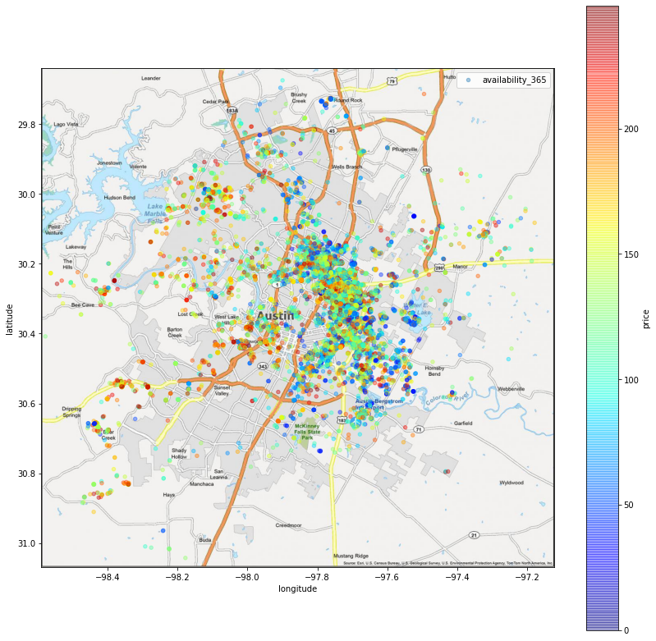
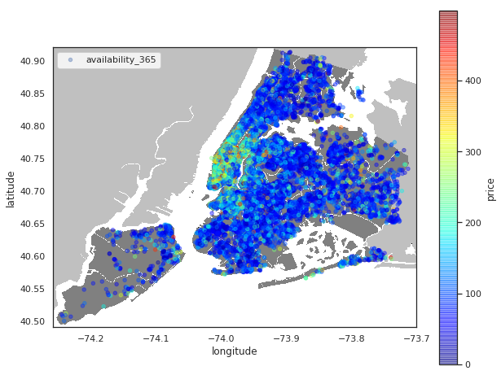
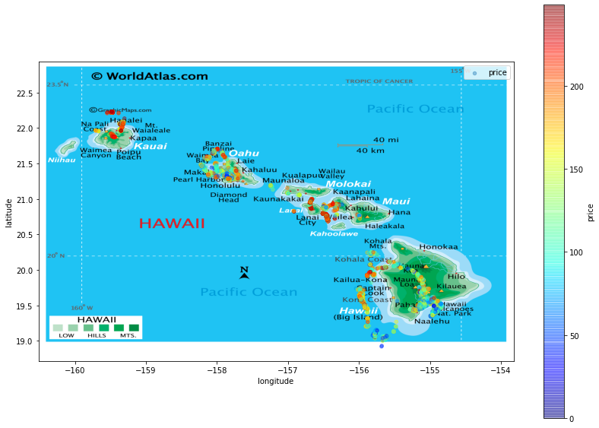
Airbnb listing price and location maps
​

Slide 6
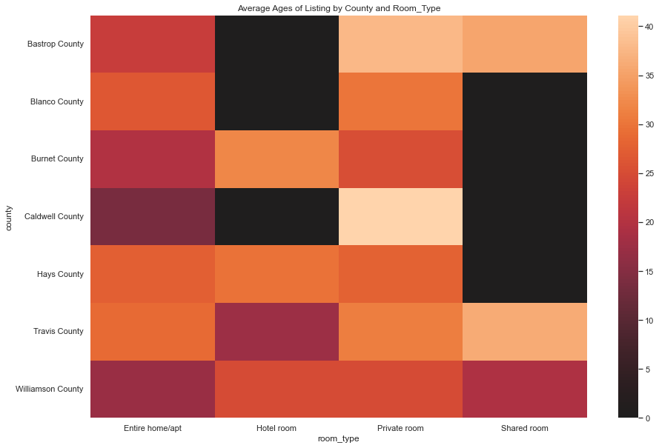
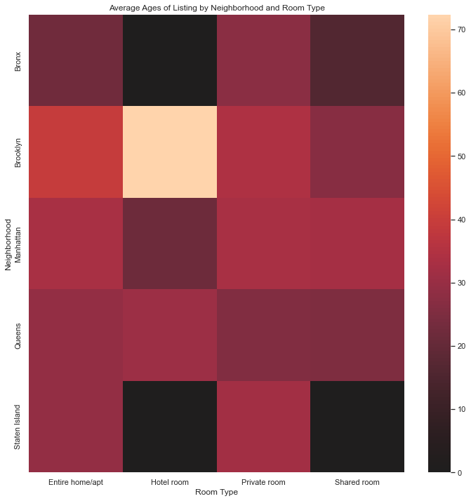
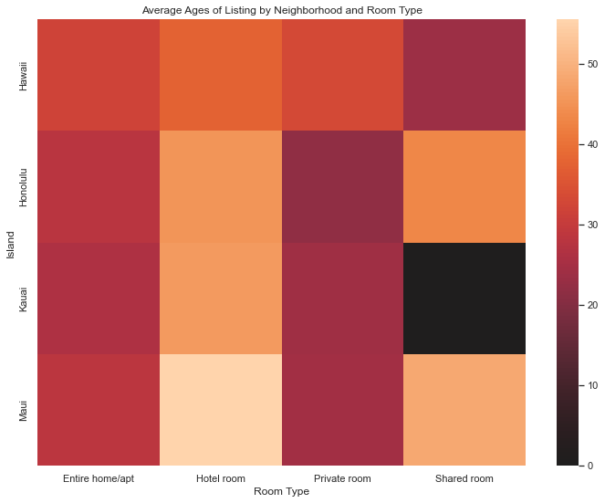
Average age (in months) of listing by location and room type
Austin, Texas
New York City, New York
Hawaii
​
Rooms in New York City are newer than Austin and Hawaii on average.

Slide 7
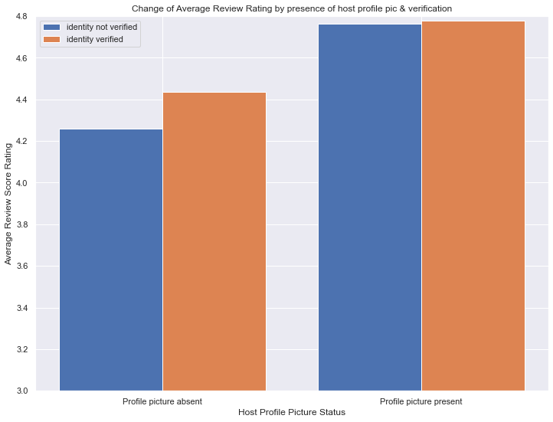
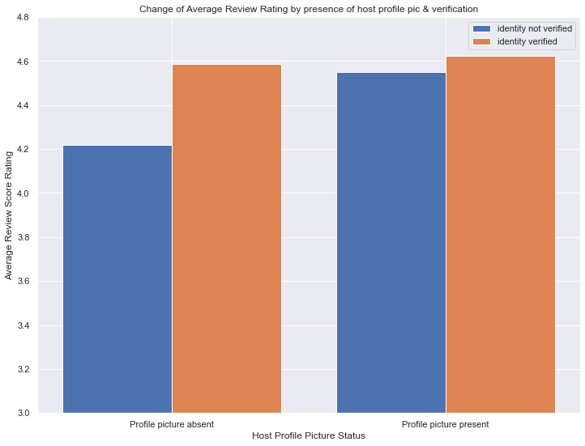
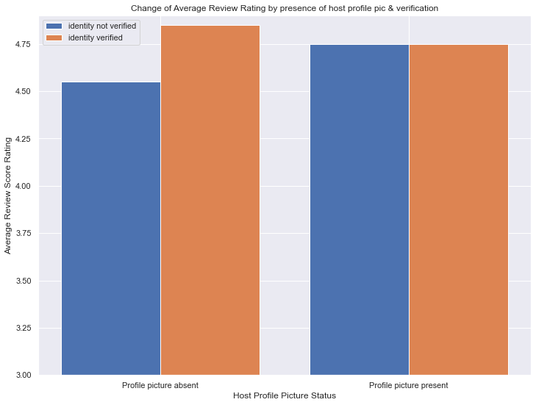
Effect of host identity verification and profile picture on the average review rating
Austin, Texas
Hawaii
​
New York City, New York
The ratings are highest for the hosts that have a profile picture and their identity verified

Slide 8
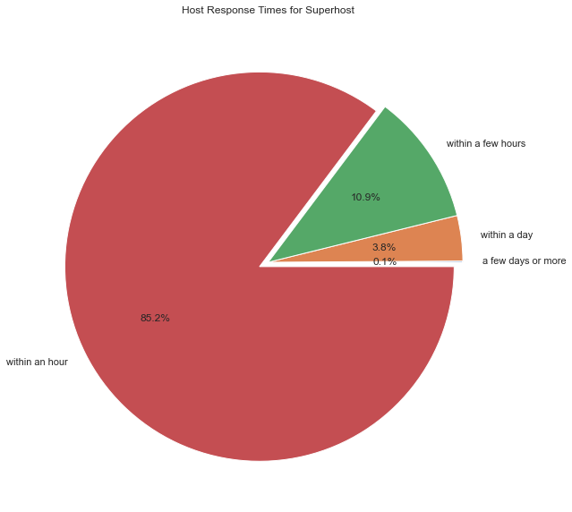
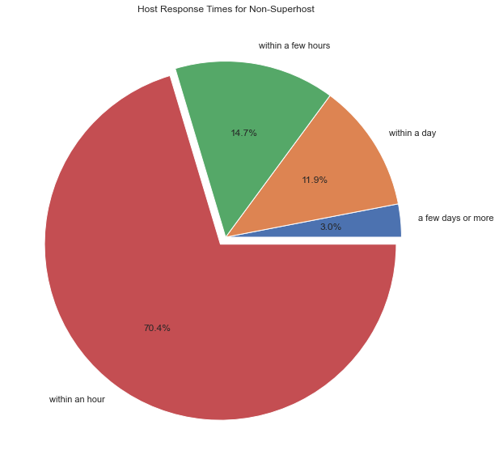
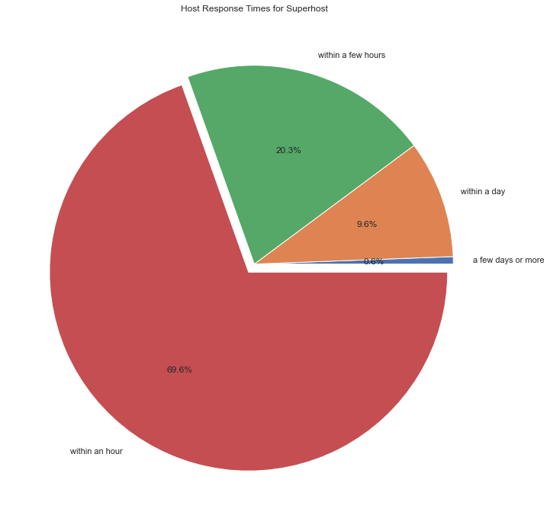
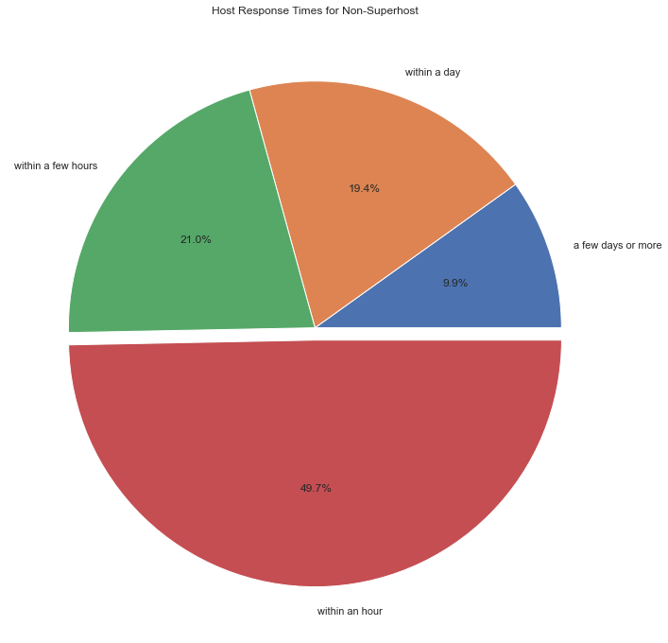
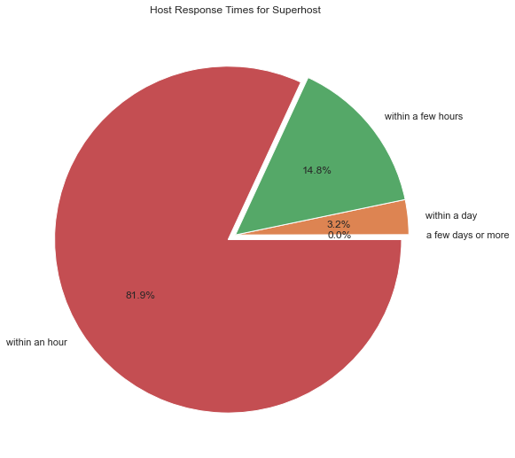
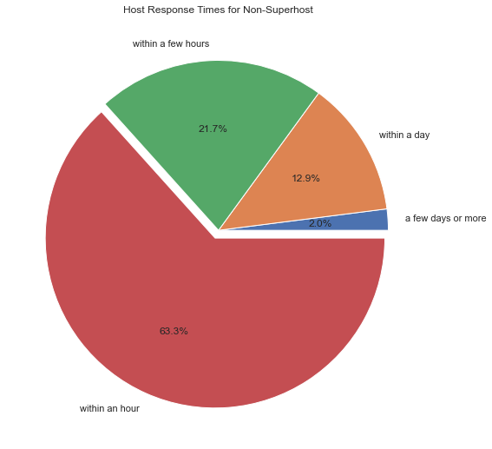
Relationship between superhost status and average host response time
Austin, Texas
New York City, New York
​
Hawaii
The average response time is shorter for superhosts, and majority reply within an hour.

Slide 9
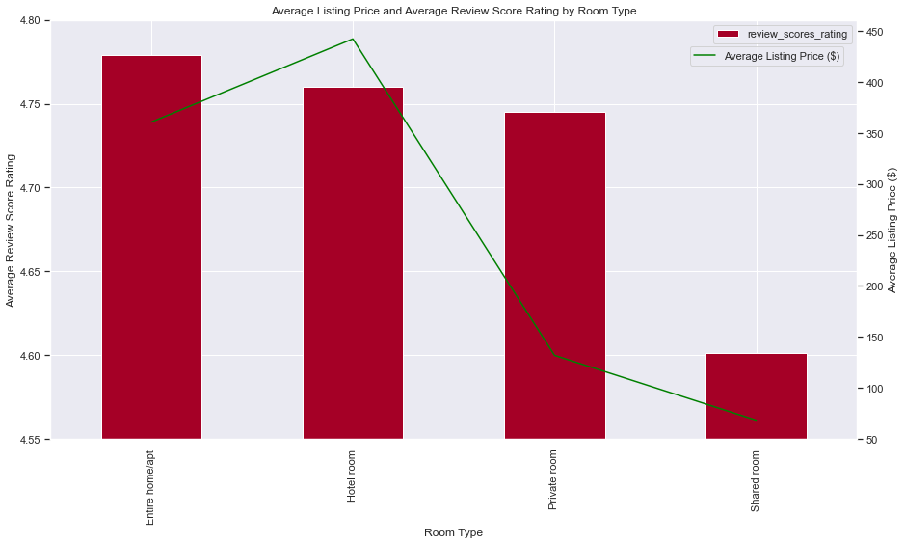
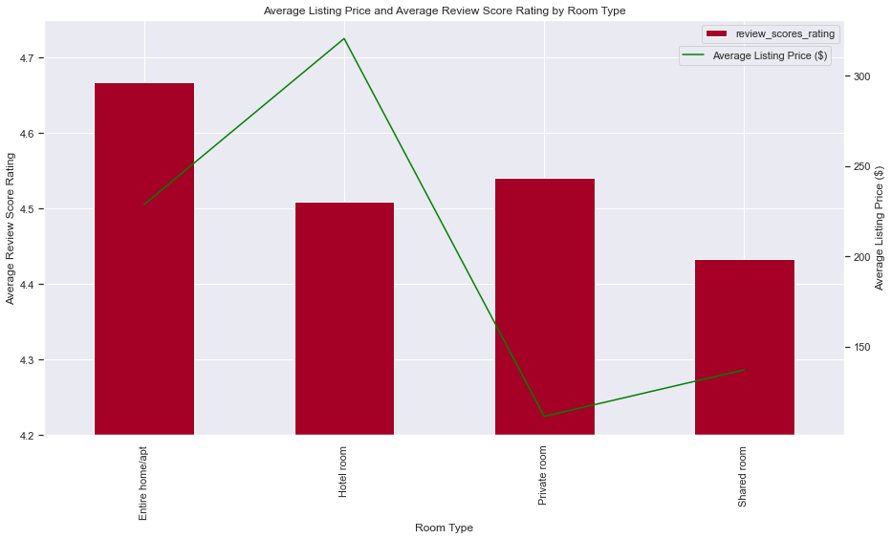
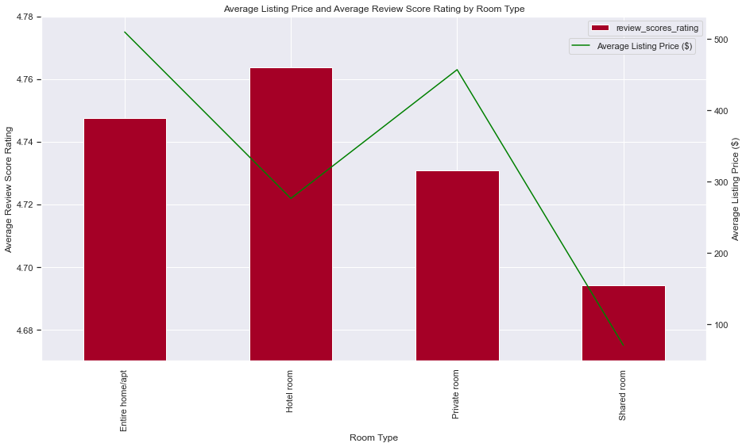
Relationship between room type, listing price and the average rating
Austin, Texas
New York City, New York
Hawaii
​
Entire home/apt have higher ratings and lower prices as compared to hotel rooms.
Private rooms and shared rooms have significantly lower prices as compared to hotel rooms.
However, hotel rooms have higher ratings and lower price in Hawaii

Slide 10
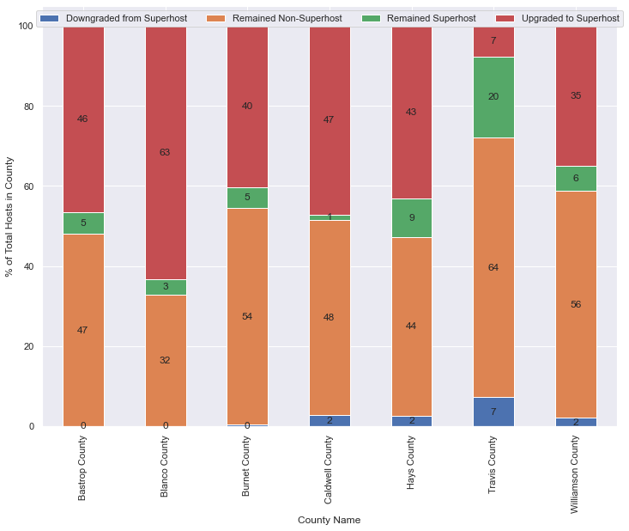
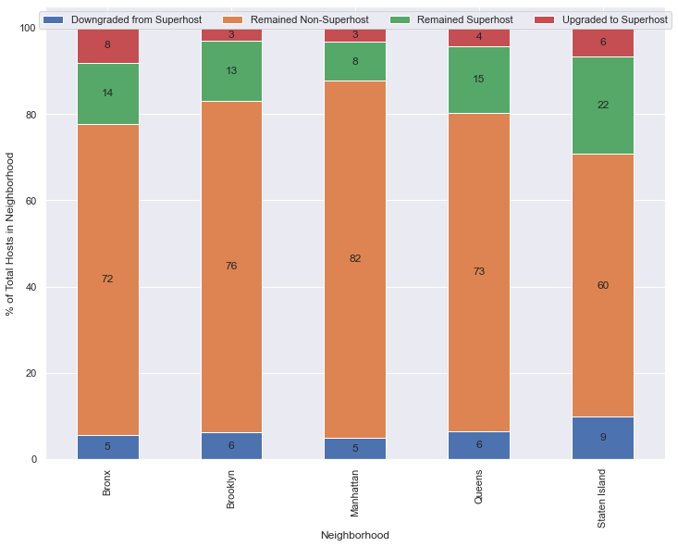
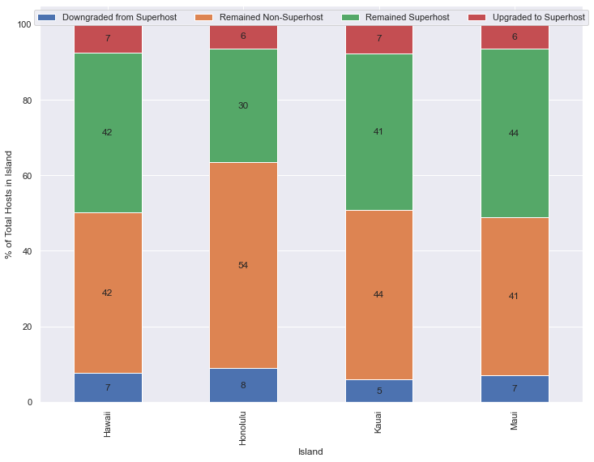
Quarter on Quarter movement of hosts to/from superhost status across locations
Austin, Texas
New York City, New York
Hawaii
​
Prime areas (Travis county, Manhattan, Honolulu) see maximum retention of super host and non-super host status, and lowest migration to superhost status

Slide 11
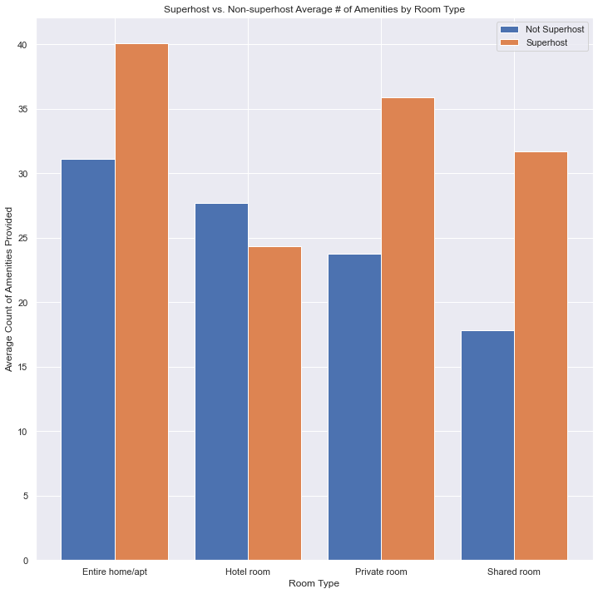
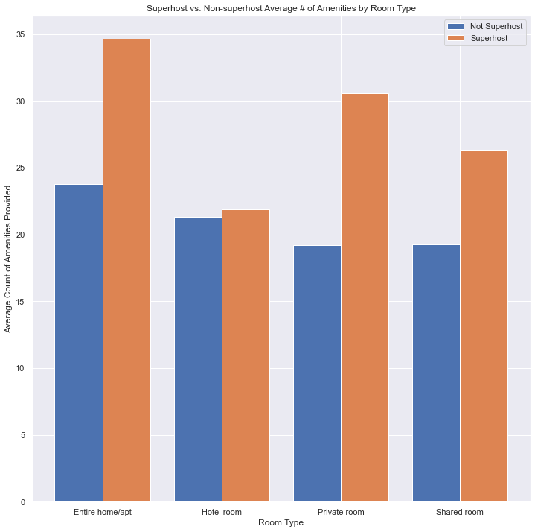
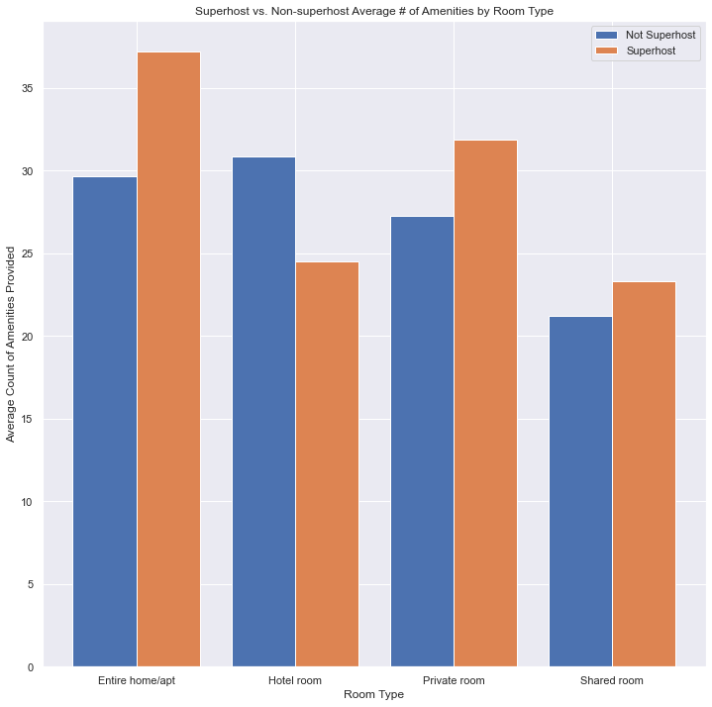
Amenities offered by Superhost vs Non Superhost split by room type
Austin, Texas
New York City, New York
Hawaii
​
Super hosts tend to offer more amenities than regular hosts for all room types except hotel, inferring that offering more amenities may be one of the reasons that makes them super hosts.

Slide 12
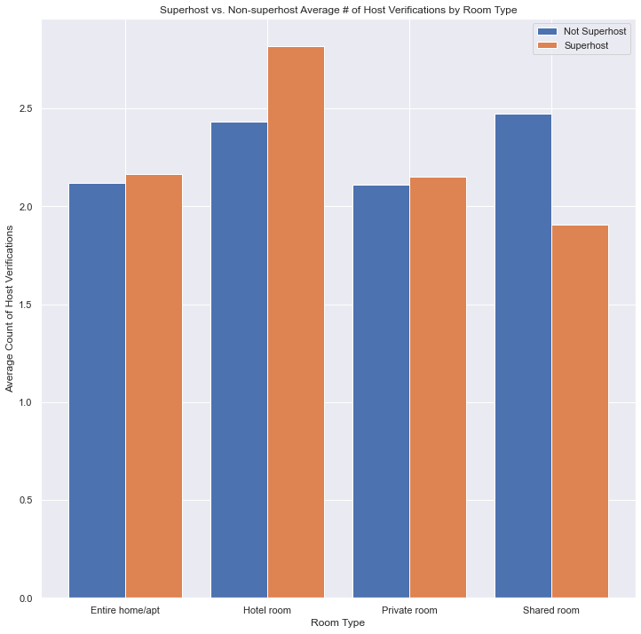
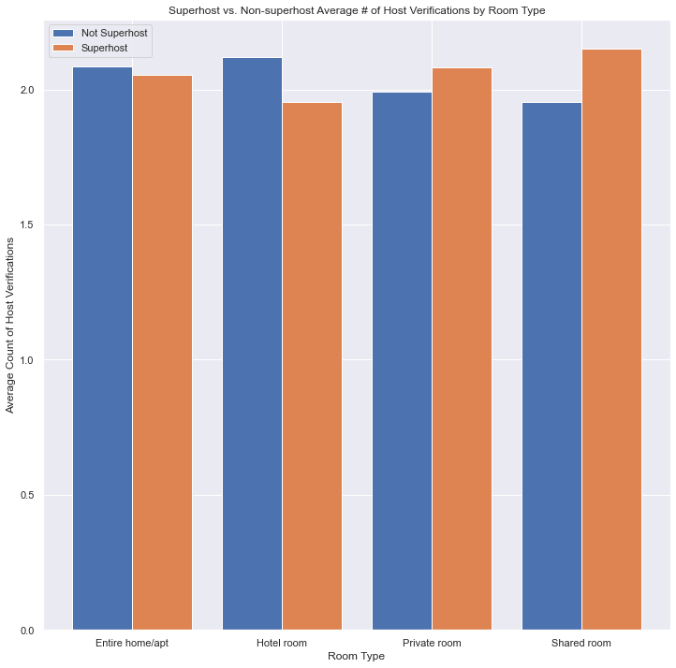
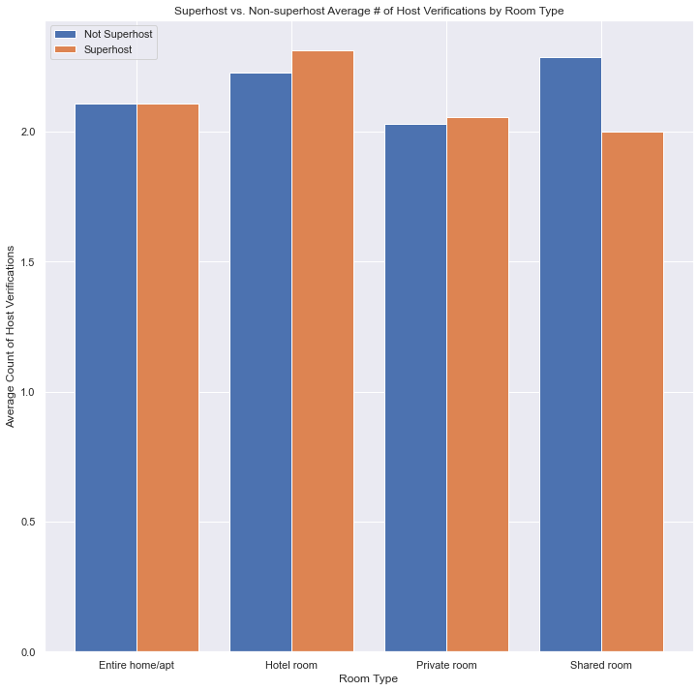
Relationship between host verifications, superhost status and room type
Austin, Texas
New York City, New York
Hawaii
​
Super hosts tends to have more verifications than non super hosts.
For shared room in Austin and Hawaii, non super hosts have more verifications super host.

Slide 13
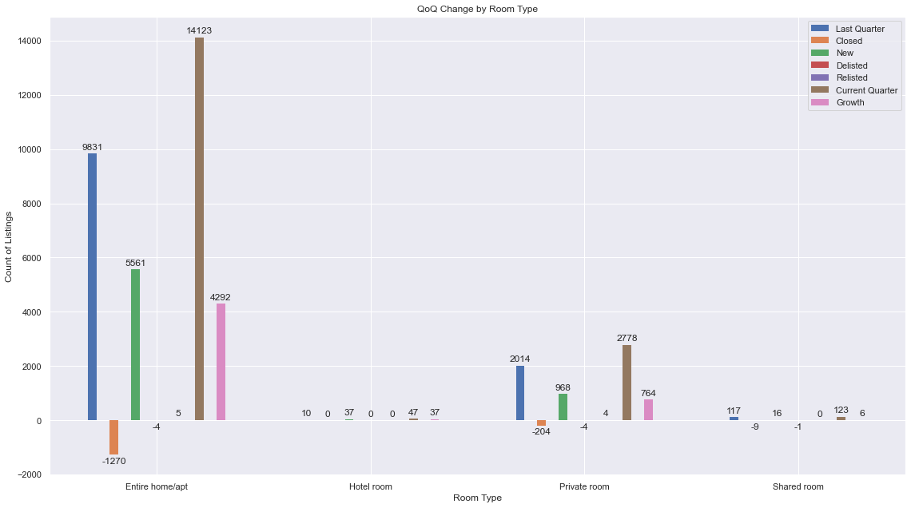
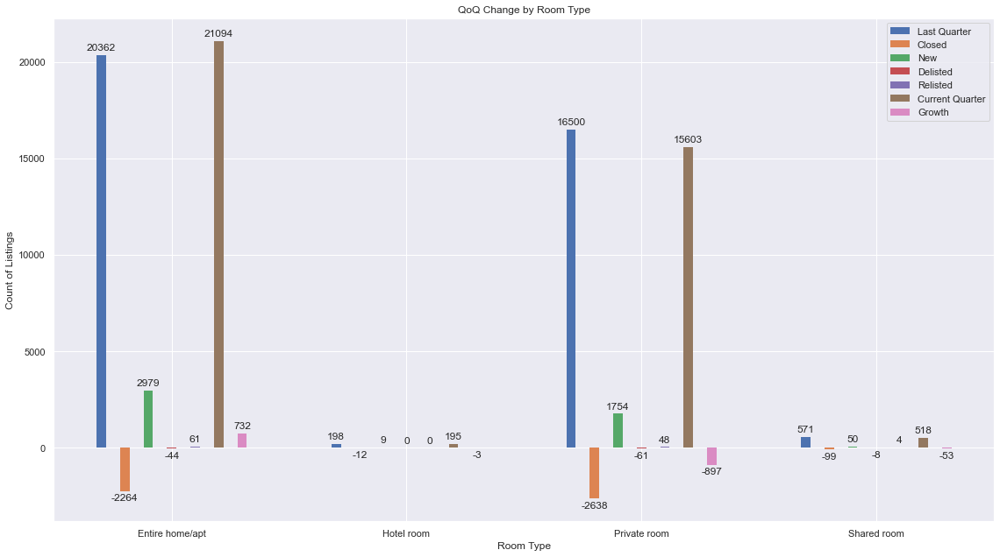
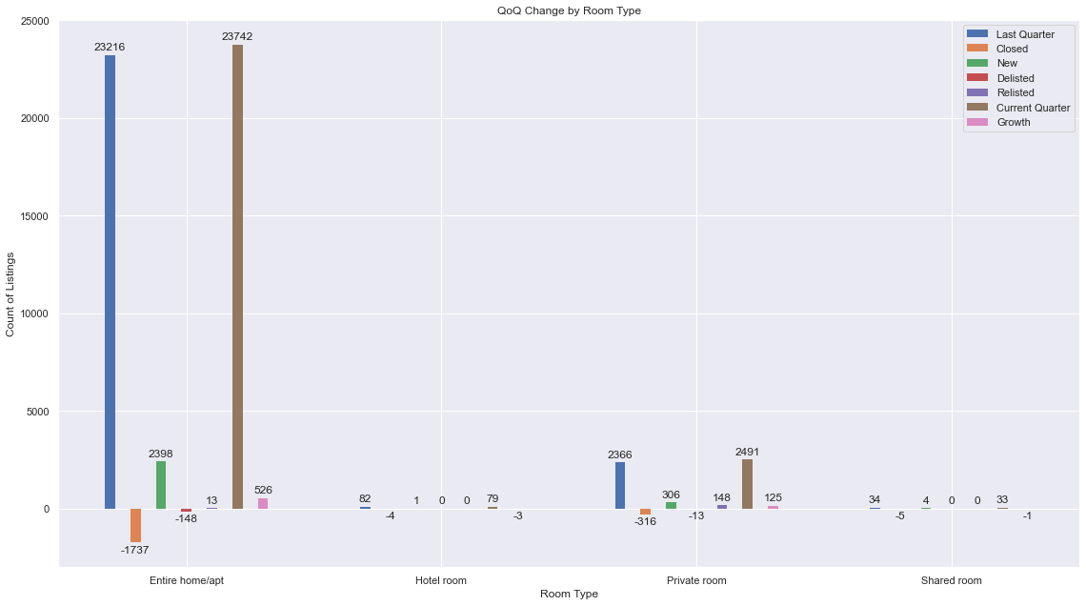
Quarter on Quarter change by room type
Austin, Texas
New York City, New York
Hawaii
​
The numbers of entire home/ apartment had grown in one quarter for all three locations.

Slide 14
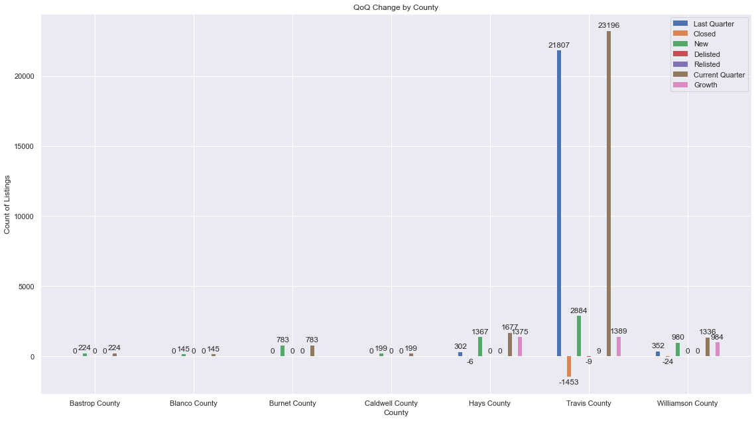
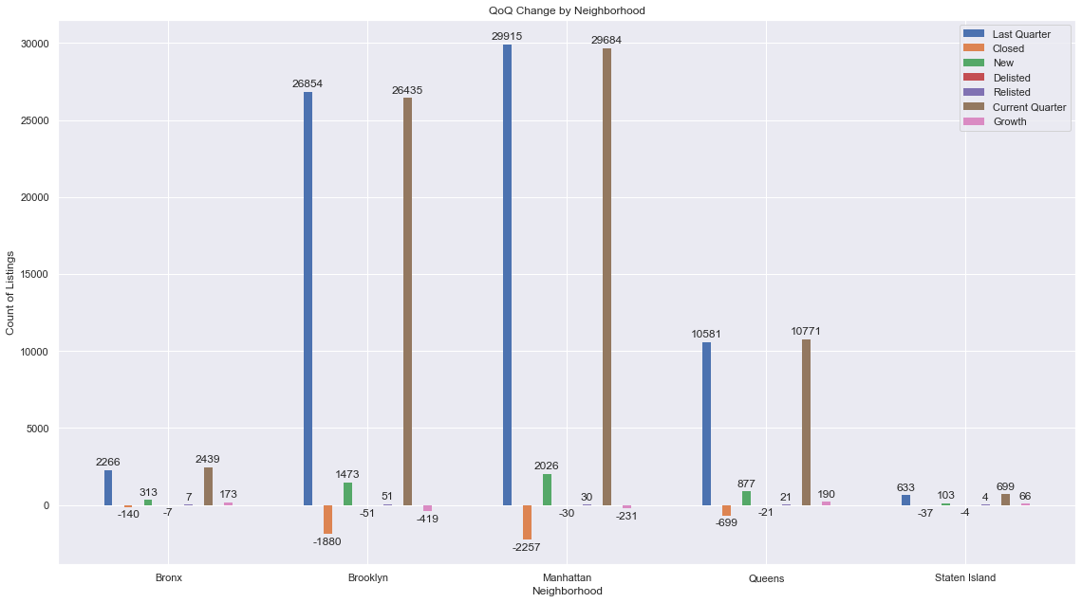
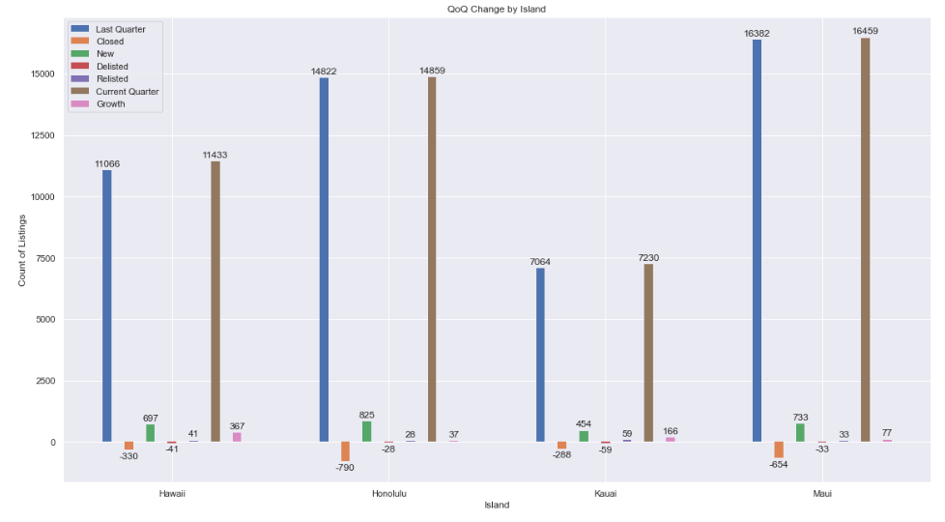
Quarter on Quarter change by county
Austin, Texas
New York City, New York
​
Hawaii
In Austin, 3 counties see increase in the number of listings in one quarter. In the other cities, there is no significant growth in the number of listings

Slide 15
Conclusion
Travelers can expect to live in newer rooms when traveling in New York City than Austin and Hawaii.
Hosts with higher ratings usually have profile photo added and identity verified, so hosts should update their profile
People who want to be superhosts should reply to messages from customers within an hour and should offer more amenities.
Travelers should plan to stay at entire home/apt in Austin and New York City and at hotels in Hawaii as they are cheaper and have higher ratings
The number of entire home/apartment have grown for all three locations in one quarter.
​

Slide 16
Thank you!

